Slide 1
  CSBWG Work Plan Item K1
  Develop a Management Plan for the CSB Initiative
  March 2025
  IHO Sec.

Slide 2
History of the New Work Item K
Recap:
CSBWG13 agreed to submit the CSB initiative as a UN Decade action.
CSBWG14 noted that in order to do this, it will either need to be presented as a Programme or a Project. Either option necessitates describing the CSB initiative in terms of a programmatic structure that delivers measurable outputs, outcomes and impacts. It is simply impossible to write the submission to the UN Decade without first defining the shape and nature of the IHO CSB Initiative
CSBWG15 agreed a programme structure for the CSBWG workplan, including the addition of a new work item.

Slide 3
History of the New Work Item K cont.
Ultimately the Work plan of the CSBWG remains the same and of a Programme Structure
The principle with this option is that delivery of the CSB initiative becomes one item of the CSBWG Work Plan, and is limited to Project Type work bounded by the red box
The CSB Initiative is the outward facing data collection campaign.
The rest of the CSBWG work items support CSB as a concept, and support its standardization, usage, policy considerations, technology developments etc.
IHO CSB Initiative

Slide 4
History of the New Work Item K cont.
Concept is a federated approach to the initiative
CSBWG is responsible for the CSB Initiative Hub, together with guidance material, website etc.
Individual partners responsible for regional projects, intiatives etc.
IHO-YCM Collaboration
SB2030 CSB Support
Great Barrier Reef project
IHO CSB Initiative
IHO CSB Initiative
Seakeepers
Rosepoint

Slide 5
Work Item K.1
Develop a management plan for the IHO CSB Initiative
Initial Work undertaken to date
Background research undertaken as to options for managing a complex project such as the CSB initiative:
  The federated/distributed structure requires flexibility and lean governance
  Strong emphasis on managing the environment – providing best practice, conducive policy etc.
  Clear goals and success measurement
  Strong structure required to ensure that all activities deliver required outputs, outcomes and impact
Reported to CSBWG Intersession 01/2024
Subsequently, further work has been undertaken to look at options for incorporating the final two points into the CSB Intiative Structure

Slide 6
Work Item K.1
Theory of Change Analaysis
‘Theory of Change’ is a technique that allows organisations to identify what activities need to be undertaken to meet their strategic objectives, as well as identifying key elements of the delivery environment, immovable constraints, assumptions and risks
Problem Statement/Analysis
Activities
Outputs
Outcomes
Impacts
Delivery
Environment
Constraints
Assumptions and risks

Slide 7
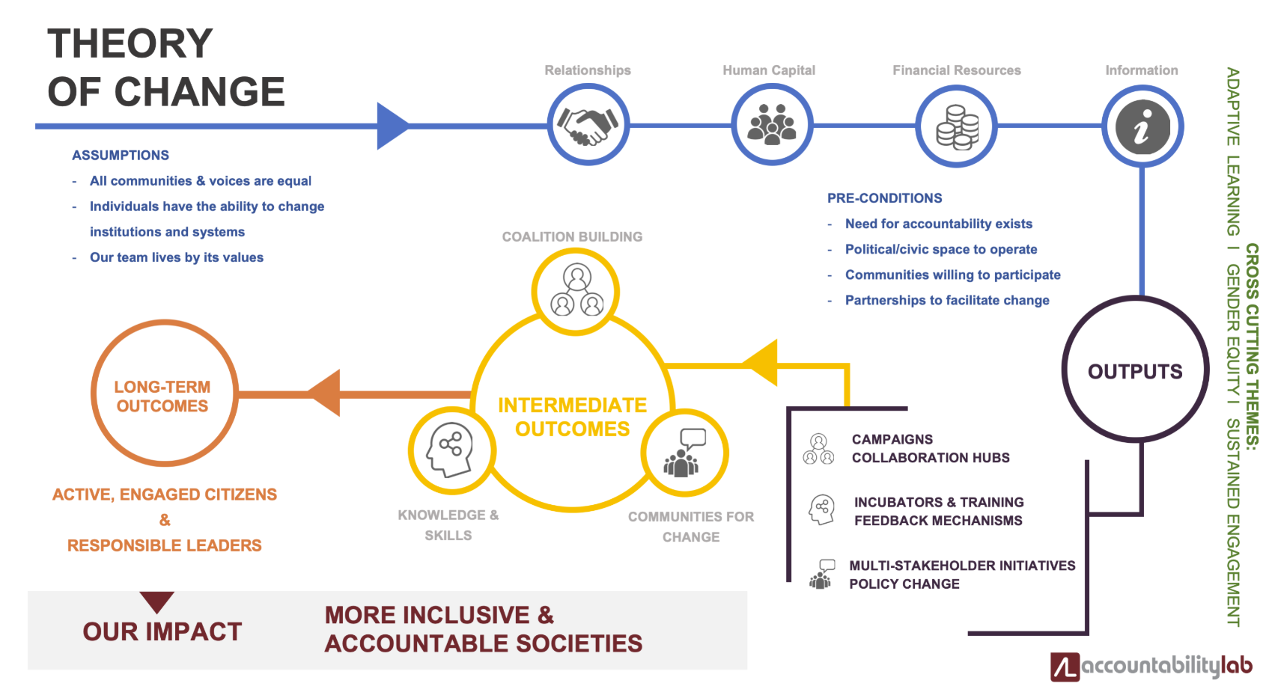
Work Item K.1
Theory of Change Analaysis - Examples
The Accountability Lab was founded in early 2012 as an effort to work with young people to develop new ideas for accountability, transparency and open government.

Slide 8
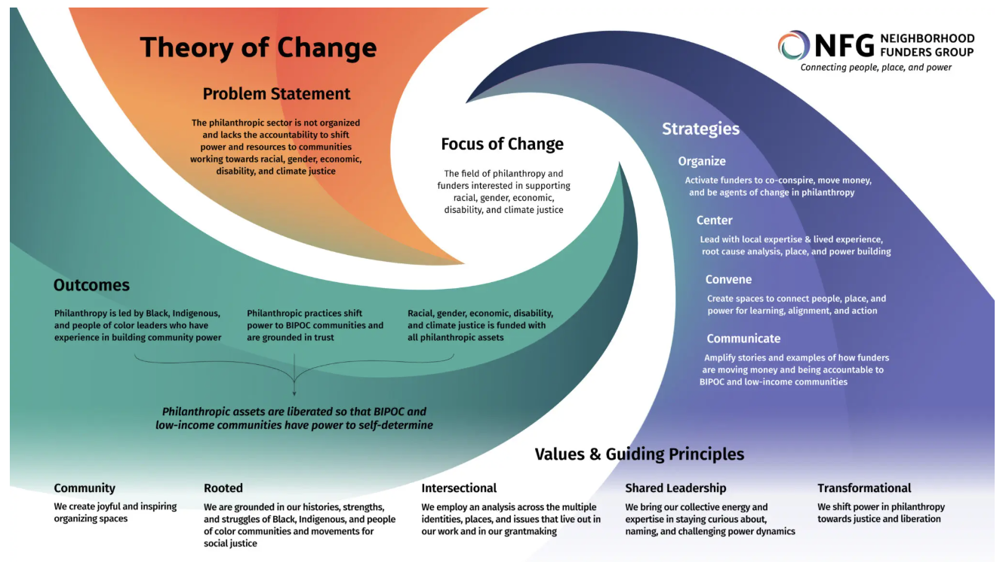
Work Item K.1
Theory of Change Analaysis - Examples

Slide 9
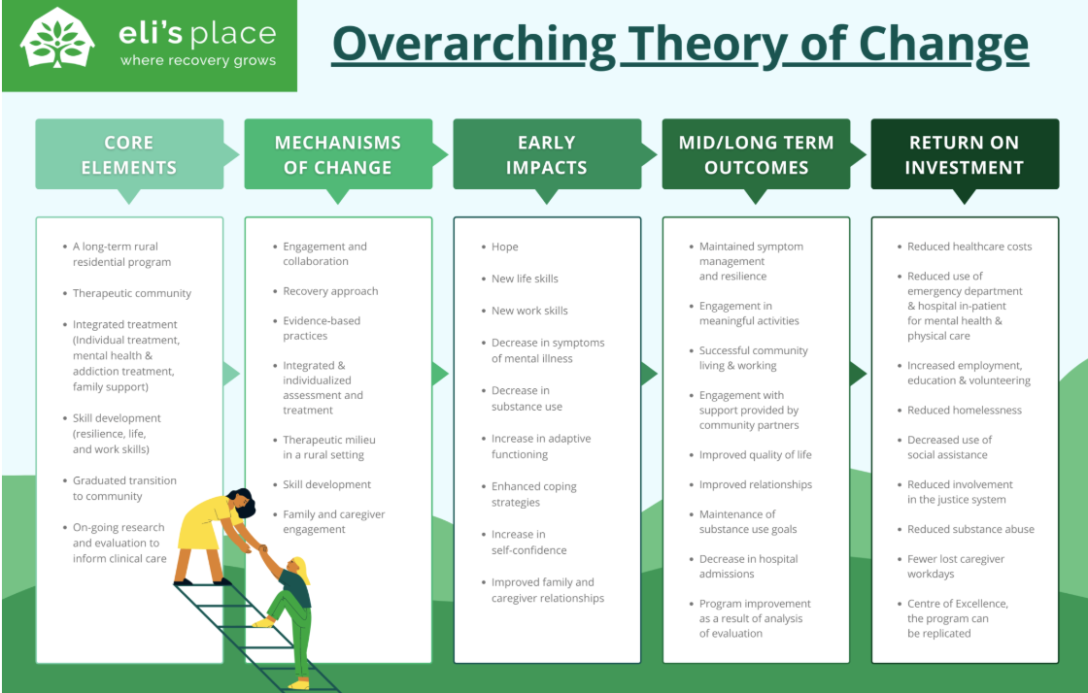
Work Item K.1
Theory of Change Analaysis - Examples

Slide 10
Work Item K.1
Success Criteria
In order for a ToC model to be developed for CSB, clear target Impacts and outcomes need to be developed
Much of the strategic analysis has already been done
This work can feed the development of new SPIs that can feed into the IHO Strategic Plan review

Slide 11
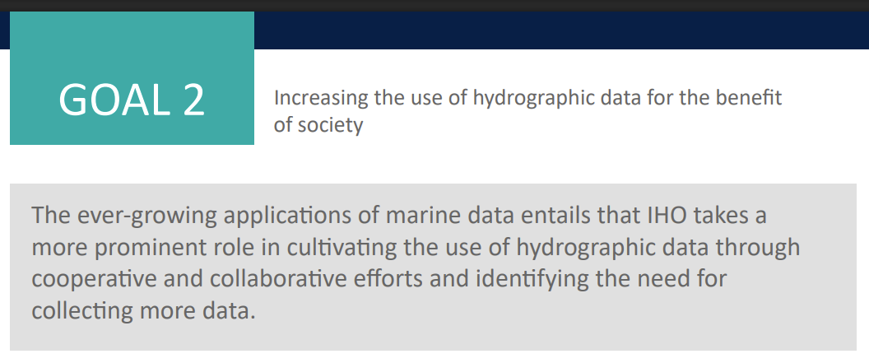
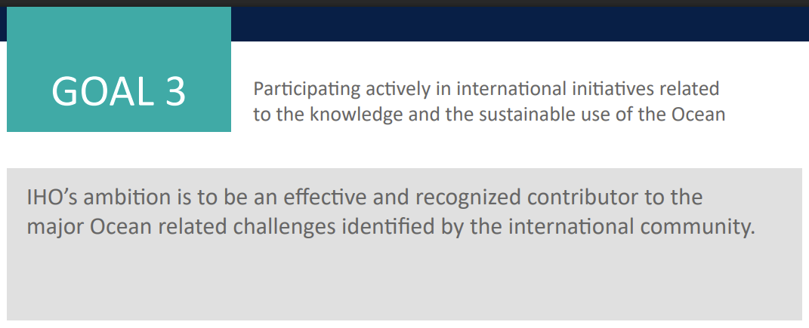
Work Item K.1
Relevant Strategic Level Ambition
IHO Strategic Goals
GEBCO Vision:
To bring knowledge about our planet’s seabed to everyone
GEBCO Mission:
To produce free, open and complete seabed data and information for the world’s oceans. This is achieved by enabling and inspiring seabed mapping efforts through international collaboration, technological innovation, capacity development, and education.

Slide 12
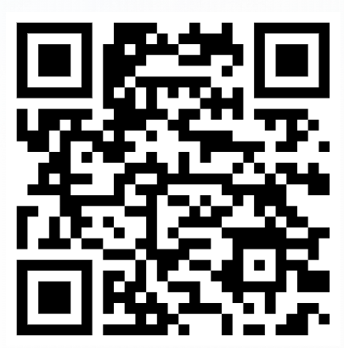
Work Item K.1
Proposed activity – Develop Success Criteria
Question A: How could we define/frame what a successful CSB Initiative looks like?
Question B: How could we measure progress against these?
Virtual Whiteboard Link:
https://miro.com/app/board/uXjVILxh7Tk=/?share_link_id=675033543873

Slide 13
Work Item K.1
Proposed next steps
Take feedback and develop a draft ToC for the CSB Intiative
Report back to Intersession Meeting
Develop SPIs for inclusion in new IHO Strategic Plan
Communicate

Slide 14
Work Item K.1
Action required of CSBWG16
Note the report
Discuss the proposal
Endorse the creation of a ToC model for the CSB Initiative
Report back to Intersession Meeting for approval of the ToC model

