Slide 1
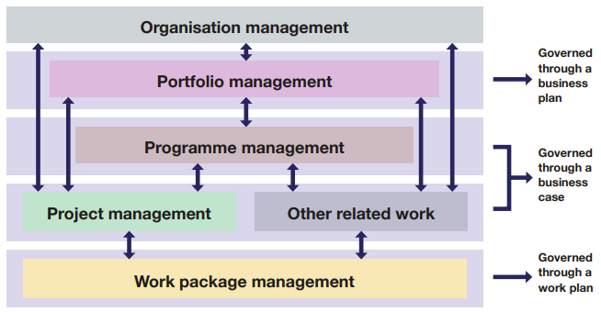
Programmatic work structure (modified from Governance review Draft v1, fig 3).
*Colours following the UK Government Functional Standard for Project Delivery presented in the review.
Strat advisory

Slide 2
Current governance
GEBCO Guiding Committee
Chair & VC
from members
5 IOC members
5 IHO members
TSCOM Chair
SCRUM Chair
SCET Chair
SCOPE Chair
Seabed 2030 Dir
DCDB Dir
Notes:
Too many in the room
Strategy vs technical talk in short time

Slide 3
Future Governance option for GEBCO
* Inspired from the European companie’s directors' governance model
Non-Exec Committee
Governance, oversight, and providing strategic guidance.
They do not work in the business
Exec Committee
work in the business
actively involved in managing the company's operations and implementing the strategies

Slide 4
Composition option
Programme Management Board
Strategic (Non-Exec) Committee
Chair
and VC within
5 IOC members
5 IHO members
Seabed 2030 Strat advisory
Exec Committee (Chair within)
SCOPE Chair
SCET
Chair
NF training Program Dir
SCUFN Chair
SCRUM Chair
TSCOM Chair
Seabed 2030 Dir
DCDB
Dir
IHB
(Finance)
Composition
Elected members only in the non-Exec committee
keep non-Exec separate from Exec Committee Chair/VC position,
Exec committee members are Chairs of SCs and major projects
Non-exec can be members of SCs
Chairs of SCs can be member of other SC

Slide 5
Future Governance option with programme structure
Non-Exec Committee
Chair
and VC within
5 IOC members
5 IHO members
Seabed 2030 Strat advisory
Exec Committee (Chair within)
SCOPE Chair
SCET
Chair
NF training Program Dir
SCUFN Chair
SCRUM Chair
TSCOM Chair
Seabed 2030 Dir
DCDB
Dir
IHB
(Finance)
Symposium project
ET project
Gazeteer project
Technical project
Seabed 2030
NF training
WP1
WP2
WP3
WP4
WP5

