Slide 1
Technical Subcommittee on Ocean Mapping (TSCOM)
GGC39 October, 2022
George Spoelstra (Chair)
Federica Foglini (Vice-Chair)

Slide 2
TSCOM
The Technical Sub-Committee on Ocean Mapping (TSCOM) was established in 2006 as part of the GEBCO program with the aim to:
Provide ongoing advice to the GEBCO Guiding Committee and all associate groups and projects interested in the building and use of the GEBCO product.
Serves the greater bathymetric, hydrographic, and maritime communities as authoritative source for technical expertise in seafloor mapping and forum for discussion on emerging technologies and applications of bathymetric and hydrographic data.

Slide 3
TSCOM Membership (as of fall 2022, new members in red)
Chair, George Spoelstra (GGSgc, NL)
Vice Chair: Federica Foglini (CNR, IT)
Christie Reiser (NOAA, USA)
Helen Snaith (BODC, UK)
Caitlyn Raines (esri, USA)
Heather Stafford (NGA, US)
Pauline Weatherall (BODC, UK)
Mark Zimmerman (NOAA, USA)
Karen Cove (CARIS, CA)
Arne Johan Hestnes (Kongsberg, NO)
Aileen Bohan (INFOMAR, IR)
Non-Voting Members
Eunmi Chang (Seoul University, KO)
Martin Jakobsson (SU, SE)
Jennifer Jenks (NOAA, US)
Voting Members
Wetherbee Dorshow (EarthAnalytics,USA)
Thierry Schmitt (SHOM, FR)
Erin Heffron (Ocean Mapping Service, USA)
Vicki Ferrini (LDEO, USA)
Leonard Gomes (Marinha, BR)
Tim Kearns (GLOS, US)
Boele Kuipers (NHS, NO)
Paul Johnson (CCOM, USA)
Cisco Navidad (CSIRO, AU)
20 voting
3 non-voting
members

Slide 4
Team photo TSCOM meeting September 2022
Lost on the clipboard

Slide 5
Membership and ToRs
Continue to enthuse new members
Try to balance membership globally
Review of ToRs (strategy and governance review)
Question 1: ToR state 50% attendee rate for meetings. More members may complicate this.
Question 2: Voting and non-voting members. ToR speak about members and “experts”

Slide 6
Metadata working group Federica Foglini
Original objective: provide advice on metadata to be provided by the data producer
Ongoing collaboration with the CSBWG
Metadata working group acts as the glue between various workitems of TSCOM.
After initial closure, chair will restart the working group

Slide 7
Cookbook Editorial Board Christiane Reiser
Objective: Managing the Cookbook publication
epub will be published end of year 2022
Closer co-operation with SCET
Rethinking Cookbook purpose
2023 Action Items
Call for chapters owners
Align with strategy

Slide 8
GEBCO Website Working Group Caitlyn Raines
Migrated GEBCO website to new platform is completed (drupal)
Content management system will be open for GEBCO website editors
Google workspace is available (including mailing lists)
2023 Action Items
Review the needs and requirements for an GEBCO website governance standard to support the modernization and subsequent maintenance of the GEBCO website
Investigate possible integration of SCOPE website into main GEBCO website
Align with GEBCO strategy

Slide 9
DCDB Update Jennifer Jencks
Continue to improve DCDB pipepline
Continue to educate GEBCO Community on DCDB
Industry day (organized as workshops)
Aimed at:
Software industry
Sensor manufacturers
Survey companies
Goal: industry to facilitate pipeline
Question: what’s in it for them?
2023 Action Items
DCDB Industry day and data contribution workshop (on the use and leveraging of web services)

Slide 10
Opportunistic mapping resources working group Erin Heffron
Objective: To develop, test, and deliver resources that promote acquisition of seabed data by the seafloor mapping community in areas identified as gaps in the current coverage following the A+B+C=100% paradigm
Preliminary report is submitted. Needs more work
Preliminary report conclusion: required data is not globally available
2023 Action Items
Design and develop A+B+C=100% data layer in close cooperation with Seabed 2030

Slide 11
Applied Discrete Global Grid Systems Boele Kuipers
Workgroup established (4 members so far)
Goal is to research current state of the art technologies and advise on the use of A-DGGS for GEBCO grid
We aim from strong industry support

Slide 12
Using Deep Argo Float profiles as validation Thierry Schmitt
Initiated by IHB
Objective: Check out grounding of Deep Argo Float vs known bathymetry from GEBCO
Project at its early stage, experimenting (seeking internship candidates)
First meeting with ARGO community scheduled for November
Focus on accuracy
2023 Action Items
Investigate feasibility

Slide 13
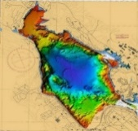
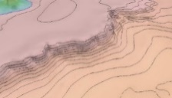
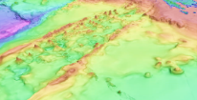
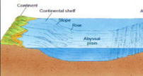
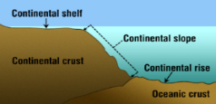
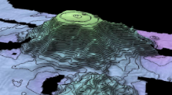
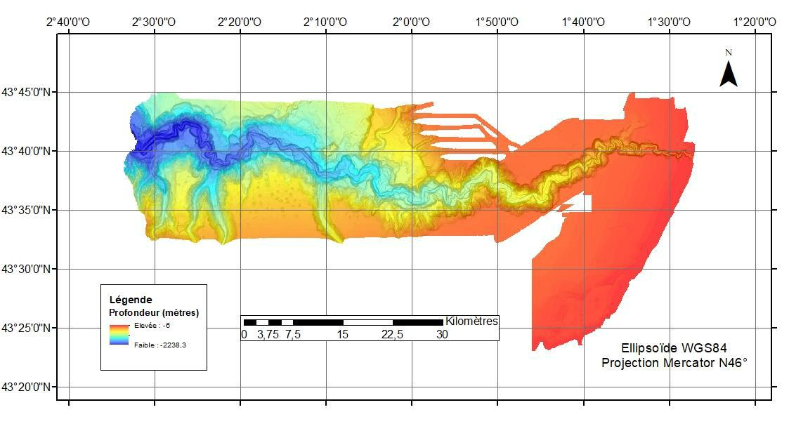
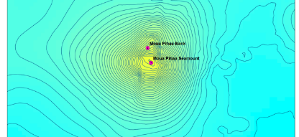
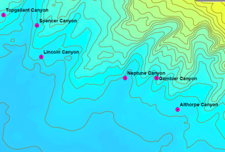
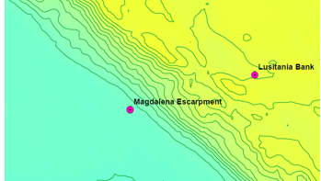
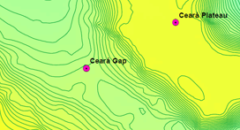
Undersea Feature Detection Project (action not started)
Lead/requested by CHS (Anna Heindi, SCUFN member)
Basin
Seamount
Sea Channel
Shelf
Ridge
Abyssal Plain
Slope
Guyot
Closed Loop
Trend variation
Slope variation
Negative Space
Contour Pattern Recognition

Slide 14
GEBCO grid
TSCOM advices to turn GEBCO grid into official IHO publication
Actions:
a governance structure
product definition
QA/QC and review procedure (repeatability, reproducibility, accountability etc)
Workgroup to draft these

Slide 15
Matters requiring GGC action
Addition of the digital GEBCO grid to the list of IHO publications
Approval of 2023 budget
Approval of 2023 workplan

Slide 16
Questions
?

