Slide 1
GGC40
Item 2.1
IHO update
9 November 2022
IHO Director – Luigi SINAPI

Slide 2
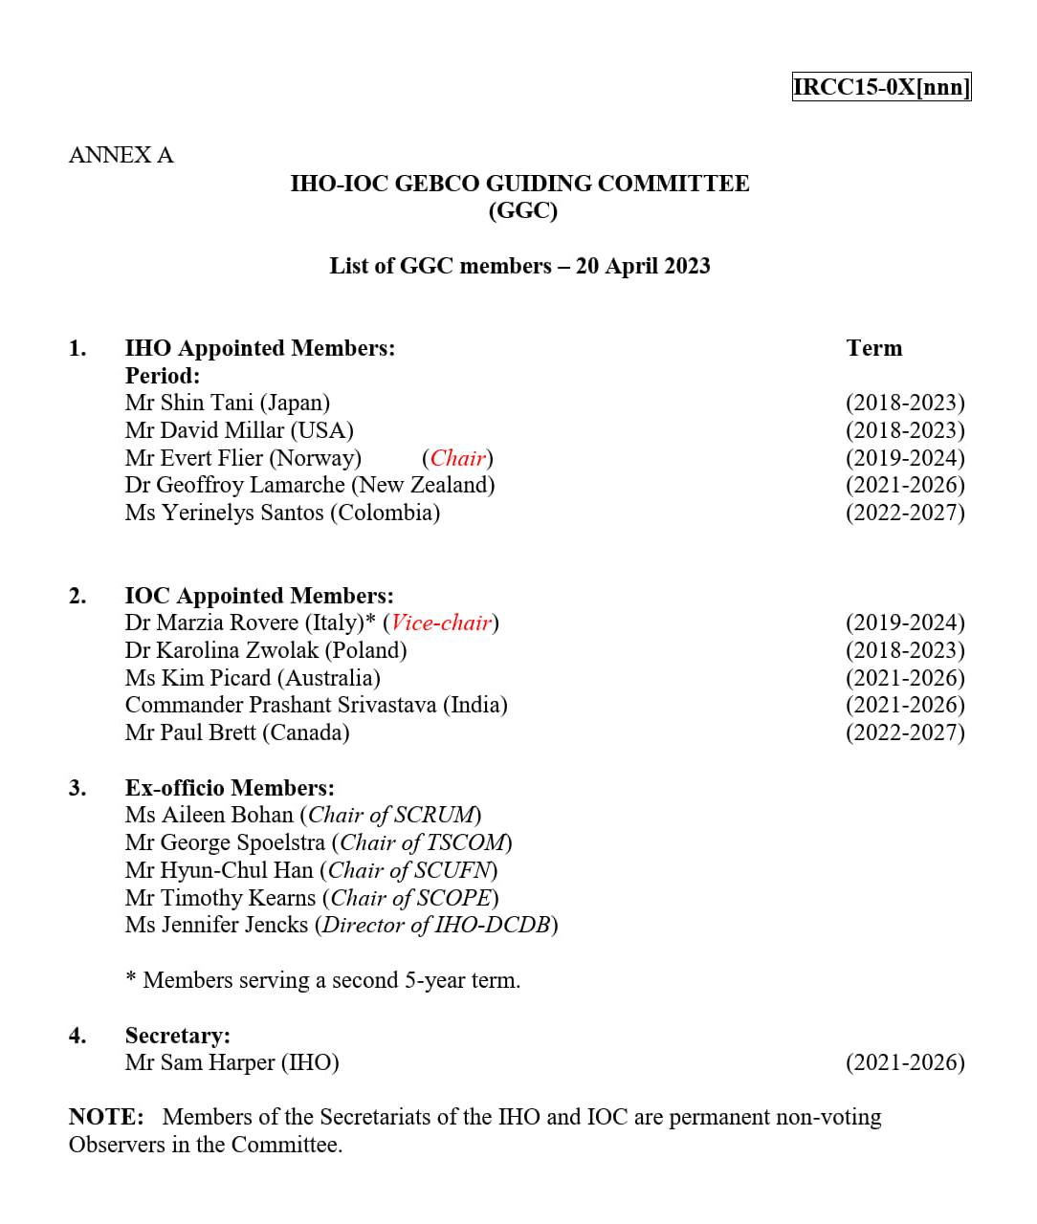
GEBCO Guiding Committee Membership
GGC Membership is consolidated as per the last update dated 20 April 2023
Nr.3 GGC members (2 of IHO and 1 of IOC) end their mandate in the current year
Considerations on Ex-officio members to be defined in line with the new GEBCO Governance
Need of an additional mandate of 5 years or specific IHO and/or IOC CL for Nomination/s of expert/s to fill in the vacancy/ies

Slide 3
IHO ASSEMBLY-3 DECISIONS OF INTEREST OF GGC
IHO STRATEGIC PLAN
Agreed on the continuation of conduct of the annual Work Programmes on the basis of the Strategic Plan in place for 2021 – 2026 and directed the Council accordingly.
Approved that Goal 1 of the IHO Strategic Plan and its targets shall have the highest priority in the implementation of the 2024–2026 Work Programme.
Tasked the Council with the development of the revised Strategic Plan to be put in place for 2027 – 2032 in compliance with the Planning Cycle and to submit the result for adoption by A-4 in 2026. The Council is empowered to establish a Working Group for this discrete purpose, if appropriate.

Slide 4
IHO ASSEMBLY-3 DECISIONS OF INTEREST OF GGC (cont.)
SOUTHERN OCEAN
Approved the proposed IHO Resolution on the recognition of the Southern Ocean.
Took note of the consequences on the limits of some global sea areas as a result of recognition of the Southern Ocean.
Endorsed the fact that this new Resolution is without prejudice to or limitation of the views of the IHO, any other international body or any IHO Member State regarding the subject matter addressed.

Slide 5
IHO ASSEMBLY-3 DECISIONS OF INTEREST OF GGC (cont.)
CAPACITY BUILDING & GEBCO
Recognized the important global maritime issues facing the hydrographic community worldwide and that addressing these issues will require expanded global hydrographic capacity.
Approved the proposal to establish an ad hoc Project Team under IRCC to explore the possible establishment of reliable alternative funding for activities including capacity building and GEBCO.
Authorized Council via IRCC to review progress reports from the Project Team at least annually and provide guidance to the Project Team in preparation to report out to 4th Assembly (A4).

Slide 6
IHO COUNCIL-7 OUTCOMES OF INTEREST OF GGC
CAPACITY BUILDING & GEBCO
Noted the outcome of a scoping team and endorsed to establish a Project Team on Fund Generation of IHO’ Project Initiatives under the IRCC. IHO Secretariat to issue a CL on the establishment of the IHO FG PT, as soon as the draft TORs and ROPs are finalized by correspondence within the IRCC. (Deadline: December 2023)
EMPOWERING WOMEN IN HYDROGRAPHY (EWH) Project
Tasked the IRCC, to first define through the CBSC the regulatory framework (M-3) for a continued activity on this social theme through a proposal for an IHO Resolution; agreed to continue with the EWH project led by the CBSC supported by remaining funds and future financial and / or in-kind support; and finally to develop a proposal on the future framework for an IHO social Programme (incl. Gender Balance in Hydrography) to be submitted to A-4.

Slide 7
IHO COUNCIL-7 OUTCOMES OF INTEREST OF GGC (cont.)
IHO STRATEGIC PERFORMANCE INDICATORS (SPI)
Noted the dashboard (target 2026, WP2 and WP3 SPIs value as of 31 Dec. 2022) allocated to the IHO Secretariat, HSSC and IRCC (IHO Annual Report 2022, Annex B refer) and its update for WP1 as of 1 Oct 2023.
NEW IHO STRATEGIC PLAN 2027-2032
Acknowledged that the current structure of the Strategic Plan (SP) 2021-2026 was still relevant at conceptual level (vision, goals, etc.), and agreed that the objective for the next SP 2027-2032 should be limited to a revision of the current SP. Tasked the HSSC and IRCC to provide their inputs on the possible axis of evolution of the existing SP in preparation of the revision phase (2024-2025) of the current SP and welcomed the offer from the Council Vice-Chair to lead a correspondence group to prepare the next IHO Strategic Plan 2027-2032. (Deadline: C-8 (-3 months)).

Slide 8
IHO COUNCIL-7 OUTCOMES OF INTEREST OF GGC (cont.)
FURTHER DIGITALIZATION OF IHO SECRETARIAT`S OPERATION
Endorsed the IHO Secretariat’s ambitions to further digitalize the services rendered to IHO Member States and welcomed the offer to IHO MS who would like to be involved in the different testing and acceptance phases of the new IHO Portal.
IMPLEMENTATION OF A NEW GLOBAL MSDI LAYER DEDICATED TO MARINE PROTECTED AREAS (MPA)
Agreed on the strategic need to promote the S-100 Concept with a quick-win through S-122, and tasked the IHO Secretariat to establish liaison with relevant data providers of MPAs and tasked the IRCC through the MSDIWG to establish a pilot project for the High Sea and MPAs adopted by IMO, to demonstrate the benefits of S-122 for non-navigation purposes.

Slide 9
IHO Strategic Priorities
Strategic priorities (with reference to the IHO Strategic Plan 2021-2026)
Participating actively in international initiatives related to the knowledge and the sustainable use of the Ocean
Improve knowledge of the world's seafloors
Implement a synergic GEBCO-Sebed2030 approach to the Agenda 2030 Sustainable Development Goal 14 of the United-Nations and UN Decade 2021-2030 of Ocean Sciences
Frame the resources devoted to the knowledge and description of the Ocean, by focusing on the HIGH SEAS’ areas and engaging with any sort of Institution/Company/Research Centre/University (Agreements, MoU, etc.);
Implement a GEBCO Communication Strategy aligned with the IHO-IOC Communication Strategies
Define the rules of mutually supplementing engagement of different bodies/organizations involved (SCOPE, GGC, IHO/IOC, CSB and Seabed2030).

Slide 10
IHO activities/initiatives of interest of GGC
IHO-OECD WORKSHOP - The Future of Seabed Mapping and its Associated Uses by 2045 (November 2023)
2024 Ocean Decade Conference (Barcelona, April 2024)
IHO-OECD-Others Satellite Event - The Seabed Data We Need for the Ocean We Want
WMU-IHO-Others Satellite Event - The People We Need for the Ocean We Want: Achieving Gender Equality for the Ocean Decade
C. U.N. OCEAN CONFERENCE (Nice, 2025)

Slide 11
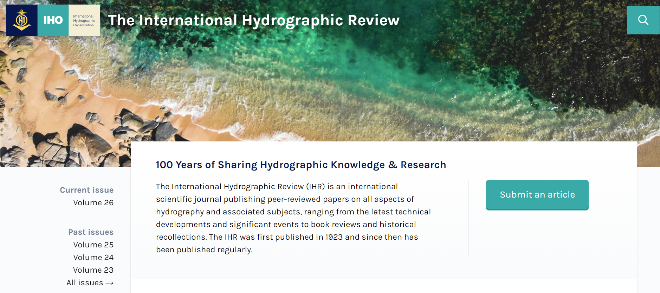
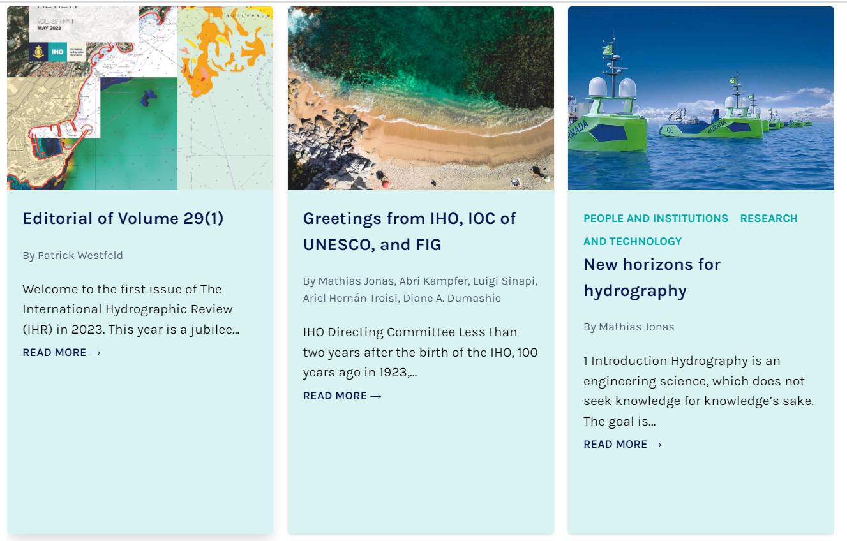
IHO Outreach
World Hydrography Day 2024 MOTTO PROPOSAL:
"Hydrographic Information -Enhancing Safety and Efficiency in Marine Activities “ (iaw IHO CL 35/2023)
IHO Public Relations and Communication (PRC) policy
LinkedIn page passed 8,600 followers in November 2023
International Hydrographic Review
New Editor: Dr Patrick Westfeld
New WEBSITE: https://ihr.iho.int/

Slide 12
Action Requested of the GGC
GGC40 is invited to:
Note this Report
Take into consideration the A-3 Decisions on the future of the IHO Strategic Plan and the new IHO priorities in the approval of the new GEBCO Governance and GEBCO Strategy
Consider a qualified GGC participation in the new IHO Project Team on “Fund Generation of IHO’ Projects Initiatives” to be nominated with an IHO CL by the end of this year
Take any other actions as considered appropriate.

