Slide 1
Governance Review –
GGC40
Sam Harper
GEBCO Secretary

Slide 2
01
Work undertaken to date
Status of project team work items:
Establishment of Project Team – Complete
Map organizational and functional structure – Complete
Identify relationships and conduct governance instrument gap analysis – Complete (phase 1)
Assess instruments and work plans of GEBCO bodies to identify initial findings – Complete (Except SB2030)
Financial review – Initial review complete
Legal review – Initial consultation undertaken
Final summary report and continuous improvement process development – 1st Draft complete

Slide 3
03
Appointment of EAP
To date, three of the four positions identified have been filled with only a representative
from industry to be appointed. Currently the EAP is constituted of:
Legal Representative – Dr Virginie Tassin Campanella, Avocat à la Cour (Paris Bar)
& EU/EFTA Attorney-at-Law (Zürich Bar), Vice President of the Scientific Council
of INDEMER (Monaco)
Financial Representative – Mrs Sandrine Brunel, IHO Secretariat
Academic Representative – Dr Paul Elsner, University of London
Industry/Private Sector Representative – Not appointed

Slide 4
03
Governance Framework
In undertaking this governance review, it was essential to draw upon standardized best practice that exists as relates to programme management and delivery. Whilst there is a huge amount of literature on the subject, and many different approaches to progamme governance, two principle sources were referenced:
ISO 21500:2021 (Guidance on project management), and ISO 21502:2020 (Guidance on program management)
The UK Government Functional Standard for Project Delivery
These two references were chosen on the basis that the ISO standards are by definition generic and cross cutting, whilst the UK Government Functional Standard for Project Delivery has proven utility (from the experience of the author) for the implementation and delivery of projects using the principles set out in the ISO Standards.

Slide 5
03
Governance Framework
  ISO 21500:2021 (Guidance on Project Management) and ISO 21502:2020 (Guidance on Program Management)
ISO 21500:2021 and ISO 21502:2020 provide international standards and guidance on project and program management. These standards offer a structured approach to managing initiatives effectively. In the context of a governance review of GEBCO, the following principles apply:
Governance Framework: Evaluate the presence of a well-defined governance framework within GEBCO. Ensure that roles, responsibilities, and authorities are clearly defined, and that there is alignment between project and program governance structures.
Benefit Realization: Assess GEBCO's approach to defining, tracking, and realizing the benefits of its initiatives. Ensure that benefit realization plans are in place and that they align with the organization's mission and objectives.
Documentation and Record-Keeping: Examine GEBCO's documentation practices, including records of decisions, project plans, and governance meeting minutes. Ensure that documentation is thorough and accessible.
Continuous Improvement: Promote a culture of continuous improvement within GEBCO by identifying opportunities to enhance governance processes and practices. Regularly review and update the governance framework to adapt to changing needs and best practices.

Slide 6
03
Governance Framework
  UK Government Functional Standard for Project Delivery
The UK Government Functional Standard for Project Delivery provides a comprehensive framework for managing projects effectively within government organizations. Whilst GEBCO is a jointly owned programme of two inter-governmental organisations (so not strictly speaking government organisations), the expectations of good governance placed upon the parent organisations of GEBCO by their respective member states, means that this resource is highly relevant. In addition, the framework was used as the basis for the governance of a number of highly successful UK seabed mapping programmes (e.g. the Civil Hydrography Progeamme, The Commonwealth Marine Economies Programme and the Overseas Territories Seabed Mapping Programme). When applied to a governance review of GEBCO, the following key components and principles become relevant:
Governance Structure: Assess GEBCO's existing governance structure, including roles, responsibilities, and decision-making bodies. Ensure that the structure aligns with best practices and promotes accountability.
Stakeholder Engagement: Evaluate how GEBCO engages with its stakeholders, including government agencies, international organizations, and the public. Ensure transparency and consider the needs and expectations of various stakeholders.

Slide 7
03
Governance Framework
Risk Management: Review GEBCO's risk management practices, including the identification, assessment, mitigation, and monitoring of risks. Ensure that risks are adequately addressed to protect the organization's mission and objectives.
Performance Measurement: Examine the key performance indicators (KPIs) and metrics used by GEBCO to measure project and program success. Ensure that these measurements align with organizational goals.
Decision-Making Processes: Assess the clarity and effectiveness of decision-making processes within GEBCO, particularly at the governance and executive levels. Ensure that decisions are well-informed and transparent.

Slide 8
03
Financial Review
The following activities have been undertaken:
Review of internal IHO management processes
New procedures developed
Full audit of the GEBCO fund(s)
Assessment and adoption of recommendations of the Funding Strategy – subject to strategy development
Consideration of IHO Project team on Seeking External Funding Sources

Slide 9
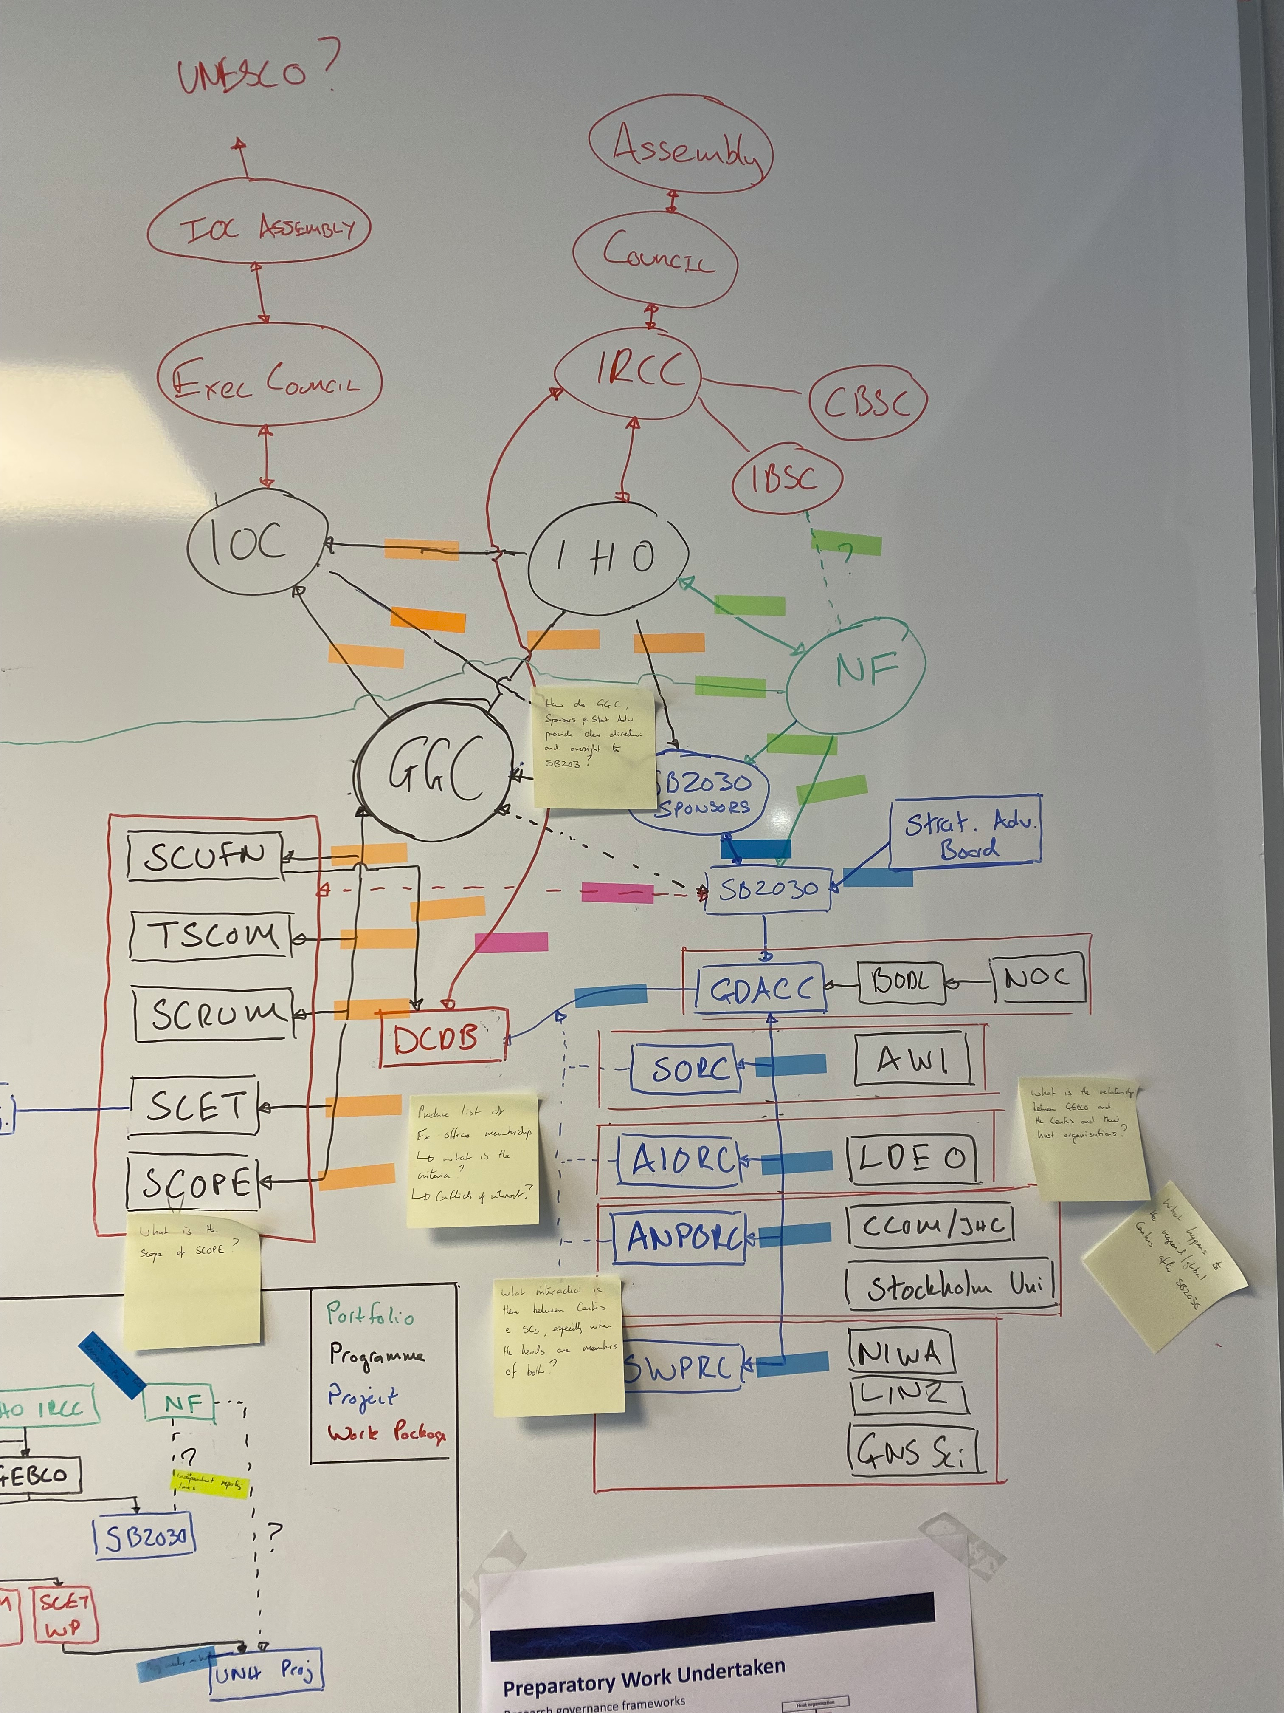
02
GEBCO Organogram
Summary
All relationships codified
Relationships bounded in red have been described and analyzed
Findings listed with potential solutions provided if appropriate

Slide 10
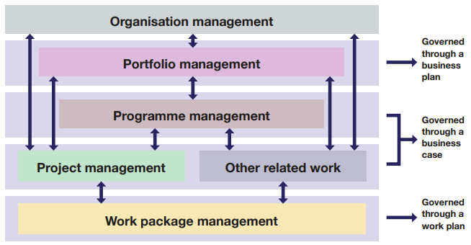
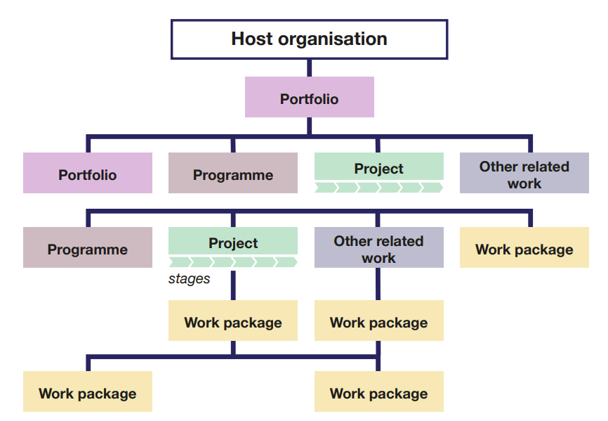
03
GEBCO Programme Work Structure
Current Programme Structure
New Recommendations
Programme Management Board
Finance Committee

Slide 11
04
Analysis of GEBCO Bodies – Methodology
In order to identify the initial set of findings presented in this paper, a series of guiding questions were developed to assist in the review of governance instruments and work plans:
Do the relevant governance instruments exist?
Are the governance instruments up to date and adequately support the work of the group or committee?
Is the work plan clear, current and logically structured?
Is the work of the GGC and SCs appropriately structured in terms of programme delivery hierarchy?
Is the membership of the group or committee appropriate and are there any barriers to effective contribution?
Are any relevant working practices sufficiently clear, formalised and fit for purpose?

Slide 12
05
Findings – Parent Organisations
Finding Ref. | Type | Detail | Recommendation
IHO - IOC 1 | Instrument | MoU between two organisations is out of date and predates SB2030 and the UN Ocean Decade | Review and update MoU
IHO – IOC2 | Instrument | No mechanism to transfer funds between parent organisation | Develop partnership arrangement

Slide 13
06
Findings – GGC
Finding Ref. | Type | Detail | Recommendation
GGC 1 | Instrument | ToRs largely fit for purpose but should be reviewed in light of Strategy to ensure that objectives are consistent | Review ToRs to ensure alignment with strategy
GGC 2 | Process | No portfolio board and lack of programme structure | Consider when approving future versions of WPs
GGC 3 | Membership | Membership (especially Ex-Officio) is potentially problematic in that there is the possibility for conflict of interest where committee members are the recipient of GEBCO project funds | Consider the make up of the GGC membership against new stratetgy and governance norms
GGC 4 | Finance | No formal guidance on finacial management and accountability | Note and include in financial review. Get external advice

Slide 14
07
Initial Findings – GGC
Finding Ref. | Type | Detail | Recommendation
GGC 5 | Personel | Difficulty with subordinate projects using IHO/IOC postal address and the status of individuals working on them | IHO to engage Gov of Monaco to discuss
GGC 6 | Membership | Unlike IHO/IOC apointed members of the GGC, it is not a condition of SC Chair's membership of GGC to be able to attend annual meetings, with associated T&S covered by their employer or individually. | Adjust ToRs to reflect that on taking up office, the expectation is that they will have the support of their organisation or the personal means to attend GGC meetings
GGC 7 | Membership | The number of GGC members (15) is quite large for a body such as GEBCO | Consider the shape and size of the GGC
GGC 8 | Membership | The roles and responsibilities of GGC members are not clear, and further confused by the three categories of appointment | Clarify roles and responsibilities of GGC member and whether the categories of appointment support or hinder effective delivery of GGC business

Slide 15
08
Findings - TSCOM
Finding Ref. | Type | Detail | Recommendation
TSCOM 1 | Instrument | ToRs largely fit for purpose but should be reviewed in light of Strategy to ensure that objectives are consistent | Review ToRs to ensure alignment with strategy
TSCOM 2 | Operations | Work Plan is very complex and could be rationalised | Rationalise work plan to reduce items and improve clarity
TSCOM 3 | Instrument | No instrument in place to describe the role of NOAA in hosting the Archived GEBCO grid in the DCDB | Incorporate into IHO - DCDB MoU
TSCOM 4 | Instrument | No instrument in place to describe the role of NOC/BODC in managing the GEBCO website | IHO/IOC to consider implementing an MoU

Slide 16
09
Initial Findings - TSCOM
Finding Ref. | Type | Detail | Recommendation
TSCOM 5 | Membership | Need for dedicated secretary that can accommodate more frequent meetings | Identify a secretary from within the membership, establish terms of service and update ToRs accordingly
TSCOM 6 | Instrument | No formal instrument/agreement to describe interface with SB2030 | Consider within review of SB2030 governance documents
TSCOM 7 | Product | No formal statement of the ownership of GEBCO products | Give all GEBCO products an IHO/IOC formal publication reference e.g. Digital Atlas
TSCOM 8 | Membership | Number of full members could hinder decision making and ability to be quorate | Review and potential reduce number of full members – adjusting ToRs as required

Slide 17
10
Initial Findings - SCRUM
Finding Ref. | Type | Detail | Recommendation
SCRUM 1 | Instrument | ToRs largely fit for purpose but should be reviewed in light of Strategy to ensure that objectives are consistent | Review ToRs to ensure alignment with strategy
SCRUM 2 | Work Plan | Potential overlap in terms of scope with TSCOM/SB2030 - May just need clarification in Work Plan | Work with other SCs and SB2030 team to review workplan and add notation where required to clarify areas of common interest
SCRUM 3 | Work Plan | Work plan is complicated and could be rationalised | Review Work plan once strategy has been published and agree prioritisation
SCRUM 4 | Process | Timing of meetings could be adjusted to have one preparatory virtual meeting and one in person meeting alongside Map the Gaps and GGC | SCRUM to consider and agree on a routine that works for membership
SCRUM 5 | Membership | Number of full members could hinder decision making and ability to be quorate | Review and potential reduce number of full members – adjusting ToRs as required

Slide 18
11
Initial Findings - SCOPE
Finding Ref. | Type | Detail | Recommendation
SCOPE 1 | Instrument | ToRs largely fit for purpose but should be reviewed in light of Strategy to ensure that objectives are consistent | Review ToRs to ensure alignment with strategy
SCOPE 2 | Process | Potential need to define a formal process for approval of comms material that affects other SCs or bodies. | Define process diagram that can be appended to ToRs
SCOPE 3 | Process | Timing of meetings could be adjusted to have one preparatory virtual meeting and one in person meeting alongside Map the Gaps and GGC | SCOPE to consider and agree on a rotuine that works for membership
SCOPE 4 | Membership | Role of Reps of IHO/IOC unclear and process for reviewing outward communications activity not in place. | Consider a new category of participation of IHO/IOC Comms Reps in SCOPE
SCOPE 5 | Membership | Number of full members could hinder decision making and ability to be quorate | Review and potential reduce number of full members – adjusting ToRs as required
SCOPE 6 | Relationship | Formal relationship between Map the Gaps and SCOPE/GEBCO is unclear and undocumented | Relationship should be clarified and formalized via an appropriate instrument

Slide 19
12
Key governance instruments that require attention
The following Governance instruments have been identified as either missing or require revising:
Finding Ref. | Type | Detail | Recommendation
INSTR1 | Instrument | MoU between IHO and IOC is out of date | Review and revise
INSTR2 | Instrument | Governance documents for SB2030 no longer reflect the current operational reality of the programme. | Review governance documents and update as required
INSTR3 | Instrument | There is no formal agreement between SCOPE/GEBCO and Map The Gaps that sets out roles responsibilities etc. | Agree the nature of the relationship(s) and formalize in an appropriate instrument
INSTR4 | Instrument/Process | Lack of clarity about the enduring role of the directing team for the NF UNH Course. | Depending how this is incorporated into SCET, consideration should be given to ToRs

Slide 20
12
Key findings for discussion:
The Key Cross cutting findings that have been identified are summarized as:
The need for a Programme Management Board
The need for a finance committee
The need for discipline in the structuring of work plans to observe programme hierarchy norms
Review how the membership of the GGC is constituted
Review how the membership of the SCs are constituted

