Slide 1
The General Bathymetric Chart of the Oceans
STRATEGY 2024-2030
Strategy Drafting Working Group
Geoffroy Lamarche; David Millar; George Spoelstra; Kim Picard
Notes:
Note that the logos are old ones. Needs updating!

Slide 2
A somewhat lengthy - but worthwhile - process
Decision to write a strategy at GGC annual meeting Novembre 2021
Set up of a Strategy Drafting Working Group
TOR and SOP - Jan-Jun 2022
Agreement for short document (<5 p)
Developed in parallel with governance review (Sam Harper)
First draft discussed at GGC annual meeting November 2022
4 - 5 e-meetings per year + multiple emails
Many drafts circulated
Consultation with GGC 'sensu largo'
Draft discussed at GGC annual meeting November 2023
Final review IHO Nov-Dec 2023
Final draft Feb 2024
Notes:
Timeframe was never really challenged; but a view to review the Strategy in 2-3 years

Slide 3
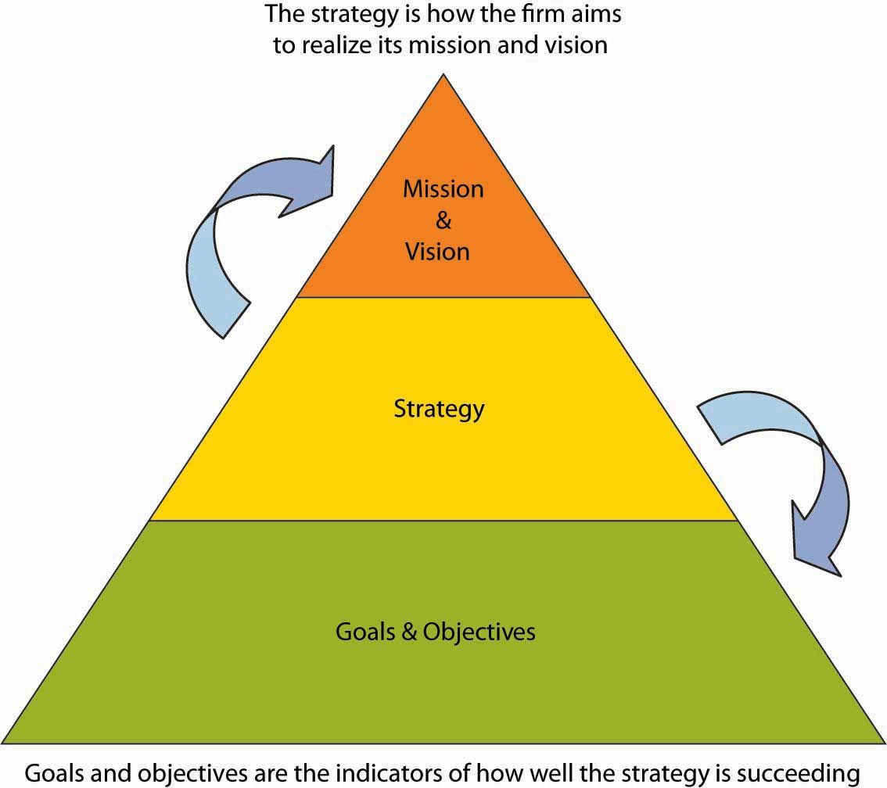
Strategy Outline
Vision
Mission
Introduction
GEBCO’s vision and mission
Objectives and Outcomes
Principles and strategies to deliver our objectives
A better future
Outcomes
Objectives

Slide 4
The vision
To bring knowledge about our planet's seabed to everyone
The Mission
To produce free, open and complete seabed data and information for the world’s oceans. This is achieved by enabling and inspiring seabed mapping efforts through international collaboration, technological innovation, capacity development, and education.
.
Notes:
main comments
It is fair to say that this is what tool the most time to get a consensual decision. Quite surprisingly (for me [GL] at least])
Is this a realistic expectation in today's global strategic landscape? Reality is that not all contributors to GEBCO will release their entire bathymetric data sets (e.g. looming "seabed warfare" and unlikely to wean
Datasets or current products such as IBCAO, IBCSO, the GEBCO Grid?
dataset and information are too wide terms and carry a substantial risk with the; Bathymetry is missing.
produce may also be too precise.
We need to be consistent with language and support "datasets and products" throughout the document.

Slide 5
Pillar 1
Data
GEBCO Strategy 2024-2030 - Outcomes and Objectives
Activities
Objectives
Outcomes
Delivering open and fit for purpose seabed data
• To compile, maintain and improve the most accurate, reliable and relevant sets of seabed data based on internationally approved geospatial standards focused on bathymetry and the authoritative GEBCO Gazetteer of Undersea Feature Names.
• Open and equitable (free and easy) access to comprehensive seabed data and information for everyone under Create Commons or comparable license terms.
A fully explored and well understood global seabed contributing towards improved ocean science and facilitating decision making on sustainable ocean management, conservation and the global economy.

Slide 6
Pillar 2
Technology & Standards
GEBCO Strategy 2024-2030 - Outcomes and Objectives
Activities
Objectives
Outcomes
Supporting, promoting and using innovative solutions to continuously improve the GEBCO data value chain
To actively support, promote and use innovative solutions to continuously improve the seabed data value chain, including solutions contributing to ocean management, conservation and the global economy.
Innovative technologies and standards that improve the seabed data value chain and maximise benefits for GEBCO and the broader community.

Slide 7
Pillar 3
Capacity
GEBCO Strategy 2024-2030 - Outcomes and Objectives
Activities
Objectives
Outcomes
Establishing global infrastructure to develop capacity
Establish a globally distributed network of facilities and experts to support communication, encourage education and promote training.
To double global ocean mapping capacity in the next five years.
An engaged, qualified and diverse global community of professionals inspired to support GEBCO in executing its mission and vision.

Slide 8
Pillar 4
Community
GEBCO Strategy 2024-2030 - Outcomes and Objectives
Activities
Objectives
Outcomes
Engaging communities and partners to best deliver GEBCO’s mission
Increase engagement with the general public to improve their awareness of the relevance of GEBCO’s work.
Seek ongoing support of global leadership from all sectors and parent organisations for GEBCO.
A diverse community that understands the importance of GEBCO and engages and actively contributes to the programme.

Slide 9
Pillar 5
Governance
GEBCO Strategy 2024-2030 - Outcomes and Objectives
Activities
Objectives
Outcomes
Gaining support for our mission through robust processes that influence decision-making
To build a sustainable GEBCO Marine Spatial Data Infrastructure (MSDI).
To influence policy through robust science-based evidence to increasing support for sustained public and industry seabed mapping.
An adequately funded long-term programme under the IHO and IOC of UNESCO.
Improved coordination of ocean mapping efforts that maximise benefits to all ocean stakeholders.

Slide 10
Principles and delivery strategies
Support the IOC and IHO in engaging with national government and coordinating efforts
Engage at the UN and other multilateral organisations
Leverage the parent organisations, subcommittees, subordinate projects and other relevant initiatives
Nurture and develop partnerships with stakeholders to enhance visibility and efficiency
Ensure the entire ocean space is considered
Ensure open, diverse, equitable and inclusive cultures
A better or enhanced future – building on the past 120 years
Evolve GEBCO’s governance to allow the programme and community to effectively exert itself as the thought leaders
Promote and acquire an expanding type of datasets
Support coastal communities and indigenous knowledge.
Support ocean literacy to raise awareness
Endeavour to promote the development of new technology
Notes:
Purposefully reasonably brief and open

Slide 11
The General Bathymetry Chart of the Ocean OUR STRATEGY 2023-2028
Pillar 2 - Technology and standards
Outcome: Innovative technologies and standards improving data value chain, maximize benefits for GEBCO and the broader community
Objective : To actively support, promote and use innovative solutions to continuously improve our seabed data value chain, including solutions contributing to ocean management, conservation and economy of our planet.
Pillar 1 - Data
Outcome 1- A fully explored and well understood global seabed supporting improved scientific knowledge and decision making on sustainable ocean management, conservation and economy of our planet.
Outcome 2 - An open and equitable (free and easy) access to comprehensive seabed data and information for everyone
Objective: To compile, maintain and improve the most accurate, reliable and relevant seabed datasets based on internationally approved geospatial standards focused on bathymetry and undersea feature gazetteer
Vision
To bring knowledge about our planet’s seabed to everyone
Pillar 3 - Community
Outcome: A diverse community that understands the importance of GEBCO, and engages and actively contributes to the program.
Objective: Increase engagement with general public to improve their awareness of the relevance of GEBCO’s work
Seek ongoing support of global leadership from all sectors and parent organizations for GEBCO
Mission
To produce free, open and complete seabed data and information for the world’s oceans. This is achieved by enabling and inspiring seabed mapping efforts through international collaboration, technological innovation, capacity development, and education.
Pillar 4 - Capacity
Outcome - An engaged, qualified and diverse global community of professionals inspired to support GEBCO in executing its mission and vision
Objectives: Establish a globally distributed network of facilities and experts to support communication, encourage education and promote training
To double global ocean mapping capacity in the next five years
Pillar 5 - Governance
Outcome 1 An adequately funded long-term program under the IHO and IOC
Outcome 2 An improved coordination of ocean mapping efforts that maximize benefits to all ocean stakeholders
Objectives To build a sustainable GEBCO Marine Spatial Data Infrastructure (MSDI)
To influence policy through robust science-based evidence to increasing support for sustained public and industry seabed mapping
Notes:
NNEDS UPDATING WITH FINAL VERSION WORDING

Slide 12
The General Bathymetry Chart of the Ocean THE STRATEGY 2024-2028
Pillar 1 - Data
Vision
To bring knowledge about our planet’s seabed to everyone
Pillar 2 - Technology and standards
Pillar 3 - Capacity
Mission
To produce free, open and complete seabed data and information for the world’s oceans. This is achieved by enabling and inspiring seabed mapping efforts through international collaboration, technological innovation, capacity development, and education.
Pillar 4 - Community
Pillar 5 - Governance
Notes:
NNEDS UPDATING WITH FINAL VERSION WORDING

