Slide 1
Governance Review –
The story so far
IHO Assistant Director Sam Harper
GEBCO Secretary

Slide 2
01
Recap of Work Undertaken to date
Status of work items:
Map organizational and functional structure – Complete
Identify relationships and conduct governance instrument gap analysis – Complete
Assess instruments and work plans of GEBCO bodies to identify initial findings – Complete
Financial review – Initial review complete
Legal review – Initial consultation undertaken
Final summary report and continuous improvement process development – Complete

Slide 3
02
Key Considerations/Clarifications
The Governance review report is meant to be a tool to assist GEBCO in adapting its working practices to become more efficient and able to meet the objectives set out in the strategy
It is up to the GGC to decide how to take this forward in terms of implementation
In some cases, recommendations are already being worked upon and in some case complete
The strategy and Governance review have been done in parallel and this has limited its depth
Some elements have been left out of scope (SCUFN, SB2030 etc.)
A key feature is the proposal of a continuous improvement process to allow the routine review and adjustment of processes and ways of working.

Slide 4
03
Governance Framework
In undertaking this governance review, it was essential to draw upon standardized best practice that exists as relates to programme management and delivery. Whilst there is a huge amount of literature on the subject, and many different approaches to progamme governance, two principle sources were referenced:
ISO 21500:2021 (Guidance on project management), and ISO 21502:2020 (Guidance on program management)
The UK Government Functional Standard for Project Delivery
These two references were chosen on the basis that the ISO standards are by definition generic and cross cutting, whilst the UK Government Functional Standard for Project Delivery has proven utility (from the experience of the author) for the implementation and delivery of projects using the principles set out in the ISO Standards.

Slide 5
04
Financial Review
The following activities have been undertaken:
Review of internal IHO management processes
New procedures developed
Full review of the GEBCO fund(s)
Assessment and adoption of recommendations of the Funding Strategy – subject to strategy development
Consideration of IHO Project team on Seeking External Funding Sources

Slide 6
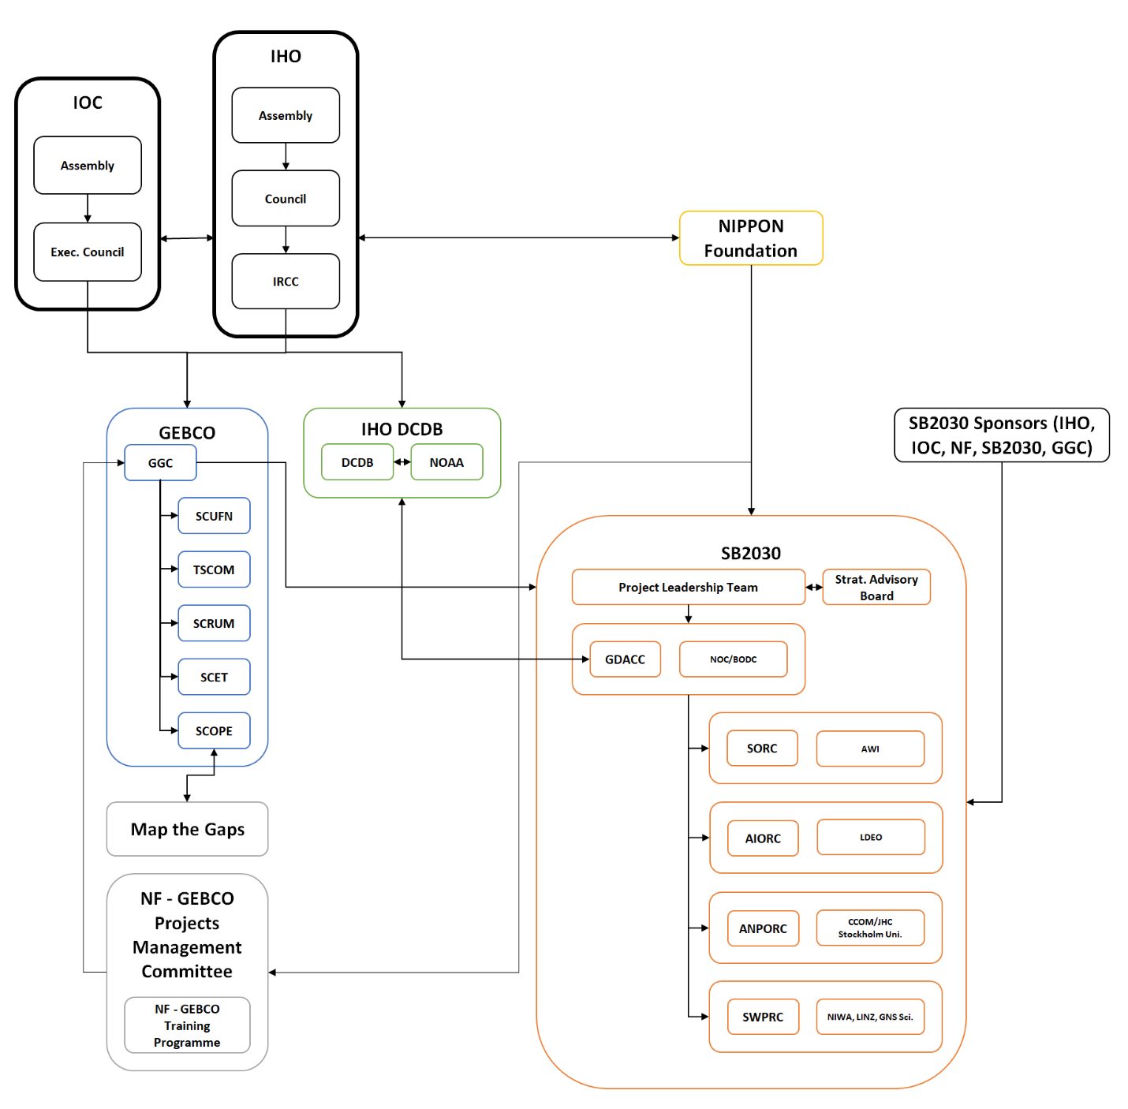
05
GEBCO Organisational Mapping
Summary
All relationships codified
Relationships bounded in red have been described and analyzed
Findings listed with potential solutions provided if appropriate

Slide 7
06
Analysis of GEBCO Bodies – Methodology
In order to identify the initial set of findings presented in this paper, a series of guiding questions were developed to assist in the review of governance instruments and work plans:
Do the relevant governance instruments exist?
Are the governance instruments up to date and adequately support the work of the group or committee?
Is the work plan clear, current and logically structured?
Is the work of the GGC and SCs appropriately structured in terms of programme delivery hierarchy?
Is the membership of the group or committee appropriate and are there any barriers to effective contribution?
Are any relevant working practices sufficiently clear, formalised and fit for purpose?

Slide 8
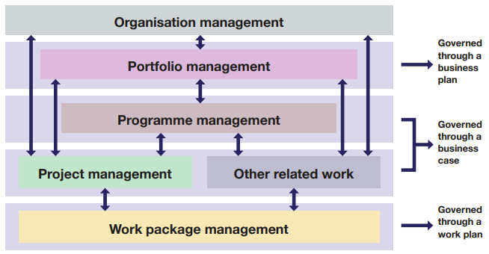
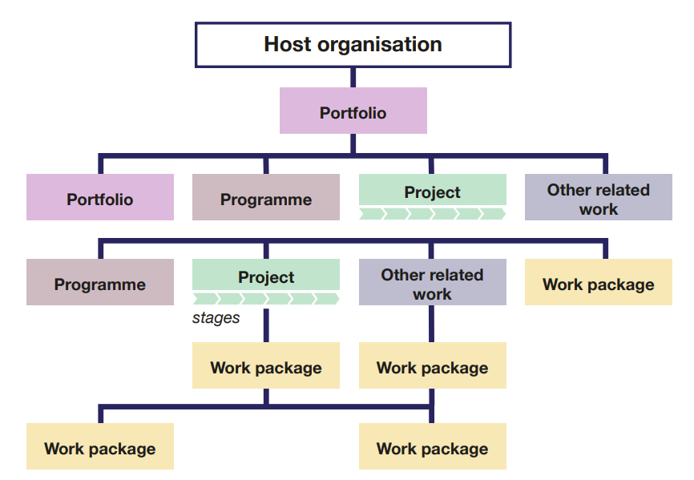
07
GEBCO Programme Work Structure
Current Programme Structure
New Recommendations
Programme Management Board
Finance Committee
Source: UK Government Functional Standard for Project Delivery

Slide 9
08
Key Cross-Cutting Findings
The key cross-cutting findings that have been identified are summarized as:
The potential need for a Programme Management Board/dedicated resource
The potential need for a finance committee
The need for discipline in the structuring of work plans to observe programme hierarchy norms
Review how the membership/structure of the GGC is constituted
Implementation of a continuous improvement process/framework

Slide 10
09
Submission of Report to Parent Bodies
At the 16th Session of the IHO Inter-Regional Coordination Committee (IRCC16) (10 – 12 June 2024), IHO Members States unanimously endorsed the GEBCO Governance Review Report.
At the 57th IOC Executive Council, IOC Member States endorsed the GEBCO Governance Review Report. In doing so they noted the complexity of the findings and requested that the GGC be given the time to consider it properly.
Both Parent organisations requested that the GGC develop an implementation plan and report back accordingly.

Slide 11
10
Prioritisation and Risk Management
Following endorsement of the report, a number of conversations were had regarding preparation for GGC41
Question: How do you implement the Governance report?
Key elements identified – analysis and prioritization of the findings + risk management and continuous improvement
Risk assessment of current organizational reality also part of strategy implementation methodology
Gov review report findings transferred into a generic risk and issues log
Risk/issues Log was circulated amongst GGC, SC Chairs and other key stakeholders

Slide 12
11
Risk and Issues Log
In transferring the findings to the log, a number of observations were made:
The log/matrix contains both issues and risks
    Issues: things that exist now, that need to be solved
    Risks: Things that could happen in the future that can be monitored, mitigated or eliminated

Slide 13
12
Risk and Issues Log
In transferring the findings/recommendations to the log, a number of observations were made:
2. Risk/Issue description
    Risk Description
    Risk Consequence Description
    Risk Control Description
    The majority of the findings/recommendations from the report transferred into the Risk Control Description
    As a result, the risk and consequence descriptions were reverse engineered from the text of the report. There is a subjective element to this which will need to be reviewed.

Slide 14
13
Risk and Issues Log
In transferring the findings to the log, a number of observations were made:
3. Risk Categories
    5 Categories:
    Governance
    Financial
    Delivery
    Strategic
    Compliance
    Each category has a look up table for Likelihood and Consequence Scoring values

Slide 15
14
Risk and Issues Log
In transferring the findings to the log, a number of observations were made:
3. Risk Categories – Example: Governance
Governance Risk
Consequence:
Score | Description
1 | Minimal Impact - Minor governance issues with little to no impact on decision-making processes.
2 | Minor Impact - Limited impact on governance; minor procedural issues that are easily rectifiable.
3 | Moderate Impact - Noticeable governance deficiencies that could disrupt some aspects of decision-making or cause delays.
4 | Major Impact - Significant governance breakdowns that undermine the decision-making process and lead to substantial delays or inefficiencies.
5 | Catastrophic Impact - Complete governance failure, leading to severe disruption of organizational oversight and potential legal ramifications.
Likelihood:
Score | Description
1 | Very Low - Governance issues are highly unlikely to occur.
2 | Low - Governance issues are possible but unlikely to manifest.
3 | Moderate - Governance issues are somewhat likely and could occur under certain conditions.
4 | High - Governance issues are likely to occur if current conditions persist.
5 | Very High - Governance issues are almost certain to occur without intervention.

Slide 16
15
Risk and Issues Log
Next Steps:
The 42 risks/issues need to be sorted into a risk matrix and an issues log
The risks/issues need to be consolidated where there is duplication
The risks/issues need to be scored and prioritized
Owners and deadlines for actionneed to be assigned
The process needs to be integrated into GEBCO’s working practices

Slide 17
16
Proposed Document Management
Post endorsement of the report, a number of minor editorial changes have been required, and one substantive inaccuracy
Propose that a version control page is added
These changes can be incorporated and referenced
Such an approach allows a for a historical record since endorsement
Forms part of the Continuous Improvement framework

Slide 18
17
Actions requested of the GGC
GGC is asked to:
Note the work undertaken so far;
Consider including the proposed continuous improvement framework, including the risk/issues log into the development of the strategy implementation plan;
Take any other action it deems necessary.

