Slide 1
GGC41
Item 6.1
Strategy implementation process for
GEBCO
4 November 2024, Nadi, Fiji

Slide 2
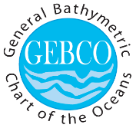
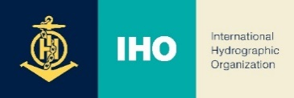
“A goal without a plan is just a wish”
Antoine de Saint-Exupéry

Slide 3
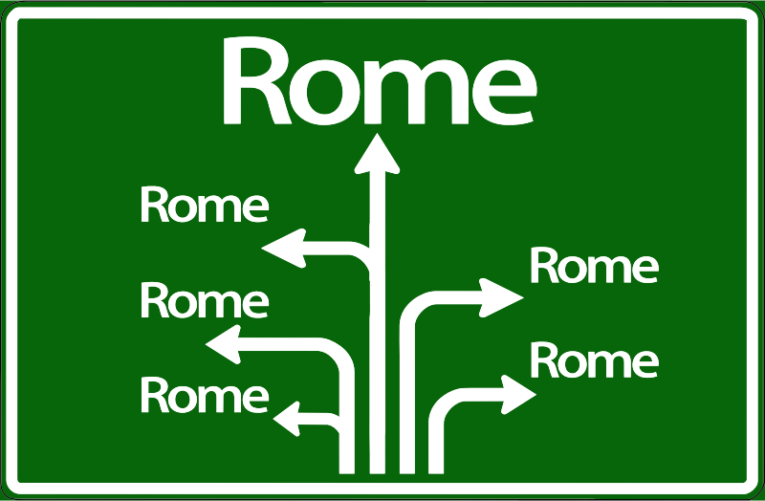
What does it mean to implement a strategy

Slide 4
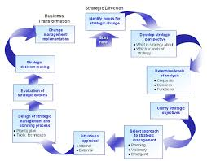
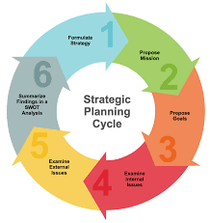
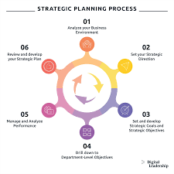
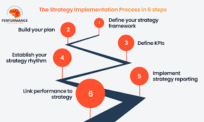
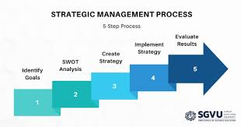
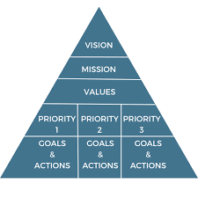
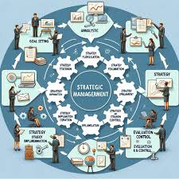
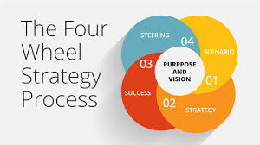
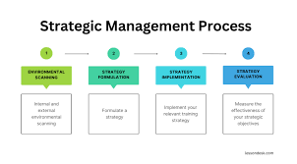

Slide 5
Global program under UN structured parent organizations
Nonprofit
No competition
Volunteers

Slide 6
Overview of the Strategy Implementation Process
STEP 1: Choosing the right time
STEP 2: Building the team
STEP 3: Reviewing your existing vision and mission
STEP 4: Analyzing the current situation
STEP 5: Developing your strategic plan
STEP 6: Aligning with the new strategic plan
STEP 7: Creating an operational plan
STEP 8: Risk management assessment
STEP 9: Collecting the right information for effective monitoring (KPIs)
STEP 10: Monitoring and control
STEP 11: Reporting on your performance

Slide 7
Aligning with the new strategic plan
Adopt the plan
16th meeting of the IHO InterRegional Coordination Committee (IRCC) and the 57th IOC Executive Council
Launch the plan
Are we fit for purpose?
SWOT
Critical review of the governance structure and propose required changes
Governance review
Perform start, stop continue exercise on the current workplan(s)
Change management

Slide 8
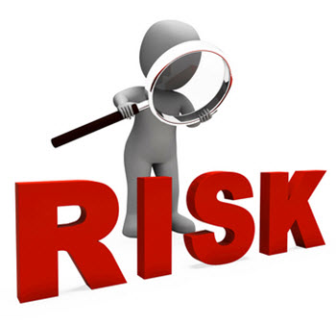
Risk management
risk is defined as the “effect of uncertainty on objectives,” where the effect is considered as “a deviation from the expected, positive and/or negative.”
We have to:
identify all the potential risks GEBCO faces (internally and externally)
prioritize them on the basis of impact and likelihood
GEBCO Risk registry

Slide 9
Collecting the right information for effective monitoring (KPIs)
Ensuring conformity control
Reporting to internal and external (sponsors) audiences
Constant learning and improvements

Slide 10
Monitoring and control
“Strategic monitoring” involves gathering and analyzing data to see whether your organization is on track to achieve strategic goals, while “strategic control” involves making appropriate changes based on these findings.

Slide 11
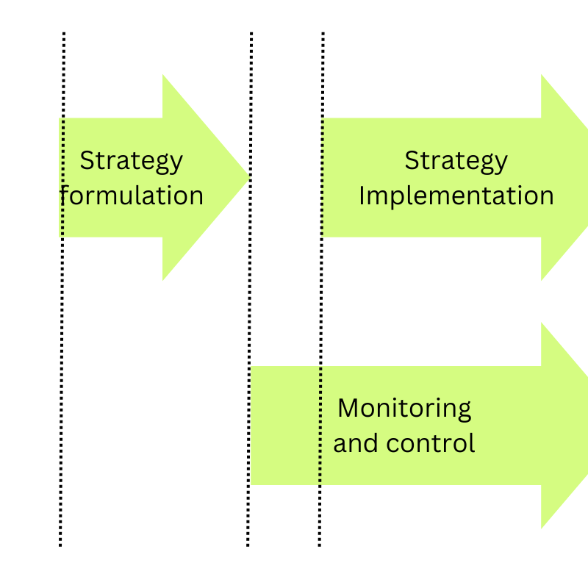
Monitoring and control
“Strategic monitoring” involves gathering and analyzing data to see whether your organization is on track to achieve strategic goals, while “strategic control” involves making appropriate changes based on these findings.

Slide 12
Lastly: Reporting
The reporting framework and plan should be established at the development phase of a strategic plan
Stakeholders should be informed in advance about the time periods in which they will be receiving reports and what these reports will help them evaluating and understanding our work

