Slide 1
GGC41
Item 2.1
IHO update
4 November 2024
IHO Director – Luigi SINAPI

Slide 2
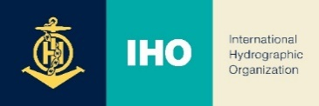
IHO Membership (since GGC 40)
In November 2023, CABO VERDE became the 99th IHO Member State (4.033 km² land, 5.934 km² sea)
The IHO Member States, primarily via their Regional Hydrographic Organizations, are invited to continue to promote the benefits of IHO membership in their respective regions (including land locked states) and in their role as the chart producing agency for coastal states who do not run a full-service hydrographic office.
In May 2024, KIRIBATI became the 100th IHO Member State (811 km² land, 5,1 million km² sea).

Slide 3
GEBCO Guiding Committee Membership
GGC Membership is consolidated as per the last update dated 4 April 2024
Nr.2 GGC members (1 of IHO and 1 of IOC) end their mandate in the current year
Nr.1 GGC vacancy in the IOC GGC members
Ex-officio members to be defined in line with the new GEBCO Governance
Need of an additional mandate of 5 years or specific IHO and/or IOC CL for Nomination/s of expert/s to fill in the vacancy/ies

Slide 4
IHO COUNCIL-8 OUTCOMES OF INTEREST OF GGC
CAPACITY BUILDING & GEBCO
The Council requested the Project Team on Fund Generation through IRCC to enhance the ToRs to incorporate a systematic survey of current and future IHO standards products and services for which users can potentially be charged and propose basic conditions such as single fee, subscriptions or other options.
EMPOWERING WOMEN IN HYDROGRAPHY (EWH) Project
The Council invited the IRCC assisted by the IHO Secretariat to issue CLs for endorsement of the ToR / ROP and the subsequent creation of the Project Team by the end of 2024, to submit a proposal for an IHO Resolution on Gender Balance / Inclusiveness to Council-9 for the following submission to A-4 for approval.

Slide 5
IHO COUNCIL-8 OUTCOMES OF INTEREST OF GGC (cont.)
STRATEGIC PERFORMANCE INDICATORS (SPI)
The Council noted the dashboard (target 2026, WP2 and WP3 SPIs value as of 31 Dec. 2023) allocated to the Secretariat, HSSC and IRCC (IHO Publication P-7 - Annual Report 2023 refer).

Slide 6
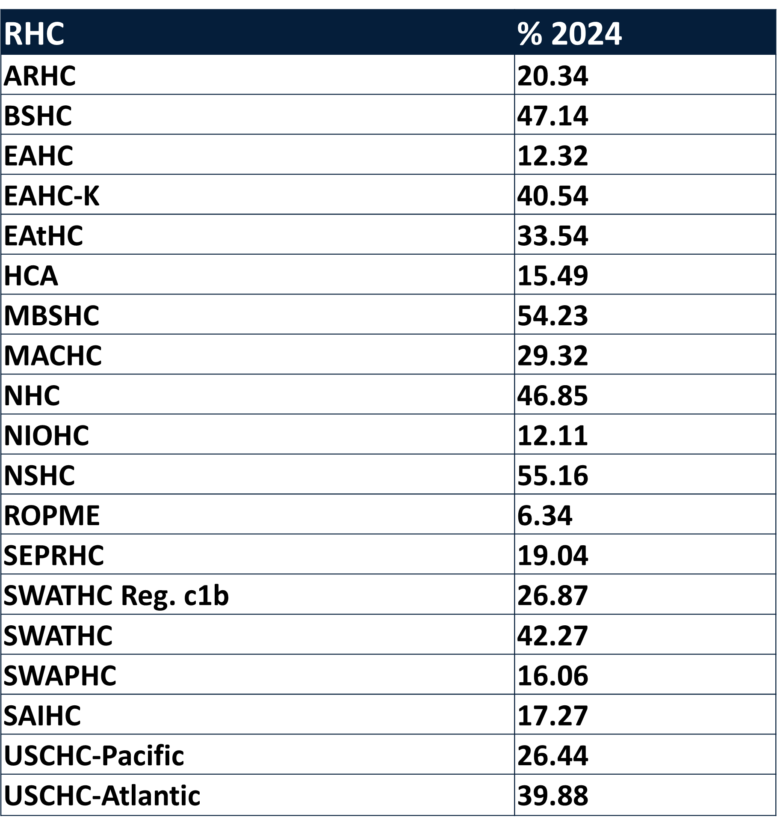
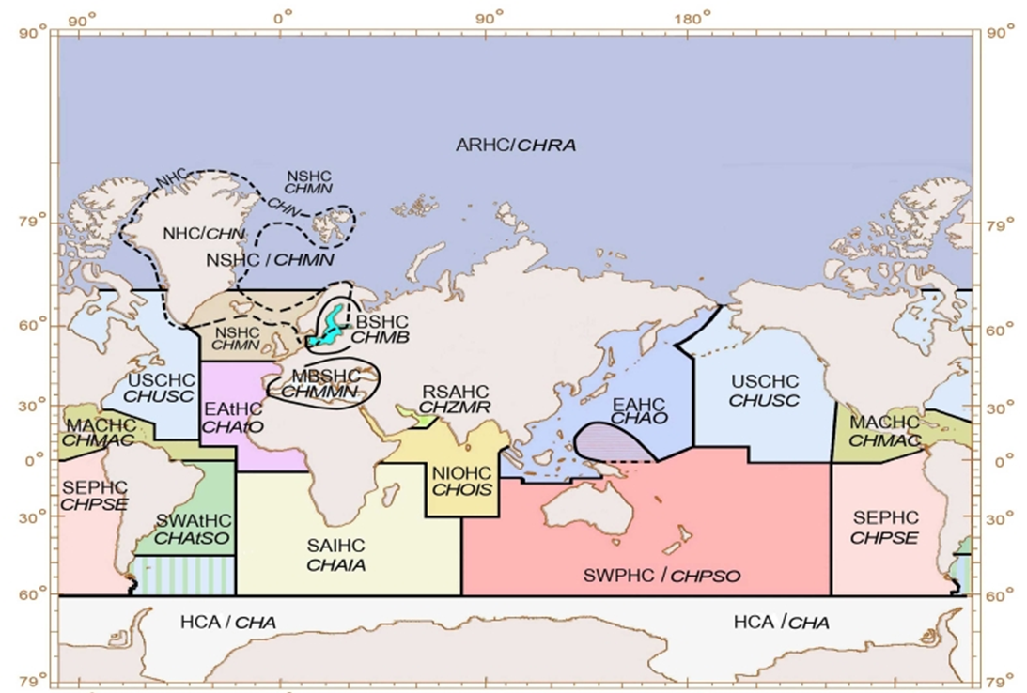
IHO COUNCIL-8 OUTCOMES OF INTEREST OF GGC (cont.)
SPI 3.2.3 per Regional Hydrographic Commissions

Slide 7
IHO COUNCIL-8 OUTCOMES OF INTEREST OF GGC (cont.)
NEW IHO STRATEGIC PLAN 2027-2032
The Council established the Strategic Plan Review Working Group (SPRWG), agreed to nominate US (Benjamin Evans), NZ (Adam Greenland), and DK (Hendrik Justus Stang) as Chair, Vice-Chair and Secretary of the SPRWG, respectively. The Council endorsed the proposed TORs and ROPs of the SPRWG. IHO Secretariat issued the IHO CL 38/2024 to all IHO MS calling for SPRWG Membership and inviting to provide comments to the TORs if any.

Slide 8
IHO COUNCIL-8 OUTCOMES OF INTEREST OF GGC (cont.)
FURTHER DIGITALIZATION OF IHO SECRETARIAT`S OPERATION
Noting the intention that the full operation of the IHO Portal is scheduled to commence in January 2025, the Council invited the IHO Secretariat to issue an informative IHO CL announcing the commissioning date, providing links to tutorials and user manuals (inc. for accredited WGs’ Secretaries, should they wish to upload documents directly), explaining the consequences and impact on the current IHO website, RHCs and WGs meetings, etc.
MARINE PROTECTED AREAS (MPA)
The Council tasked the MSDIWG through the IRCC, in liaison with the NIPWG, Protected Seas, ECDIS OEMs, GIS software manufacturers, the UN, IUCN, and IHO Member States, to coordinate a pilot project aiming to demonstrate the operational implementation of S-122 - MPA product.

Slide 9
IHO Strategic Priorities for GGC
Implement the GEBCO GOVERNANCE Review
Define a Strategic Implementation Plan
Prepare a Communication Strategy aligned with the IHO-IOC Communication Strategies
Participate actively in international initiatives related to the knowledge and the sustainable use of the Ocean (e.g. UNOC25)
Review the organizational diagram of GEBCO and update the GGC ToRs and RoPs
Fill up the vacancies in the GGC membership

Slide 10
IHO activities/initiatives of interest of GGC
IHO Strategic Plan Review Working Group (SPRWG) to review the IHO Strategic Plan (2027-2023)
IHO Fund Generation Project Team to explore options for the establishment of alternative funding for the IHO Capacity Building and GEBCO
IRCC-17 planned in Monaco from 3 to 5 June 2025
BLUE ECONOMY & FINANCE FORUM 2025 (Monaco, 7-8 June 2025) & U.N. OCEAN CONFERENCE 25 – UNOC25 (Nice, 9-13 June 2025)

Slide 11
IHO Outreach
World Hydrography Day 2025 motto proposal:
“SEABED MAPPING: ENABLING OCEAN ACTION (IHO CL to be issued soon)
IHO Public Relations and Communication (PRC) policy
LinkedIn page passed 10,000 followers in October 2024
INTERNATIONAL HYDROGRAPHIC REVIEW
Editor: Dr Patrick Westfeld
WEBSITE: https://ihr.iho.int/

Slide 12
Action Requested of the GGC
GGC41 is invited to:
Note this Report
Take into consideration the Decision C8/57 on the review of the IHO Strategic Plan (IHO CL 38/2024 - Invitation to participate in the Strategic Plan Review Working Group refer)
Consider a qualified GGC participation and/or propose new source of contributions to the IHO Project Team on “Fund Generation of IHO’ Projects Initiatives”
Take any other actions as considered appropriate.

