Slide 1
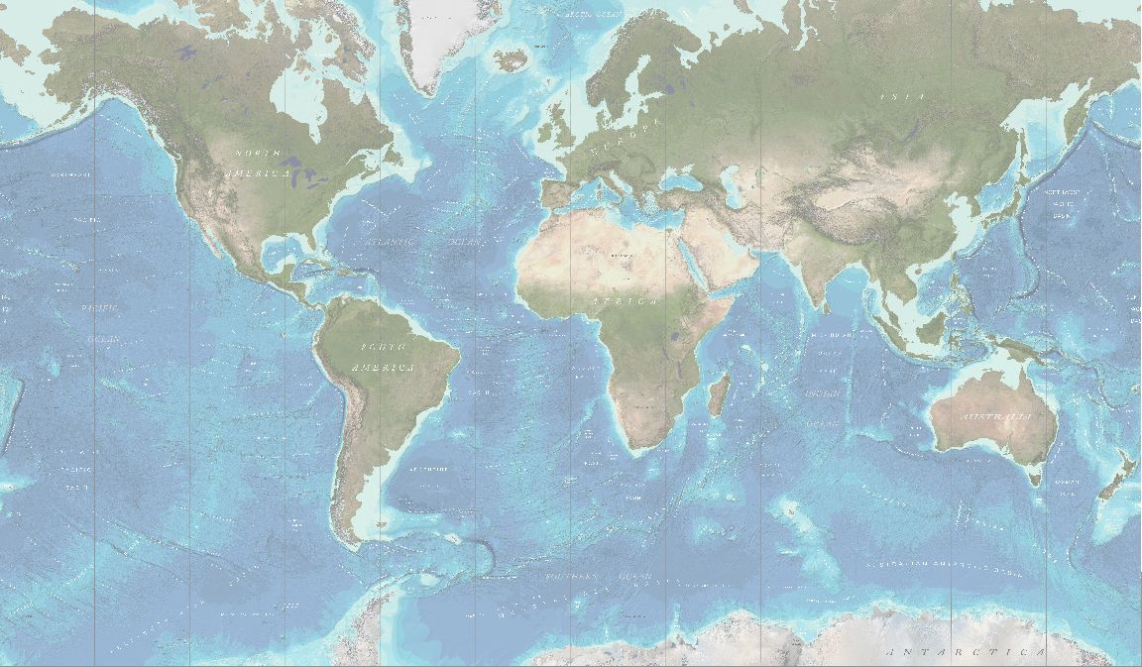
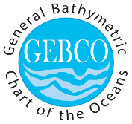
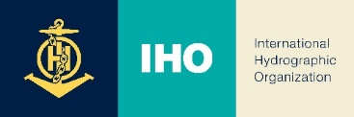
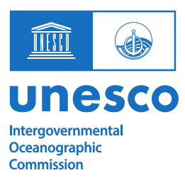
IOC Report to GGC 41

Slide 2
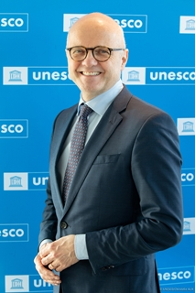
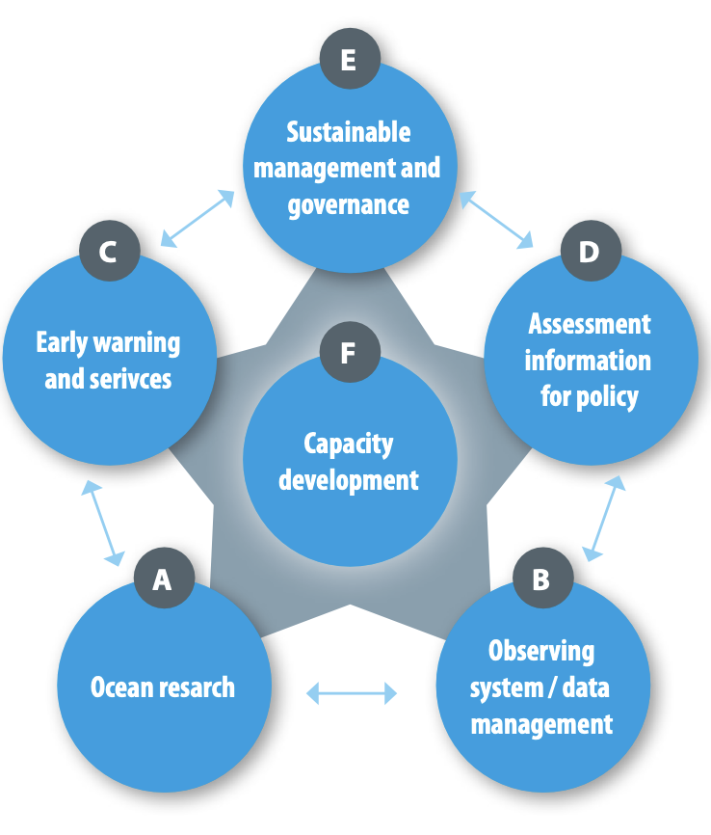
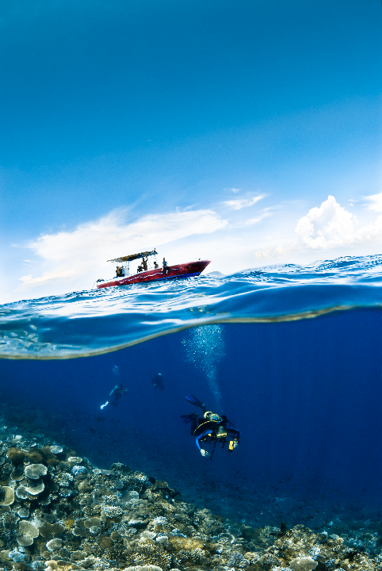

A DEEP PURPOSE: Putting knowledge to use
New Leadership since March 2024:
Vidar Helgesen, IOC Executive Secretary
“to promote international cooperation and to coordinate programmes in research, services and capacity-building, in order to learn more about the nature and resources of the ocean and coastal areas
and to
apply that knowledge for the improvement of management, sustainable development, the protection of the marine environment, and the decision-making process of its Member States.”
IOC/EC-57/5.1.Doc1 presents detailed information and areas of enhanced programme delivery

Slide 3
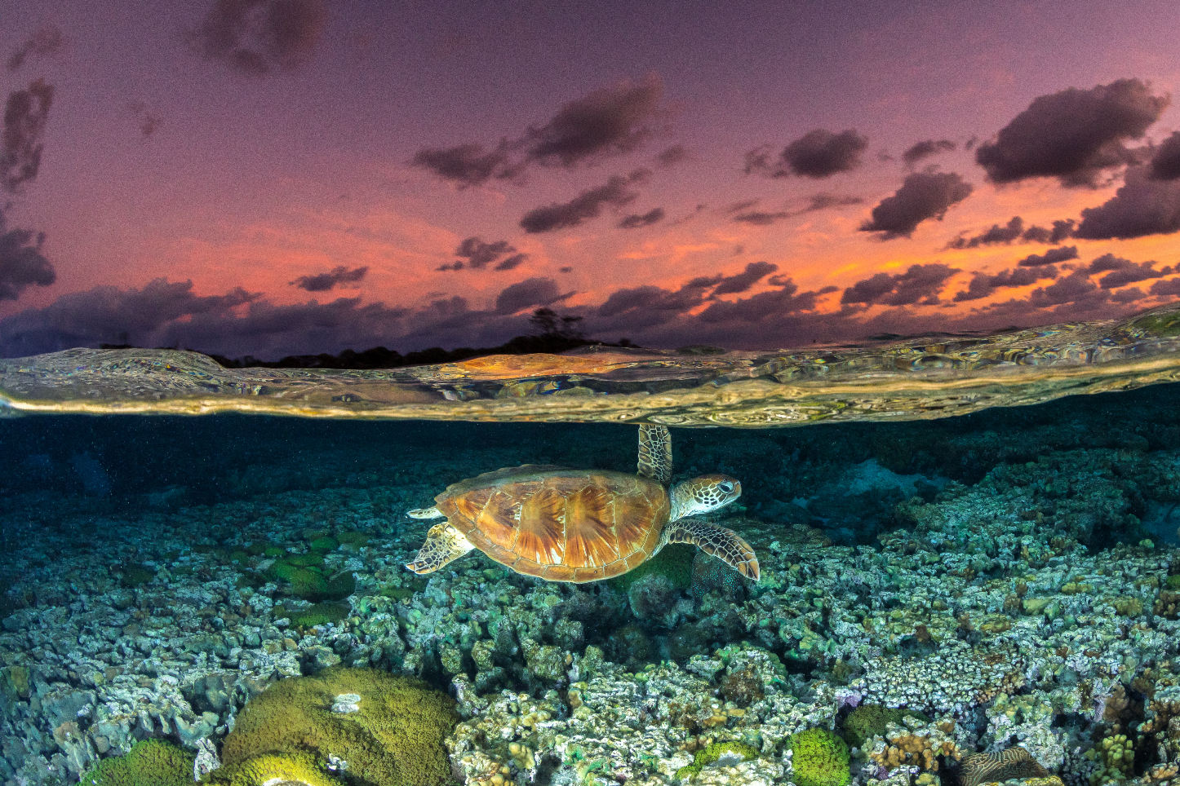

Updates from the 57th Session of the IOC Executive Council (June 2024)

Slide 4
GEBCO Governance Review and Strategy
Recalling IOC Decision A-32/Dec.4.1,
Having considered document IOC/EC-57/4.4.Doc(1) containing the Report and Recommendations of the GEBCO Governance Review Project Team (2024) and IOC/INF-1538, which presents the New GEBCO Strategy,
Takes note of the report and its recommendations, as well as of the GEBCO Strategy;
Requests the GEBCO Guiding Committee to consider the recommendations, identify the implications, if any, of their implementation, and report progress to the Governing Bodies of IOC and IHO through the report of the GEBCO Chair, including the preparation of an Implementation plan.

Slide 5
Triennial Review of the Working Group on User Requirements and Contributions to GEBCO Products (2024) – Rationale
GEBCO provides global bathymetric data which is crucial to the work of the IOC Community both from a user and contributor perspective
EC Decision XLIX.4.4 (2014) to strengthen IOC engagement in GEBCO
Regular mechanism established to assess user requirements needs as it relates to GEBCO products, from the IOC perspective, and identify ways to strengthen potential IOC contributions to GEBCO data and products (Terms of reference defined through Decision EC-XLIX/Dec.4.4 (2016) and Decision A-31/3.5.1 (2021))
Previous Assessment conducted in 2017, 2021 building on an international questionnaire
2024 assessment based on inputs of MS representatives, national institutions working with ocean mapping products, IOC technical bodies but also industry and non-governmental organisations (using the global network of the GEBCO-Nippon Foundation Seabed 2030 Project)
Assessment product transmitted to IHO and GEBCO Guiding Committee to inform their work and future developments
Notes:
The General Bathymetric Chart of the Oceans (GEBCO) project is a joint project of the International Hydrographic Organization (IHO) and the IOC
Mapping the ocean in its entirety has been the ultimate goal of GEBCO since its birth in 1903 under the initiative of Prince Albert I of Monaco.
Knowing the shape and depth of the seafloor (bathymetry) is fundamental to understanding Ocean circulation patterns – affecting climate change and weather forecasting, tides and wave action, sediment transport, tsunami wave propagation, underwater geo-hazards, as well as geological processes and biological systems. It is therefore very much relevant to the work of the oceanographic community, and therefore the IOC, both as users of bathymetric data products but also and providers of seabed data that can contribute to GEBCO goals
In 2014, IOC MS decided that IOC should increase its engagement in GEBCO and later in 2016 it was decided to have a regular mechanism established to assess the user requirements to GEBCO products, from the IOC perspective, and identify ways to strengthen potential IOC contributions to GEBCO data and products from the oceanographic community, and broader maritime end-users’ perspective.
An initial assessment was conducted in 2017, then in 2021 and now in 2024. In this year assessment, particular efforts have been made to capture the user requirements of member states and governmental organizations that have interest in GEBCO products, as well as those from industry/civil society organization. To do this, the survey developed by the team was circulated throughout the extensive network of the Nippon Foundation/GEBCO/Seabed 2030 project.
The findings of the Working Group are presented in Document IOC/EC-57/4.4.Doc(2)
The report and any decision that the IOC Executive Council may take, will be forwarded to the IHO and GEBCO Guiding Committee, and will inform the future work of GEBCO.

Slide 6
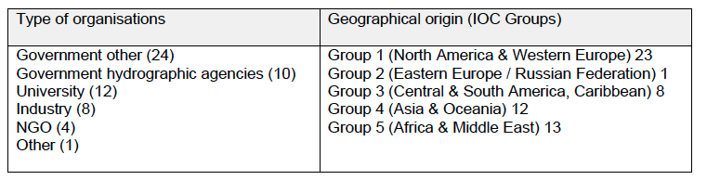
Triennial Review of the Working Group on User Requirements and Contributions to GEBCO Products (2024) – Summary of findings
A total of 59 responses from 39 countries were received, to the questionnaire circulated through IOC Circular Letter and Seabed 2030 networks (Opened from 14 March-19 April 2024)
Respondents are highly supportive of GEBCO, with over 90% valuing the GEBCO gridded bathymetry datasets, over 70% valuing the GEBCO web services, and over 60% valuing the undersea feature names and capacity development aspects of GEBCO’s work.
Less interest in availability of hard copy products or in the History of GEBCO.
Notes:
Let me now go the summary of the main findings:

Slide 7
Triennial Review of the Working Group on User Requirements and Contributions to GEBCO Products (2024) – Summary of findings
Demand for higher resolution products, with considerable interest in expanding the scope of GECO data products to include a larger number of parameters and data layers, notwithstanding that some of these lies outside GEBCO’s current remit.
Demand for greater choice of file formats and improved compatibility with state-of-the-art software products used in the geospatial sector, including better visualisation tools.
Concerns about security within coastal zones and EEZs, with a greater awareness of risks to subsea infrastructure from malevolent actors.
Suggestion to create an international seabed data users group is a commonly requested feature, that would help transfer skills and promote knowledge exchange and capacity development.
Provision of specialist training sessions and workshops identified as a priority
)

Slide 8
Triennial Review of the Working Group on User Requirements and Contributions to GEBCO Products (2024) – Summary of findings
Concept of rewards and incentives for sharing data emerged from several respondents, particularly where this might encourage industry to share data more widely.
Working Group, further recommended to integrate the GEBCO capacity development needs and priorities within the IOC Capacity Development Strategy and delivery mechanism such as the Ocean Teacher Global Academy.
Connecting the GEBCO data infrastructure with the IOC Ocean Data Information System was also highlighted.
For future assessments of GEBCO user needs, the Working Group recommended that the results should be more granular in order to identify needs by type of users or by regional groups.
The Working Group welcomed the increased diversity of respondents compared to the 2021 previous exercise but highlighted the lack of responses from specific IOC programmes.
More in-depth discussion/needs assessment to be conducted with IOC programmes in the future.
Decides to conduct the next Review of User Requirements and Potential Contributions to GEBCO, with the next assessment to be presented to the IOC Assembly in 2027;

Slide 9
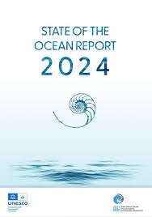
OTHER RELEVANT IOC EC ITEMS
IOC Wide Strategy Sustainable Ocean Planning and Management (SOPM)
Working Group established (MS + Programmes)
Finalise SOPM Strategy and develop implementation plan for Assembly 23
2nd edition of State of the Ocean Report
Published in June 24, GEBCO chapter
Endorses the continued publication of the StOR
Implementation of the IOC Capacity Development Strategy (2023-2030)
New IOC Group of Experts on Capacity Development (GE-CD)
Assist with assessment of CD needs across the whole of IOC
CD Implementation plan
Ocean Observations in Areas under National Jurisdiction
WG established and working
MS/Experts review experiences and challenges, best practice regarding sustained ocean observations in areas under national jurisdiction

Slide 10
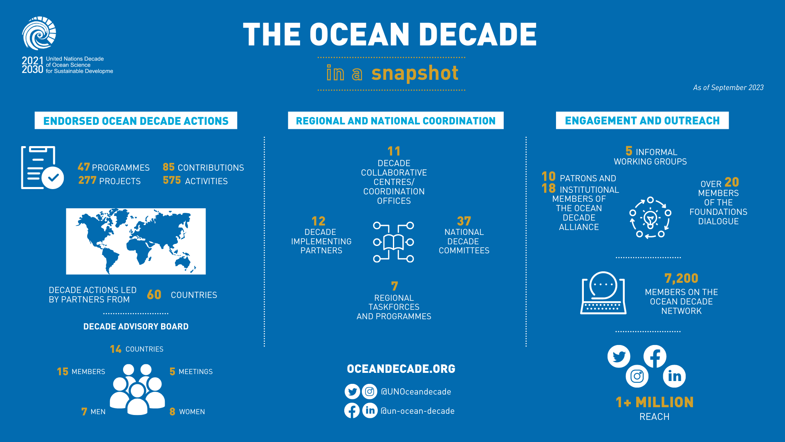

Current Status

Slide 11
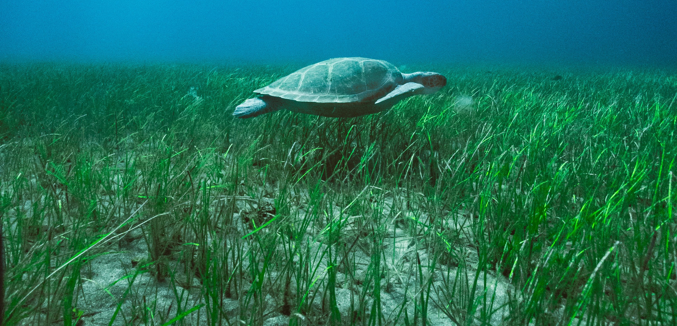
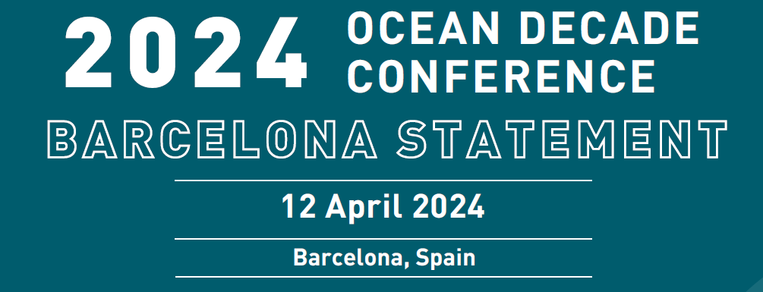
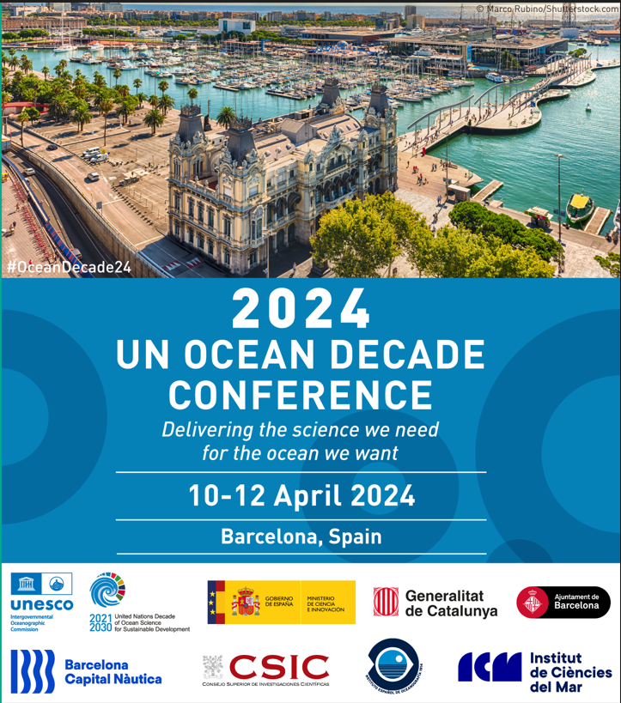
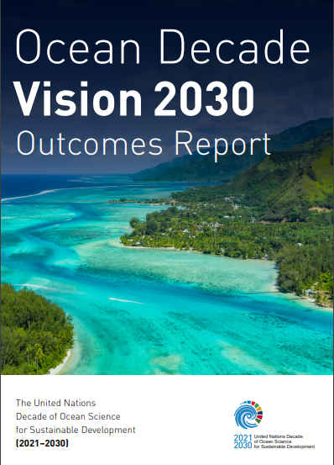
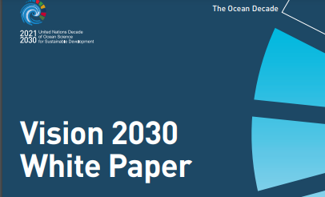
2024 OCEAN DECADE CONFERENCE
Take Stock – Set Priorities – Catalyze Action
2,630 in-person attendees from 124 countries
> 3,000 online viewers
165 Satellite Events
1.SCIENCE & KNOWLEDGE PRIORITIES
2.CROSS-CUTTING / ENABLING ENVIRONMENT PRIORITIES
3. ANNOUNCEMENTS & COMMITMENTS
10 x

Slide 12
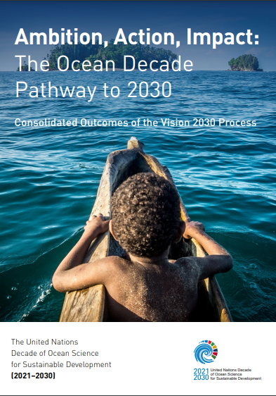
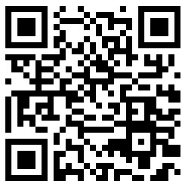

SCIENCE & KNOWLEDGE TO DEVELOP SOLUTIONS FOR …
1. Marine pollution across land-sea continuum
2. Deep-sea ecosystems & emerging threats
3. Sustainable aquatic food production
4. Evidence-based Sustainable Ocean Plans
5. Sustainable and climate resilient ocean economy
6. Policy to regulate marine carbon dioxide removal initiatives
7. Decision support tools for coastal resilience
8. Financial instruments, policies and models to diversify and accelerate investment in ocean science
9. Social science and ocean literacy research on human-ocean connection
10. Ocean health and human health
Notes:
Point to the QR code, final report was finalized and launched 2 weeks ago at AORIA meeting in Canada
1. Marine pollution across land-sea continuum
2. Deep-sea ecosystems & emerging threats
3. Sustainable aquatic food production
4. Evidence-based Sustainable Ocean Plans
5. Sustainable and climate resilient ocean economy
6. Policy to regulate marine carbon dioxide removal initiatives
7. Decision support tools for coastal resilience
8. Financial instruments, policies and models to diversify and accelerate investment in ocean science
9. Social science and ocean literacy research on human-ocean connection
10. Ocean health and human health

Slide 13
ENABLING FACTORS FOR SUSTAINED IMPACT…
Strengthened role of policy / user needs as drivers of Decade Actions
Address specific needs of SIDS/LDCs
Approaches, tools and skills to increase inclusivity of all knowledge systems
Reinforced national level action & strengthened national science – policy – society uptake
Capacity development with sustained impact for individuals and institutions
Industry engagement including with insurance, finance, tourism & fisheries sectors
Strategic communications and broad approach to ocean literacy across all sectors of society
Equity, inclusivity & diversity across generations, genders and geographies
Sustained & sustainable investment for ocean science initiatives and infrastructure
Notes:
Strengthened role of policy / user needs as drivers of Decade Actions
Address specific needs of SIDS/LDCs
Approaches, tools and skills to increase inclusivity of all knowledge systems
Reinforced national level action & strengthened national science – policy – society uptake
Capacity development with sustained impact for individuals and institutions
Industry engagement including with insurance, finance, tourism & fisheries sectors
Strategic communications and broad approach to ocean literacy across all sectors of society
Equity, inclusivity & diversity across generations, genders and geographies
Sustained & sustainable investment for ocean science initiatives and infrastructure

Slide 14

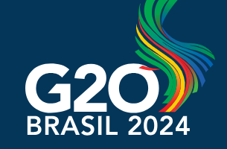

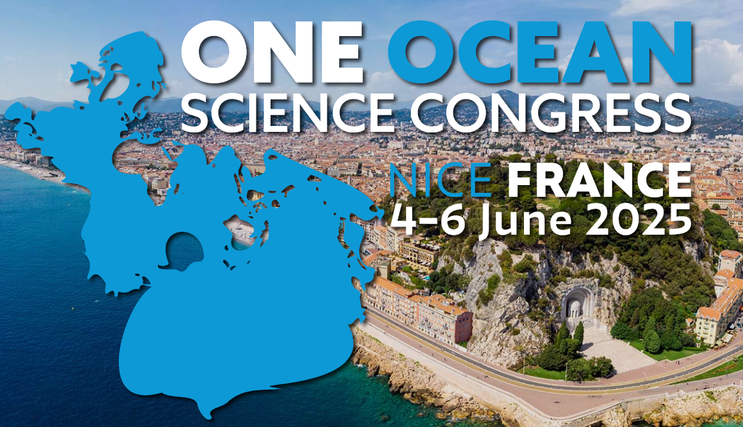


FROM AMBITION TO ACTION
Translation of global actions to regional and national priorities and strategies & strengthened role for NDCs, DCC/DCOS
New co-designed Decade Actions through tailored Calls for Decade Actions & proactive p/ships
Ocean Decade “Flagship Initiatives” to create p/ships to inform the global agenda on key issues
Investment in ocean science
Seabed mapping & data sharing
Coastal cities resilience
Marine pollution
Sustainable Ocean Planning
Partnerships to facilitate collective action & investment in the lead-up to 2025 United Nations Ocean Conference & beyond

Slide 15

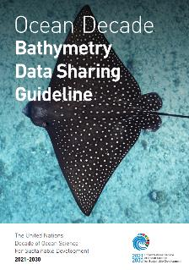


Ocean Decade Corporate Data Group
Bathymetry Data Sharing Guideline

Slide 16
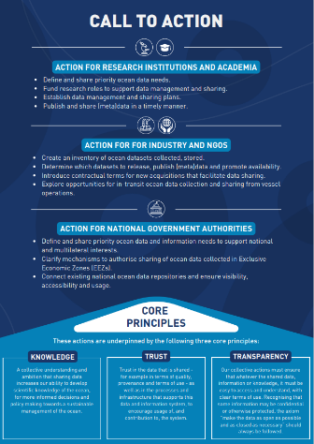






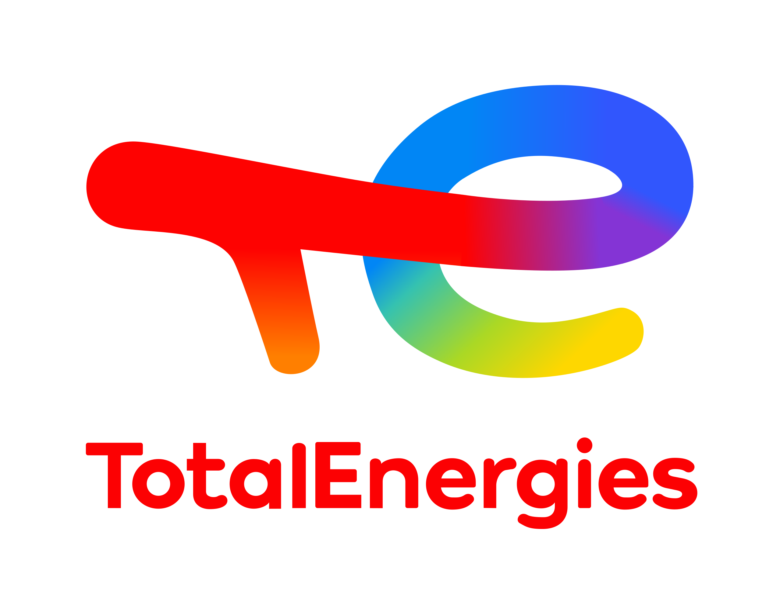



The Ocean Decade Corporate Data Group
1
  Identify barriers and solutions to sharing privately collected and owned ocean data
Notes:
The purpose of the Ocean Decade Corporate Data Group is to provide an ongoing forum to identify opportunities and challenges to sharing of privately held data, and address and develop solutions to these challenges.
The objective of the group is to establish a strategy, framework, and best practices for companies to provide public access to their privately held ocean data within the framework of the Ocean Decade.
The group is focusing on use cases for bathymetry (now ready) , Marine Mammal Observations and CTD data (Conductivity, Temperature, and Depth).

Slide 17
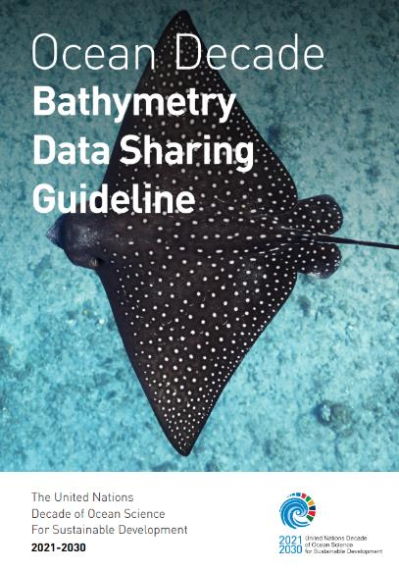
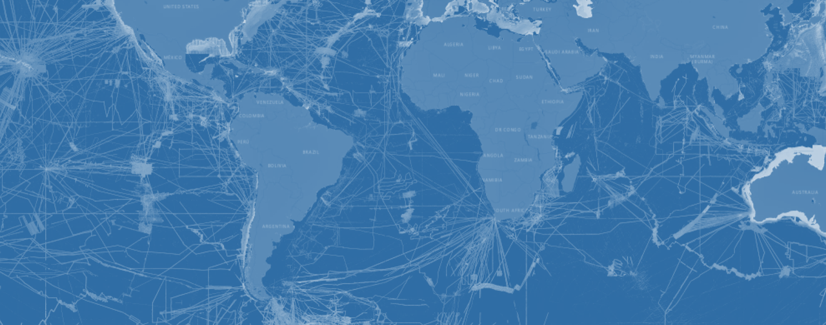
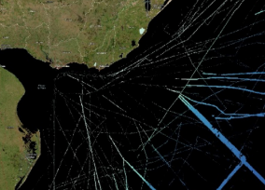
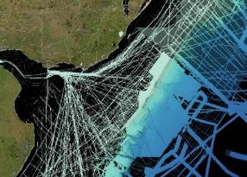




2
Ocean Decade Corporate Data Group
Bathymetry Data Sharing Guideline
2014
2024
Example:
Seabed 2030 bathymetric data coverage 2014 to 2024 – yellow area corresponds to bathymetry extracted from ~40,000 km² of 3D seismic data contributed by ANCAP.
Currently >26% of the global seabed is mapped.
Estimated additional 15%-20% of the seabed has already been mapped but not yet shared.
Majority of unshared seabed mapping data is held by the private sector.
Source: Seabed2030
Use QR code to download
the Guideline
Notes:
Targeted audience is industry
The Bathymetry Data Sharing Guideline highlights the opportunities and mutual benefits for industrial companies working in the marine environment to unlock and make their existing and future surveys’ bathymetry data publicly available to GEBCO / Seabed 2030.
It provides practical guidelines and best practices on how to share their data.
In the middle is an example where the work of the CDG allowed approx 40,000 km2 of bathymetry data extracted form 3d seismic data off the coast of Uruguay to flow into the GEBCO Seabed 2030 platform.

