Slide 1
International Hydrographic Organization Inter Regional Coordination Committee SOUTH EAST PACIFIC REGIONAL HYDROGRAPHIC COMISSION (SEPRHC) REPORT
Lieutenant Commander Navy of Colombia
NATHALIA MARÍA OTALORA MURILLO
National Hydrographic Service of Colombia (DIMAR-CIOH)
On behalf SEPRHC (chair)
Genoa, Italy 3- 5 June 2019

Slide 2
I. Membership
Ecuador
Colombia
INOCAR
DIMAR
PERU
Chile
DHN
SHOA
Notes:
(this hydrographic commissions is integrated by 4 member states, it has the privilege to have panama as observer state)

Slide 3
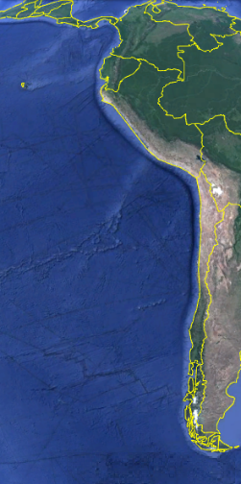
II. SEPRHC maritime scenario
Issue | Qty
Length | 8,621 Km
Countries | 5
Terminals | 17
Ports | 54
Navareas | 3
Fuente: Google earth
Notes:
Nevertheless, in this region there are more than 8500 KM of Coast, we have more than 71 between terminals and ports and 3 NAVAREAS among other aspects. In this way and considering the increase of maritime activities in our region, the capacity building program of IHO is a great help to try provide each time better hydrographic products and services.

Slide 4
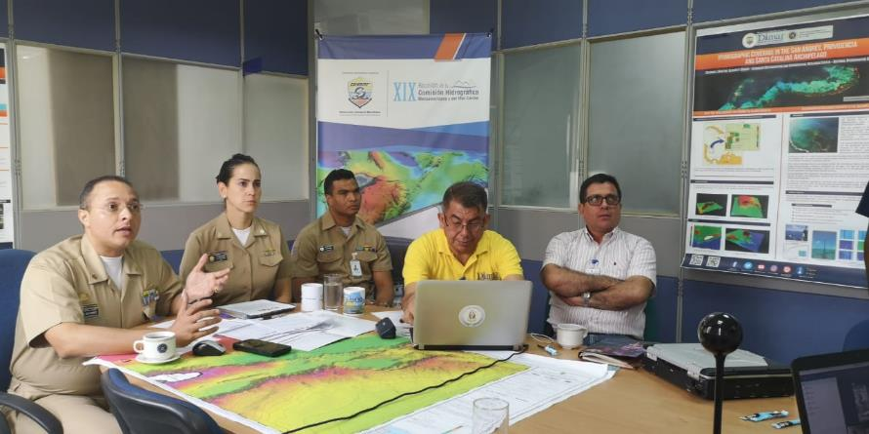
III. V video conference SEPHRC 21 March 2019
Notes:
The control of action of IRCC task are review by video conferences

Slide 5
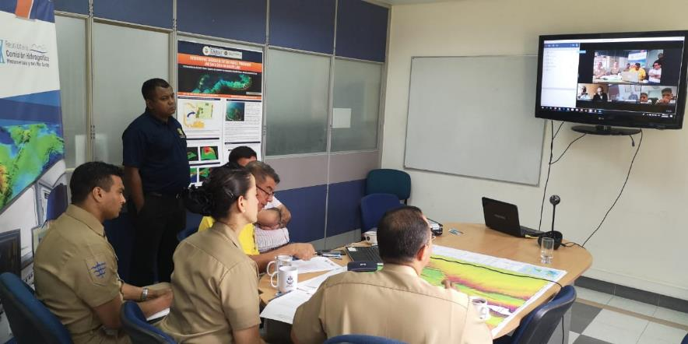
III. V video conference SEPHRC 21 March 2019
Notes:
First video conference 26th February 2018.
Second video conference 3rd May 2018.
Third video conference 26th July 2018.
Four video conference 11th November 2018.
Five video conference 21th March 2019.

Slide 6
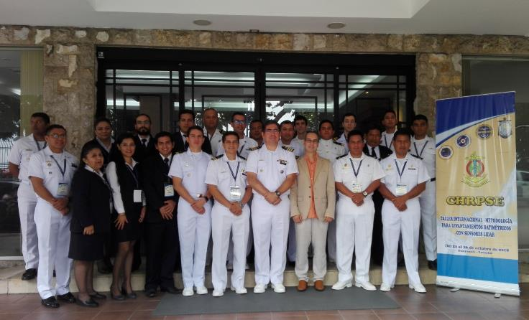
IV. Workshops
P21. Workshop on LIDAR technology and methodology for
shallow waters and coastline hydrographic surveys.
October 2018
Notes:
Workshop on LIDAR technology and methodology for shallow waters and coastline hydrographic surveys. Held in Guayaquil Ecuador 22 to 26th October 2018
RHC Disasters. On going
MSDI

Slide 7
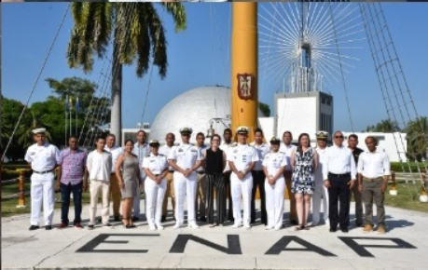
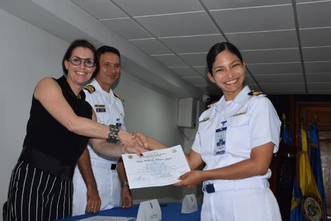
IV. Workshops
IALA – DIMAR-ENAP
17 to 21 December 2018
Colombia
Notes:
After this course DIMAR – ENAP and IALA are trying to sign one memorándum of agreement. The ENAP hope to be a official Academy for course of IALA

Slide 8
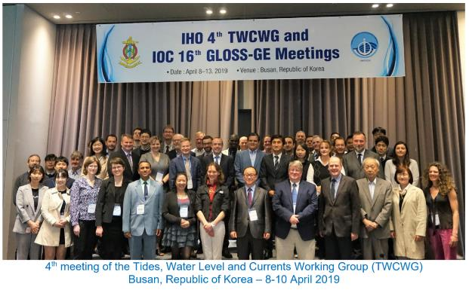
V. Current SEPRHC Working Groups
TWCWG - Peru attend in Busan
MARITIME DISASTERS - On going.
Notes:
The Officer Gonzalo Agurto Barragán from Peru attend this meeting in name of SEPRHC. Colombia had the intention to attend but internal issues was no possible

Slide 9
VI. Status of IRCC actions (See Appendix A)
N | Action | Responsible | Deadline | SEPRHC status
3 | to submit draft IHO Resolution 2/1997 as amended (Annex C) to the RHC Members for comments and report back to IRCC (6.2) | RHC Chairs | Oct 2018 | Done
5 | to provide comments to the revised draft IHO Resolution 2/1997 as amended (6.2) | RHC Chairs | IRCC10 | Done 3 MS
Notes:
After Meeting IRRC 10, the Commander Gustavo Gutierrez wrote a letter to members states about this actions. This actions was treat during the different video conferences as results of this effort, three MS vote in favor. You can see CL IHO 8/2019.

Slide 10
VII. SEPRHC cooperation with stakeholders
There are active cooperation between SEPRHC, SWAtHC and MACHC.
The relationship among navies is strong a continuous.
The SEPRHC explore more efficient relationship with the some universities in the region to support the CB activities.
Notes:
Active cooperation in capacity building is in place between SEPRHC, SWAtHC and MACHC. The projects submitted to the CBSC always consider the participation three Hydrographic Commissions. Spanish speakers
Member states are involved with other intergovernmental organizations related to maritime and navigation safety like IOC, IALA, and IMO.
Under the agreements between navies there are a lot of cooperation in capacity building among hydrographic services.
In particular, Colombia has received assessorial in Antarctic expedition of Ecuador, Peru and Chile.
The Antarctic Treaty is another organization that the four members state works together
In the SEPRHC have been adopted one measure when occur natural disasters occur. The HS establish coordination's with other institute of respective government.
After XIII SEPRHC, is highlight MS compromise to support Panama.

Slide 11
VII. Conclusions
The SEPRHC will continue working in the tasks and commitments signed in the XIII SEPRHC act. Every two months the advances are reviewed through video conferences.
The Commission continue work in consistency with the IRCC and CBSC work plans.
SEPHRC XIV will be the next year in Chile. TBD date

Slide 12
VII. Achievements and lessons learned
The CB promoted by IHO trough CBSC has been very important for our region.
The cooperation among the navies is excellent.
The need of SEPRHC members states to participate actively in the IHO bodies and WG´s continues to be promoted.
Notes:
The SEPRHC gives thanks to CBSC by the continuous support in Capacity Building. The close relation between MS permit the easy communicates, share the information and work early.
This cooperation has been critical to promoting an understanding of respective national directions, hydrographic priorities and interests, and resulting opportunities for collaboration and mutual assistance.

Slide 13
VII. Actions Required of IRCC
The IRCC is invited to:
a. Note this report.

Slide 14
International Hydrographic Organization Inter Regional Coordination Committee SOUTH EAST PACIFIC REGIONAL HYDROGRAPHIC COMISSION (SEPRHC) Thanks
Lieutenant Commander Navy of Colombia
NATHALIA MARÍA OTALORA MURILLO
National Hydrographic Service of Colombia (DIMAR-CIOH)
On behalf SEPRHC (chair)
Genoa, Italy 3- 5 June 2019

