Slide 1
Report of the Crowdsourced Bathymetry Working Group to IRCC11
Jennifer Jencks
CSBWG Chair
Director, IHO Data Centre for Digital Bathymetry
jennifer.jencks@noaa.gov

Slide 2
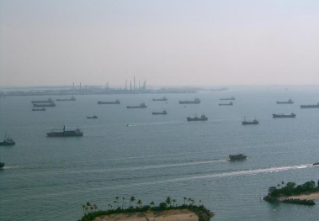
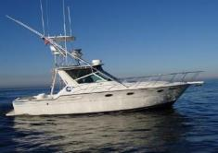
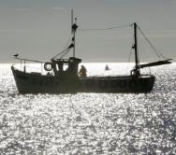
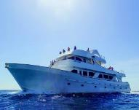
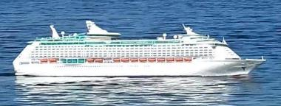
CSB Working Group Task
The CSBWG is tasked by the IRCC to develop a draft IHO publication on policy for trusted crowdsourced bathymetry (CSB).
This document will provide guidelines on the collection and assessment of CSB data for inclusion in the global bathymetric data set which is maintained in the IHO Data Centre for Digital Bathymetry (DCDB).

Slide 3
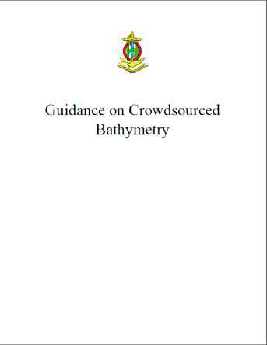
Progress on IRCC Action Item
IRCC10:
Decision 20: To endorse the CSB Guidance Document.
Action 16: Chair to submit the CSB Guidance Document to the Council for endorsement and subsequent approval by MS (deadline: C-2).
B-12 Edition 1.0.0 submitted to C-2.
Subsequent changes required by C-2 incorporated into Edition 2.0.1 for approval by IHO Member States under IHO CL 11/2019 dated 25 January 2019.
35 Member States approved the adoption of B-12 out of 38 replies.
A follow-up IHO CL is being prepared with the full details, including responses to the comments provided.
To access the document: https://www.iho.int/srv1/index.php?option=com_content&amp;view=article&amp;id=635&amp;Itemid=988&amp;lang=en

Slide 4
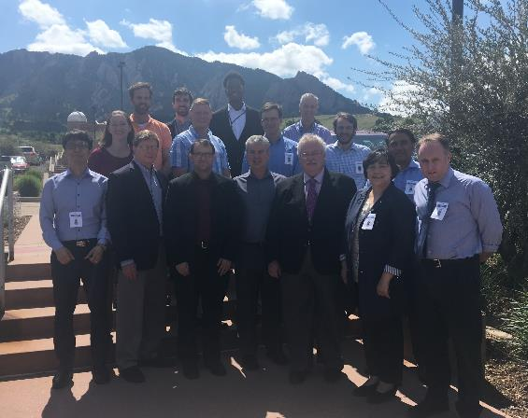
CSB Working Group 6th Meeting
Chair (Jennifer Jencks, USA) and Vice-Chair (Serge Gosselin, Canada) of CSBWG
Representatives from four Member States
Canada, Norway, UK and USA
Observers and expert contributors from the World Ocean Council, the NF-GEBCO Seabed 2030 Project, ONE Data Technology Co, Dongseo University and Farsounder INC
Remote participation by: Denmark, GMATEK, Sea-ID, ChartWorld/SevenCs and TeamSurv
Assistant Director David Wyatt represented the IHO Secretariat
Hosted by the NOAA’s National Centers for Environmental Information, on 19-21 June 2018

Slide 5
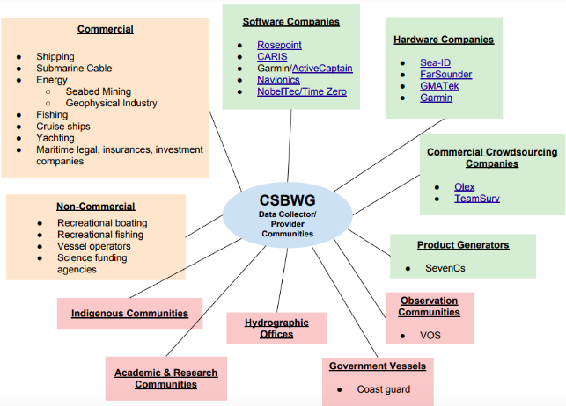
CSB Working Group 6th Meeting
Provided updates on a number of ongoing CSB-related projects.
Discussed future tasks approved by IRCC10 as a result of the adoption of the revisions to the ToRs of the CSBWG.
Focused on future outreach strategies for which various sectors were identified and 5 headline topics (need, how, what, incentives and benefits) were defined to increase contributions and participation
These would be further developed at the next meeting.
Hosted by the NOAA’s National Centers for Environmental Information, on 19-21 June 2018

Slide 6
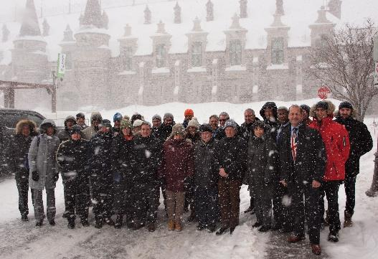
CSB Industry Workshop
Goal: To showcase a variety of current industry CSB participants and discuss the potential for future collaborations to advance the IHO CSB Initiative.
Key Objectives:
Raise awareness of corporate leadership/opportunities to stimulate action for the collection and sharing of CSB data;
Discuss CSB acquisition methods/procedures/opportunities;
Information sharing on transit/CSB data acquisition and exchange formats and protocols;
Determine tools, methods and protocols to leverage/stimulate a generic participative approach for CSB data collection
Develop synergies with global initiatives including Seabed 2030
Representatives from: CIDCO, Da Gama Maritime, EGS Survey (representing ICPC), ECC, ESRI, FarSounder, Fugro, GMATEK, Hypack, Olex, Secunda, SevenCs/ChartWorld and Teledyne CARIS
Hosted by the Canadian Hydrographic Service, Quebec City, Canada, on 12-13, February 2019

Slide 7
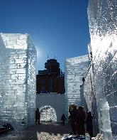
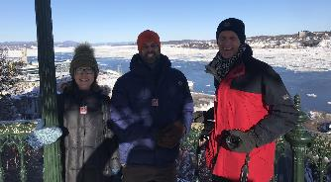
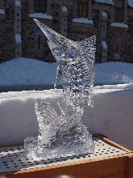
CSB Industry Workshop
Industry reps. given an initiative overview, short presentations on current industry partner projects, examples of CSB data usage by HOs and other projects, and tech. perspectives.
Discussion on how to expand the initiative into various maritime sectors, what methodologies were appropriate to incentivise data gathering activities, how data could be made available and what recognition strategies were desirable.
These discussions and recommendations will pave the way towards improved private-sector participation in the collection of CSB.
Hosted by the Canadian Hydrographic Service, Quebec City, Canada, on 12-13, February 2019

Slide 8
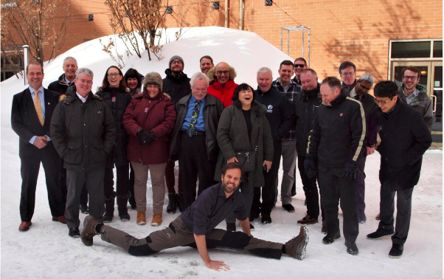
CSB Working Group 7th Meeting
Chair (Jennifer Jencks, USA) and Vice-Chair (Serge Gosselin, Canada) of CSBWG
Representatives from eight Member States
Canada, Denmark, India, Italy, New Zealand, Norway, UK and USA
Observers and expert contributors from ONE Data Technology Co, Dongseo University, Farsounder INC, Da Gamma Maritime Ltd, GMATEK Inc, and Fugro.
Assistant Director David Wyatt represented the IHO Secretariat
Hosted by the Canadian Hydrographic Service, Quebec City, Canada, on 13-14, February 2019

Slide 9
CSB Working Group 7th Meeting
Representation at events & meetings is essential to raise awareness & progress contributions & participation.
Current outreach strategies will focus on the Geophysical, Research Vessel, Cruise Liner, Submarine Cable, & Recreational Leisure sectors.
Leading organizations & companies within each sector to be identified & approached to act as CSB ambassadors.
Closer liaison with various IHO bodies, groups/organizations, & projects still needs to take place (eg: DQWG, MSDIWG, Seabed 2030)
Hosted by the Canadian Hydrographic Service, Quebec City, Canada, on 13-14, February 2019

Slide 10
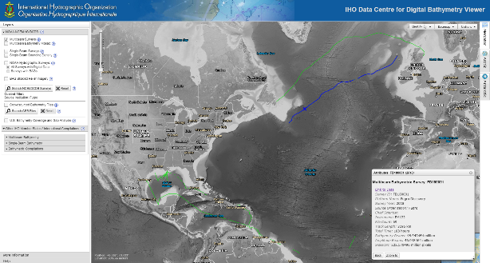
CSB Working Group - Significant Highlights
Cruise Liner: Carnival Cruise Line & MacGregor
The Macgregor Maritime Data Engine (MDE) is a data normaliser that collects, standardizes and stores data from a ship’s Voyage Data Recorder (VDR)
Working to implement a single interface between MDE and the DCDB that can connect the Carnival fleet
Marine Survey: Fugro
Signed data submission agreement with DCDB
Contributed over 20 transit surveys
Fugro Transits

Slide 11
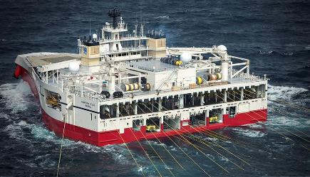
CSB Working Group - Significant Highlights cont…
Seismic Survey: PGS
MoU signed by PGS CEO
Test data currently being evaluated by Norway
Research Vessel: Antarctic Treaty Consultative Meeting 42 (Prague, Jul ‘19)
Working Paper drafted by Norway
Assisted/co-sponsored by Italy, New Zealand and USA
Stronger resolution for countries to commit their research vessels to contribute to bathymetric data collection.

Slide 12
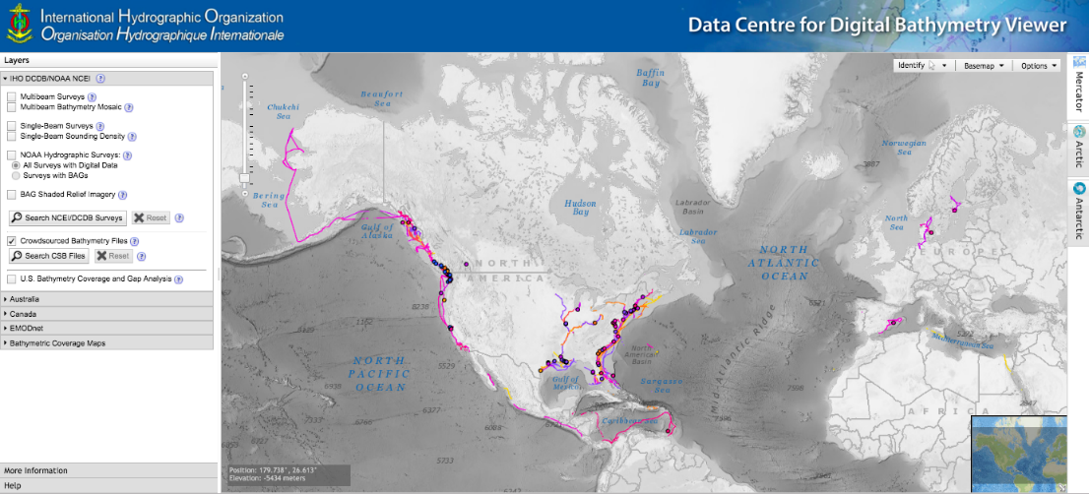
IHO DCDB Database
154 million soundings
168 contributing vessels
6585 data deliveries

Slide 13
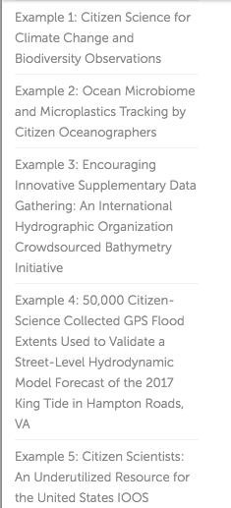
CSB Use Cases – Frontiers in Marine Science journal
Case Study #1: NOAA Chart Adequacy Assessment
Case Study #2: Canadian Hydro Service: Inside Passage
https://www.frontiersin.org/articles/10.3389/fmars.2019.00225/full#h5

Slide 14
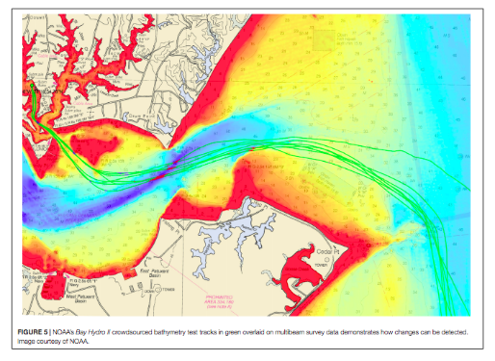
CSB Use Cases – NOAA Chart Adequacy Assessment
Describes NOAA & George Mason University collaboration to:
Use CSB to assess NOAA nautical chart adequacy
Determine when areas require updated survey information
Identify chart discrepancies before an incident occurs.
https://www.frontiersin.org/articles/10.3389/fmars.2019.00225/full#h5

Slide 15
CSB Use Cases – CHS Inside Passage
CHS has used CSB to update several IP charts along coastal routes.
A systematic comparison of charted depths < 10 m yielded improved charted channel depths, data density and improved chart compilation in areas that were surveyed with singlebeam.
CSB helped prioritize survey areas for the following survey season and initiated the publication of Notices to Mariners.
CSB revealed some chart compilation problems.
Don’t use the chart to figure out how much anchor chain you need!
https://www.frontiersin.org/articles/10.3389/fmars.2019.00225/full#h5

Slide 16
Why CSB? – by Pete Wills (CHS)
The potential is enormous as is our coastline.
We have always received reported shoals from mariners and put them on charts.
CSB is an evolution of the mariners reporting system.
We still need to assess the quality of data however it comes in.
We have very old sparse surveys or no surveys in many areas.
Mariners have better positioning and sonars today than much of the older data.
Free

Slide 17
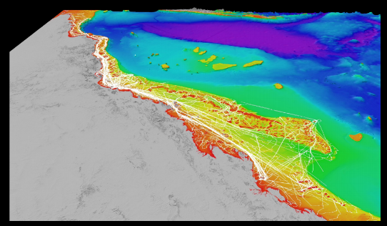
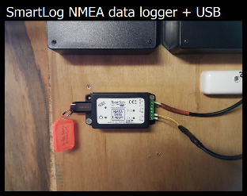
Use Case – Great Barrier Reef Project (James Cook U.)
~40% of GBR shelf is mapped with in situ depth soundings, with a need to preserve, share and fill the data gaps
Many vessels on the GBR (from expedition dive boats to recreational fishing boats) use some type of echo sounder and GPS for safe navigation and guiding activities
In 2018, James Cook U. started the ‘Crowdsourced Bathymetry on the Great Barrier Reef’ project to collect CSB from voluntary vessels
Partnered with the Great Barrier Reef Foundation to establish a pool of TeamSurv SmartLog USB data loggers.
This project is also an activity of the Citizens of the Great Barrier Reef, which gives people an increasing role in contributing valuable citizen science data to improve a fundamental dataset that helps the Reef.

Slide 18
Use Case – Great Barrier Reef

Slide 19
Problems Encountered
There continues to be a need to overcome skepticism within parts of the IHO community and sections of the marine domain where an overly cautious focus on potential, although untested, legal issues and concerns on commercial exploitation of data is observed.
Increased awareness and information as well as stakeholder engagement/involvement should all help to overcome these reservations.
There is a growing concern over the apparent lack of dedicated resources available within national HOs to process data available via the DCDB.
This is an issue that will need to be addressed for the full benefits of CSB to be realized and will require for HO’s to consider engaging efforts and resources, including the development of automated processing, to integrate CSB data into their routines.

Slide 20
Other Items of Note
The continued importance of liaison with other IHO bodies, as well as appropriate engagement with industry to progress the work items, was identified as a key enabler for the project.
There is a need to showcase various use cases of CSB data to indicate the benefits and how MS can utilize ‘free’ data for their own national uses.

Slide 21
Actions requested of IRCC
Note the contents of this report;
Encourage IHO Member States to release datasets or subsets into the public domain via the IHO DCDB;
Request IHO Member States state their policy on data gathering restrictions within their maritime areas of jurisdiction, as requested in IHO CL 11/2019, to enable CSB activities to be undertaken;
Request IHO Member States to support the CSB initiative with positive actions, such as requiring all research vessels collect bathymetric data for late uploading, when on passage or when it does not interfere with other research activities;
Request the IHO to support a scaled trial of CSB data collection as a follow on to earlier pilot programmes.
Reappoint the WG to continue its work under the proposed revised ToRs; and
Take what other action is deemed necessary.

Slide 22
Acknowledgements
David Wyatt (Executive secretary)
Serge Gosselin (Vice-Chair)
All the amazing CSB Working Group members
The IHO, GEBCO, SMEs and observers whose contributions are making this possible!

Slide 23
Final Thought – UN Decade of Ocean Science for Sustainable Development
195 UN member states have given their support/approval
SDG14 will not be achievable without a comprehensive map of the world ocean floor
Some of these same member states do not fully support the CSB activity in their EEZ, yet have limited resources or capability to collect the data themselves.

