Slide 1
Report of the IHO Data Centre for Digital Bathymetry to IRCC11
Jennifer Jencks
Director, IHO Data Centre for Digital Bathymetry
jennifer.jencks@noaa.gov

Slide 2
IHO CL 23/1990 dated 25 June 1990 - IHO DCDB
IHO CL23/1990 highlighted comments received from the IHO Member States to the modified proposal by the USA for the establishment of an IHO DCDB at the US National Geophysical Data Center (NGDC) of Boulder, Colorado, USA.
The modified proposal received overwhelming support and therefore the date of establishment of the IHO DCDB was fixed as 1 June 1990.
As a result of the NOAA Data Center restructuring and consolidation in 2015, the IHO DCDB is now hosted and maintained by the National Centers for Environmental Information (NCEI), which means that the previous agreement with NOAA is out of date and needs to be revised to reflect the current structure.
IRCC11 June 2019

Slide 3
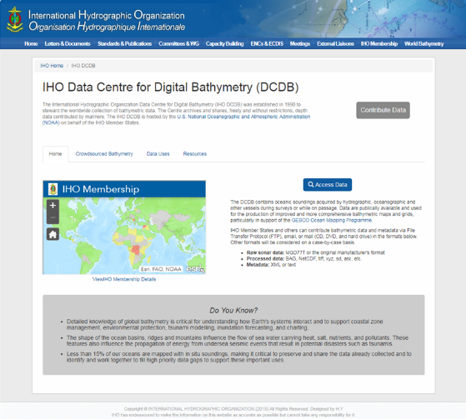
IHO Data Centre for Digital Bathymetry (DCDB)
The IHO DCDB is the recognized IHO repository for ocean bathymetric data collected by hydrographic, oceanographic and other vessels.
Since 1990, NOAA’s NCEI (formally NGDC) has hosted the DCDB.
The DCDB archives and shares, freely and without restrictions, depth data contributed by mariners
www.ngdc.noaa.gov/iho/
IRCC11 June 2019

Slide 4
Contributing data to the DCDB
IHO Member States and other organizations can contribute bathymetric data and metadata:
Raw sonar data: all original manufacturer's format
Processed data: BAG, NetCDF, tiff, xyz, sd, asc, etc.
Metadata: XML or text
We accept bathymetric data via FTP, e-mail, or mail (hard drive, DVD).
www.ngdc.noaa.gov/iho/
IRCC11 June 2019

Slide 5
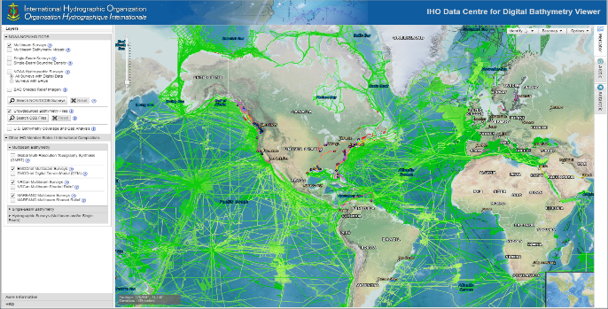
Accessing data from the DCDB
The DCDB utilizes NCEI’s standard web services for promoting data access - both the discovery and delivery of data and metadata.
www.ngdc.noaa.gov/iho/
IRCC11 June 2019

Slide 6
IHO Crowdsourced Bathymetry Initiative
Establishment of the IHO Crowdsourced Bathymetry Working Group
Enhance the IHO’s DCDB to accept, archive, and make available to the public CSB data
IRCC11 June 2019

Slide 7
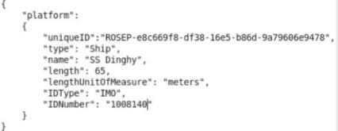
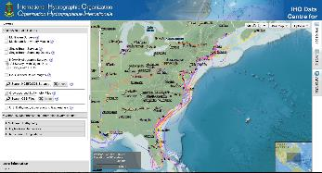
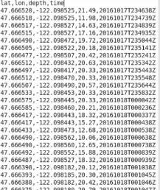
IHO DCDB CSB Enhancements
Data discovery and access via our map viewer.
Data delivered as a collection of files.
CSB data log file (with JSON metadata string)
Frequent update of viewer
Data and identifying token are submitted to DCDB via HTTP post
IRCC11 June 2019

Slide 8
Crowdsourced Bathymetry
International
Since 1990, the quantity of data archived in the DCDB has grown considerably both in area coverage and size.
Today, the DCDB archives > 30 TB of oceanic soundings acquired by vessels during surveys or while on passage.
~2800 multibeam bathy surveys, ~5500 singlebeam bathy surveys, and over 100 unique contributing vessels in support of the IHO CSB initiative.
Research & Exploration
Industry
DCDB
Long Term Archiving
Data Discovery
RAW BATHY (+)
NOAA Charting & Exploration
Public
(eg: HO’s, industry, academic/research institutions)
Google ESRI
GEBCO
SB2030
DCDB data holdings are routinely used for the production of improved and more comprehensive bathymetric maps and grids, particularly in support of the GEBCO Ocean Mapping Programme and the Nippon Foundation-GEBCO Seabed 2030 project.

Slide 9
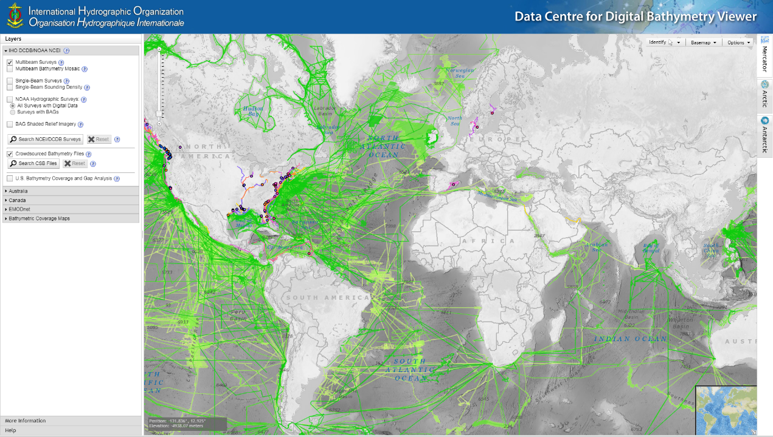

Slide 10
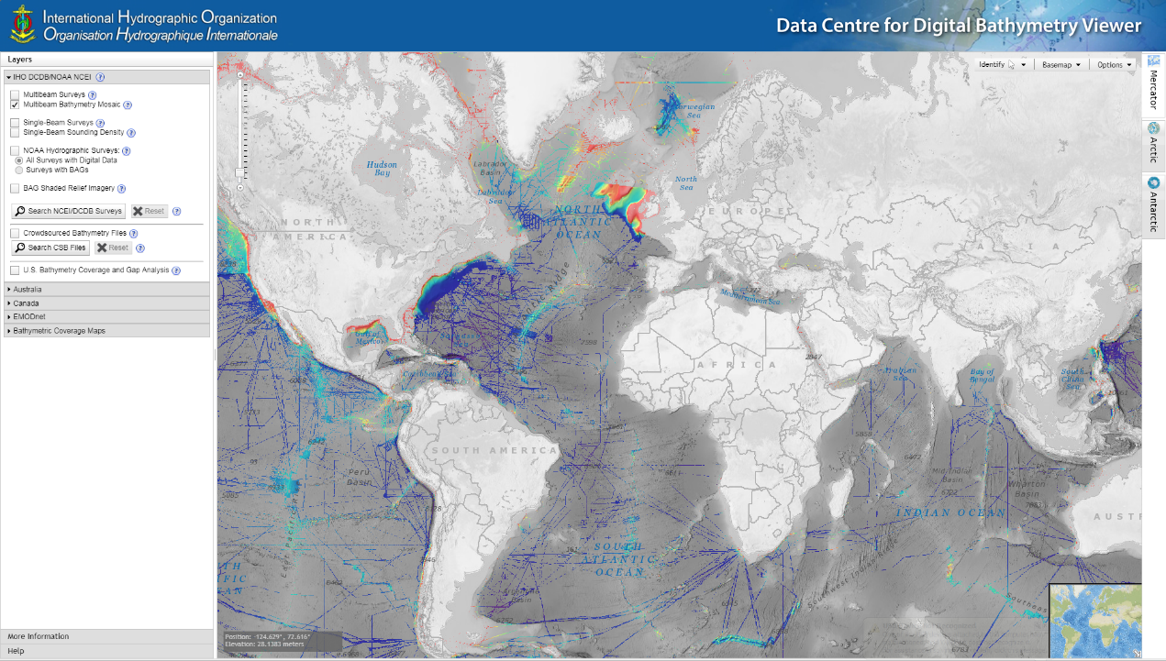

Slide 11
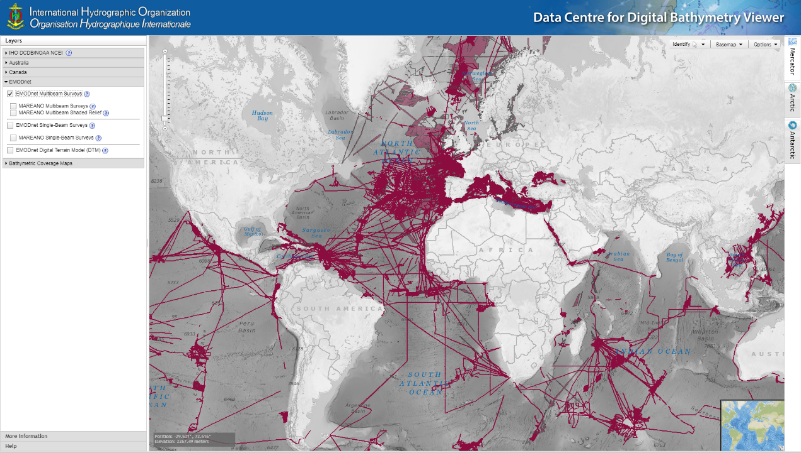

Slide 12
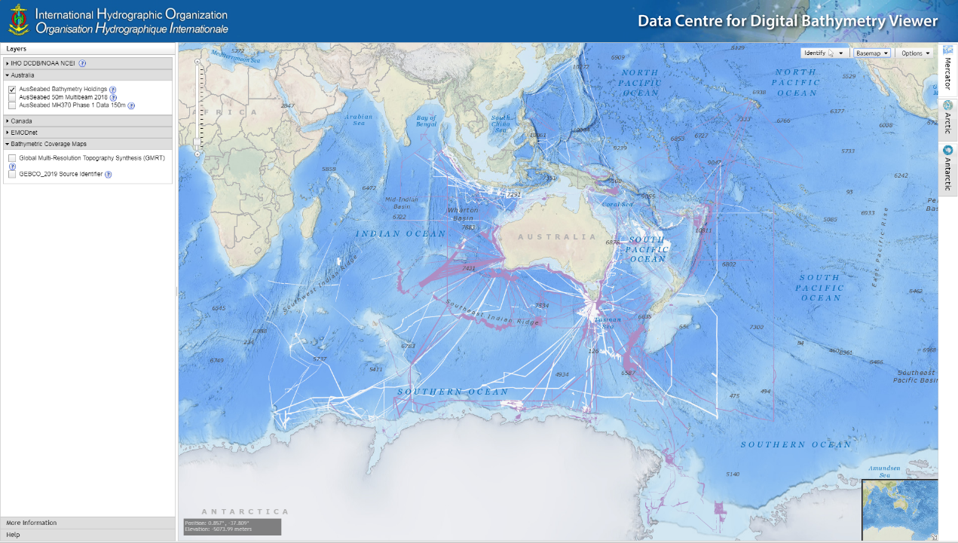

Slide 13
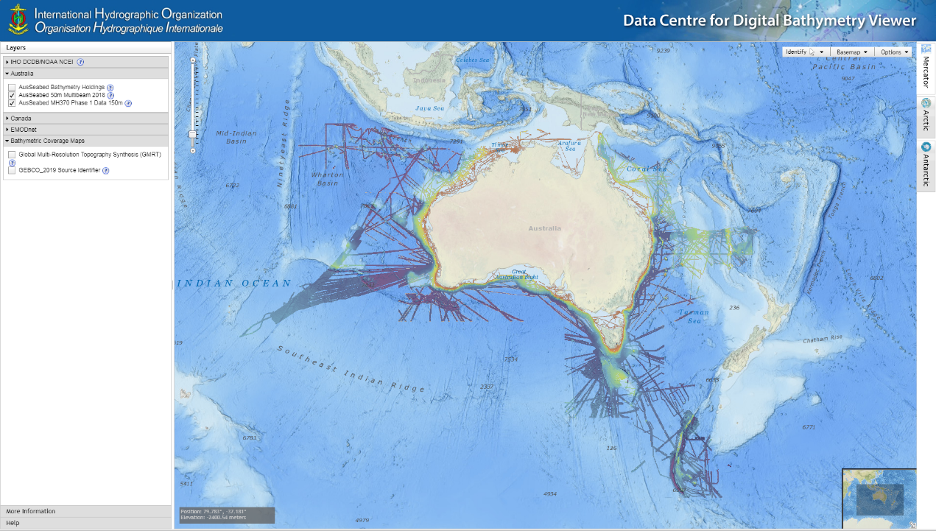

Slide 14
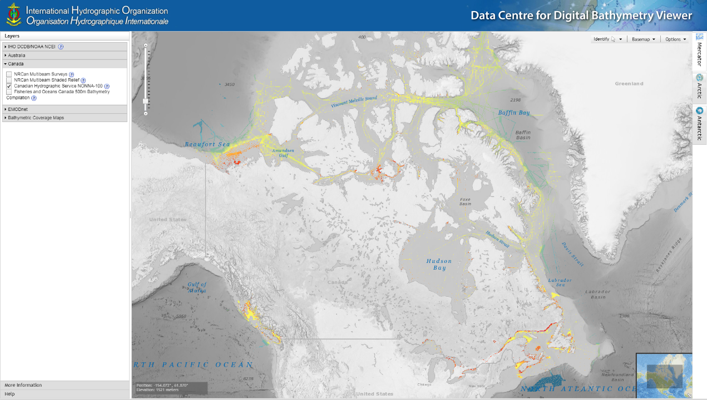

Slide 15
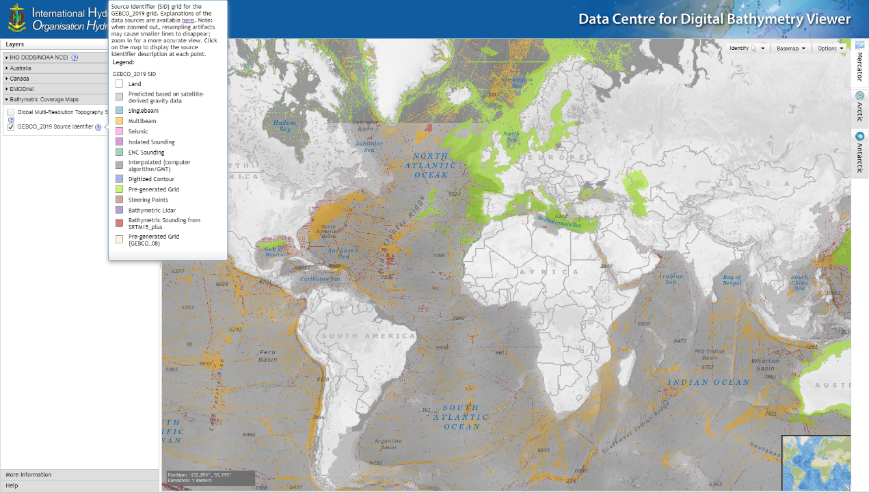

Slide 16
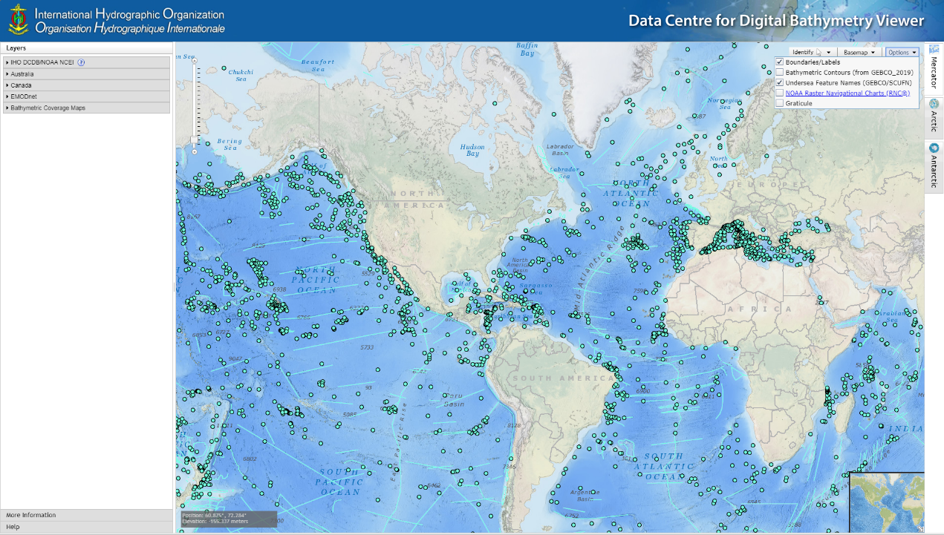

Slide 17
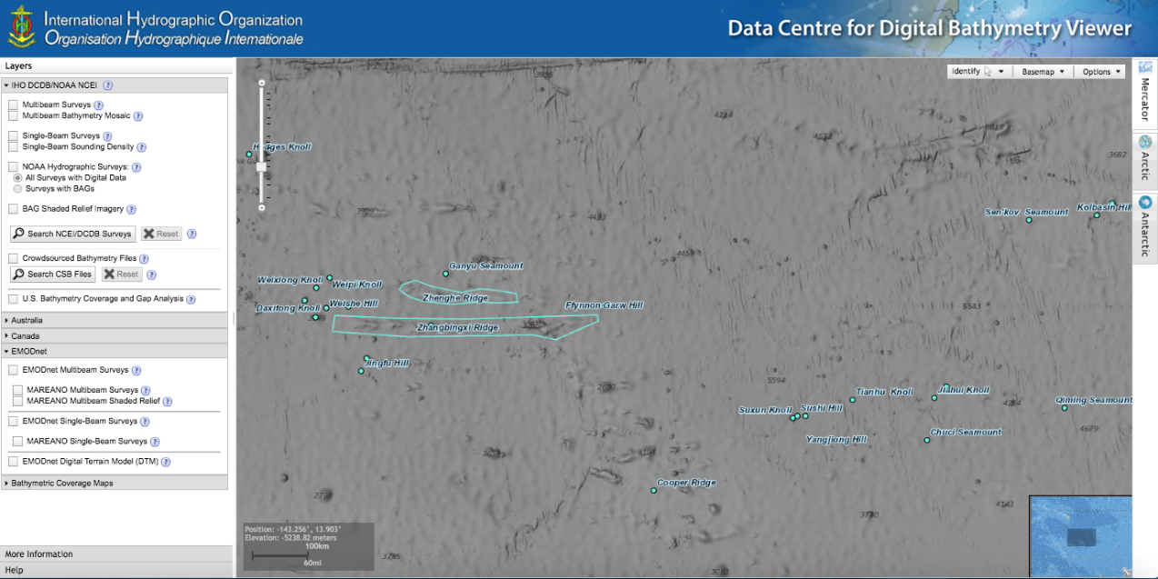

Slide 18
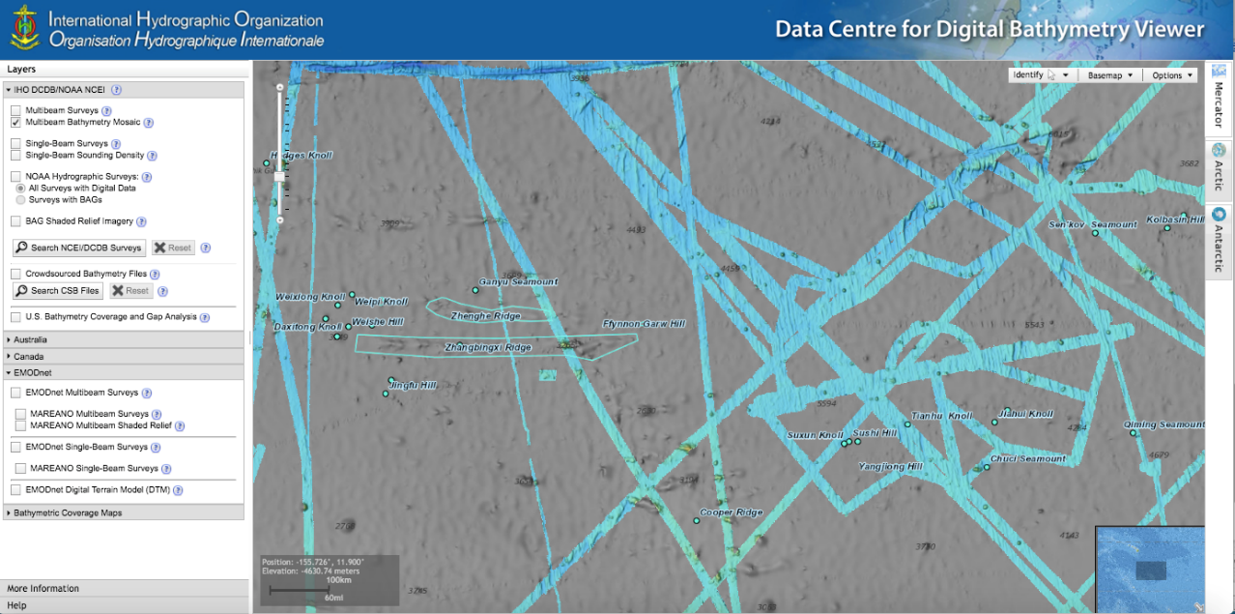

Slide 19
Next Steps & Vision
Develop beyond our current basic file management capabilities to a continuous point store.
Moving to the cloud will allow for CSB data (and theoretically all bathymetric data sources) to be stored as a seamless collection of points.
The DCDB could then provide a variety of enhanced services along with the data itself:
The ability for users to generate bathymetric grids of a given area using user-specified resolution
To retrieve data density information
Better support the guiding of future data collection efforts
Work with Member States to archive and make publicly available shallow water bathymetry extracted by Member States from ENC Usage Bands 2 and 3 coverage.
IRCC11 June 2019

Slide 20
Conclusions and Recommended Actions
It has been considered within the Secretariat that the IHO Member States should take more ownership of the IHO DCDB and its development.
It is therefore proposed to include a reasonable funding contribution in the next 3-year (2021-2023) IHO budget and work programme, subject to approval of Member States.
In this manner, it is felt IHO Member States will feel more able to contribute ideas to the future development of and the services provided by the IHO DCDB.
IRCC11 June 2019

Slide 21
Conclusions and Recommended Actions cont...
It is also hoped that the DCDB will be recognized as an IHO Member State resource, in which all IHO Member States will have an interest and stake thus benefiting from the globally contributed bathymetric dataset.
It is highlighted that the DCDB is an IHO Member States owned resource that requires additional data to increase the coverage and move towards a comprehensive global bathymetric dataset. Therefore IHO Member States and stakeholders are invited to contribute and encourage the provision of bathymetric data regardless of its origin or reason for gathering
IRCC11 June 2019

Slide 22
Justification and Impacts
During this review of the DCDB activities and its future support and service provision, it has been recognised that there is also a need to revise the original (1990) Terms of Reference (ToR) for DCDB.
It is intended that proposed revised ToR will be submitted to the Member States for approval later this year.

Slide 23
Actions requested of IRCC
Encourage Member State and stakeholder bathymetric data contributions to the DCDB, regardless of origin; and
Review draft CL at Annex
Take any other action it considers appropriate.

