Slide 1
Update on UNGGIM activities
IHO Secretariat
Report to IRCC12
VTC, 6 - 7 October 2020
By Dr Mathias Jonas
Secretary-General
IRCC12-07B

Slide 2
The United Nations Committee of Experts on Global Geospatial Information Management (UNGGIM) role
UN-GGIM plays a leading role in setting the agenda for the development of global geospatial information management and promoting the use of geospatial information in addressing key global challenges

Slide 3
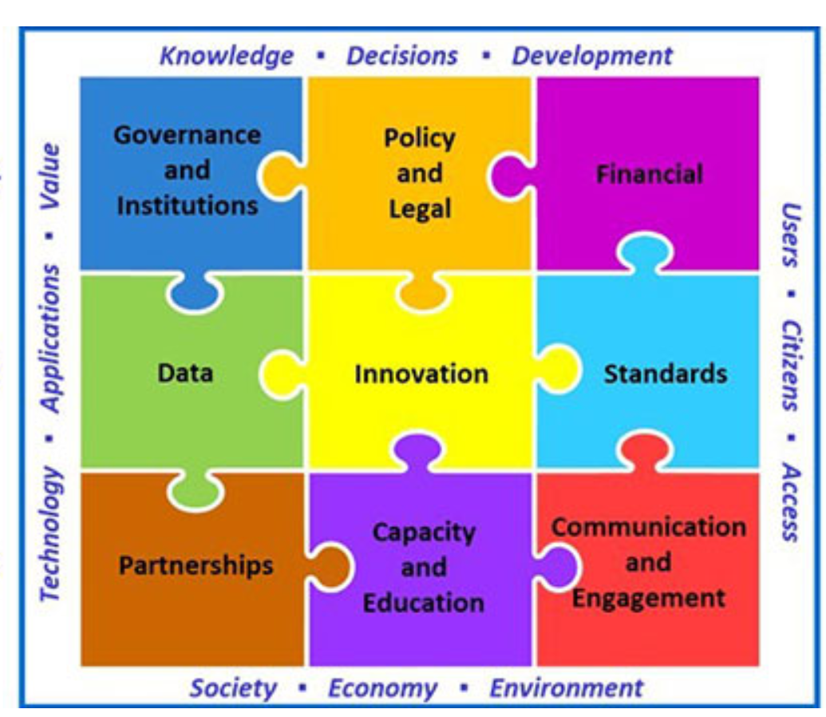
The UNGGIM 10th Session
It was held on 26-27 August and 4 September 2020
Virtual event allowed sufficient time for written submissions and informal consultations
More than 400 participants attended representing numerous UN Member States and observing organisations
The Secretary-General of the IHO, Dr Mathias Jonas attended

Slide 4
The UNGGIM 10th Session activities
Progress on:
Integrated Geospatial Information Framework (IGIF)
Future Trends in Geospatial Information Management
A Framework for Effective Land Administration
Strengthening geospatial information management
The sustainability and quality of the global geodetic reference frame
How geospatial information supports and informs the sustainable development goals
Activities of the Committee's Experts and Working Groups.

Slide 5
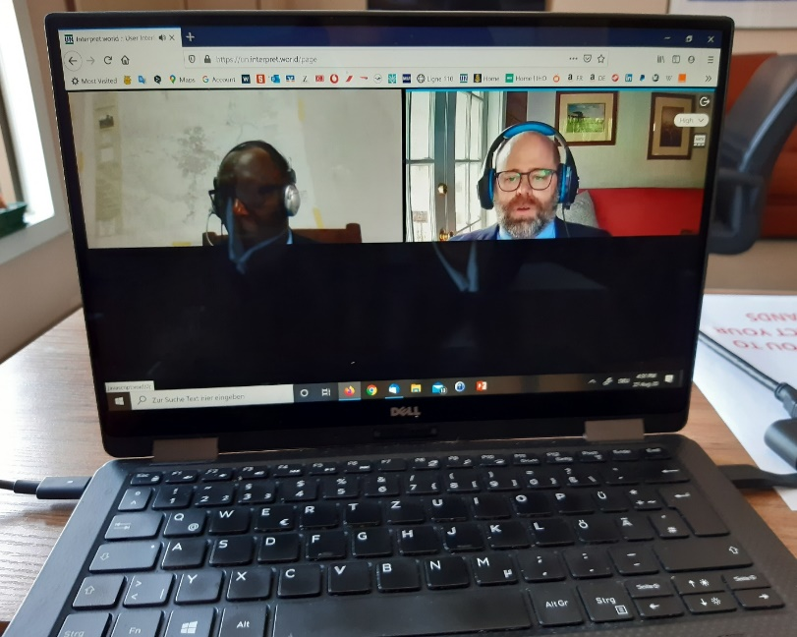
The UNGGIM 10th Session - Working Group on Marine Geospatial Information
The Committee of Experts:
Welcomed the report of the Working Group on Marine Geospatial Information
Took note on the ongoing efforts of the Working Group to implement the Integrated Geospatial Information Framework (IGIF) within the marine domain
Considered the integration of terrestrial and maritime geospatial data are priority areas for many UN Member States
Recognized the Working Group’s continued engagement and support towards the Decade of Ocean Science for Sustainable Development, the General Bathymetric Chart of the Oceans (GEBCO), the Seabed 2030 Project, and the Innovation and Technology Laboratory of the International Hydrographic Organization in Singapore
Encouraged to consider engaging other International Organizations focusing on ocean sciences and observations.

Slide 6
Actions requested of IRCC:
Note the report
Commend the activity of the UNGGIM Working Group on Marine Geospatial Information and its Chair

