Slide 1
Capacity Building Sub-Committee
(CBSC)
Report to IRCC13
By Evert Flier
CBSC Chair

Slide 2
Capacity Building in 2020/2021
Effects of COVID-19 pandemic
E-Learning Center by KHOA
Initial phase of «Empowering women in Hydrography» program by CHS, agreement signed
Intersessional CBSC meeting Feb 2021 + regular CBSC meeting May 2021

Slide 3
Capacity Building Fund
The Capacity Building Fund receives regular contribution from two sources:
• IHO budget (regular annual contributions and eventual contributions from budget surplus, current level & developments)
• Donations made by
governments,
other international organizations,
funding agencies,
public or private institutions,
associations or private individuals in support of IHO CB.

Slide 4
Contribution to Capacity Building
Contribution from Republic of Korea
Republic of Korea contributes significantly to CB, in 2021 more than 315 K€.
The Programme Management Board (PMB), consisting of representatives from ROK and IHO. Almost all contribution is earmarked for designated projects. Major normal projects are:
Funding students from IHO MS for Cat "A" Hydrography at USM
Training for Trainers
Cat "B" Hydrography at KHOA, Busan, ROK

Slide 5
Contribution to Capacity Building
Contribution of Japan through the Nippon Foundation
Japan continuously provides its important input through the Nippon Foundation (NF) by funding CB training projects.
The NF-IHO Cartography, Hydrography and Related Training (NF-IHO GEOMAC [former CHART]) Project is fully funded by the NF.
The NF is substantially funding other projects outside the direct context of the IHO CB.

Slide 6
Contribution to Capacity Building
Contribution of Canada
IHO and Canada established a new Capacity Building project; “Empowering women in Hydrography”. Agreement between IHO secretariat and CHS has been recently signed.
Details will be defined in the future meeting of the Project Team.

Slide 7
Contribution to Capacity Building
Contribution from other Member States
Several MS provide support for IHO CB activities.
(provision of facilities, trainers, personnel, advice …)
The CB programme depends on these contributions.
Virtual CB activities organized for one RHC but accessible for other RHCs will be put on a new CB activity calendar to allow for better planning and increased participation.

Slide 8
Capacity Building Fund
Situation 2021 | IHO | ROK | Nippon | Total
Balance 2020 | 266,956.09 | 318,203.20 | 265,291.00 | 850,450.29
Income 2021 | 125,000.00 | 275,425.97 | 298,866.00 | 699,291.97
Contribute from ROK to non-earmarked projects | 40,000.00 | - | - | 40,000.00
Available for 2021 | 431,956.09 | 593,629.17 | 564,157.00 | 1,589,742.26
Expected Expenditures in 2021 CBWP | -438,914.54 | -221,184.99 | -265,291.00 | -925,390.53
Expected Balance in 31/12/2021 | -6,958.45 | 372,444.18 | 298,866.00 | 664,351.73
Projects not funded at 2021 CBWP | 554,458.00 | - | - | 554,458.00

Slide 9
Capacity Building Fund
Situation 2022 | IHO | ROK | Nippon | Total
Expected balance 2021 | -6,958.45 | 372,444.18 | 298,866.00 | 664,351.73
Expected income 2022 | 85,000.00 | 315,000.00 | 298,866.00 | 698,866.00
Expected surplus from IHO | 0.00 | - | - | 0.00
Available for 2022 | 78,041.55 | 687,444.18 | 597,732.00 | 1,363,217.73
Earmarked projects 2022 | 0.00 | -513,040.66 | -597,732.00 | -1,110,772.66
Regular CBWP projects 2022 | 77,055.00 | 513,040.66 | 597,732.00 | 1,110,772.66
Expected Balance End 2022 | 991.00 | 0.00 | 0.00 | 991.00
Projects not funded 2022CBWP | 481,115.00 | - | - | 481,115.00

Slide 10
Capacity Building Work Programme
Capacity Building Work Programme 2021
WP for 2021 updated with consequences of COVID-19.
Surplus budget needed for WP 2022 due to postponing of CB activities to 2022.

Slide 11
Capacity Building Work Programme
Capacity Building Work Programme 2022
Submissions from the RHCs have been prioritized at CBSC19.
The accepted submissions would need about 1,371,000 €.
The Work Programme allocates 890,000 €.
It is expected that several of the funded projects from the CBWP2021 need to be moved to the CBWP2022.

Slide 12
Limited CB Fund
The appeal of the CBSC last year to ascertain a minimum level of funds has led to a significant attention and fruitful discussions on all levels of the IHO.
Capacity Building in Hydrography is a core strategic issue within the IHO, especially at IRCC and Council meetings.
Rapid further decline in IHO CB budget for non-earmarked CB activities in upcoming years

Slide 13
Revised CB Strategy
CB Strategy PT, met three times between intersessional CBSC in Feb and CBSC19
Conducted Gap analysis between new IHO Strategy and current CB strategy; identified three work items:
Draft aligned CB strategy
Update phases of development (to potentially include a phase 0 on governance)
Add a 5th step to the process of the CB Strategy (Awareness; Assessment; Analysis; Action) to address Measures of Effectiveness (MoE)

Slide 14
IHO e-Learning Center
Introduction / Background
The Assembly endorsed the installment of an IHO e-Learning Center based on A-2 Pro 3.3 and related recommendations of the IRCC/CBSC
Key outcomes include the recognition of :
The importance and potential of e-Learning for the improvement and extension of Capacity Building activities in hydrography;
The acceleration of e-Learning during and post-pandemic world; and,
The initiative from Republic of Korea to establish and support an IHO e-Learning Center, to provide the infrastructure and to cooperate with IBSC, its Member States and industry.
IRCC13-07C

Slide 15
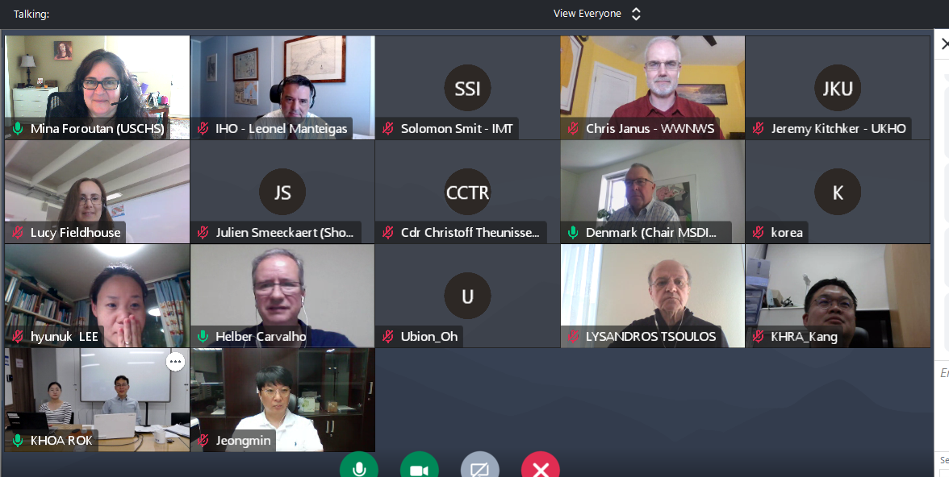
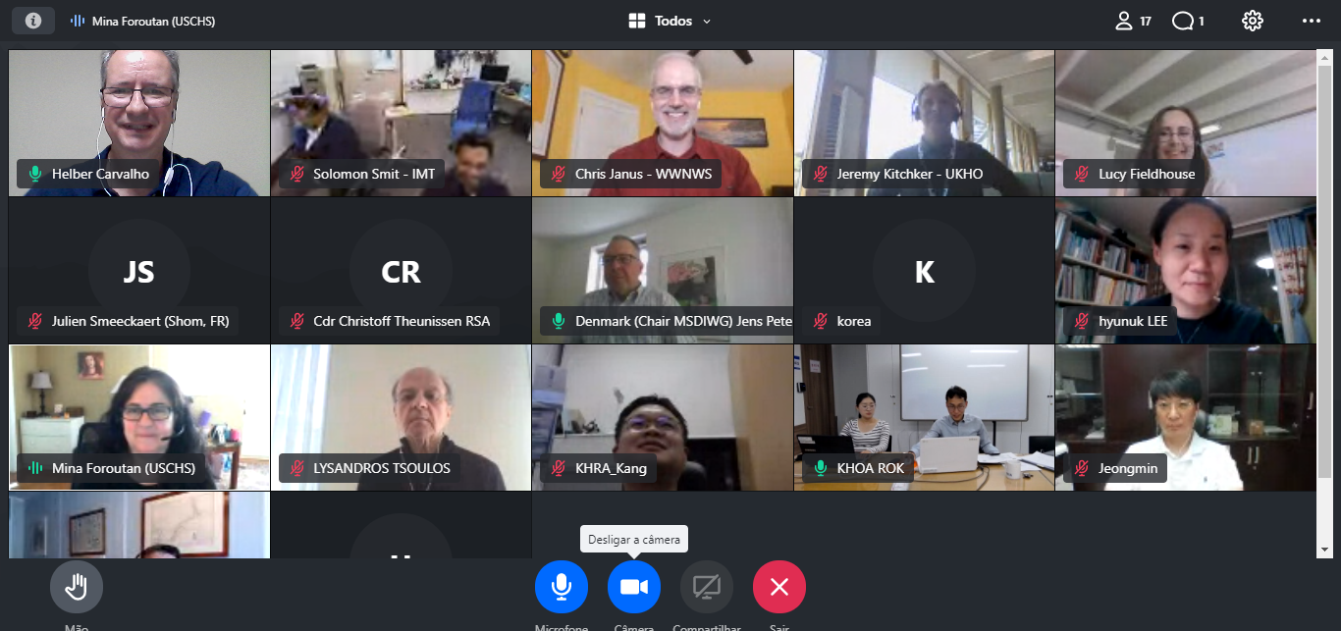
IHO e-Learning Center
Establishment of PT (Representatives)
The Project Team of IHO e-Learning Center started Its work after CBSC-18 with ten (10) representatives. InMarch 2021, during the 2nd Meeting, the PT grew by receiving 5 new members and replacing two (2). After3rd Meeting, 1st June 2021, increasing the efforts two (2) new members joined to PT, replacing one.
Nowadays, the PT has fourteen (14) participants.
3 meetings to date (September 2020, March & June 2021)
Images of 3rd Meeting, 1st, June
IRCC13-07C

Slide 16
IHO e-Learning Center
Successes to date
Terms of Reference
Rules of Procedure
Finalization of the Implementation Plan
Sharing Member States’ experiences and contends:
MSDIWG
IC-ENC
SANHO
KHOA
SHOM
UNESCO - Global Citizen Education
IRCC13-07C

Slide 17
IHO e-Learning Center
Planned Activities for 2021
- Continuation with sharing of Member States’ experiences
- Drafting of the IHO e-Learning Center Guidelines
Small Task Force setup to finalize
Projected completion September 2021
- Creation of Center e-Learning Website
- Uploading 4 e-Learning curriculums
Projected completion November 2021
- Report to CBSC19 and IRCC13CBSC19
IRCC13-07C

Slide 18
IHO e-Learning Center
Planned Activities for 2022
Continuation with sharing of Member States’ experiences
Set up the Center Steering Committee
Finalize the framework of the Center
Run the Center Secretariat
Testing of operational site with IHO Member States
Report to CBSC20 and IRCC14
IRCC13-07C

Slide 19
e-Learning System & Website - System architecture (updated)
Targeting
10,000 users
1,000 client concurrent connection
Reliable & convenient service
CDN
Internet
Firewall
Users
(PC, Mobile)
Switch HA
L4/7 Switch #1
L4/7 Switch #2
Monitoring
system
Dual WEB
VOD system
Source management,
DB monitoring
WEB#1
WEB#2
Stream Server
DB Server
Storage Server
Etc. Server
WEB_NAS
VOD_NAS
DB
Active
Etc. Data
IRCC13-07C

Slide 20
Type of IHO e-Learning Courses
OPEN
course
REGULAR
course
CERTIFICATE
course
SPECIAL
course
Log-in not required
No course registration
Containing short video clips
Available to all
Log-in required
Require the approval of Steering Committee
For fundamental knowledge
Run on a monthly basis
Log-in required
Require the approval of IBSC
For certification
Run regularly
For special subjects
Taught by subject experts in real-time
Not regular course
IRCC13-07C

Slide 21
IHO e-Learning Center
Conclusions
- IHO e-Learning Center is proceeding with the cooperation of IHO, Project Team, Republic of Korea, IBSC, and Member States;
- A great deal of gratitude is owed to the KHOA who actively supported the budget required for building an e-Learning system and a website in 2021;
- The CBSC e-Learning Project Team is committed to developing and implementing the IHO e-Learning Center; and
- Despite of the ongoing pandemic, it is expected that the Center will be operational test from 2022.
IRCC13-07C

Slide 22
Action requested of IRCC
note the report,
to note the significant effort from CB Coordinators to assess the needs in the region, to identify national and regional projects that may contribute to the CBWP and to coordinate the support for countries in need,
take any further action as seen appropriate

Slide 23
Thank you for your support in Capacity Building

