Slide 1
Agenda Item 06.1F
BSHC
Report to IRCC13
VTC, 23 – 25 June 2021
By Magnus Wallhagen
BSHC Chair
IRCC13-06.1F

Slide 2
Work on Strategic Plan and Gap Analysis (top 3 aspects)
Based on the new IHO Strategic Plan, the BSHC will discuss how to align.
Goal 1: Coordination of the S-100 implementation in the Baltic Sea will be discussed at the next BSHC Meeting
Goal 2: Continue to cooperate with HELCOM on hydrographic surveying of the Baltic Sea and to provide bathymetry data also to other stakeholders (EMODNet Bathymetry etc), inline with EU initiatives and Seabed 2030.
Goal 2 and 3: The implementation of a common Baltic Sea Chart Datum 2000 facilitates the usage of hydrographic data in combination with data produced as results of other international initiatives in the Baltic Sea Region.

Slide 3
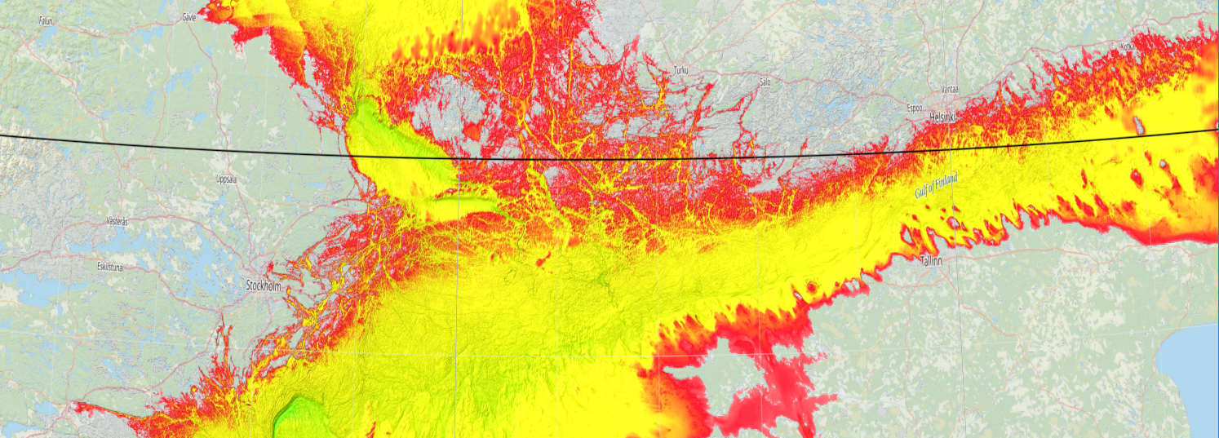
Important Findings (RHC top 3 challenges)
S-100 implementation: regional coordination, within the Baltic Sea, on publication of S-101 ENCs, agreement on other applicable S-100 products and cooperation between HOs and other national authorities on S-100 products were HOs is not the data owners.
Baltic Sea is a vulnerable sea basin with serious environmental problems. HOs see a potential to contribute to international initiatives to “save the Baltic Sea” by extended usage of hydrographic data, but there are obvious challenges; lack of resources, business models and classified high resolution bathymetry
Hydrographic surveying of the most shallow waters of the Baltic Sea with its vast archipelago, which is resource consuming. Perform in accordance with the HELCOM agreement.

Slide 4
Proposals
Take note of the BSHC Report
Encourage other RHCs to coordinate the efforts on the implementation of S-100.

