Slide 1
IRCC14-06.1I
SWPHC
Report to IRCC14
Denpasar - Bali, Indonesia + VTC (Hybrid Meeting)
6 – 8 June 2022
By Adam Greenland
SWPHC Chair
IRCC14-06.1I

Slide 2
Status of IRCC actions and recommendations to RHCs
No. | Recommendation | Status
Item 5, Rec 3 | RHC and MS to advise the IHO Secretariat of any update/change to their position in relation with the CSB questionnaire (IHO CL 21/2020) | SWPHC19 Action 8: IHO Members to review their policy on data release and consider submitting a positive response to CL 21/2020 (IHO CSB Data for Public Domain) AU has responded positively to CL 21/2020
Item 6.1, Rec 7 | RHCs to consider extend the role of Charting Regional Coordinators for the implementation of the S-100 Implementation Roadmap | SWPHC19 Action 15: SWPHC to consider extending the role of the Charting Regional Coordinator for the implementation of the S-100 Implementation Roadmap SWPHC ICCWG will undertake the role
Item 6.1, Rec 9 | RHCs to coordinate the efforts on the implementation of S-100 and promote the cooperation and exchange of experiences | October 2021: SWPHC S-100 workshop to share experiences in implementing the S-100 Universal Data Model to meet Goal 1 of the IHO Strategic Plan. SWPHC19 Action 16: SWPHC to coordinate the efforts on the implementation of S-100, promote the cooperation and exchange of experiences, and identify CB requirements. S-100 Workshop planned for August 2022 TBC

Slide 3
Key Achievements
New version of SWPHC Statutes approved
Development and adoption of the SWPHC Work Plan 2022-2023
SWPHC19 Agenda Item 13 UNGGIM Integrated Geospatial Information Framework (IGIF) & Open Data – the value proposition
Goal 2, Target 2.3, SPI 2.3.1 & Goal 3, Target 3.2, SPI 3.2.1
Notes:
Statutes – post adoption of Resolution 2/1997 at A-2) ESTABLISHMENT OF REGIONAL HYDROGRAPHIC COMMISSIONS (RHC)
SWPHC work plan delivers to IHO SP Goals 1, 2 & 3 + addition of specific Goal for SWPHC – Goal / Target / Activities (see table). More on HLP to follow
In delivering to the IHO SP SWPHC19 hosted a session with expert contributors on UNGGIM IGIF and Open Data – the value proposition (Andy Coote UK, Lesley Arnold AU), followed by a panel session chaired by the Director General of the Pacific Community (Stuart Minchin) which included Dr Kim Picard (AU). More to come on the next slide
The work plan also identified other activities to assist MS deliver to the IHO SP Goal 1, in particular, two workshops,
one on environmental emissions from shipping and expectations of MS (SPI 1.1.2 – number of data products and services based on S-100 that cater for the new requirements; autonomous shipping and reduction of emissions
the second on cyber security to RHC (SPI 1.2.1 - % of data products and services based on S-100 that are covered IHO Standards, specifications and guidelines on cyber security)

Slide 4
SWPHC19-13 UN-GGIM IGIF & Open Data VP
Agenda Item 13: UNGGIM Integrated Geospatial Information Framework (IGIF) & Open Data – the value proposition
Panel session questions:
What can we do to advance adoption/implementation of the IGIF and Open Data in our region?
How do we collectively work in the region to share data leading to Open Data - open by default, a reality?
The intent is to kick-start a regional discussion on the value and benefits of geospatial information, the framework and sharing data.
The outcome we are seeking are actions/commitment from SWPHC19 to collaborate with international and regional entities and Coastal States to develop a strategy to support the implementation of the IGIF, understand the value of open data and commit to sharing data.
Notes:
In delivering to the IHO SP SWPHC19 hosted a session with expert contributors on UNGGIM IGIF and Open Data – the value proposition (Andy Coote UK, Lesley Arnold AU), followed by a panel session chaired by the Director General of the Pacific Community (Stuart Minchin) which included Dr Kim Picard (AU).
The panel session asked two Qs…
Outcome of this session was the recognition that to achieve Goals 2 & 3 there is a pressing need to engage with international and regional agencies, development partners and Coastal States to adopt and give effect to open data policies and to raise their understanding and the value of hydrography in their development programmes.
Goal 2, Target 2.3. Apply UN shared guiding principles for geospatial information management – Innovation principle e) Open Data
Goal 3, Target 3.2, Improve knowledge of the worlds seafloors, data provided to IHO DCDB and Seabed 2030
This has led to a submission of a substantive paper to IRCC14 agenda item 9B, on raising awareness of hydrography and open data.

Slide 5
Key Achievements
Notes:
December – call for nominations released by CL 05/2021
Hydrographic Leaders Programme pilot programme comprises a cohort of 17 participants from 12 nations each matched with a mentor.
The programme aims to build a leadership pipeline for representation of hydrographic activity in the region. It will build and encourage a network of leaders for the SWPHC.
First and foremost the HLP delivers to SWPHC Goal and Targets to Increase participation in SWPHC and IHO activities in a leadership role

Slide 6
Inputs
Activities
Long term outcomes
Outputs
Intermediate outcomes
Resources (time, money) UKHO and FCDO. Programme Steering Group Members of the South West Pacific RHC. Internal technical expertise. Participants’ time, commitment and their prior learning. Participants’ sponsors. External leadership development expertise. Programme management and administration expertise. Access to online platform, and internet connectivity and bandwidth. | Activities to build commitment from the target audience, sponsors and strategic allies. Programme and relationship management (strategic and operational). Design and delivery of an application process. Design and delivery of a leadership programme comprising behavioural and technical skills and knowledge delivered through: Monthly workshops. Interactive sessions with guest speakers from stakeholder nations. Mentoring programme. Action learning groups. Design and delivery of programme monitoring / learning, evaluation and reporting. | Programme is shaped with: Programme participants to tailor content and process. Strategic allies to build a shared commitment. Leadership pipeline in the region. Programme participants have increased: Technical competence including knowledge of the Law of the Sea and international regulation. Understanding of the perspectives of key stakeholders from industry, defence and the political lens on hydrography. Skills and knowledge in influencing and managing stakeholders, presenting, negotiating and policy making. Programme reports. Learning from the pilot programme. Communication plan and narrative. | Programme participants have increased confidence and motivation: To lead hydrography work in their region. This includes taking on formal leadership roles. To represent their region and nations at international fora. Increased visibility through this programme. In addition: The Future Leaders cohort increasingly work together outside the programme structure. The strategic allies collaborate more on building regional capacity and capability. | In line with the International Hydrographic Organisation’s (IHO) strategic goals and the UN’s Shared Guiding Principles for Geospatial Information Management: Greater conformity with international standards and obligations. Increased quality, coverage and safety of navigational charts and publications leading to: improved maritime efficiency, safety and security; the protection of natural resources; safeguarding of maritime trade wider access to and use of hydrographic data to enable and inform sustainable marine economic growth. In line with the Joint Canada-IHO Project Empowering Women in Hydrography goals more women participate equitably in the field of hydrography and to assume more leadership roles within the hydrographic community.
Notes:
Theory of change model was developed to support the HLP programme planning and evaluation
Used ahead of a programme as a design tool (as here) and / or retrospectively as an evaluation tool.
As a planning tool it helps uncover underlying assumptions, and strengthen the connection (the what and the how) between inputs and activities and outcomes.
It generates knowledge about whether a programme is effective, but also explains what methods it uses to be effective.
It puts the programme in context and describes the system it operates in.

Slide 7
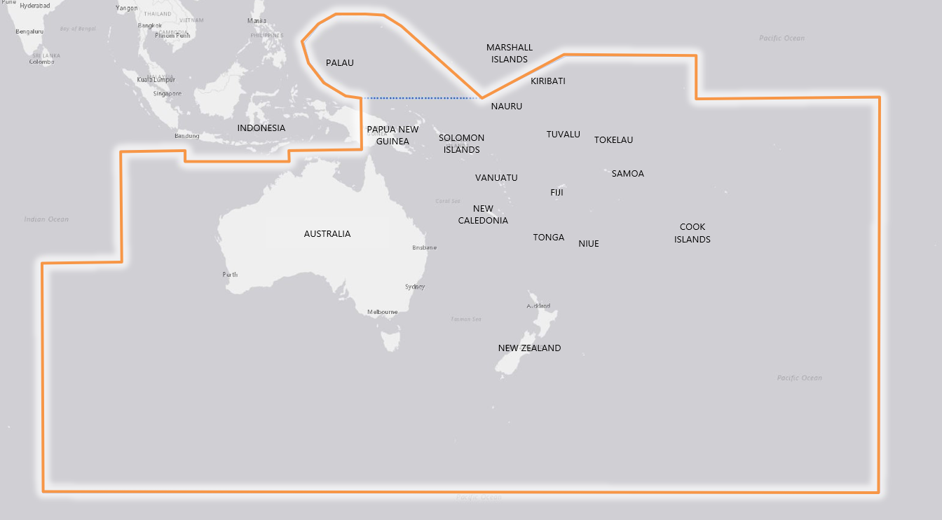
Key Achievements
Notes:
Hydrographic Leaders Programme pilot programme comprises a cohort of 17 participants from 12 nations each matched with a mentor. The programme aims to build a leadership pipeline for representation of hydrographic activity in the region. It will build and encourage a network of leaders for the SWPHC.

Slide 8
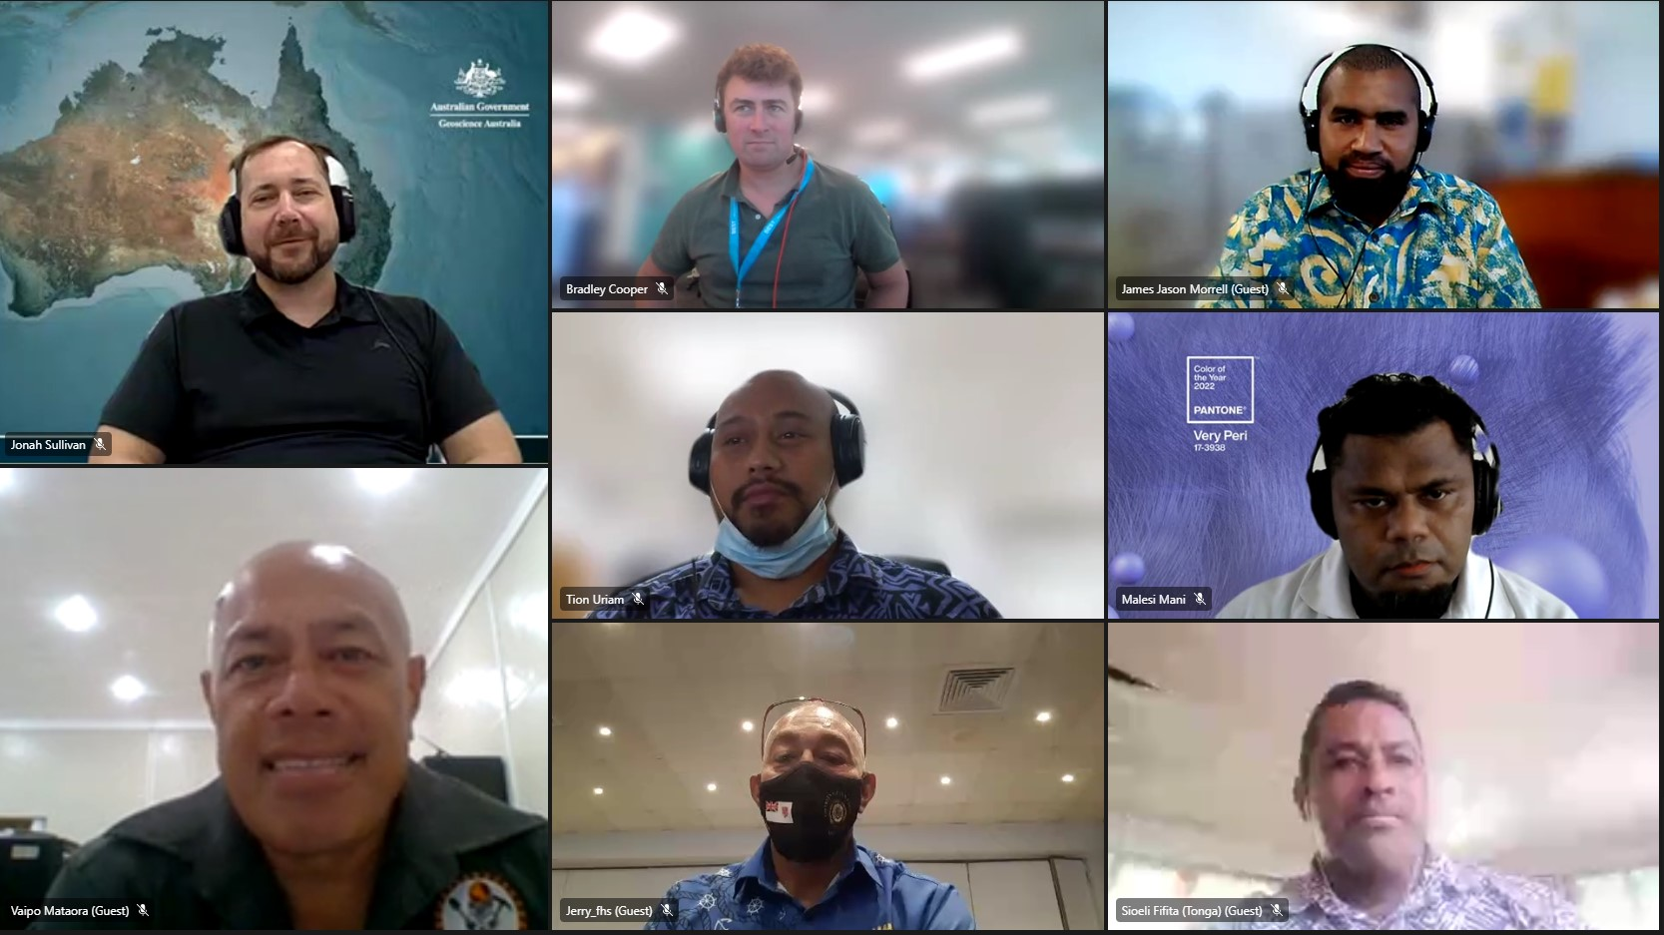
Key Achievements
Notes:
Hydrographic Leaders Programme pilot programme comprises a cohort of 17 participants from 12 nations each matched with a mentor. The programme aims to build a leadership pipeline for representation of hydrographic activity in the region. It will build and encourage a network of leaders for the SWPHC.

Slide 9
Important Findings (RHC top 3 challenges)
Awareness, coordination and collaboration between CB/development activities in the region
Establishing hydrographic governance in SWPHC Coastal States (SWPHC20 workshop)
The biggest challenge is that of engaging and coordinating with international and regional agencies, development partners and coastal states at a senior enough level, to raise awareness of the benefits of hydrography and adopting and giving effect to open data policies and mutually agreeable practices (ref: SWPHC paper on raising awareness of hydrography and open data)
Notes:
Re hydro governance, Note: In conjunction with SWPHC20 (Feb 2023) a IHO CB funded workshop on Hydrographic Governance is to be delivered.

Slide 10
Lessons Learned
Increasing global awareness and acknowledgement of the vulnerability of the region to the impacts of climate change, and the role of UN initiatives, such as the Ocean Decade and the UNGGIM IGIF, to mitigate and assist impacted Coastal States.
The SWPHC HLP has demonstrated:
There is a demand and enthusiasm to develop future leaders from the region
The high levels of support from Member States to support PICs achieve their full potential to represent the region (in its totality) at international levels

Slide 11
Proposals
The IRCC is invited to:
Note this report
Note any actions required
Note the SWPHC Work Plan 2022-2023
Note the SWPHC Work Plan activity to develop a regional stakeholder engagement plan to deliver to Goal 3, Target 3.1, SPI 3.1.1
Engage with new IMO regional representative (in response to SPI 3.1.1)
Invite IHO Secretary General to consider a regional engagement plan and potential visit (in response to Goal 3)
Develop workshops to assist RHCs deliver Goal 1, Target 1.1 & 1.2 of the IHO Strategic Plan:
Workshop on environmental emissions from shipping (COP26 outcome ) and expectations for MS (SPI 1.1.2)
Workshop on Cyber Security to RHCs (SPI 1.2.1)
Provide feedback to the SWPHC on any of the topics discussed
Notes:
The work plan also identified other activities to assist MS deliver to the IHO SP Goal 1, in particular, two workshops,
one on environmental emissions from shipping and expectations of MS (SPI 1.1.2 – number of data products and services based on S-100 that cater for the new requirements; autonomous shipping and reduction of emissions
the second on cyber security to RHC (SPI 1.2.1 - % of data products and services based on S-100 that are covered IHO Standards, specifications and guidelines on cyber security)

