Slide 1
WEND WG
Report to IRCC14
Denpasar - Bali, Indonesia + VTC (Hybrid Meeting)
6 – 8 June 2022
Dr. John E. Nyberg
WEND WG Chair
IRCC14-07.D1

Slide 2
Meetings Held During Reporting Period
WENDWG12 – 22-24 February 2022 – Monaco / Hybrid
Project team meetings
S-101 Scheming Guidelines
Implementation Guidelines

Slide 3
HD ENC Survey and Outcome
Survey conducted between July and September 2021 (CL 26/2021)
37 Member States participated in the survey
WG noted that HD ENCs were not an IHO strategic objective so does not consider it appropriate for the IHO to develop specific production guidelines for them at this time, nor to create a new strategic performance indicator for assessing the level of HD ENCs production

Slide 4
S-101 Scheming Guidelines
During the VTC WENDWG 11, the Group established a team to investigate options for helping to manage the transition from S-57 and S-101
The Group noted that the consensus for a Global Common Grid Scheme could not be reached yet due to significant objections
The WEND also agreed to revisit this issue during WENDWG 13
Thank you to Japan for leading the Group!!

Slide 5
S-1xx Implementation Guidelines
WENDWG 11 established an ad hoc team to work on the implementation guidelines for S-1xx (including S-102, 104, 111, 124, 128 and 129)
The team focused on “SOLAS” products for the first version of the Guidelines and agreed to submit them in time for IRCC-14 (see IRCC14-07D2)
Thank you to the Netherlands for leading the team!!!

Slide 6
INToGIS II Development
The WENDWG commended KHOA and other contributors on the work done to date on the development of INToGIS II!!!
Agreed on the proposed way forward on the development of INToGIS III which will use S-128, as much as is practical, to allow hydrographic offices and other users to visualize S-1xx product coverage in the future
Pleased to note the US (NGA) update on the World Port Index and looks forward to a status report on the traffic density layer later this year

Slide 7
INToGIS II Development
The WENDWG commended KHOA and other contributors on the work done to date on the development of INToGIS II!!!
Agreed on the proposed way forward on the development of INToGIS III which will use S-128, as much as is practical, to allow hydrographic offices and other users to visualize S-1xx product coverage in the future
Pleased to note the US (NGA) update on the World Port Index and looks forward to a status report on the traffic density layer later this year

Slide 8
CATZOC values and Strategic Performance Indicators
As part of INToGIS, an additional CATZOC layer is available to IHO Member States only (Manager Mode)
For the automated implementation of some SPIs, for maintaining the CATZOC layer in INToGIS, the WENDWG Chair and IHO Secretariat request that Member States reconsider their position on providing CATZOC layers and to allow the distribution of their CATZOC data to the Secretariat

Slide 9
WEND-100 Product Matrix UN-GGIM IGIF
Agreed to build a WEND-100 Product Matrix to help ensure that UN-Integrated Geospatial Information Framework pathway principles are being considered as new S-1xx products become available
Matrix is being developed in accordance with the IGIF’s nine strategic pathways
Agreed (Action WENDWG12/33) that the inclusion of a standing agenda item in forthcoming RHC conferences/meetings that facilitates the development of UN-GGIM Integrated Geospatial Information Framework (IGIF) compliant assessments of S-1xx top priority products, along with the nomination of Regional S-100 Coordinators, would be an important step in helping to advance progress on the S-100 Implementation Roadmap

Slide 10
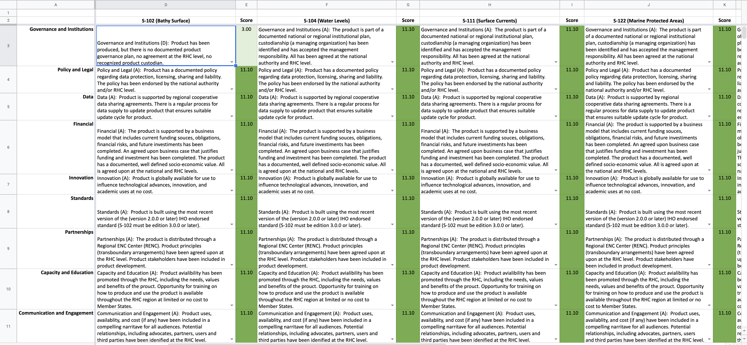

Slide 11
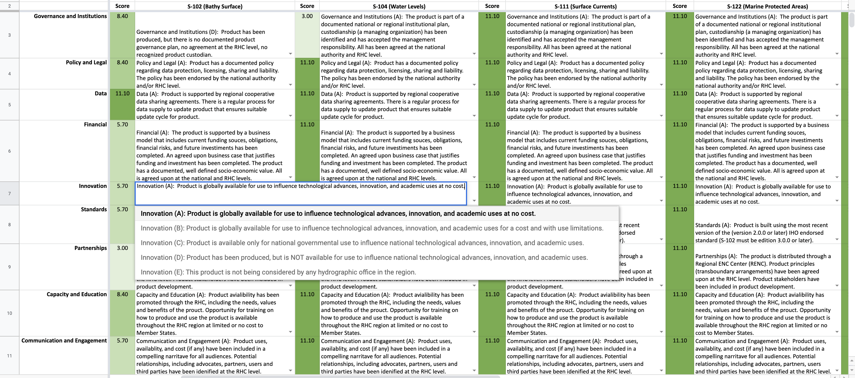

Slide 12
ENC Regional Chart Coordinator Reports
WEND WG received reports from a number of ENC Regional Chart Coordinators and discussed the expanding role of the Coordinators. The Working Group decided to propose that the IRCC recommend new S-1xx Coordinator roles to be established in the RHCs either as separate from the Chart Coordinator or as an additional duty of the Coordinator
The position would be responsible for considering the progress and coordination of S-1xx products as they become available, starting with the pathways outlined in the WEND Product Matrix

Slide 13
Action Required of IRCC
Note HD Survey and Outcome
Note the report on S-101 Scheming Guidelines
Approve the S-100 Implementation Guidelines as v.1 (IRCC14-07D2)
Note that the WENDWG was provided an opportunity to comment on the DF-Governance document
Note the progress made by KHOA to advance INToGISII and invite IHO Member States (ENC producers) to allow the provision of CATZOC to the IHO Secretariat for SPIs’ calculation if appropriate and completing the coverage of CATZOC layers in INToGIS

Slide 14
Action Required of IRCC
Endorse the WEND S-100 Product Matrix as a tool for RHCs to gage business model maturity for S-100 products
Recommend that RHCs establish an S-100 Coordinator role
Recommend that RHCs apply Action WENDWG12/33 (WEND-100 Product Matrix will be made available on the WENDWG Repository webpage when finalized).
Approve the proposed Work Programme for the WENDWG (Annex A)
Note this report

Slide 15
Thank You Very Much John.Nyberg@noaa.gov

