Slide 1
FIG/IHO/ICA International Board on Standards of Competence for Hydrographic Surveyors and Nautical Cartographers
Report to IRCC14
Denpasar - Bali, Indonesia + VTC (Hybrid Meeting)
6 – 8 June 2022
By Sobri Syawie
IBSC Vice Chair 2
IRCC14-07H

Slide 2
IBSC Membership and its Role
No changes in Board membership during reporting period:
10 Board members: 4 FIG, 4 IHO, 2 ICA (+IHO Secretary Leonel Manteigas)
Chair: Ron Furness (ICA); Vice-Chair 1: Capt. Nickolás Roscher (IHO); Vice-Chair 2 Sobri Syawie (FIG)
IHO – Capt. Andrew Armstrong; CDRE Rod Nairn and Dr. Arata Sengoku
FIG – Gordon Johnston; Adam Greenland and Prof. Dr. Harald Sternberg
ICA – Emeritus Prof. Dr. Lysandros Tsoulos
Also no changes to the Role of the Board.

Slide 3
Key Achievements
Meeting held during reporting period:
IBSC 2021 Workshop – hybrid – Lisbon, Portugal (1-5 Nov 2021)
IBSC45 Meeting – Hybrid – Cadiz, Spain (28 Mar – 8 Apr 2022)
The work programme includes:
Review IBSC Standards and maintain IBSC Publications
Review IBSC44 Conditional Recognized submissions and those that had been offered intersessional revision

Slide 4
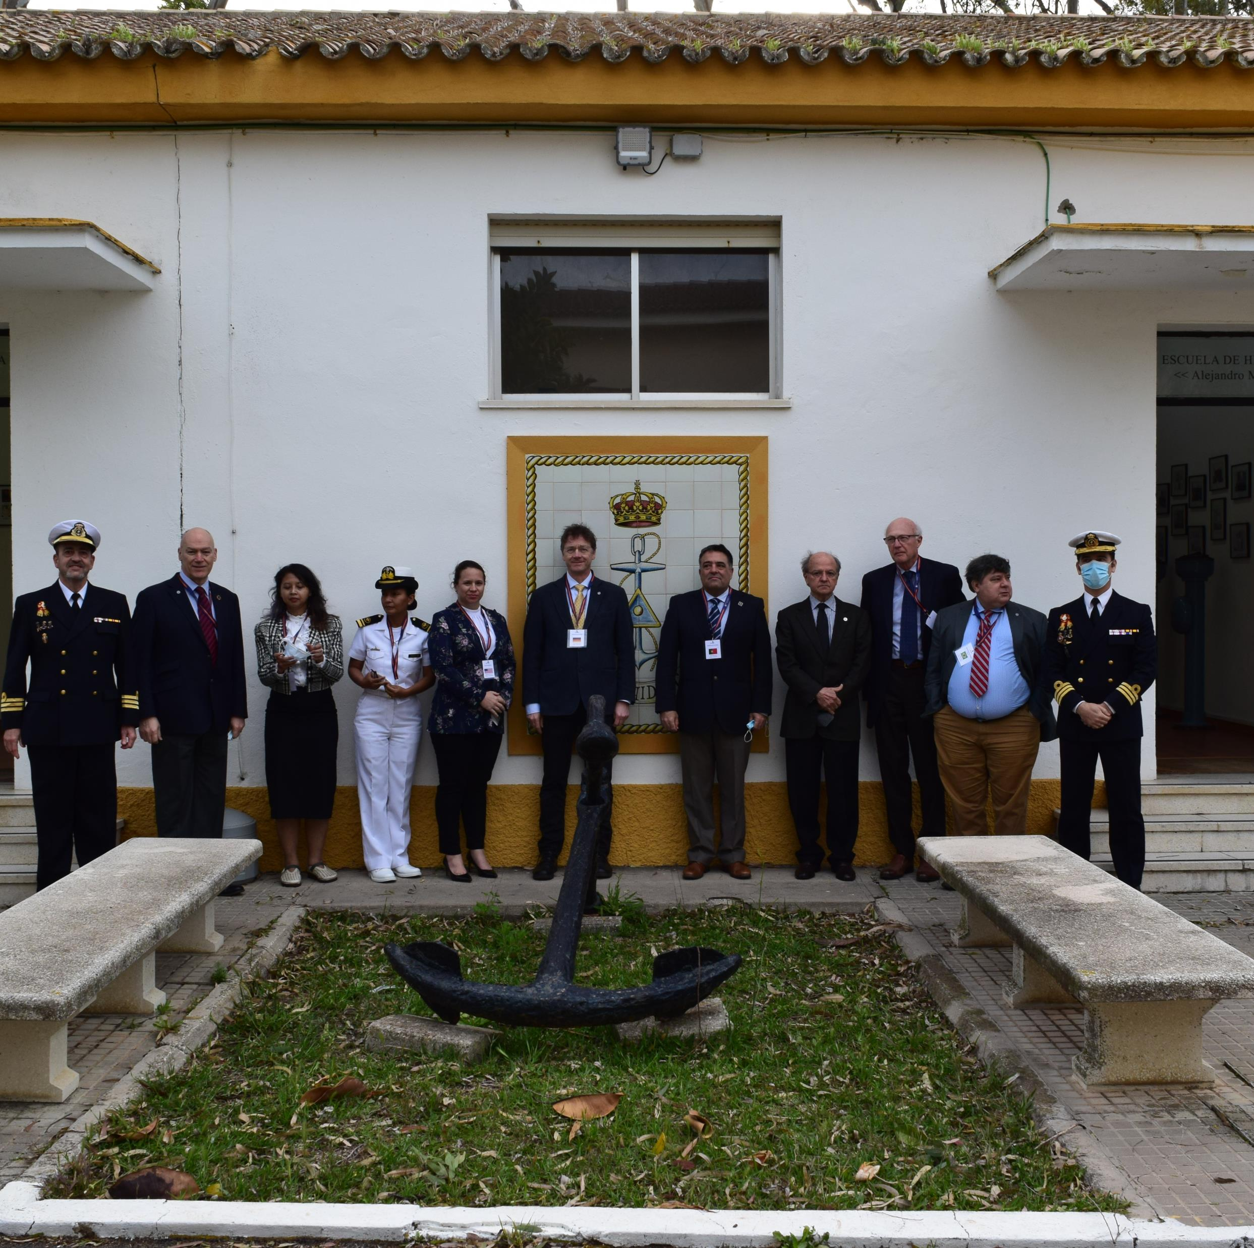
IBSC45- Cadiz, Spain - Hybrid

Slide 5
Result of Intersessional Revisions 2021
2021 | In the IBSC44 Meeting |  |  | Intersessional Revision | After Intersessional Revisions
Status | N Total | Standards |  |  | N Total | Standards
Recognized | 1 | 1 | S-5B |  | 8 | 3 | S-5A
 |  |  |  |  |  | 4 | S-5B
 |  |  |  |  |  | 1 | S-8B
Recognized with conditions | 3 | 1 | S-5A | 1
 |  | 1 | S-5B | 1
 |  | 1 | S-8B | 1
Not Recognized | 10 | 4 | S-5A | 2 | 6 | 2 | S-5A
 |  | 4 | S-5B | 4 |  | 2 | S-5B
 |  | 2 | Schemes |  |  | 2 | Schemes
Total | 14 |  |  | 9 | 14

Slide 6
Result of submissions from IBSC45
2022 | In the IBSC45 Meeting |  |  | Intersessional Revision | After Intersessional Revisions
Status | Total | Standards |  |  | Total | Standards
Recognized | 3 | 1 | S-5A
 |  | 1 | S-5B
 |  | 1 | Scheme
Could Be Recognized | 7 | 2 | S-5A | 2
 |  | 3 | S-5B | 3
 |  | 2 | Scheme | 2
Not Recognized | 3 | 2 | S-5B | 2
 |  | 1 | S-8B | 1
Total | 13 |  |  | 10

Slide 7
Important Findings
The increasing number of deficient submissions caused additional workload to the Board
Second annual meeting is required to finalize reviews of the deficient submission
The need to increase number of Board member from 10 to 12 requires revision of ToR. ICA approved the plan. Need IRCC approval.
Interns from the Empowering Woman in Hydrography project shows positive results.

Slide 8
The IRCC is invited to:
Note this report.
Acknowledge the work done by the IBSC members despite the difficulties imposed by the hybrid format of IBSC45, to review all 13 submissions received as well as offering intersessional revisions to 10.
Encourage Member States and submitting institutions to engage with the IHO Secretariat early in the process of them preparing submissions for programme recognition.
Encourage Member States and submitting institutions to consult the Guidelines, the FAQs and the White Paper (IHR-Nov-2017 – Article: Maintaining the Standards of Competence for Hydrographic Surveyors and Nautical Cartographers) early in the process of preparing submissions for programme recognition.
Agree with the IBSC Proposed Work Plan – Q2 2022 to Q2 2023 (Annex B).
Approve the Revised Term of Reference with the increase in the number of Members to 12 with more two Members from the ICA (Annex C).
Take any other actions as appropriate.

