Slide 1
WENDWG
Report to IRCC15
Tokyo, Japan
12 – 14 June 2023
John Nyberg
WENDWG Chair
IRCC15-07G

Slide 2
Meetings and new leadership
WENDWG13 – 21-23 February 2023 – Aalborg, Denmark
Dr John Nyberg and Ms Annika Axne-Kindeberg both stepped down
Mr Jens Schröder-Fürstenberg (BSH, DE) and Mr Jason Scholey (UKHO, UK) were elected as Chair and Vice-Chair respectively (effective July 1, 2023)
Next Meeting – 20-22 February 2024 – Washington, DC or Norfolk, VA, USA

Slide 3
Accomplishments Review 2019 - 2023
Early adopters of virtual work during COVID-19 pandemic
Versions of both WEND100 Principles and Implementation Guidelines completed and endorsed
WEND 100-IGIF Matrix drafted and trial run completed
Overlaps and Gaps managed according to WEND procedures
RENC coordination continued
S-101 scheming guidelines considered
Robust INToGIS progress
Transition from pure S-57 focus to S-100 world

Slide 4
RHC Participation
WENDWG is dependent on MS via the RHCs for S-57 and S-100 coordination
Has noticed sub-optimal RHC participation and reporting
This year WEND received 9 RHC reports and a similar number of WEND Matrix responses
Participation will be increasingly important in the S-100 world – S-100 coordination was noted as a concern in reports that were received

Slide 5
WEND-100 IGIF Product and Service Matrix
During WENDWG 12, the WG agreed to build a WEND-100 Product and Service Matrix using the UN-Integrated Geospatial Information Framework pathway principles.
Aim: Noting that not all S-100 based products can or will be developed by hydrographic offices, to assist RHCs and MS, through the application of basic UN-GGIM check-list and good practices (this covers: finance, data, standards, innovation, policy and legal, governance and institutions, partnerships, resources, training and capacity building and communication) applied to S-100 Products and Services, in order to identify the key issues and critical paths to be considered for healthy product lifecycle.
Notes:
The Matrix, which is not an end in itself, aims to assist Regional Hydrographic Commissions in ensuring that good practices, including, finance, data, standards, innovation, policy and legal, governance (as not all S-100 based products can be developed by hydrographic offices) and institutions, partnerships, resources, training and capacity building and communications are all being considered. The Matrix was developed in accordance with the UN GGIM’s IGIF nine strategic pathways.

Slide 6
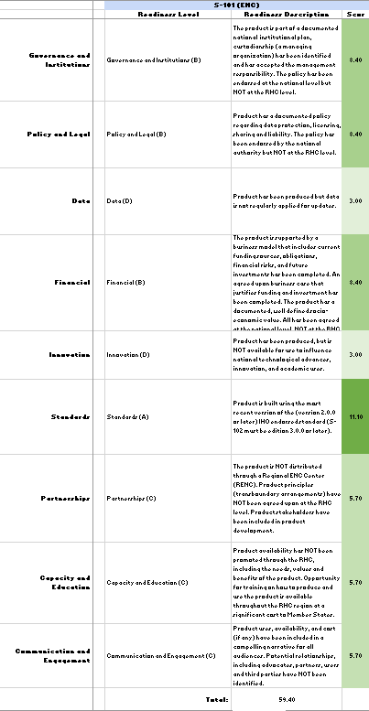
WEND-100 IGIF Product and Service Matrix
WENDWG evaluated the results of the Matrix during WENDWG 13 and noted several challenges including response rate, complexity, and question clarification.
Received responses from 8 of the RHCs and realized an average total score of 45.85. If the HCA input is removed, the average score was 41.89 (out of 100).

Slide 7
WEND-100 Principles and S-1xx Implementation Guidelines
No significant work was done on the WEND-100 Principles or S-1xx Implementation Guidelines during this reporting period
The WG considers both of these documents to be in “maintenance mode” and will include them as part of the regular agenda to consider updates as S-100 products and services mature
S-128 was discussed at length during in Denmark – will be an important consideration for WEND moving forward
Notes:
S-128
The WENDWG had a lengthy discussion regarding the importance and future of S-128, recognizing that it will be an important product specification for the WENDWG to consider due to its relationship to the future of RENC operations, the management of real time services, and the potential it has for application across various distribution platforms. The WENDWG intends to work on a joint concept paper with NIPWG/S-100WG on the operational use of S-128.

Slide 8
INToGIS III Development
Thanks to KHOA for leading this effort!
Encourage submission of S-128 datasets for use in INToGIS
Note the importance of INToGIS for sharing S-100 product coverage into the future
NGA World Port Index and Global Maritime Traffic Density Service have been added – thank you!

Slide 9
S-100 Coordinator
Many RHCs have not yet established the Coordinator role
RHCs are requesting more guidance on what the role entails
Consider an amendment to include Section 300 in S-11 Part A to describe Coordinator role
WENDWG to liaise with NCWG
Consider including S-101 scheming in Section 200 of S-11
WEND to consider new Publication S-xx on the “Guidance for the Preparation and Maintenance of S-100 Products Schemes in RHCs”
Notes:
Chart Scheming - Following WENDWG 12, the S-101 Scheming Guidelines Project team was placed on standby, where it remains. The WG still cannot find common ground for pursuing a global common grid scheme, so it has decided to task RHC Chart/S-100 Coordinators with reporting their planned S-101 chart schemes for each region, usage bands 1 – 4. The Group requested that submissions use INToGIS III if and when it is commissioned.

Slide 10
Draft S-100 Coordinator Responsibilites
Keep an inventory of S-100 products in the region. Producer Status, in progress, complete, availability Potential additional producers of product Work to ensure that Regional MS understand what S-100 products are available Update the WEND100-IGIF Matrix on a biannual (every 2 years) basis Report regional S-100 status to WENDWG Provide input to the WENDWG on RHC preferences regarding WEND-100 Principles Help to communicate latest WEND-100 Principles updates to RHC Work to coordinate new S-100 products according to WEND-100 Principles (as they are developed), following overlap, distribution and other guidance as it is agreed

Slide 11
Progress on IRCC Action Items
SPI 1.3.1
First run of the WEND IGIF Products and Services Matrix has been completed
~1/2 RHC response rate but provides a partial snapshot of where the world is with regard to S-100 readiness
If current results are used consider 50% response rate and remove HCA and MSDI reporting for a score of 41.49 of a possible 100

Slide 12
Problems Encountered
RHC Participation – low turnout is likely a result of the return from COVID
Low WEND IGIF Matrix response rate
No common ground for pursuing a global common grid scheme for S-101
S-100 Chart Coordinator role adoption

Slide 13
Actions Requested
a. Note the 2019-23 accomplishments of the WENDWG
b. Recommend that RHCs prioritize their participation in the WENDWG through the RHC Chart Coordinator or S-100 Coordinator
c. Note the results of the WEND-100 IGIF Matrix, as of February 2023 and encourage the WENDWG to use it as a tool for monitoring the S-100 implementation, for each S-100-based top priority product, per RHC.
d. Recommend that RHCs, if not done already, establish the S-100 Coordinator role or assign S-100 Coordinator duties as appropriate
e. Recommend the RHC S-100 Coordinators to update their WEND-100 IGIF Matrix submissions every two years and share their schedule and roadmap to meeting the 2026 IMO target (S-100 ECDIS) at every WENDWG meeting

Slide 14
Actions Requested
f. Note the impending importance of S-128, its relationship to the WENDWG and the joint concept paper with NIPWG/S-100WG
g. Commend KHOA for the progress on advancing INToGIS III and encourage Member States to submit their S-128 test data sets for use in it
h. Recommend that RHC Chart Coordinators/S-100 Coordinators report their planned S-101 chart schemes, usage bands 1 – 4, by 30 September. Request that submissions use INToGIS III when commissioned.
i. Approve the proposed Terms of Reference (Annex A)
j. Note this report

Slide 15
Thank You John.Nyberg@noaa.gov

