Slide 1
OGC – Updates
IHO MSDIWG Meeting – March 17, 2021
Trevor Taylor ( ttaylor@ogc.org)

Slide 2
Notes:
We at OGC are the ‘location people’, an active organization stretching across the globe providing thought leadership and innovation, interoperability solutions and consensus-based open standards. Our mission is to make location information findable, accessible, interoperable and reusable.

Slide 3
Notes:
Our actively engaged community stretches across commercial businesses, governmental organizations and academia providing unique benefits to each stakeholder. Our members are big names in the location industry and the disrupters alike. They create and use standards through OGC’s many working groups and apply them across domains ranging from research and development to full-scale operations.

Slide 4
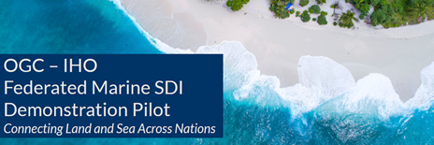
IHO-OGC FMSDI Pilot
Call for Sponsors now out!
https://www.ogc.org/projects/initiatives/fmsdi

Slide 5
OGC Marine DWG - Meeting
Thursday, March 25th, 18.15 to 19.45 EDT
Agenda - Speakers
Dr. Arne Berre, Chief Scientist, SINTEF, Norway - "Digital Twin of the Ocean (DTO) and the Destination Earth (DestinE) initiative (15 min) “
Neeher Karnik, CTO, BujiBui , USA, - " Use of AR, VR, MR, and Wearable Headsets on the Bridge of Future"
Kim Starling, Product, Brian Connon, VP Ocean Mapping, Saildrone - “ Data Challenges in the age of Autonomous Ocean Mapping Platforms
The FMSDI Pilot - Connecting Land, Sea, and Nations
Open Discussion and QA
Register at ogcmeet.org

Slide 6
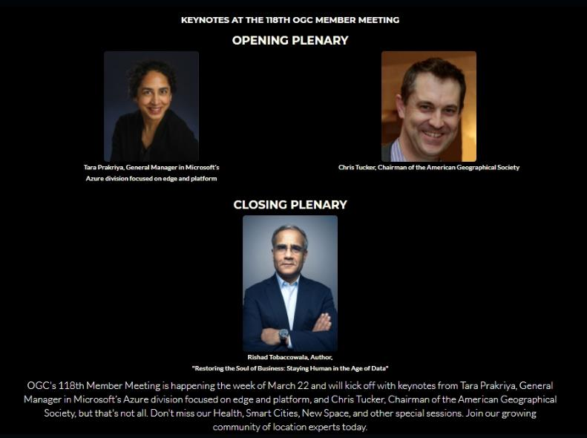
118th OGC Member Meetings
Starts March 17th, Full program is from March 22-25th
Special Sessions on Health, Smart Cities, Climate and New Space
Keynotes from Microsoft , American Geographical Society and Rishad Tobaccowala, Author of "Restoring the Soul of Business: Staying Human in the Age of Data“
Non-members are welcome for most of the sessions
See ogcmeet.org for details

Slide 7
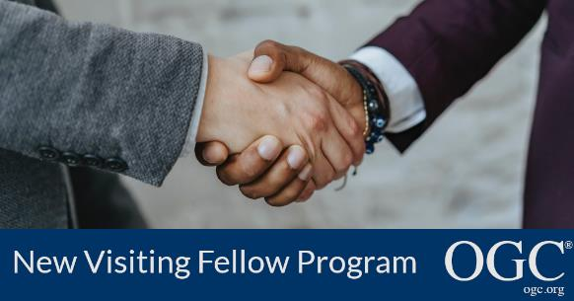
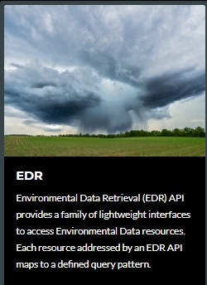
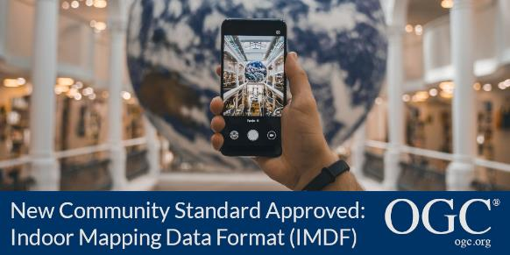
General Updates

Slide 8
Community
500+ International Members
110+ Member Meetings
60+ Alliance and Liaison partners
50+ Standards Working Groups
45+ Domain Working Groups
25+ Years of Not for Profit Work 10+ Regional and Country Forums
For more information – contact Trevor Taylor (ttaylor@ogc.org)
Innovation
120+ Innovation Initiatives
380+ Technical reports
Quarterly Tech Trends monitoring
Standards
65+ Adopted Standards
300+ products with 1000+ certified implementations
1,700,000+ Operational Data Sets Using OGC Standards
Contact info@ogc.org to schedule a meeting for an in-depth discussion with OGC staff and join our community today!
Notes:
If you have any questions, do not hesitate to reach out to OGC or schedule a follow-up. We’re working constantly to change the landscape of location information and want to help your organization get where it needs to go.

Slide 9
OGC-IHO Federated Marine Spatial Data Pilot|
Connecting Land, Sea and Nations
Trevor Taylor ( ttaylor@ogc.org)

Slide 10
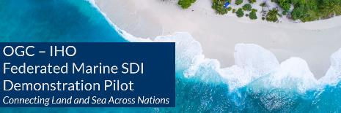
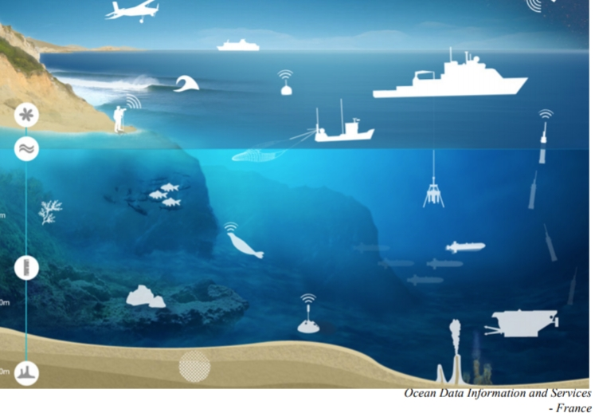
Agenda
What is the FMSDI Pilot ?
What are the Outcomes ?
Why Sponsor?
What is the Sponsorship Target ?
Interested – What’s Next ?
Project Kick Off - What’s Next ?

Slide 11
What is the FMSDI Pilot ?
Build on successful multi- stakeholder IHO-OGC MSDI Concept Development study
Demonstrate a multi-country, federated Marine Spatial Data Infrastructure (SDI) under land/sea interface use-cases.
Unlock valuable data and information for more than the traditional providers and consumers of hydrographic data.
Includes one or more land/sea interface scenarios in order to demonstrate how federated Marine SDI can provide simple, secure access across Nations and domains
Potential areas of interest include regions in the Arctic, European Coastal Waters, and South East Asia ( dependent on sponsor requirements)
OGC- IHO collaborative Pilots work extremely well – Example : IHO-OGC Maritime Limits and Boundaries Pilot

Slide 12
What are the Outcomes ?
Demonstration - A practical technology demonstration from global community experts showcasing federated Marine SDI for selected Land/Sea use cases. Possible examples include use cases for the Arctic, a European Coastal Region, and a southeast Asian region. The demonstration will show how using OGC, IHO, and other open standards enable the community ability to find, obtain, use, share, interoperate, and reuse data.
Impact on OGC Standards - Lessons learned, gaps, and the need for changes to the OGC Standards Baseline will be summarized in an Engineering Report that will inform the OGC Standards Program.
Impact on IHO Standards - Practical testing of relevant S-100 based IHO standards will accelerate the process for adoption and implementation of IHO standards. The resulting Engineering Report will help to inform the work of the IHO HSSC Working Group and will provide inputs to enhance the framework and its component standards.

Slide 13
Why Sponsor?
Improve discovery and sharing of data within your national SDIs, both terrestrial and marine, and across national jurisdictions
Prototype functional federated Marine SDI architectures and tools to connect to operational environments
Sponsor an agile, adaptive, well-governed process inclusive of new and existing data sources and technologies
Build on best-of-breed standards and conventions across sponsoring and participating organizations in a highly collaborative environment
Perform real-world testing of existing IHO and OGC standards and providing recommendations for improvements to those standards
Maximize return on investment by collaborating and sharing costs with other sponsors
Support open standards, policy (e.g Climate Change, UN SDGs), and improved information sharing with international partners
Help Impact our Global ability to Find, Access, Interoperate and Re-use in the Marine domain. Oceans and Coastal Regions are disproportionately affected by climate change - and simplified access to data and information is critical to our ability to make decisions.

Slide 14
What is the Sponsorship Target ?
The rough order of magnitude for sponsorship is a minimum of USD 400,000, shared across multiple supporting sponsors.
The OGC pilot process accounts for varying sponsor requirements, varying levels of available funding, and is flexible enough to account for different procurement processes and timelines.
The process is also open to the contribution of high-value data to the pilot.
Sponsorship funds are used to provide offset funding to participants, who are required to contribute significant in-kind resources.

Slide 15
Interested – What’s Next ?
Work with OGC staff to determine requirements
OGC staff will create a proposal ( SOW)
OGC and the Sponsor meet to ensure available budget and the SOW match
A Sponsorship Agreement is signed, subject to procurement requirements from the sponsor
Guideline – 100K+ USD (subject to negotiation) per use case
Includes technical requirements, area of interest etc
Note OGC is experienced in match-making, working with multiple sponsors and timelines
Alternate method – Sponsors has X budget available upfront – speeds up the SOW process
Sponsorship requires OGC Membership

Slide 16
Project Kick Off - What’s Next ?
Coordination Meeting(s) with all Sponsors to align requirements/match make/finalize Use case(s)
Call for Participants to OGC Members
Sponsors (with OGC staff Support) select the participants
Participant Agreements are negotiated
Project Kick off and Execution (Managed by OGC Staff)
Demonstration
Results feedback to OGC Standards Process and reported to IHO HSSC

Slide 17
Community
500+ International Members
110+ Member Meetings
60+ Alliance and Liaison partners
50+ Standards Working Groups
45+ Domain Working Groups
25+ Years of Not for Profit Work 10+ Regional and Country Forums
Innovation
120+ Innovation Initiatives
380+ Technical reports
Quarterly Tech Trends monitoring
For more information – contact Trevor Taylor (ttaylor@ogc.org)
Standards
65+ Adopted Standards
300+ products with 1000+ certified implementations
1,700,000+ Operational Data Sets Using OGC Standards
Contact info@ogc.org to schedule a meeting for an in-depth discussion with OGC staff and join our community today!
Notes:
If you have any questions, do not hesitate to reach out to OGC or schedule a follow-up. We’re working constantly to change the landscape of location information and want to help your organization get where it needs to go.

