Slide 1
IHO Secretariat´s Report on recent developments of relevance for the Baltic Sea Region Dr Mathias Jonas Secretary-General
13th Meeting of the Baltic Sea Hydrographic Commission (BSHC)
Helsinki, Finland, 19 - 21 September 2023

Slide 2
Forthcoming 7th Council, October 2023
All major items to be addressed by the report of the BSHC Council representative – note BSHC28_B2_SE Council Report
HSSC and IRCC chairs are present and will report on the most recent developments of the respective committee under BSHC28_C1 and BSHC28_D1

Slide 3
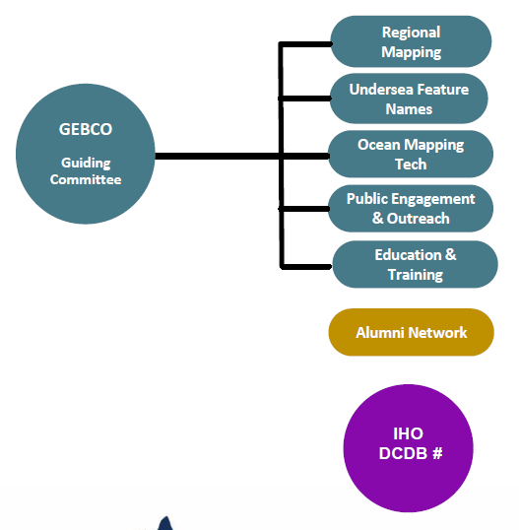
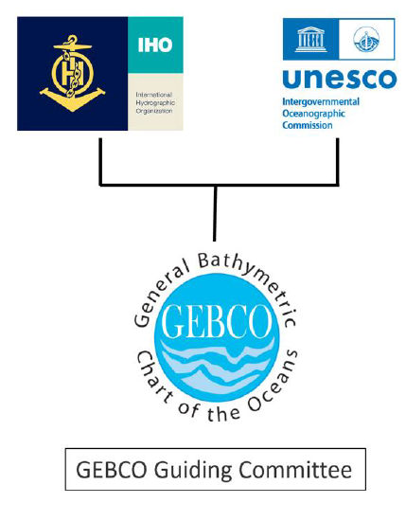
GEBCO related activities
GEBCO strategy
Governance review
1903-2023: 120 years of Ocean discovery: IHO + IOC Assembly + GEBCO Week
Work started to get IHO CSB initiative endorsed as UN Decade action

Slide 4
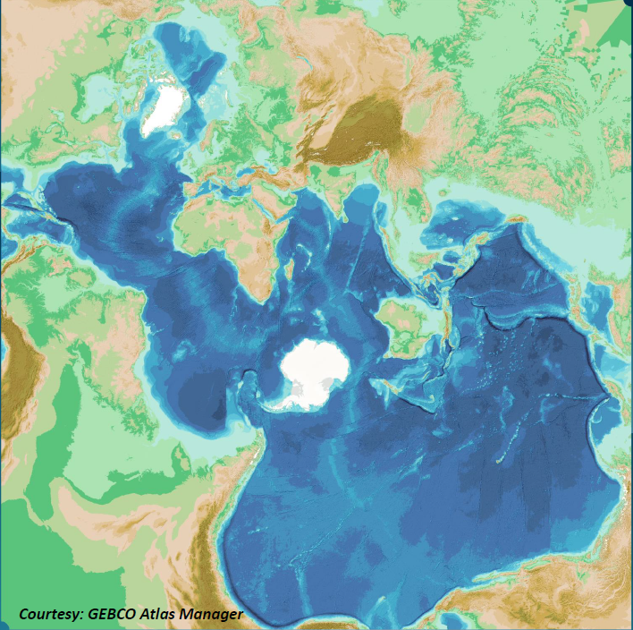
GEBCO related activities
6- 12 November: GEBCO Week in Monaco
SC Meetings, Map the Gaps Symposium (7. – 9. November) and GEBCO Guiding Committee /Steering Committee Meeting
A workshop organised jointly by the Organisation for Economic Cooperation and Development (OECD) and IHO, 13 November 2023, Monaco
“The Future of Seabed Mapping and its Associated Uses by 2045”

Slide 5
UN GGIM - 13th Session of the UN Committee of Experts on Global Geospatial Information Management (UN-GGIM) 2 - 4 August 2023
The UN-GGIM Committee of Experts endorsed the Operational Framework for Integrated Marine Geospatial Information Management UN-IGIF-Hydro (Part One & Two)
The UN-IGIF-Hydro aims to ensure the inclusion of the marine domain in the larger geospatial information ecosystem and is intended to be used by both developing and established geospatial programs which wish to implement the UN-IGIF Strategic Pathways in the marine domain.
It will play a key role in ensuring data on the marine environment is integrated, authoritative, and readily accessible and as such the framework has been endorsed as an action of the Decade of Ocean Science for Sustainable Development.
The UN-IGIF-Hydro framework recognizes hydrography and ocean mapping as important contributors to other geospatial domains.
Notes:
The complete UN-IGIF-Hydro represents several years of collaboration, global engagement, and dedication by the UN-GGIM Working Group on Marine Geospatial Information that included a three month global consultation review process, the drafting of a White Paper, several rounds of drafting group meetings, and two test workshops. The UN-IGIF-Hydro is a living document that the Working Group will continue to maintain and provide guidance on for those who intend to implement it.
Of special note from the WG meeting, Dr. Parry Oei has agreed to chair the Marine Geospatial Information Working Group for one year while we look for permanent co-chairs. There has been some expression of interest from Saudi Arabia, Canada, and South Africa. I think each of these could be potentially good for the group, but it is best to have at least one strong co-chair with experience. I am not sure if either Saudi Arabia or South Africa have candidates with experience yet, but we are eager for energetic new members and happy to have them.

Slide 6
IHO Secretariat`s domestics
Work has continued on the IHO Country Information system
The IHO Country Information system has been progressively upgraded to include administrative information and facilitate the maintenance of the IHO publications such as Yearbook (P-5) and Status of Hydrographic Surveying and Charting Worldwide (C-55) posted on the IHO website.
BSHC Members are invited to review their entry in the publications on an annual basis and provide the IHO Secretariat with the appropriate updates through the IHO Online Form system.
6

Slide 7
Progression with S-130 authoritative dataset for limits of the seas and oceans
HSSC15 endorsed S-130 Product Specification Edition 1.0.0
Start to develop S-130 sample dataset for Edition 1.0.0, to continue with a test phase.
After testing, full implementation of S-130 Edition 1.0.0 to be completed by September 2024 to gain experience for Edition 2.0.0 to be completed by end of 2024.
The Secretariat proposes the creation of S-130 Edition 1.0.0 sample test data sets under contract for the following test areas:
Southern Ocean
Baltic Sea
BSHC members are requested to agree with the use of the GIS data set consisting of the actual limits and boundaries defined by BSHC and published at the BSHC website (https://www.bshc.pro/wp-content/uploads/Baltic_Sea-Limits_of_the_sub-areas.pdf) for the purpose of the creation of a test data set aiming to further refinement of the S-130 Product Specification and final publication as authoritative data set.

Slide 8
BSHC is invited
to take note of this briefing,
and to take action as considered appropriate

