Slide 1
BSHC 28 National Report Germany
BHSC 28 Helsinki

Slide 2
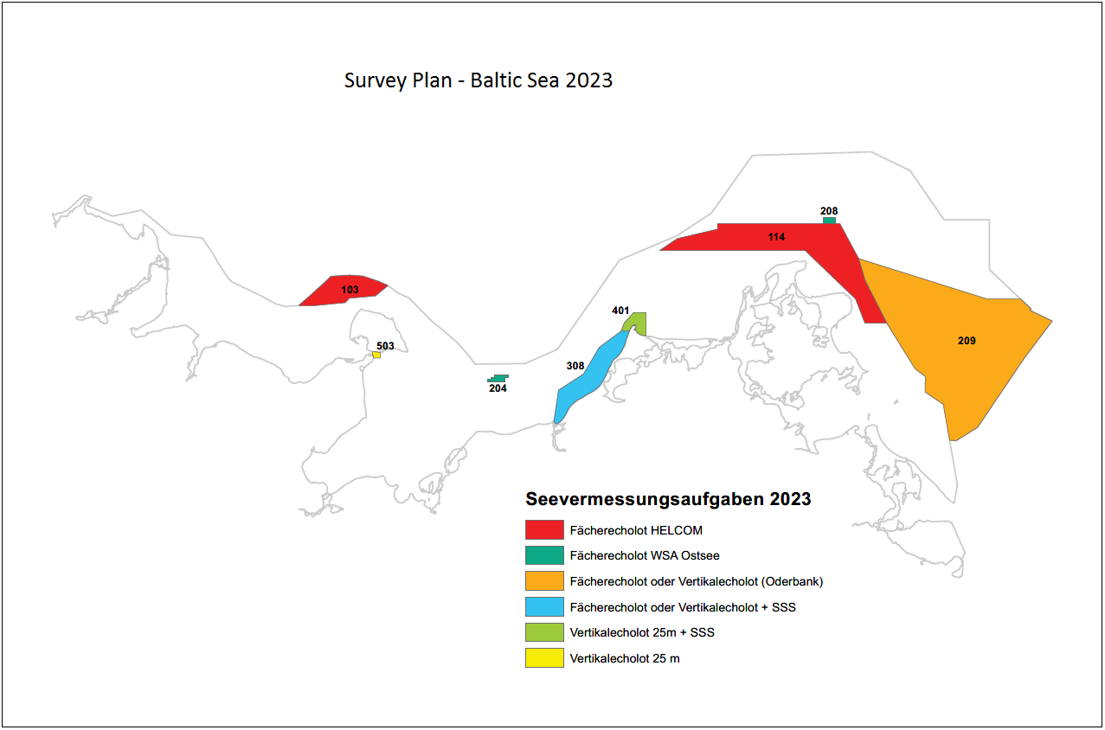
26 BSHC Conference National Report of Germany
Surveying and wreck search
Surveys in 2023:
103 Weg H planned
209 Oderbank in process
308 Rostock bis Darss in process
114 Route Sassnitz 2 in process
204 Meckl. Bucht finished
208 Rügen - Bornholm finished
401 Darsser Ort finished
503 Fehmarnsund finished

Slide 3
26 BSHC Conference National Report of Germany
New technologies
airborne laserbathymetry,
UAV imagery,
satellite-derived bathymetry as complementary data sources
how data from heterogeneous sources can be processed jointly to exploit the full information potential.
development of improved techniques to determine spatio-temporal resolved water sound velocity profiles (SVP) using dense in situ measurements and distribution model data. In this context, strategies will also be developed to predict water body characteristics in real time during hydrographic surveys in order to adjust SVP measurements accordingly.
intensive work on automatic data analysis techniques like stone detection and classification in geometric and radiometric multibeam echosound data as well as coast line extraction from multi-spectral aerial imagery, partly using deep machine learning techniques like artificial neural network.

Slide 4
26 BSHC Conference National Report of Germany
New technologies
augmented reality (AR) technologies for crewed hydrographic surveys and public relations.
potential of crowdsourced bathymetry strategies, in particular the accuracy and reliability of bathymetric measurements collected by non-survey vessels, as basis for decision-making in resource scheduling.
Interreg Baltic Sea Region project “Shared waters – Same standards. Baltic Sea partnership for future navigation (Baltic Sea e-nav)”.

Slide 5
26 BSHC Conference National Report of Germany
Charts
INT charts
42 German INT charts (North Sea, Baltic Sea and Antarctic Waters) have been updated.
15 North Sea and 15 Baltic Sea INT charts in A0 format are produced in co-operation with UKHO and are distributed through UKHO chart agents.
For the Baltic Sea, BSH is the producer of 24 INT charts. Three small scale INT charts are scheduled to be transferred to Denmark and Sweden for further processing.
To concentrate more on the German waters, the adoption of 4 Polish INT charts in the area Zalew Szcecinski was stopped.
BSH started to change the paper size of all INT charts to DIN A0. The conversion of the North Sea charts is complete and 15 Baltic Sea charts have been converted.
National paper charts for domestic waters
Published/ updated 63 North Sea and 36 Baltic Sea paper charts in DIN A1 format during the reporting period.
To provide chart coverage of new wind farms some New Charts are still planned.
The remaining 4 larger size national charts for the Baltic Sea will be replaced by DIN A1 paper charts step by step.

Slide 6
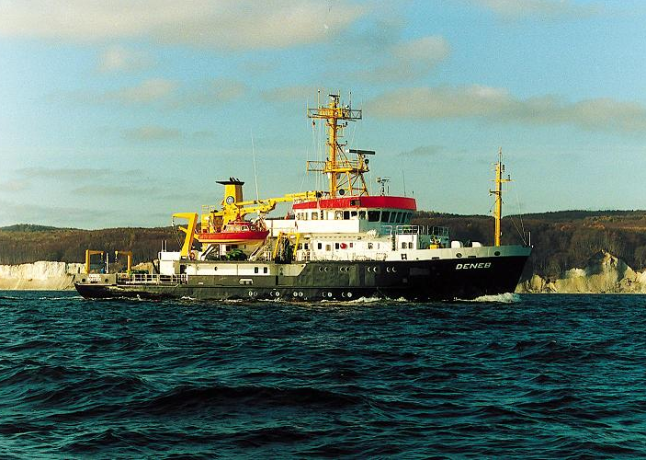
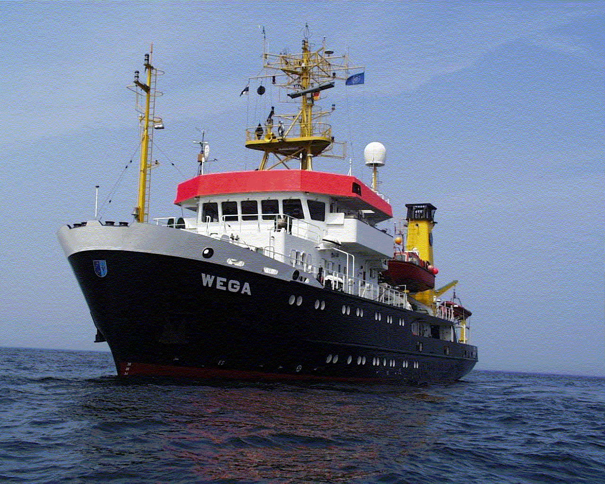
26 BSHC Conference National Report of Germany
New ships
WEGA (1990) and DENEB (1994), both Survey, Wreck Search and Research Vessels.
Call for tender has started this year (call for expression of interest as a first phase).
Negotiations are ongoing with several shipyards.
Due to high inflation and additional costs the funding for DENEB is not confirmed yet.
Vessels will be operated with environmentally friendly and climate neutral fuels based on methanol.
Size max 65 m x 15 m.
To be equipped a.o. with ASV.

Slide 7
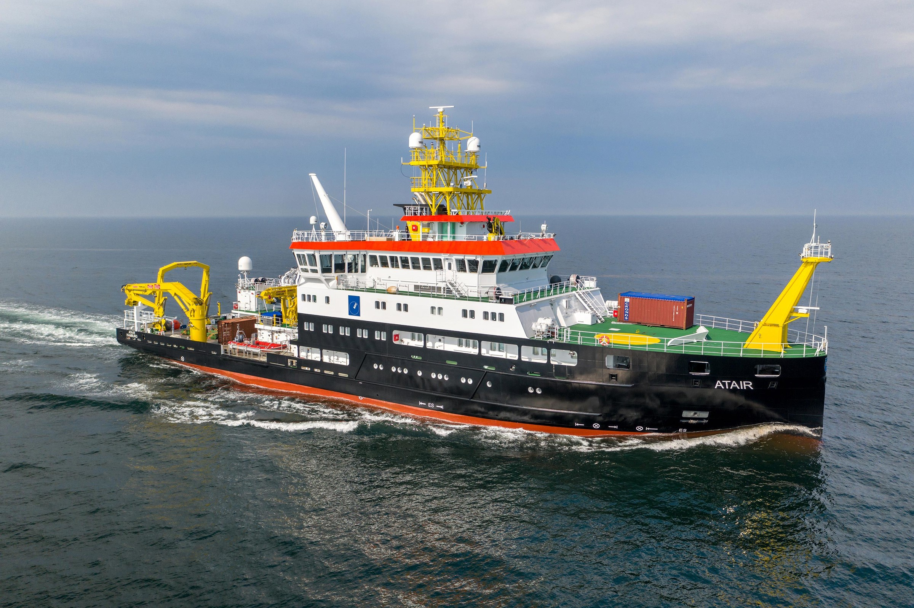
26 BSHC Conference National Report of Germany
Survey, wreck search and research vessel ATAIR

