Slide 1
HSSC Report
Agenda item C.1, Magnus Wallhagen, HSSC Chair

Slide 2
15th HSSC 15 Meeting
Helsinki, Finland, 5 - 9 June 2023 30 Member States and 82 attendees

Slide 3
S-100 Developments
Editions endorsed by HSSC
S-100 Edition 5.1.0
Edition 1.0.0 approved by HSSC (initial implementation, testing & evaluation)
S-164 Test data sets
S-131 Marine Harbour Infrastructure
S-124 Navigational Warnings (mandate given to HSSC by IRCC chair to approve this PS under WWNWS Sub-Committee)
S-130 Polygonal Demarcations of Global Sea Areas PS and dataset
HSSC noted the following incremental revisions
S-101 ENC Ed 1.1.0
S-102 Bathymetry Ed 2.2.0
S-104 Water Level Ed 1.1.0
S-111 Surface Currents Ed 1.2.0

Slide 4
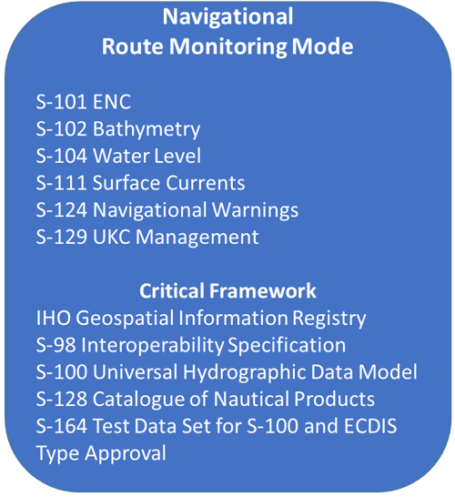
S-100 Implementation under a tense calendar
An updated S-100 Timeline is availble as part of the HSSC C-7 Report. Note the critical path between IHO Standards and the revision of the IEC 61174 ECDIS Test Standard
Approval dates for IHO MS by circular letter October – November 2024 for Phase 1 – Route monitoring Product Specifications
IHO will report to IMO NCSR the progress of Product Specifications against the S-100 implementation roadmap, as well as expected coverage of S-100 products once they start to become available.

Slide 5
Others standards development
HSSC endorsed the principle of S-66 Edition 2.0.0 Facts about Electronic Charts and Carriage Requirements (S-66 and S-67 merged, S-67 withdrawal from standards in force)
HSCC approved Ed 1.0.0 of S-68 Guidelines and recommendations for hydrographic offices for the allocation of CATZOC/QOBD (Quality of Batymetry Data) values from survey data for initial implementation, testing and evaluation
HSSC approved B-13 Guidance to Satellite Derived Bathymetry Ed 1.0.0

Slide 6
Effects of amended paper chart production practice
HSSC15-05.4C / IRCC15-09.1. German proposal for measures to mitigate the UKHO withdrawal of paper charts.
Continuation of the IHO INT Charts and the global INT Chart catalogue
Standardized format for Notice to Mariners
The HSSC was invited to:
a. note and discuss this paper,
b. invite HOs to provide paper chart corrections in the IHO commonly agreed NtM XML format online,
c. Consider the necessary steps to address the need of a full ECDIS carriage requirement to IMO
A similar paper was discussed at IMO MSC 107 (ref 107/15/2)
HSSC concentrates on technical issues about standards development
HSSC tasked the NCWG to make an impact study and develop a standard for NtM (XML) if appropriate - medium priority

Slide 7
Establishment of new Project Teams
HSSC approved ToRs for the establishment of S-100 Infrastructure Centre Establishment Project Team (ICE PT) under HSSC (following Decision A3/14)
HSSC gave the mandate to ENCWG to set up the Electronic Chart System (ECS) PT under ENCWG with following objectives :
a. to identify and prioritize ECS navigation requirements;
b. to analyse their impacts on current IHO hydrographic standards; and
c. to develop a set of recommendations/issues to be addressed by existing IHO bodies, external organisations, and member states.
HSSC approved the establishment of a new PT S-100 Security Scheme under HSSC to review the procedures for the appointment, operation, and termination process of participants in the new S-100 security scheme

Slide 8
Maritime Autonomous Surface Ships – MASS PT
MASS PT delivered their final report : assessment analysis, identifying regional situation with regard to MASS Issues and Requirements, and S-100 Gap Analysis. Available on the IHO website (HSSC 15).
MASS PT will continue as a PT and submit proposed ToR to become a WG to HSSC 16.

Slide 9
Stakeholders forum – Some challenges raised
S-101 alone does not offer much benefits for end users
Managing the impact of change
New validation challenges (growing number of data, new formats, cross-product validation, …) requires new system with inclusion of automated validation process
Simplify planning & reporting obligations : extract relevant information to create route plan, automatically fulfil report
Develop S-100 multi-fuel services for dissemination (catalogue, packaging, dissemination analysis, …)

Slide 10
BSHC 28 is invited to:
Note the HSSC report
Note the important challenges on the S-100 implementation and the commitments towards IMO and IEC
Encourage MS to actively support the development of the prioritized Product Specifications
Note the stakeholders conclusion that S-101 ENCs only do not offer much benefit. The additional S-100 layers are the game changers.
Take any action as appropriate

