Slide 1
Baltic Sea e-Nav
Shared Waters same Standards

Slide 2
Background – Unique selling point with S-100: Improved Under Keel Clearance Calculations
 |  |  |  |  | 5
 |  |  |  | 4 | Positioning
 |  |  | 3 | S-129 | S-129
 |  | 2 | S-104 | S-104 | S-104
 | 1 | S-102 | S-102 | S-102 | S-102
S-57 | S-101 | S-101 | S-101 | S-101 | S-101
Today | 2024 – 2026 |  |  | 2026 – 20xx?
BSHC 28, Helsinki Finland, 19 - 21 September 2023

Slide 3
Baltic Sea e-Nav – Scope November 2023 – October 2026
Application submitted 14 March 2023
Was approved June 2023 ☺
Goal | Period
Develop production capabilities for S-101 ENC, S-102 bathymetry and to some extent S-104 water level | 2023-2025
Establish harmonization rules for S-10x-products, under the BSHC umbrella | 2024-2026
Test, evaluate and refine the S-10x products | 2025
Commercial rollout for S-101 and S-102 in the Baltic Sea. S-104 in parts of FI. | 2026
BSHC 28, Helsinki Finland, 19 - 21 September 2023

Slide 4
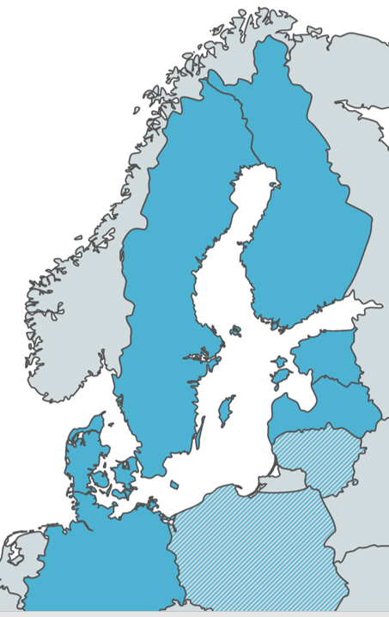
Baltic Sea e-Nav – Partnership
Hydrographic offices:
SE (coordinator), DE, FI, DK, EE, LV (Associated: LT, PL)
Academia:
RiSE (SE), SAMK (FI)
Private sector:
ECDIS OEM – Furuno
Meteorological agency:
Finnish Meteorological Institute
RENCs:
(Associated: PRIMAR, IC-ENC)
BSHC 28, Helsinki Finland, 19 - 21 September 2023

Slide 5
Baltic Sea e-Nav – Financing
Programme Interreg Baltic Sea Region
Postponed with one year after rejection of the project the first attempt (September 2022).
Approximately 5 MEuro
BSHC 28, Helsinki Finland, 19 - 21 September 2023

Slide 6
Ongoing before start up of the project
Subsidy contract between SMA and Interreg Baltic Sea Region, including clarifications of the application.
Partnership agreement between SMA and all Project Partners.
A dedicated project leader, Marlene Svegreus, has been recruited by SMA. Starting 1 October 2023.
For Project Partners to dedicate a project POC and a representative for the expected Steering Committee.
BSHC 28, Helsinki Finland, 19 - 21 September 2023

Slide 7
SINCERE – Innovation regarding UKCM Application to Horizon Europe submitted – rejected in August 2023
Goal | Period
Mainstream the use of dynamic Under Keel Clearance Management (UKCM) systems through the open release of a reference implementation to be used by companies that develop maritime information display systems. | 2024-Q3/2025
SMA: SE participation in S-129PT to prepare the S-129 standard also for ship based services (Göteborg). | 2024-2026
SMA: Provide test data in Göteborg (S-101, S-102, S-104), together with PRIMAR. | 2024-2025
SMA: Establish cooperation with SMHI (SE Met- and Oceanographic Adm.) and SHOM | 2024-2025
Partners: RiSE (coordinator – SE), SMA (SE), SHOM (FR), SMHI (SE), Kongsberg (NO), PRIMAR/ECC (NO), and others
S-129:
Under Keel Clearance Management
BSHC 28, Helsinki Finland, 19 - 21 September 2023

Slide 8
BSHC 28 is invited to:
Note the Baltic Sea e-Nav report
To note that harmonisation rules developed in the Baltic Sea e-Nav project will be presented through established BSHC WG to BSHC for approval.
Take any action as appropriate
BSHC 28, Helsinki Finland, 19 - 21 September 2023

