Slide 1
IRCC Report
Report to BSHC 28
Helsinki, Finland
20 – 21 September 2023
By Thomas Dehling
IRCC Chair

Slide 2
IRCC Introduction
The Inter-Regional Coordination Committee (IRCC) is the steering committee of the IHO for inter-regional coordination and support.
Chair: Mr Thomas DEHLING (Germany)
Vice-Chair: Dr John Nyberg (USA) until 31 August 2023
Ms Jennifer JENCKS (USA) from 1 September 2023
Members:
Chairs of the 15 RHCs and of HCA
Chairs of 9 subordinate bodies
(WWNWS, CBSC, WENDWG, MSDIWG, IENWG, CSBWG, IBSC, DCDB, GGC)

Slide 3
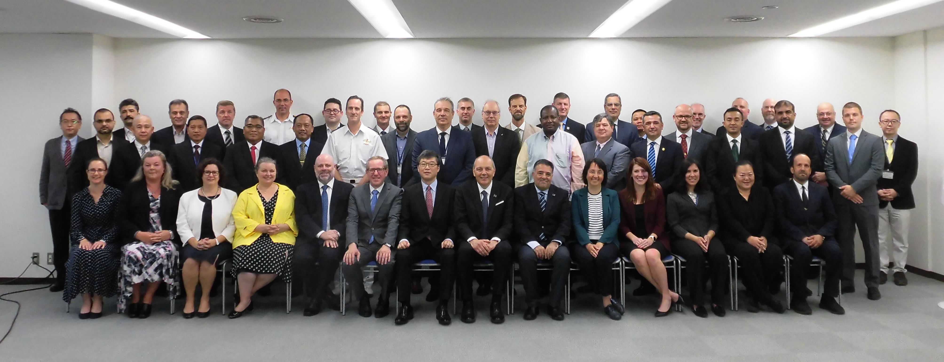
IRCC Report
IRCC 15 meeting, Tokyo, Japan, June 2023

Slide 4
IHO Assembly 3 decisions
IRCC15 had a particular focus on the 3rd Session of IHO Assembly’s Decisions affecting IRCC prior to C-7 in order to be more efficient.
A-3 tasked Council to revise Strategic Plan for 2027-2032
IRCC will be very much involved
Review of Strategic Performance Indicators (SPI)

Slide 5
IHO Assembly 3 decisions
Establish an ad-hoc Project Team under IRCC to explore the establishment of reliable alternative funding for activities related to Capacity Building and GEBCO (see A-3 Decision 20).
IRCC established a scoping Team under the leadership of Dr John Nyberg to investigate potential additional sources of funding and the Team’s objectives for the following presentation to C-7
PT composition, as well as the team’s timeline and objectives.
The possible available opportunities such as an
ENC surcharge,
voluntary contributions and
approaches to Development Banks
aim to provide additional Capacity Building opportunities and Standards development.
With reference to UN-GGIM, the important tool for engaging with the Development Banks via the
IGIF-Hydro was also discussed.

Slide 6
IHO Assembly 3 decisions
IRCC decided to continue the quite successful tool of IRCC online workshops and defined two new workshops for the intersessional period.
workshop on IBSC submissions
benefits and extension of contributions to CSB.
The organization is on the respective subordinate bodies in liaison with IHO Secretariat

Slide 7
IHO Strategic Plan
A-3 tasked Council to revise Strategic Plan for 2027-2032
IRCC will be very much involved
Review of Strategic Performance Indicators (SPI)

Slide 8
Strategic Performance Indicator (SPI)
9 SPI are allocated to IRCC
keep it simple, figures measuring the success,
comparable, simple, digital means,
find worldwide indicators that doesn´t leave any MS behind.
Please provide figures annually for IHO Publication P7 (Annual Report)
See A-3 Decision 8 point d), “Status Report on Performance Monitoring related to the Strategic Plan 2021-2026”, via the approved SPI.
The IRCC, through their subordinated bodies and with the support of the RHCs, will be engaged in measuring those SPI annually, and provide the related figures to the IHO Secretariat by December each year for the period 2024-2026.
Please suggest amendments or changes for the revised Strategic Plan if appropriate

Slide 9
IHO e-learning Center
IHO e-learning Center established
Guidelines in cooperation with the Republic of Korea.
approval of the Guidelines at IRCC 15
would not have been possible to achieve without the outstanding contribution and sustained support of ROK and especially KHOA.
IHO CL formalizing the establishment and functionality of the Center
Start the process to create the conditions for the next phase after the of CBSC established the e-learning Center (ELC) Steering Committee.

Slide 10
Actions requested
Recommendation 1: RHCs are encouraged to review the ROP and TOR based on Decision 9b of the Assembly on gender-inclusive language.
Recommendation 2: RHCs to start producing S-101 and other S-100 products by focusing on a specific part of the region.
Recommendation 2: RHC to discuss how HO‘s can assume a geo-coordinating role to help ensure provision of data on a regional level.
Recommendation 4: RHCs and Subordinate Bodies to consider to open the debate on future engagement in climate chance related activities in reference to strategic goal 3.

Slide 11
Actions requested
Recommendation 5: RHC to encourage relevant Member States to report to the IMO Secretariat and the Chair of the EGC Coordinating Panel on the progress and status of implementation of newly recognized mobile satellite services by MSI providers.
Recommendation 6: RHCs to ensure representation of their region in the CBSC and encourage other IHO Member States to join in the work of the CBSC.
Recommendation 7: RHCs to prioritize their participation in the WENDWG through the RHC Chart Coordinator or S-100 Coordinator.

Slide 12
Actions requested
Recommendation 8: RHCs, if not done already, establish the S-100 Coordinator role or assign S-100 Coordinator duties as appropriate.
Recommendation 9: RHC S-100 Coordinators to update their WEND-100 IGIF Matrix submissions every year and share their schedule and roadmap to meeting the 2026 IMO target (S-100 ECDIS) at every WENDWG meeting.
Recommendation 10: RHC Chart Coordinators/S-100 Coordinators report their planned S-101 chart schemes, usage bands 1 – 4, by 30 September. Request that submissions use INToGIS III when commissioned.
Recommendation 11: RHCs to appoint MSDI ambassadors and inform the MSDIWG with contact details

Slide 13
Actions requested
Recommendation 12: RHC to encourage MS to have more CSBWG participation
Recommendation 13: RHC to encourage MS to support the CSB initiative with positive actions, such as requiring all research vessels to collect bathymetric data for late uploading, when on passage or when it does not interfere with other research activities.
Recommendation 14: RHCs to encourage MS and stakeholder bathymetric data contributions to the DCDB, regardless of origin.
Recommendation 15: RHCs to collaborate with the DCDB on developing and highlighting annual regional breakdowns of data holdings as part of SPI reporting.
Recommendation 16: To encourage RHCs to actively contribute with new data to GEBCO.

Slide 14
Actions requested
Recommendation 17: To invite RHCs to assign the INT paper chart scheme appropriateness check and possible amendment of the scheme.
Recommendation 18: To encourage RHCs to invite Member States to consider the provision of paper chart updating procedures depending on the findings of NCWG.
Recommendation 19: To encourage RHCs to invite Member States to consider the requirements (including regulations) for non-ECDIS mandated vessels (e.g. small commercial, fishing, leisure, etc) within national, regional and global discussions on this topic (HSSC15 decision 7 regarding Electronic Chart Systems PT refers).

