Slide 1
Nordstream incident, Sept 2022

Slide 2
Items to be reported
What is Nordstream?
Scenario in September 2022
Actions and coordination by SMA and DMA
Lessons learned

Slide 3
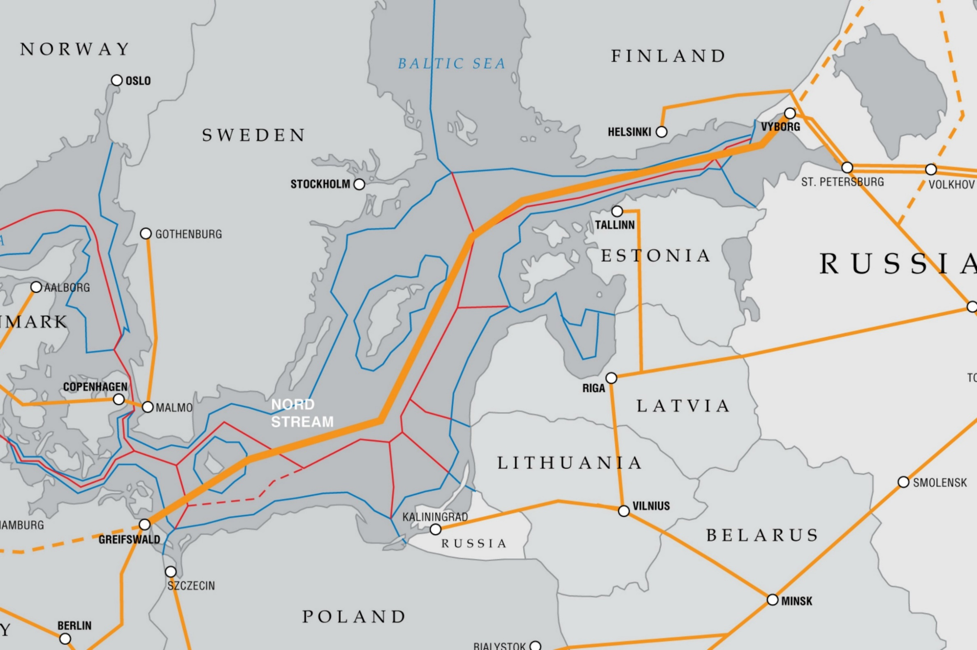
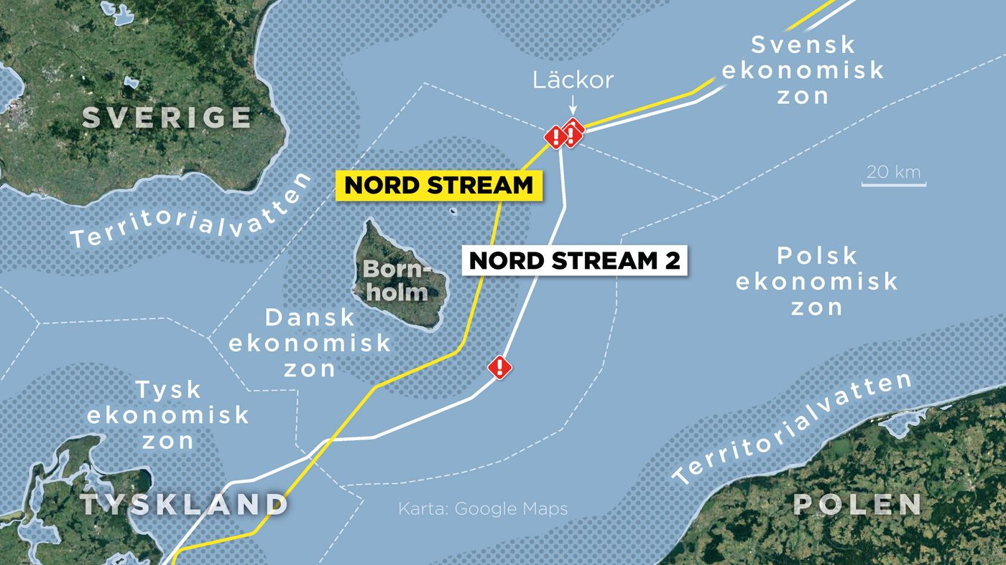
Nordstream pipeline
Four pipelines in total
Four leaks

Slide 4
Instructions to operators at Sweden traffic
Prepared in 2012 during pipeline construction
List of scenarios
Clear instructions who to contact
Example of Navigational warning to broadcast
Instructions matched reality

Slide 5
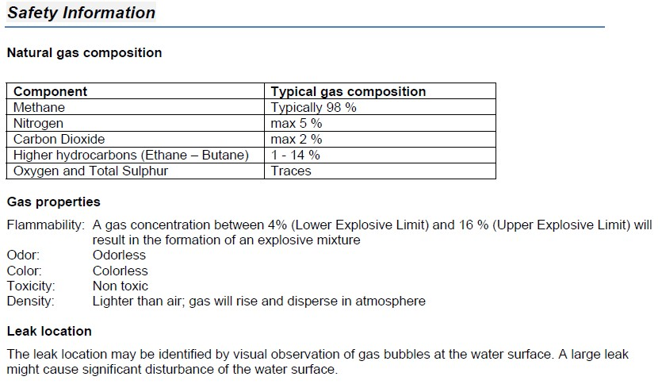
Text from the company emergency response plan

Slide 6
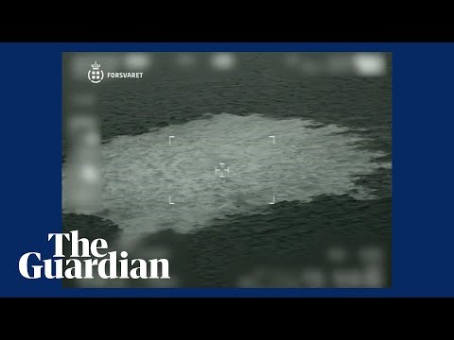
https://https://www.politico.com/news/2022/09/28/nord-stream-pipeline-explosions-eu-00059262

Slide 7
Timeline summary Sep 26, 2022
08:36 Call from company in Switzerland. Pressure drop in pipeline. No information about location at this time.
08:45 – 09:45 Information to JRCC, Coast guard, NtM. Preparation of e-mail to be sent to Germany, Poland and Denmark. Waiting for position.
Further dialog with company and other authorities.
12:27 First warning broadcast without position
13:20 Position confirmed. ”Important” warning transmitted.
Coordination with Denmark.
Information sent to UK for EGC warning.
15:30 Navtex warning changed to ”vital”.
20:20 Two new positions reported. New warning issued.
Continued dialog with vessels in the area. Denmark with northbound vessels and Sweden with southbound.

Slide 8
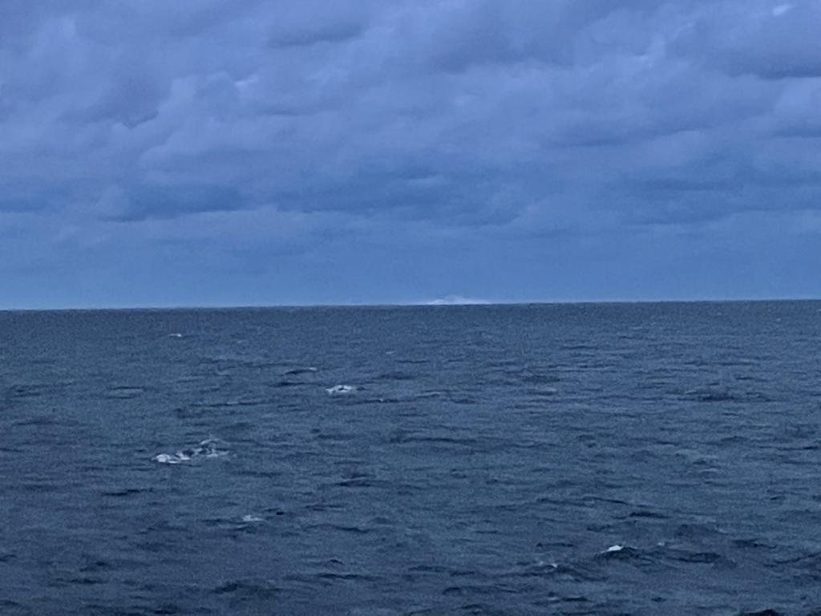
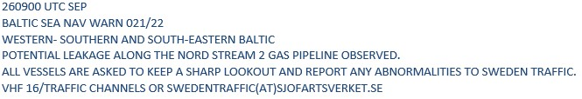
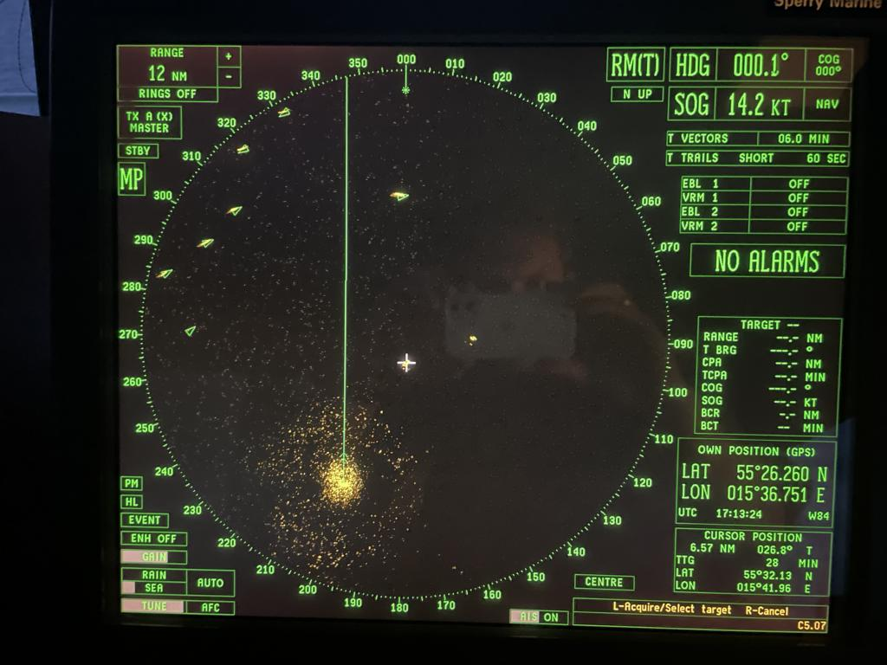
First warning
Reports from vessels in the area, helped pinpoint the location

Slide 9
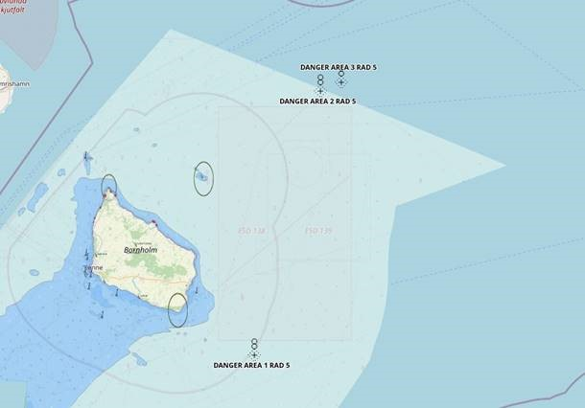
Further actions taken
Virtual AIS and ”Watch dogs” deployed to mark positions.

Slide 10
Lessons learnt
Importance of short and clear instructions, decision support for operator
Operator time log
Importance of good communications both within agencies and different counties
Difficulties with different agencies in charge in different countries. Prohibition zone varied.

Slide 11
Thank you

