Slide 1
CBSC Report
Report to BSHC 28
Helsinki, Finland
20 – 21 September 2023
By Thomas Dehling
BSHC CB Coordinator

Slide 2
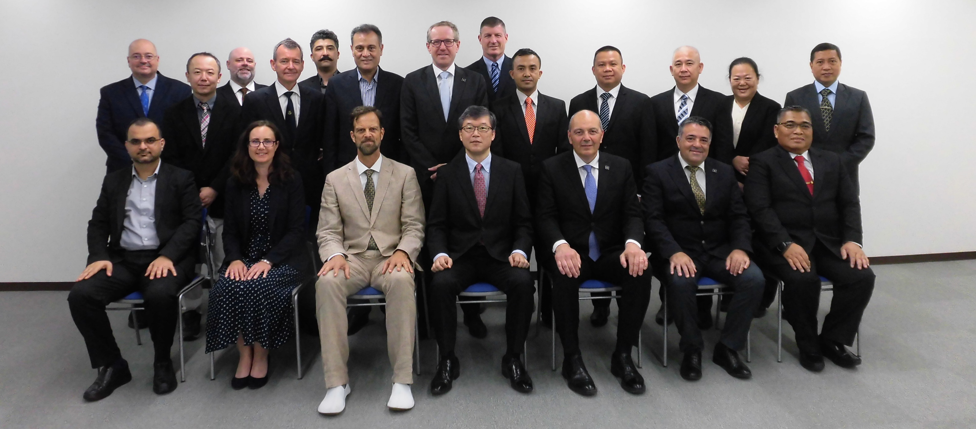
CBSC Report
CBSC 21 meeting, Tokyo, Japan, June 2023

Slide 3
IRCC Introduction
The Inter-Regional Coordination Committee (IRCC) is the steering committee of the IHO for inter-regional coordination and support.
Chair: Mr Thomas DEHLING (Germany)
Vice-Chair: Dr John Nyberg (USA) until 31 August 2023
Ms Jennifer JENCKS (USA) from 1 September 2023
Members:
Chairs of the 15 RHCs and of HCA
Chairs of 9 subordinate bodies
(WWNWS, CBSC, WENDWG, MSDIWG, IENWG, CSBWG, IBSC, DCDB, GGC)

Slide 4
Actions requested

Slide 5
Actions requested

Slide 6
Actions requested

