Slide 1
Sample Production of S-127 dataset Fulfilling NPUB Carriage Requirements by making use of S-127 conform dataset
BSHC
Die zentrale maritime Behörde in Deutschland
Bundesamt für Seeschifffahrt und Hydrographie

Slide 2
Introduction
challenges in storage of S-1xx conform data
lack of efficient software solutions available
BSH content management system is MS Office based (Word)
workaround to store relevant NPUB information in an S-127 conform database
Vision:
create and use an S-127 conform dataset to produce the VTS Guide

Slide 3
Analysis
Dismantling of VTS Guide into smaller sections – VTS centres, e.g VTS Centre Travemünde
Dismantling VTS centres into Vessel Traffic Services, e.g. Fehmarn Belt Traffic, Kiel Traffic and Trave Traffic
Analysing NPUB structure →identical and no major variations from VTS to VTS:
The name of the VTS
A graphical overview of the surveillance area
The contact details
Necessary Reports
Rules
Services
Pilot Information

Slide 4
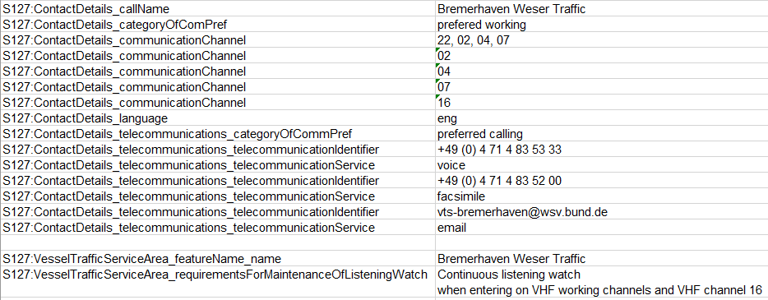
Analysis „Transforming process“
Figure 1: Extract of S-127 form (MS Excel based)

Slide 5
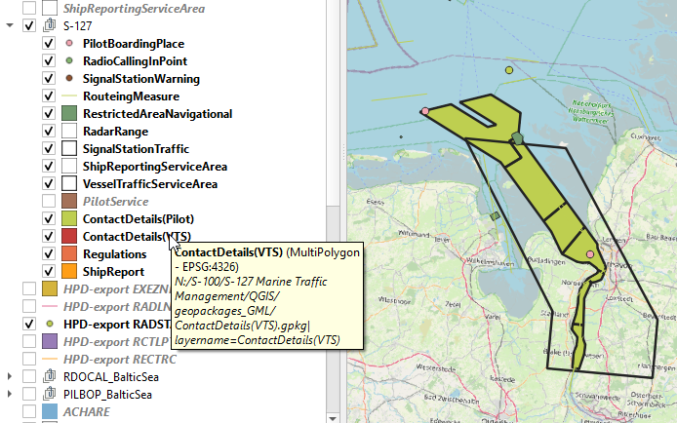
Analysis „Transforming process“
supporting nautical and geographical data were extracted from HPD
use of QGIS to display, sort and evaluate data
Figure 2: Display of intermediate results (QGIS)

Slide 6
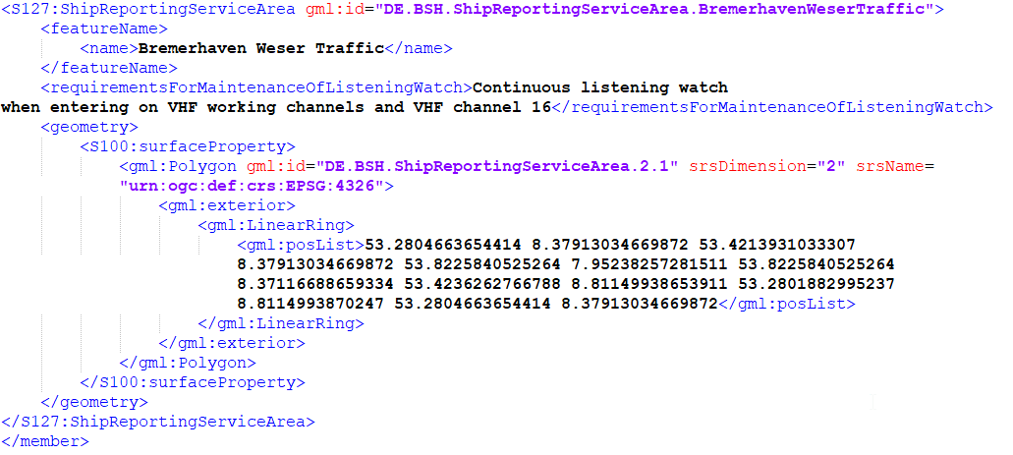
Analysis „Transforming process“
QGIS geopackage
Python
S-127
Python
VTS Guide
Figure 3: Display of intermediate results (S-127 conform gml)

Slide 7
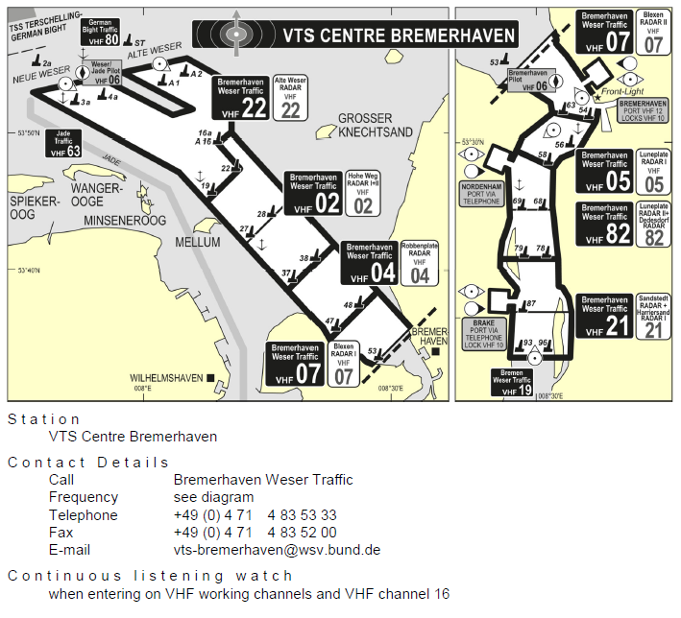
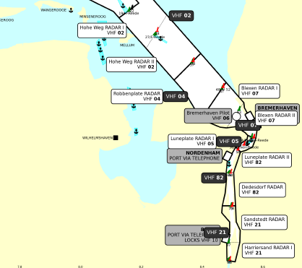
Analysis „Transforming process“
Figure 4: Comparison of VTS overview (left: "old" overview, right: data based graphic)

Slide 8
Further steps
reduction of manual work → automation
nautical check against the VTS Guide
establishment of update process
definition of unique identifiers for each individual feature (MRN)
cross product interoperability

Slide 9
Conclusion
Generation of test datasets requires manual workarounds,
Possibility of human errors
redundant data storage,
one for the S-127 datasets and one for the NPUB content, could be avoided soon

Slide 10
Actions required
The BSHC is invited to:
note this presentation (including input paper and to annexes)
be encouraged to present further national developments

