Slide 1
Sustainable Development Goals and the Importance of Hydrography
Jamie McMichael-Phillips,
Head of Partnering & Engagement (Asia Pacific)

Slide 2
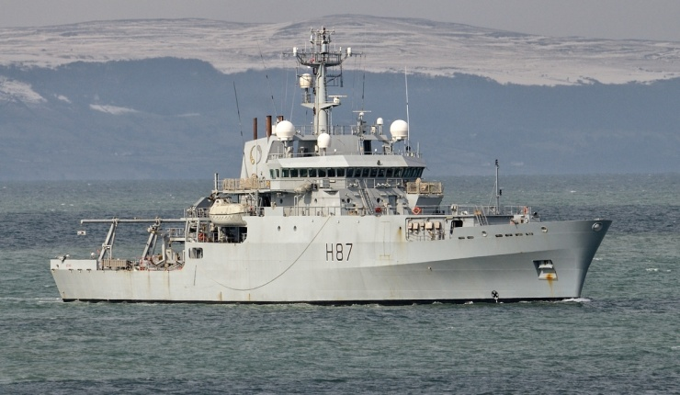
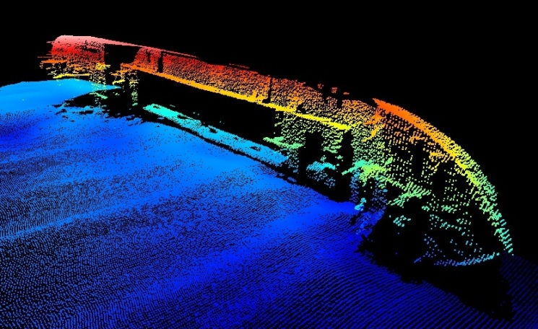
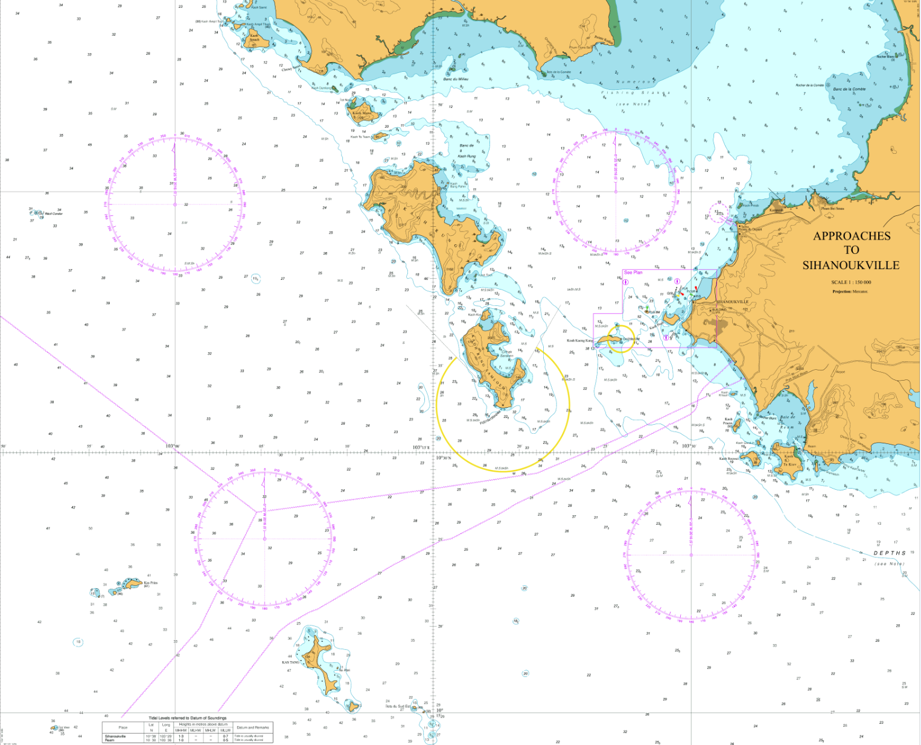
What is Hydrography ?
IHO Definition
“Hydrography is the applied science which deals with the measurement and description of the physical features of oceans, seas, coastal areas and inland waters, as well as with the prediction of their change over time.”

Slide 3
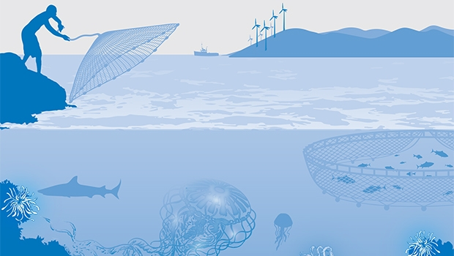
Blue Economy
World Bank definition
“Sustainable use of ocean resources for economic growth, improved livelihoods, and jobs while preserving the health of ocean ecosystem.”

Slide 4
Maritime Trade
80% of all trade in goods transported by sea
Containerised trade more than tripled in last 10 years
48 million twenty-foot equivalent units (TEUs)

Slide 5
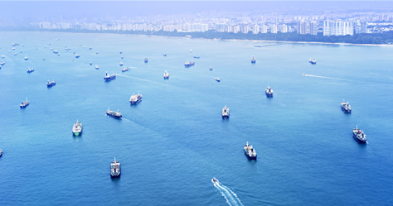

Slide 6
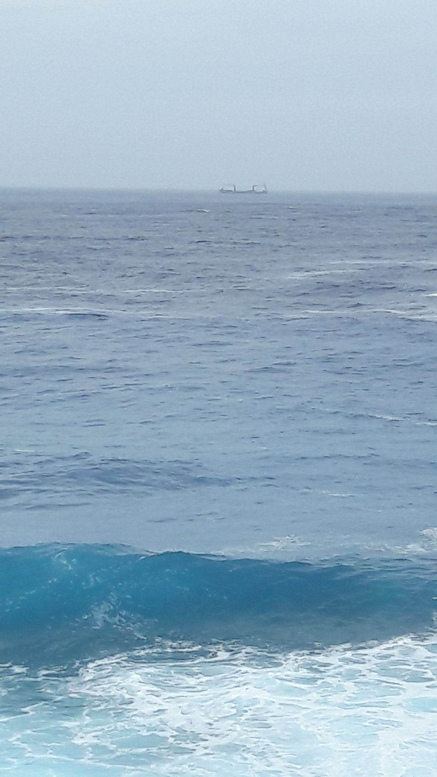

Slide 7
But …..
It is much more than simply trade ……..

Slide 8
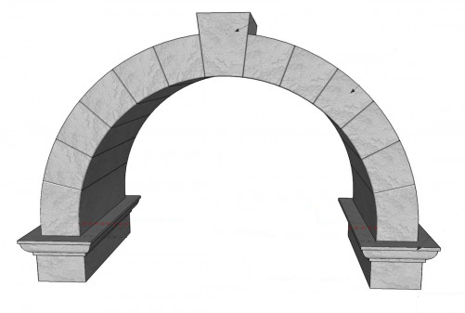
Hydrography and the Bigger Picture
Habitat Mapping
Inundation mapping
MPAs
Disaster preparedness
Fisheries Management
Disaster mitigation
Coastal Zoning
Coastal land use planning
Hydrography
A keystone data type for safe navigation plus much more
Oceans Governance
Climate change resilience

Slide 9
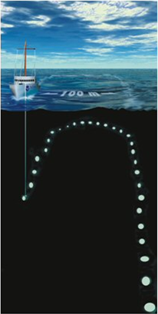
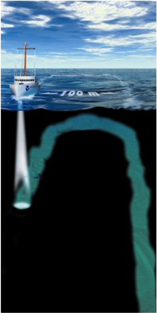
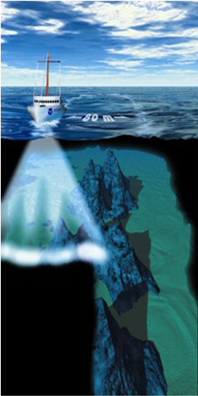
Issues with Data Age and Resolution
1800s
Today
The age of the survey indicates which method has been used

Slide 10
Old data does not support the needs of the Blue Economy
It is largely inadequate for safe navigation
It is largely inadequate for modelling
It does not support fisheries management
It does not support knowledge and protection of key habitat areas
It does not support resource exploitation
It can discourage some shipping from visiting

Slide 11
IMO/IHO

Slide 12
SOLAS and International Obligations
SOLAS Chapter V: Safety of Navigation (Part of IIIC)
Reg. 4 Navigational Warnings
Each Contracting Government shall take all steps necessary to ensure that, when intelligence of any dangers is received from whatever reliable source, it shall be promptly brought to the knowledge of those concerned and communicated to other interested Governments
In January 2016 the IMO Mandatory Audit Programme commenced
Notes:
This is the easiest Phase of the IHO CB Model to obtain. Is this currently achieved? What if a shipping container falls overboard? How do you notify other vessels it could be a danger to them?
The IHO offers courses on this and one is planned for EAtHC – not sure if to be delivered in French or English. M2 and S-4 Part B Section 600 also outline requirements

Slide 13
SOLAS and International Obligations
SOLAS Chapter V: Safety of Navigation (Part of IIIC)
Reg. 9 Hydrographic Services
Contracting Governments undertake to arrange for the collection and compilation of hydrographic data and the publication, dissemination and keeping up to date of all nautical information necessary for safe navigation….
Contracting Governments undertake to co-ordinate their activities to the greatest possible degree in order to ensure that hydrographic and nautical information is made available on a world-wide scale as timely, reliably, and unambiguously as possible.
In January 2016 the IMO Mandatory Audit Programme commenced

Slide 14
IHO Capacity Building Maturity Model
Phase 1
Collection and dissemination of Maritime Safety Information
Hydrographic Governance
Phase 2
Hydrographic surveying prioritisation and capability
Production of paper charts, ENCs and nautical publications
Phase 3
Notes:
The IHO is the advisory body that sets standards for Hydrographic Surveying and Marine Cartography. They work closely with the IMO.
Phase 1 assistance and training is open to all coastal states regardless of their IHO membership. It is important to establish a MSI network in all CS so that information is passed to the mariner in a timely fashion. This can be as simple as local notices to mariners and radio warnings – can get urgent safety related information out to the mariner that could impact them.
Phase 2 Showing that you understand the need for hydrography, have established a survey plan and a mechanism for undertaking the survey either through in house capability or contracting out the survey.
Phase 3 in order to meet obligations for SOLAS vessels within your waters you need to ensure that navigational products are as up to date as possible with regards seabed mapping information, an updating mechanism is in place and the products available to purchase. Production of charts and associated publications is complex and time consuming.
Underlying all this is legislation, SLA’s, plans and strategic objectives across government which all form hydrographic governance.

Slide 15
UN Sustainable Development Goals

Slide 16
UN Sustainable Development Goals
Can we afford not to do hydrography?
What are the SDGs?
What are the Key SDGs?
How does Hydrography fit?
What are the challenges for incorporating hydrography into SDGs?
Summary

Slide 17
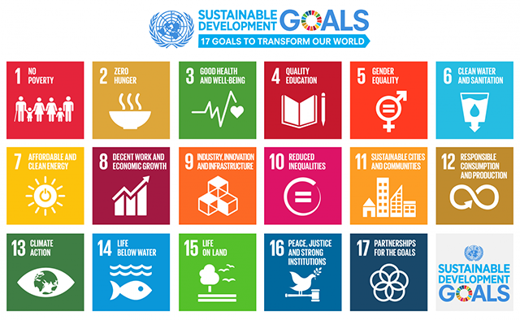
UN Sustainable Development Goals
Notes:
In September 2015, the UN General Assembly adopted the 2030 Agenda for Sustainable Development that includes 17 Sustainable Development Goals (SDGs). Building on the principle of “leaving no one behind”, the new Agenda emphasizes a holistic approach to achieving sustainable development for all.
Of these 17 SDGs two are most relevant to hydrography 14 and 9.

Slide 18
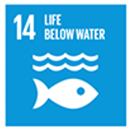
SDG 14 Life Below Water
Conserve and sustainability use the oceans, seas and marine resources for sustainable development.
Key Target:
14.7 By 2030 increase the economic benefits to small island developing states and least developed countries from the sustainable use of marine resources, including through sustainable management of aquaculture and tourism.

Slide 19
SDG 9 Industry, Innovation and Infrastructure
Build resilient infrastructure, promote inclusive and sustainable industrialization and foster innovation.
Key Target:
9.1 Develop quality, reliable, sustainable and resilient infrastructure, to support economic development and human well being with a focus on affordable and equitable access for all.
Notes:
Adequate navigational products ate part of a national infrastructure.

Slide 20
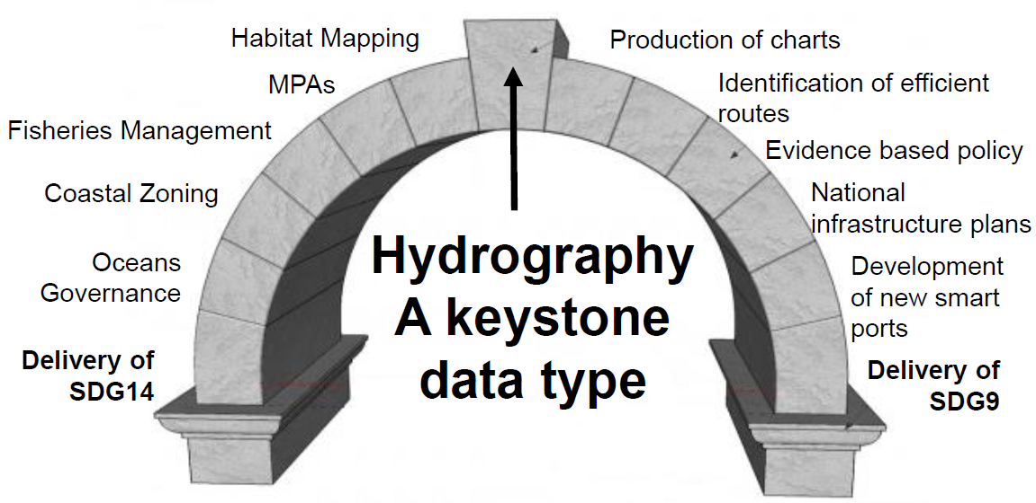
How does Hydrography fit into the SDGs?

Slide 21
Challenges for Incorporating Hydrography?
There are some very real challenges for incorporating hydrography in to delivery of SDGs:
Hydrography does not always attract attention
Seabed mapping is a starting component not an outcome in its own right
National HOs are rarely asked to contribute to cross government policy
The seabed is invisible to the public and therefore not politically attractive
Notes:
Some governments do not fully understand the importance of hydrography. An increase in the awareness that seabed mapping is a baseline dataset that can be used for more than just charting will only improve its importance to wider government strategic goals.

Slide 22
Challenges for Implementing SDGs?
The key challenges for implementation represents an opportunity and spatial data
….. If a marine protected area is delimited without an understanding of the seabed, it may unnecessarily hinder access to a port

Slide 23
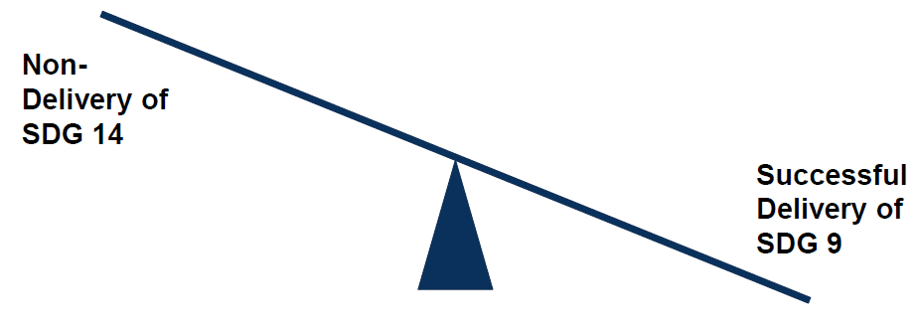
Challenges for Implementing SDGs?
The key challenges for implementation represents an opportunity and spatial data
….. If a new port is developed without an understanding of the seabed, it may damage a habitat essential for food security

Slide 24
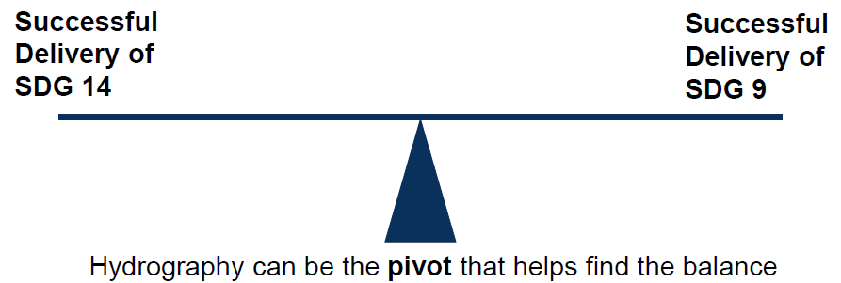
Challenges for Implementing SDGs?
The key challenges for implementation represents an opportunity and spatial data
….. If both activities are approached with a good understanding of the seabed, then both can be achieve sustainably

Slide 25
UN Sustainable Development Goals
Notes:
In September 2015, the UN General Assembly adopted the 2030 Agenda for Sustainable Development that includes 17 Sustainable Development Goals (SDGs). Building on the principle of “leaving no one behind”, the new Agenda emphasizes a holistic approach to achieving sustainable development for all.
Of these 17 SDGs two are most relevant to hydrography 14 and 9.

Slide 26
SDG Summary
Key considerations going forward:
The SDGs offer an opportunity to raise the profile of our work
Some SDGs will not be sustainably implemented without seabed mapping
Incorporation of seabed mapping into the delivery of SDGs will raise global awareness and generate funding opportunities
The will only happen if we get better at educating our audience
Notes:
The solution? Educate your audience

Slide 27
Summary
Improving data quality will reduce liability and risk and can also increase vessel traffic/size
Efforts to raise the profile of hydrography within government are never wasted
Hydrographic data is wider than just producing SOLAS products eg. delivery of SDGs, Blue Economy, coastal zone management etc.

Slide 28
Questions?

