Slide 1

IHO Council
Report of C-3
Chair RDML Shep M. Smith
Vice Chair ADM Palmer

Slide 2
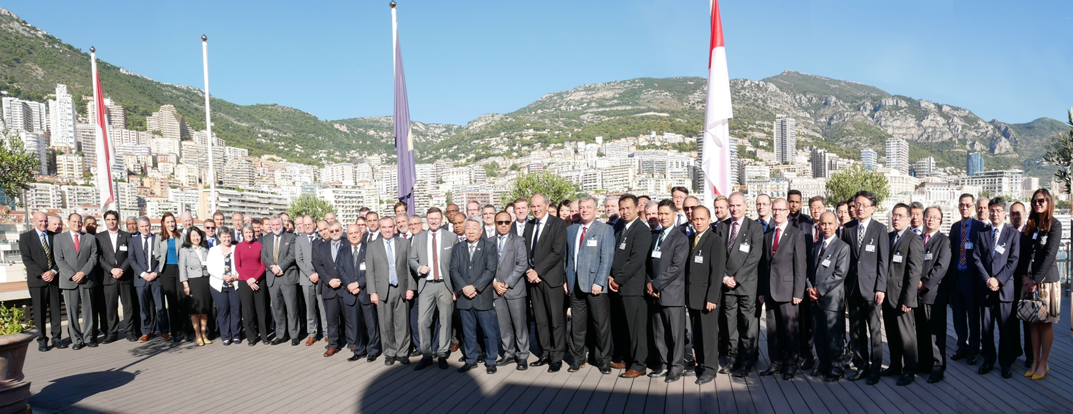
Oct 15-17, Monaco
Member states attending: 38 (including MS observers)
Registered attendees: 70
MACHC: Brazil, Netherlands, etc.
Summary Report available on IHO Council-3 meeting site

Slide 3
Council Endorses Strategic Plan to Assembly-2
Culmination of 24 months of work of the SPRWG--Congratulations!
Brief, concise, readily understood and relevant
Three Goals, three targets each, and 8 Strategic Performance Indicators
If adopted at A-2, plan covers 2021-2026 and work plan will be aligned to the new structure

Slide 4
Strategic Plan Goals
Evolving the hydrographic support for safety and efficiency of maritime navigation, undergoing profound transformation
Increasing the use of hydrographic data for the benefit of society
Participating actively in international initiatives related to the knowledge and the sustainable use of the Ocean
Goal 1
Example Target: Deliver standards for hydrographic data and specifications of hydrographic products; support their regular production; and coordinate regional and global services for their provision.
Example SPI: Percentage of Member States having operationalized production and distribution of hydrographic data products and services based on IHO Universal Hydrographic Data Model (S-100), under an implementation framework of coordination and agreed timelines (2026: 100%)

Slide 5
S-100 Implementation Strategy & Roadmap
A living document
Annually maintained with the Council Chair, IRCC & and HSSC Chairs, and IHO Secretary-General for engagement, production and capacity building
Reviewed and adopted annually by Council
Engagement with IMO targeting January 2024 for initial S-mode
Realizing a new generation of maritime and marine services (WENS)
Notes:
the topic was among the most important to be discussed by the Council and carried a mix of emotions by Member States. The main drivers to develop S-100 are further digitization in the shipping industry - for classic and autonomous navigation – and the benefits of “smart hydrography”. The new S-100 will not only improve safety of navigation and shipping in ports, but provide a cyber-secure, easily maintained software foundation that will support creative industry policy.
The IHO will coordinate with IMO and industry stakeholders concerning the transition to the S-101 ENC production, coverage and use in end user applications. Since the so called “S-mode” for ECDIS is scheduled to be implemented by IMO on new ECDIS from January 2024 onwards
“dual fuel”
Capacity Building requirements
The Council / HSSC / IRCC Chairs / Secretary-General supported by subject matter experts as appropriate to maintain this roadmap as an incremental document (including narrative and timelines) on an annual basis
S-100 Master Plan currently maintained under the leadership of the S-100WG
propose the Assembly to task the Council to maintain the S-100 roadmap on an annual basis as a key priority of the Council activities

Slide 6
C=Council
A = Assembly
SR = Stakeholder Review
MS = IHO Member State
S-129 UKC
Development and Testing
SR
HSSC Approval
S-129 Edition 1.0.0 Released
S-128 Catalog of Catalogs
Development (TBD)
S-127 Sea Traffic Management
Development (TBD)
S-124 Nav Warnings
Development and Testing
IRCC Approval
S-124 Edition 1.0.0Released
S-123 Radio Services
HSSC Approval
S-123 Edition 1.0.0 Released
S-122 MPAs
HSSC Approval
S-122 Edition 1.0.0 Released
S-121 - MLB
SR
HSSC Approval
S-121 Edition 1.0.0 Released
S-111 Surface Currents
HSSC Approval
S-111 Edition 1.0.0 Released
S-104 Water Levels
Development and Testing
HSSC Approval
S-104 Edition 1.0.0 Released
S-102 Bathy
Development and Testing
SR
HSSC Approval
MS Vote
S-102 Edition 2.0.0 Released
S-101 ENC
HSSC Approval
S-101 Edition 1.0.0 Released
S-101 Edition 1.X.X
2018
2019
2020
2021
A2
C2
HSSC11
C3
C4
HSSC10
HSSC12
September 2019
S-100 Edition 4.0.0
S-100 Edition 5.0.0

Slide 7
“Hydrographic Interest”
General Regulations Article 16 (c) “…The definition of what constitutes an interest in hydrographic matters shall be reconsidered at the latest at the second Assembly meeting.”
“Hydrographic Interest” is currently defined as “tonnage” and is explicitly used to determine 1/3 of the Council Seats
“Tonnage” itself is explicitly to be used to determine the number of votes per MS for election of SG and Directors and contributions of MS for covering the functioning of the IHO (IHO Convention)
Council-1 declined to consider alternative definitions of “hydrographic interest”
Commend Uruguay, Argentina, and Brazil on very thorough and thoughtful presentation of an alternative measurement at C-3-
  Tonnage, national seaborne trade, “offer” and “demand”
  Detailed assessment made for member states with the proposed new measure- see C3-03.4B
Notes:
Brazil comment on an earlier draft on this slide following phone call with Brazil on Nov 12:
National Flag Tonnage and National Seaborne Trade were the parameters used to express the “demand” from the maritime community.
National Capacity Building Phases of Development Assessments and the National ENC coverage (Usage Bands 2, 3, 4 and 5) were the parameters used to reflect the “offer” of the Hydrographic Offices
we would like to point the IHO Council Decision C3/11: "...confirmed, iaw the IHO Convention, that there was no linkage between Council membership (defined in General Regulations) and Assembly voting and dues assessment (Art IX (b) and XIV (a) of the IHO Convention refer)."
ARTICLE IX
Where decisions cannot be reached by consensus, the following provisions shall apply: (b) For the election of the Secretary-General and the Directors, each Member State shall have a number of votes determined by a scale established in relation to the tonnage of their fleets.
Article XIV
The expenses necessary for the functioning of the Organization shall be met:
From the ordinary annual contributions of Member States in accordance with a scale based on the tonnage of their fleets
Article 16 of the General Regulations
The remaining one-third of Council seats shall be held by Member States that have the greatest interest in hydrographic matters and have not been selected under the procedure described in subparagraph (b) above. The definition of what constitutes an interest in hydrographic matters shall be reconsidered at the latest at the second Assembly meeting. Meanwhile, the scale by which an interest in hydrographic matters is measured shall be national flag tonnage. The table of national flag tonnages is derived in accordance with the procedures set forth in Articles 5 and 6 of the Financial Regulations.

Slide 8
Other
S-100 Showcase and Seabed 2030 to be highlighted at A-2
Resolutions and Rules updated
  General Regulations Articles 12, 15, 20 (Medical fitness)
  Interpretation of Rules updated
  IHO Res 2/1997(RHCs), 2/2007, 1/2005, (disaster response)
  Revision of Rule 12 of the Council ROP
  Rules 8,11, 12 of Rules of Procedure to Council (Chair and Vice Chair)
IHO Innovation & Technology Laboratory (Singapore) proposal
IHO Capacity Building Funds not equal to the demand

Slide 9
Council 4-6 Main Theme Proposed
“The effective implementation of the Revised Strategic Plan
considering application of the
principles of ISO 9001”

Slide 10
Next Steps
Council Report to Assembly-2
  9 Proposals and Recommendations (Due Dec 15)
Every RHC to designate the MS who will have a seat to the next Council
Candidates for Chair & Vice Chair of Council (2020-2023)
MS proposals to A-2 (due Dec 20) with comments in red book expected by 20 Jan 2020
Next meeting: October 20-22, 2020, Monaco

Slide 11
Personal Reflections
Initial skepticism from many of purpose, role, and value of the Council
However, I am now convinced that the Council is indispensable
  Only executive, actionable, timely oversight venue to consider all three programs of the IHO in concert
  Can drive external relations and needs of the organization
  Membership and interest high! Excellent discussions
  Strategic and tactical perspective considered concurrently
Small enough venue for participants to actively participate even if it’s their first meeting or English is not a native language…fosters better understanding, appreciation, and trust among member states. This is critical for the IHO to move efficiently enough to maintain credibility.

