Slide 1
20th Meeting of the Meso America – Caribbean Sea Hydrographic Commission National Report by
Antigua and Barbuda

Slide 2
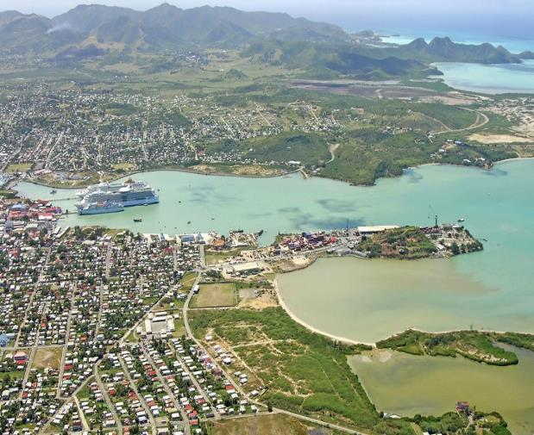
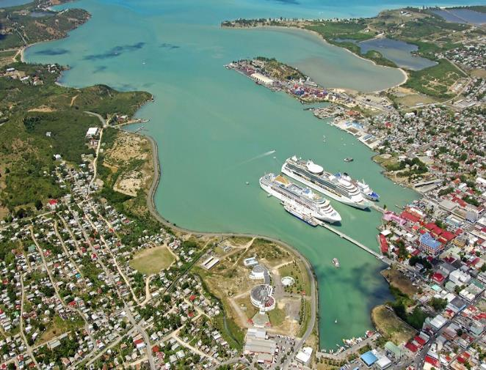
Top achievements during the year
dredging the main shipping channel, building a new seawall (harbor defense structure), new cruise berth (5th ), land reclamation and renovation of the entire Heritage Quay area

Slide 3
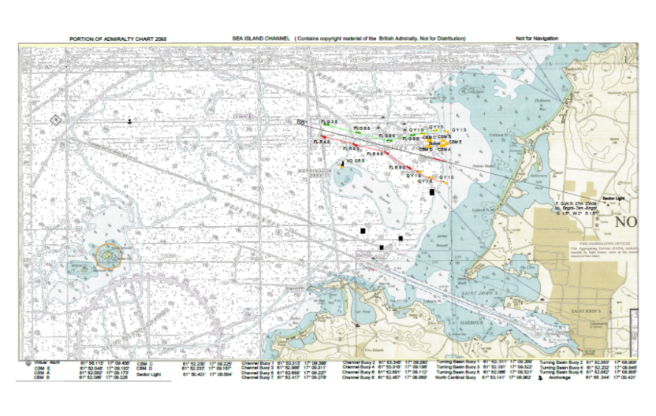
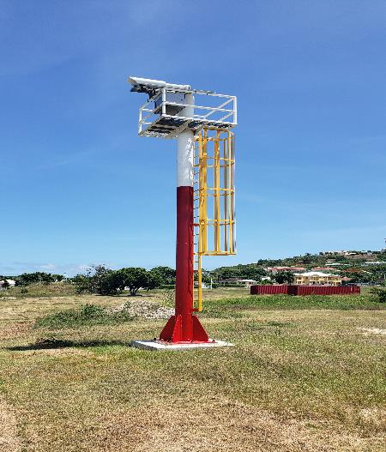
Top achievements during the year
new channel and mooring for the West Indies Oil offshore terminal and facilities to include a five buoy Conventional Buoyage Mooring (CBM) system

Slide 4
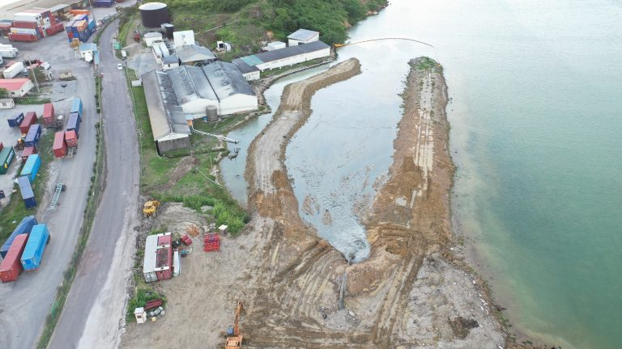
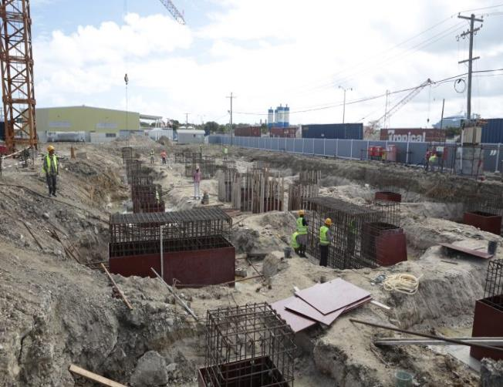
Top achievements during the year
the provision of Conflict, Security and Stability Funding (CSSF) for Multibeam Equipment and Training to Antigua and Barbuda

Slide 5
Top challenges and/or obstructions
Individual approach to development
Training received not effectively utilized
Cooperation between stakeholders working towards achieving the same goals
Political will
Efforts to make Hydrography a higher priority item

Slide 6
Top Plans that affect the region
Regional approach to Hydrographic Governance in the OECS
deployment of a Hydrographic Working Group to the OECS Member States to determine the maritime spatial needs of the OECS region
development of capacity building programmes, regional cooperation harmonised hydrographic governance which supports implementation of the OECS Economic Union
UKHO and the OECS Commission, working in collaboration with the Commonwealth Secretariat, to complete the regional hydrographic scoping study report by 31st December 2019

Slide 7
Top 2 recommendations for MACHC plenary (Criteria: Greatest collective regional impact, return on investment, potential for leveraging resources/partnerships)
What is your greatest capacity building priority to recommend for IHO CB funding consideration (Phase 1)?
Maritime Safety Information training
Hydrographic Awareness Seminar (pre-MACHC meeting)
What is your greatest capacity building priority (Phase 2 or Phase 3) for which to seek other partnership/funding opportunities outside of IHO CB?
Phase 2
Aids to Navigation maintenance

