Slide 1
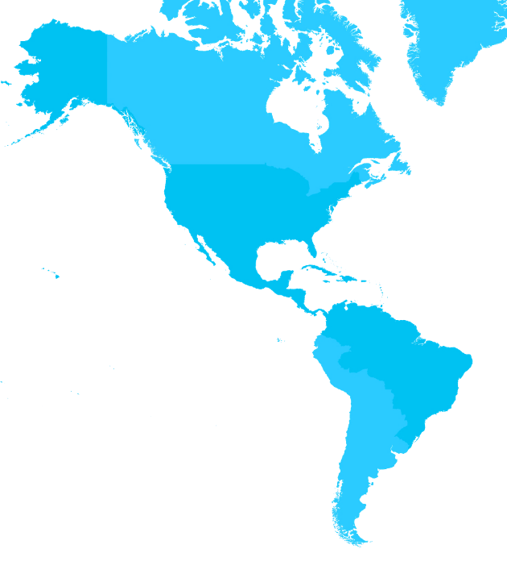
4.2 IOC of UNESCO Subcommission for the Caribbean and Adjacent Regions 20th Meeting of the Meso America – Caribbean Sea Hydrographic Commission. Sto Domingo 2-6 December 2019 Dr Cesar TORO IOC of UNESCO IOCARIBE

Slide 2
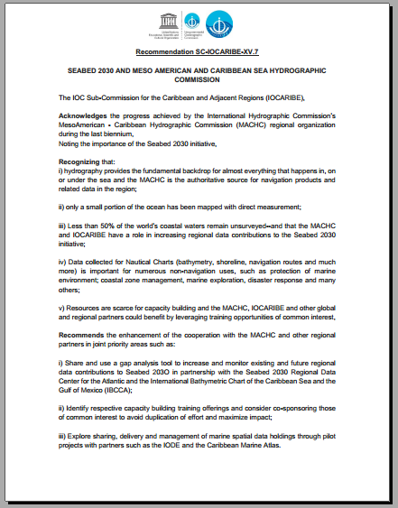
The IOC Sub-Commission for the Caribbean and Adjacent Regions (IOCARIBE) at its Fifteenth Session SC-IOCARIBE-XV in Aruba May 2019 recommended the enhancement of the cooperation with the MACHC in joint priority areas

Slide 3
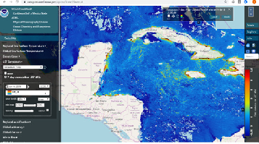
Monitoring and Forecasting of Maritime Hazards
for the Wider Caribbean
Currently, there is a documented lack of reliable long-term marine data resources to support the development of strategies and policies related to sustainable use of the marine environment around Small Island Developing States in the Caribbean and adjacent countries in Latin America. The region is facing many coastal hazards including tsunamis, storm surges, large amounts of Sargassum seaweed beaching on coastlines and frequent unreported oil spills.

Slide 4
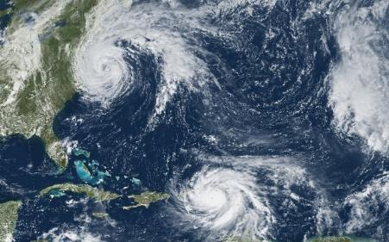
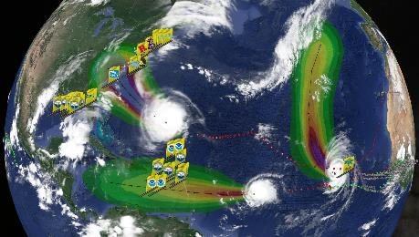
IMPROVEMENT OF HURRICANE OBSERVING FORECASTING CAPACITY
Video removed by the IHO due to space
IOCARIBE GOOS - HURRICANE

Slide 5
Video removed by the IHO due to space
IOCARIBE GOOS - HURRICANE
IMPROVEMENT OF HURRICANE OBSERVING FORECASTING CAPACITY

Slide 6
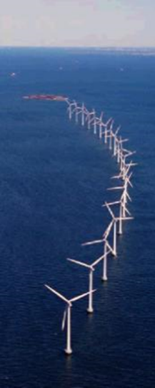
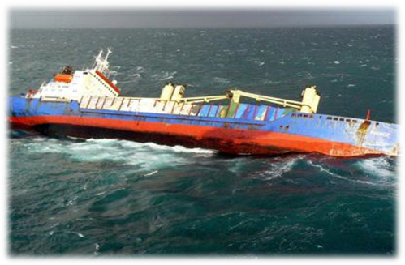
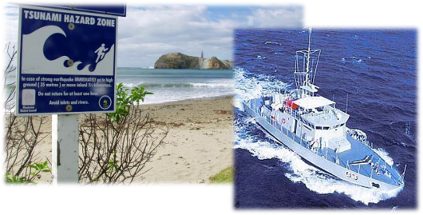
Hydrography provides the fundamental backdrop for almost everything that happens in, on or under the sea and the MACHC is the authoritative source for navigation products and related data in the region.

Slide 7
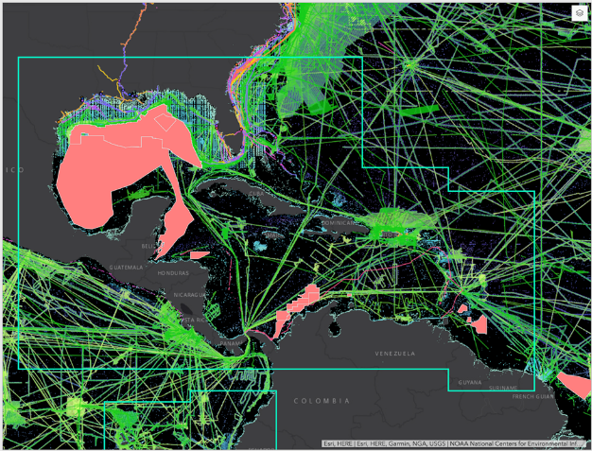
Only a small portion of the ocean has been mapped with direct measurement; About 50% of the world’s coastal waters remain unsurveyed--and that the IOCARIBE and MACHC have a role in increasing regional data contributions to the Seabed 2030 initiative;

Slide 8
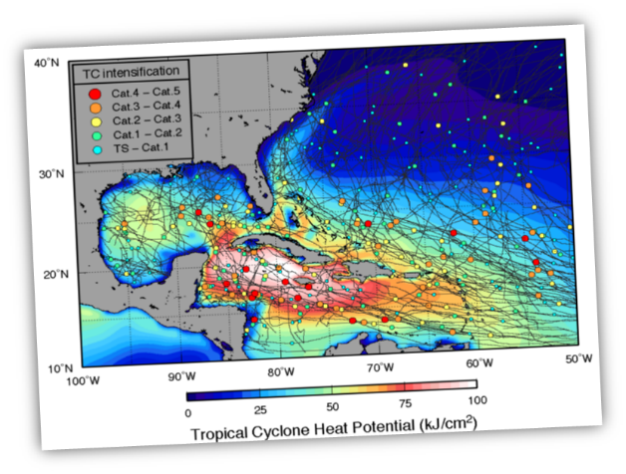
Data collected for Nautical Charts (bathymetry, shoreline, navigation routes and much more) is important for numerous non-navigation uses, such as protection of marine environment; coastal zone management, marine exploration, disaster response and many others.

Slide 9
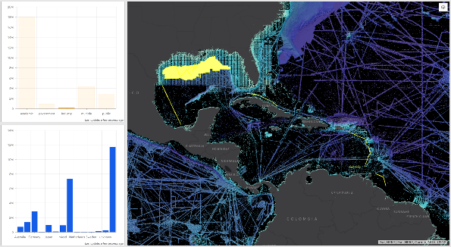
Share and use a gap analysis tool to increase and monitor existing and future regional data contributions to Seabed 203O in partnership with the Seabed 2030 Regional Data Center for the Atlantic and the International Bathymetric Chart of the Caribbean Sea and the Gulf of Mexico (IBCCA);

Slide 10
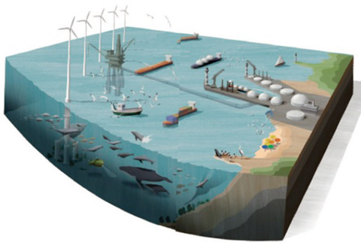
Partnerships - Resources are scarce for capacity building and IOCARIBE, the MACHC, and other global and regional partners could benefit by leveraging training opportunities of common interest. Identify respective capacity building training offerings and consider co-sponsoring those of common interest to avoid duplication of effort and maximize impact; Explore sharing, delivery and management of marine spatial data holdings through pilot projects with partners such as the IODE, Caribbean Marine Atlas, CARIBE-EWS, CIFDP-C, Marine Spatial Planning, IOCARIBE-GOOS

Slide 11
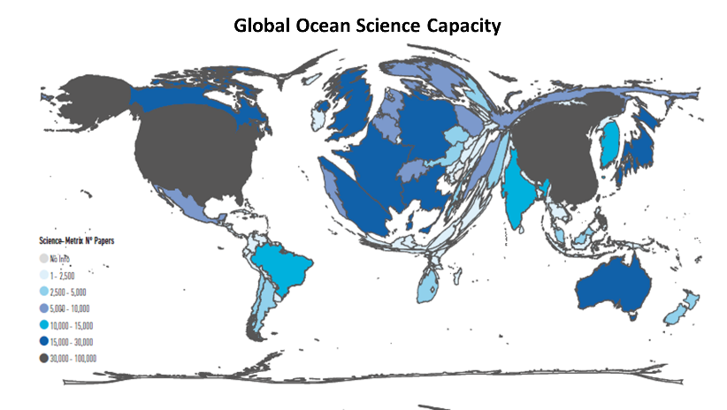
Ocean / Hydrographic Sciences Partnerships for UN Decade SEABED 2030
The UN Decade of Ocean Science for Sustainable Development (2021-2030)

Slide 12
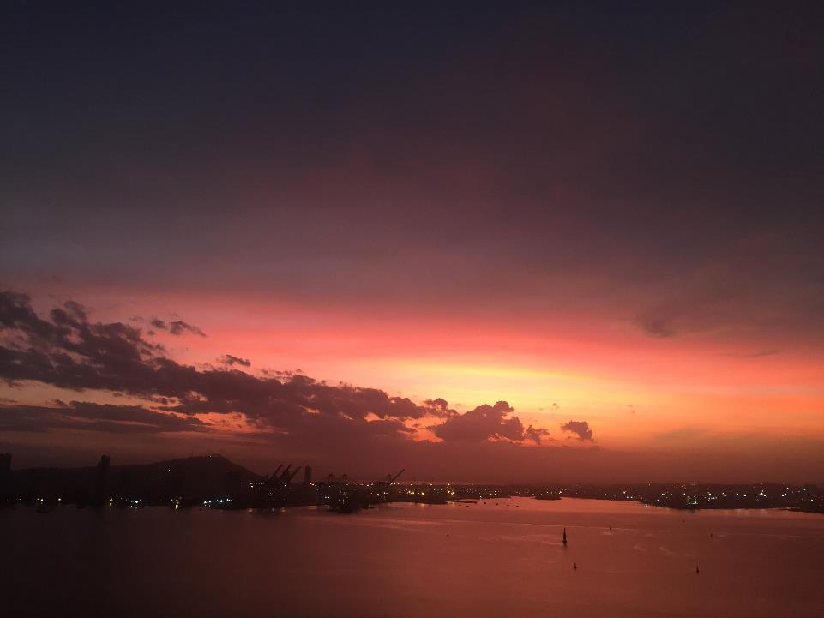
ioc.unesco.org
iocaribe.ioc-unesco.org/
감사합니다!
¡Muchas gracias!
Merci beaucoup!
Thank you!
شُكْرًا
Спасибо
谢谢
Danki

