Slide 1
Building maritime and marine capacity in the Caribbean, for climate-resilient and sustainable development
Ideas for a funding project to be considered by the
Joint IHO-IMO-IOC-WMO-IAEA-IALA-FIG-IMPA
Draft 5 December 2019

Slide 2
Background
The Caribbean is a region of the Americas that consists of the Caribbean Sea, its islands and the surrounding coasts.
Area: 2.754 million km²
Population: 44.42 million (2019)
(Source: Wikipedia)

Slide 3
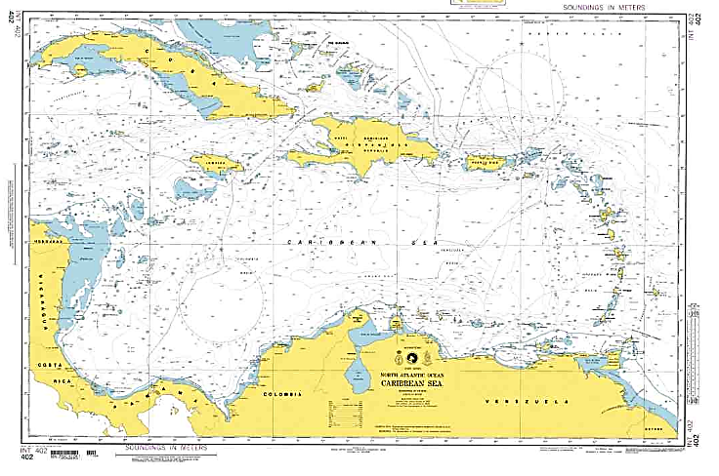

Slide 4
Background
The Caribbean is characterized by a significant maritime trade using the sea as a highway to facilitate the movement of persons and goods among seaside countries within the region.

Slide 5
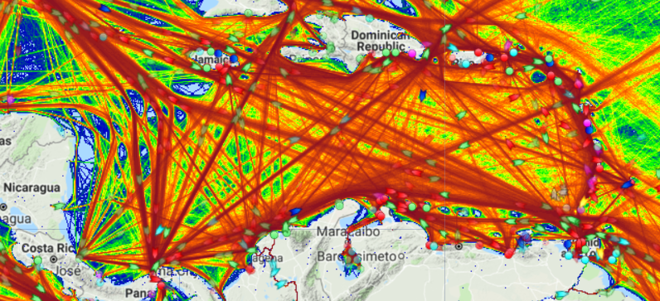

Slide 6
Background
The Caribbean has seen an increase in disasters linked to extreme weather events and climate change, with a significant economic, social, health, cultural and environmental impacts.
The German watch Global Climate Risk Index 2018 (period of 1997 to 2016), several of the countries in the GCR were among the 20 most affected nations in the past 20 years.

Slide 7
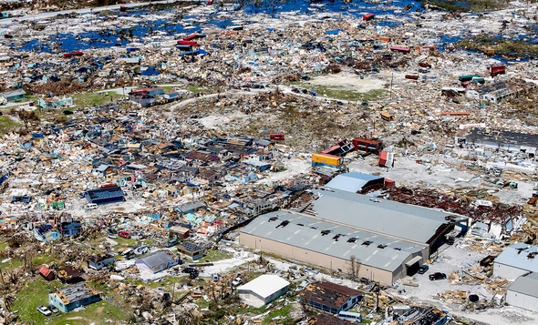
Hurricane Dorian

Slide 8
Maritime Accidents in the Caribbean
58 accidents were reported in the Caribbean in the last 16 years, including:
8 collisions
10 fires or explosions
5 foundered
7 mechanical damages and technical failures
10 groundings

Slide 9
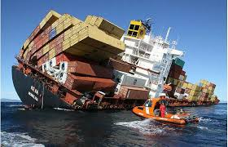
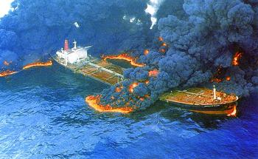
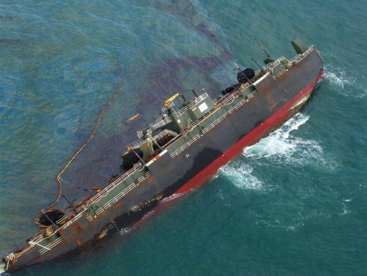
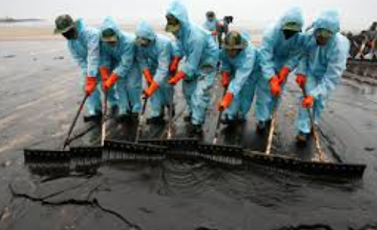
Examples

Slide 10
The Challenge
Build maritime and marine capacity and infrastructures in the Caribbean, for climate-resilient and sustainable development.

Slide 11
The Proposal
1st Step: conduct a risk analysis (heat maps) that will consider:
Navigation accidents
Marine sensitive areas
Economic impact
Human impact
Weather factors

Slide 12
The Proposal
2nd Step: assess the maritime and marine capacity and infrastructures in the Caribbean that can contribute to climate-resilient and sustainable development and to risk mitigation.

Slide 13
The Proposal
3rd Step: build capacity and infrastructures to ensure the protection of the marine environment, the safety of live at sea and at the coast and ensure sustainable development in the Caribbean.

Slide 14
Expected benefits
The expected outcomes will contribute to the monitoring and management of maritime navigation and of weather phenomena by supporting the:
prioritization of resources
reduction of risks
improved protection of the marine environment
expansion of international trade opportunities in a sustainable way

Slide 15
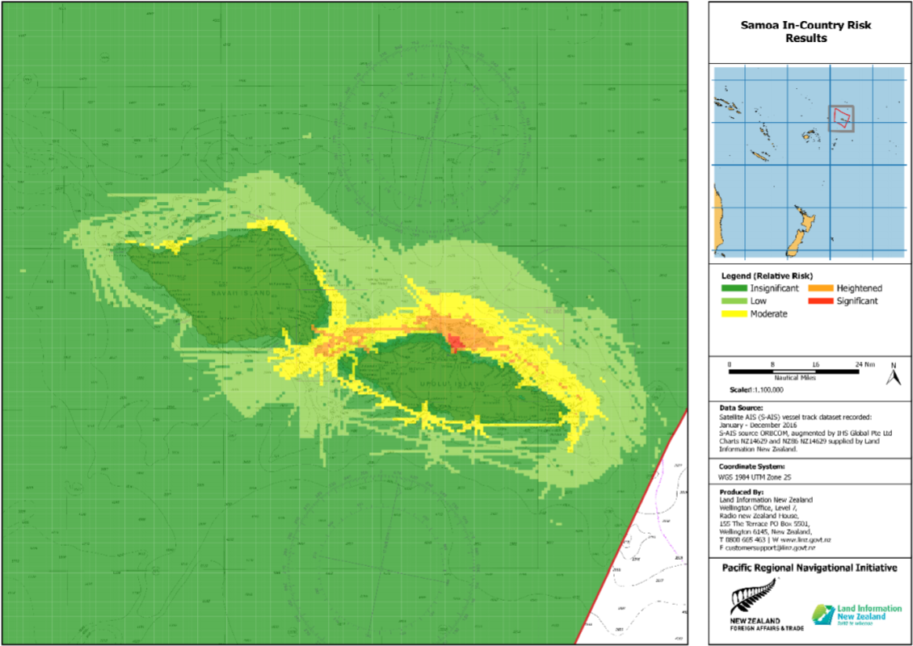
Expected benefits
Simulation of a heat map in the Caribbean

Slide 16
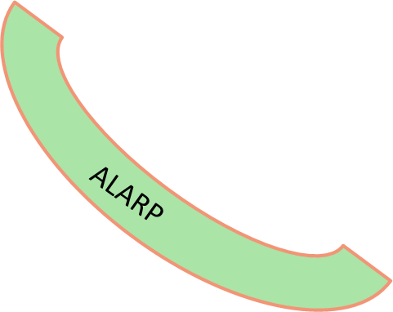
RISK VALUE MATRIX |  | LIKELIHOOD
 |  | Very Rare (1) | Rare (2) | Occasional (3) | Frequent (4) | Very frequent (5)
CONSEQUENCE | Catastrophic (5) | 5 | 10 | 15 | 20 | 25
 | Major (4) | 4 | 8 | 12 | 16 | 20
 | Severe (3) | 3 | 6 | 9 | 12 | 15
 | Minor (2) | 2 | 4 | 6 | 8 | 10
 | Insignificant (1) | 1 | 2 | 3 | 4 | 5
Moderate Risk
Reduce to As Low As Reasonably Practicable (ALARP) level using Risk Control Options.
Source: IALA

Slide 17
Conclusion
The expected outcomes will contribute to the monitoring and management of maritime navigation and of weather phenomena
with the goal of
building maritime and marine capacity and infrastructures in the Caribbean, for climate-resilient and sustainable development.

