Slide 1
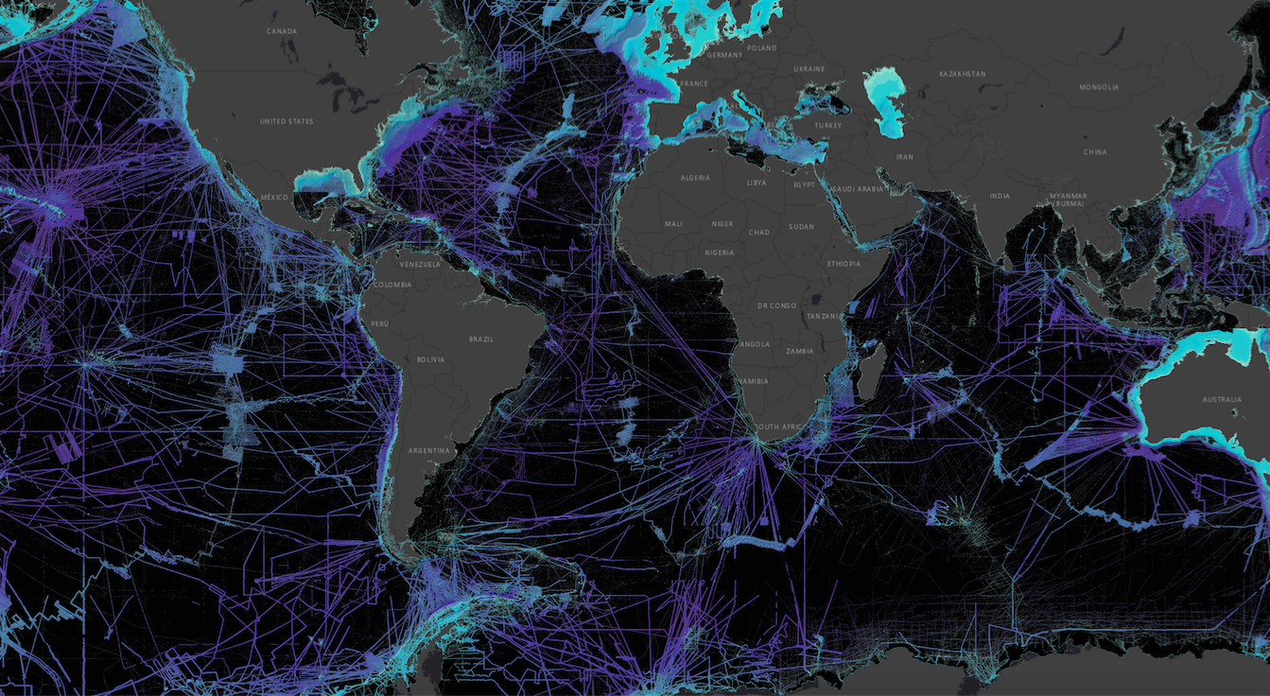
IHO Crowdsourced Bathymetry Initiative
An IHO-led collaborative project to better enable mariners and professionally manned vessels to collect “crowdsourced bathymetry”
bathydata@iho.int

Slide 2
Crowdsourced bathymetry (CSB) is the collection of depth measurements from vessels, using standard navigation instruments, while engaged in routine maritime operations.
Notes:
This is not systematic surveys on hydro ships; any vessel operating that has an interest in collecting and providing that data.
Fugro sometimes presents themselves as collecting CSB...but really, they are collecting mulitibeam data while in transit...we refer to that as Transit Data. It is not CSB by this definition.

Slide 3
The Role of CSB Data:
Valuable data with scientific, commercial & research value at no cost to the public sector
Support national and regional development activities
Fill gaps where data is scarce
Useful along shallow, complex coastlines that are difficult for traditional survey vessels to access and may be more frequently visited by recreational boaters
Identify uncharted features
Assist in verifying charted information
Confirm whether charts are appropriate for the latest traffic patterns.
NOAA’s Bay Hydro II CSB test tracks in green overlaid on multibeam survey data demonstrates how changes can be detected. Image courtesy of NOAA.
...but only if vessels collect and donate depth information while on passage

Slide 4
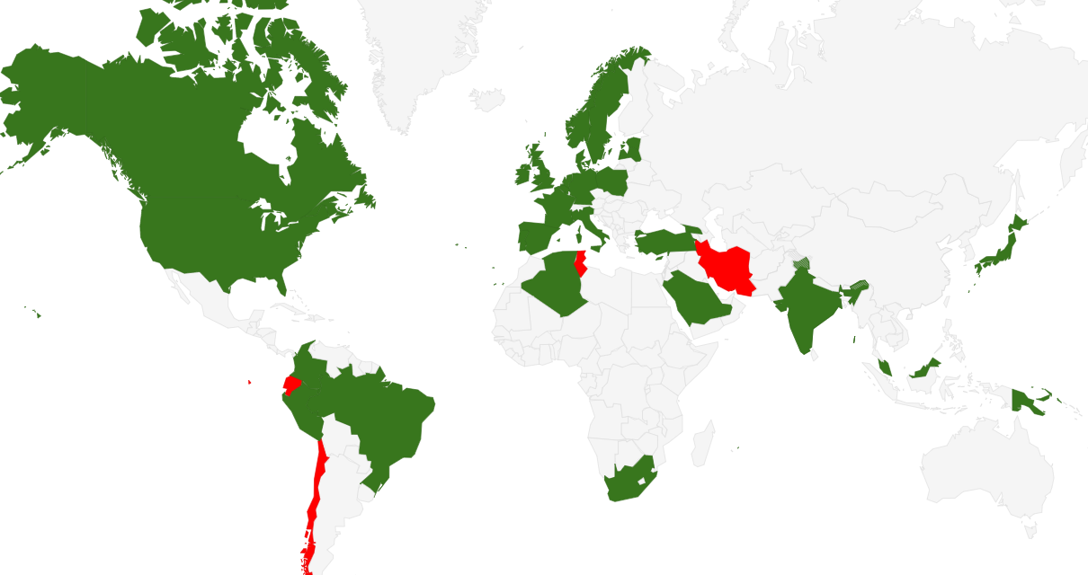
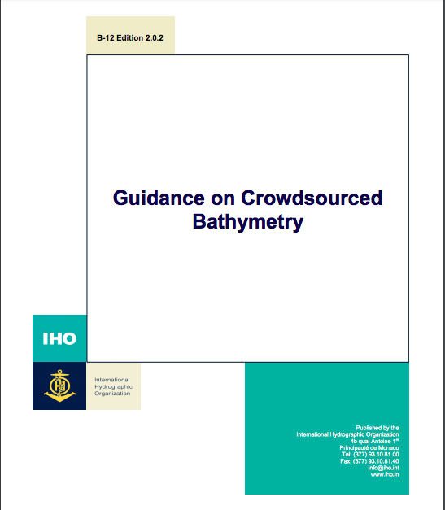
IHO CL 11/2019
https://www.iho.int/iho_pubs/bathy/B_12_Ed2.0.2_2019.pdf
“CALL FOR APPROVAL OF EDITION 2.0.0 OF IHO PUBLICATION B-12”
35 Member States approved the adoption of B-12 out of 38 replies.
Notes:
This document, B-12 IHO Guidance on Crowdsourced Bathymetry, was published earlier this year and is available online.

Slide 5
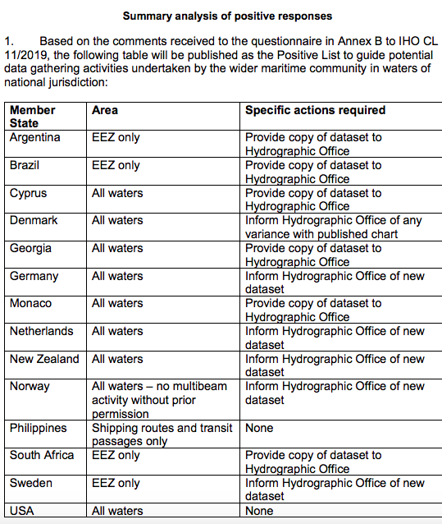
IHO CL 11/2019 Annex B
“ACCEPTANCE OF CROWDSOURCED BATHYMETRY ACTIVITIES IN NATIONAL WATERS OF JURISDICTION”
13 IHO MS have replied “positive”
CL 47/2019 provides a summary analysis of positive responses ==>
The IHO DCDB will filter out CSB data collected from the waters of all coastal countries not included on the positive list. This includes:
MS we believe are pro-CSB but have not replied
Coastal countries that are not IHO MS
Notes:
remove screen grab and give a few more talking points...

Slide 6
IHO Member States:
The IHO encourages member states who have not responded to review Annex B CL 11/2019 and, if possible, offer a positive response before the Assembly.
Note: A MS can include "conditions" or "prerequisites" as needed.
Notes:
Example caveats shown in right hand column

Slide 7
Non-IHO Coastal States:
The IHO encourages all coastal states of the MACHC to provide their position on CSB Activity in their areas of national jurisdiction to the MACHC Seabed 2030 Coordinator as soon as possible.
Note: A Coastal State can include "conditions" or "prerequisites" as needed.
Notes:
tell MACHC Seabed 2030 Coordinator

Slide 8
RHCs should consider designating a SB 2030 representative to:
Liaise with appropriate GEBCO Seabed 2030 Regional Data Assembly and Coordination Centres
Consider traditional hydrographic collection methods as well as others that may apply, including CSB, SDB, scientific data collection, and industry-specific data and serve as a point of contact for other working groups accordingly.
Report the state of regional ocean mapping efforts, including national statistics (according to Reg. Centre data)
Lead regional efforts to coordinate potential data collection opportunities, connecting data providers with the appropriate GEBCO Regional Centres.
Encourage national commitments for data sharing and new data collection.
Develop joint regional campaign mapping plans for areas outside national jurisdiction.
Ensure that efforts to collect data for Seabed 2030 are coordinated within the region
Place a strong emphasis on acknowledging participation from data providers.

Slide 9
ALL states are invited to ask questions and share perspectives during and after the meeting.
Thank you.

