Slide 1
IMO/IHO World-Wide Navigational Warning Service NAVAREA IV / XII
United States

Slide 2
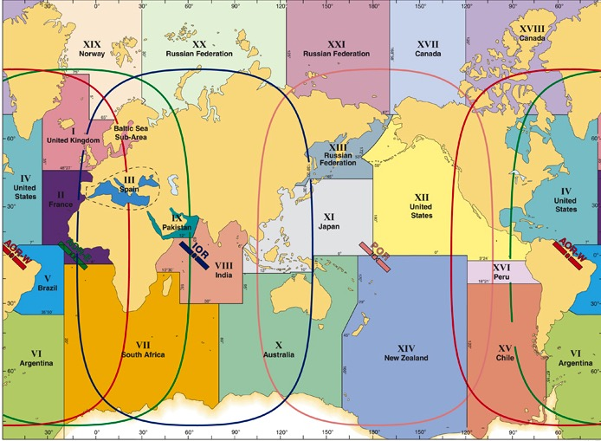
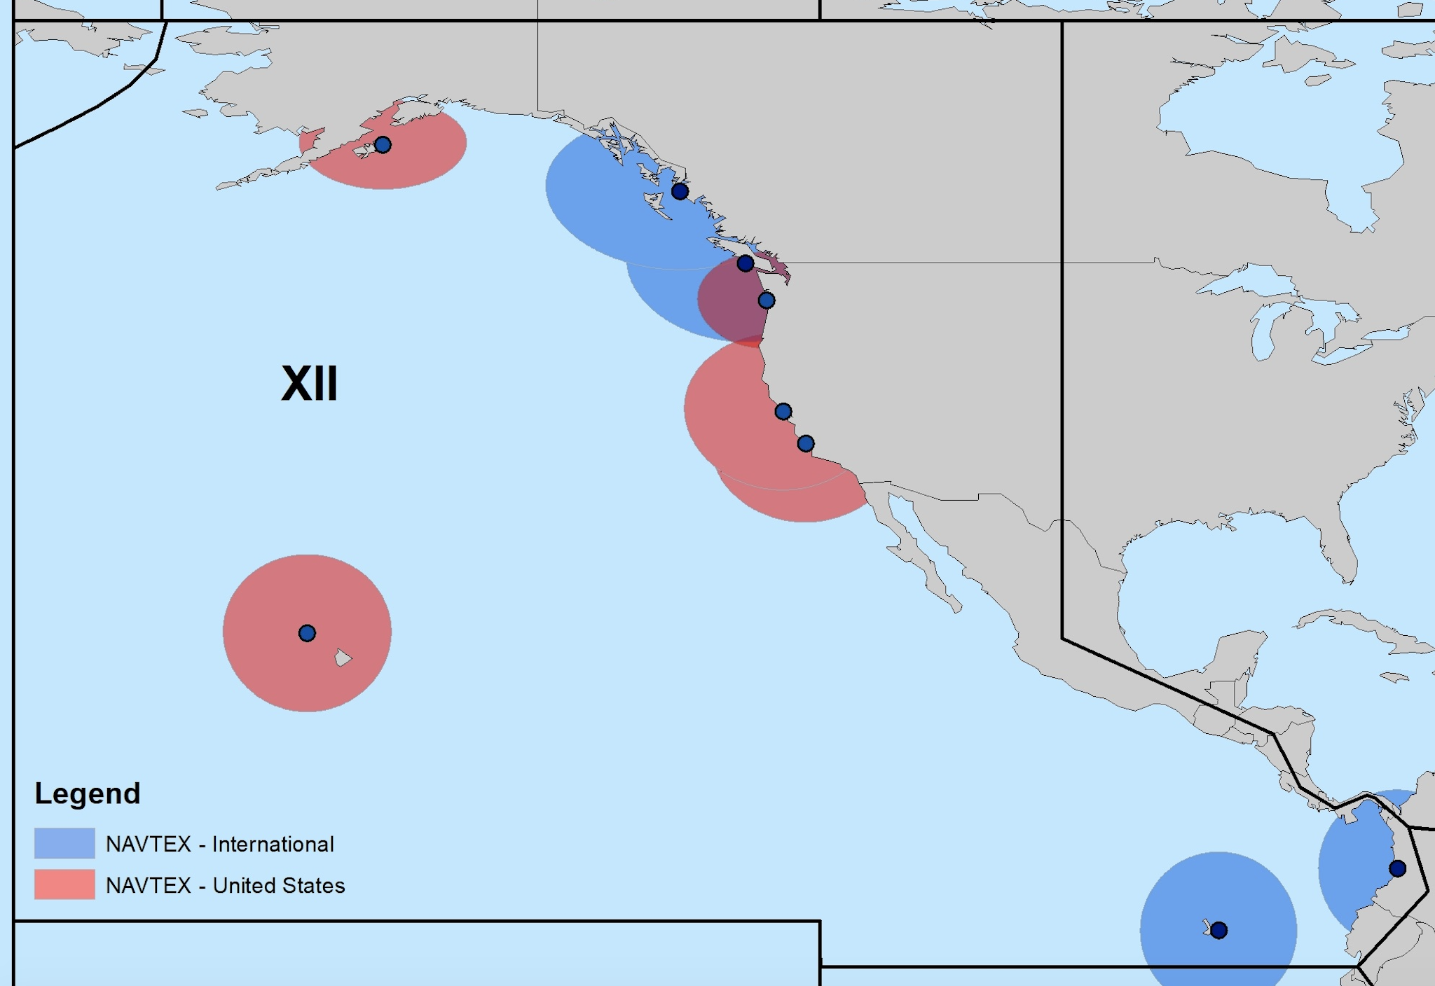
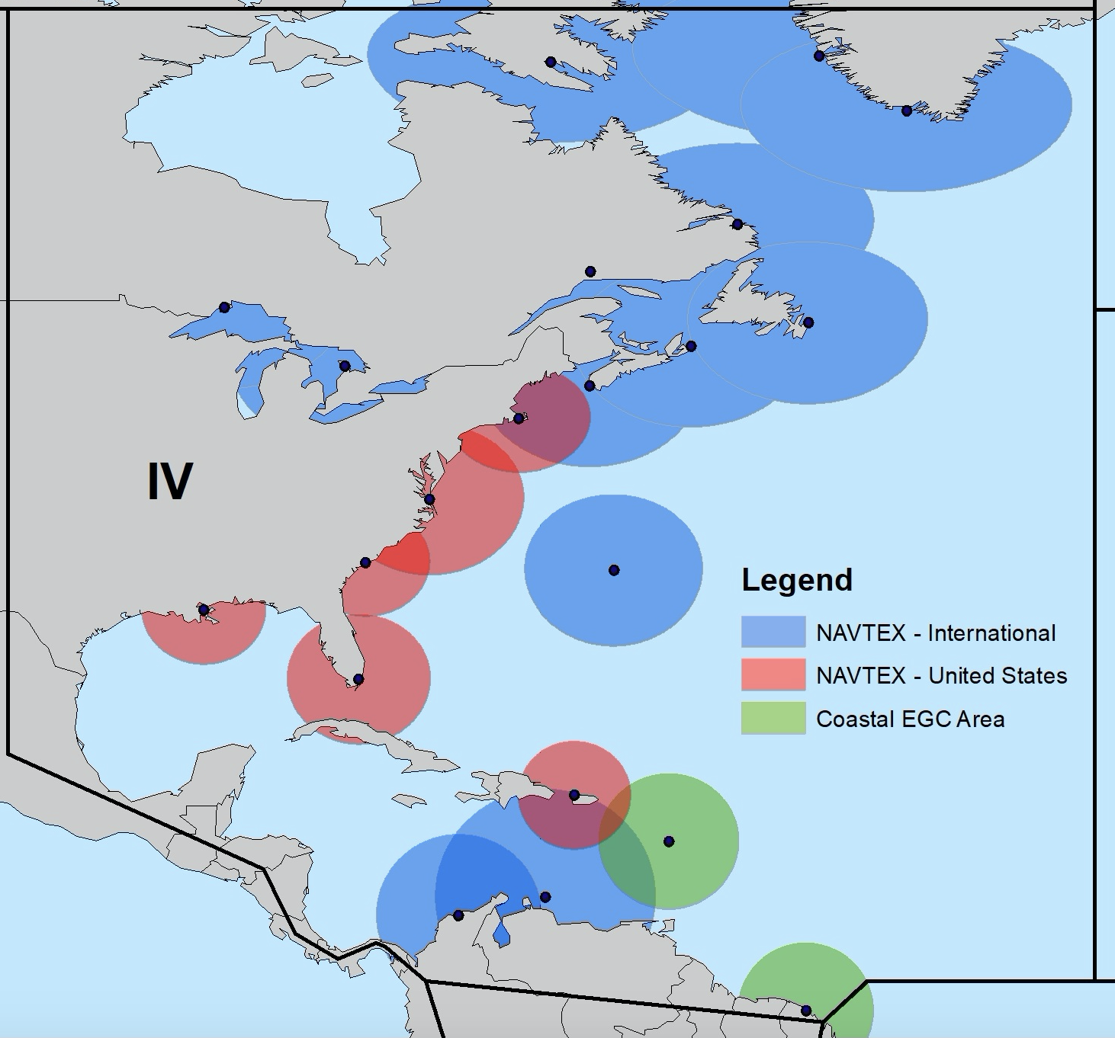
IMO/IHO World-Wide Navigational Warning Service (WWNWS)
Internationally and nationally coordinated service for the promulgation of navigational warnings
IMO Resolution A.706(17) MSC.1 Circ. 1288/Rev.1

Slide 3
MSI Capacity Building – Dominican Republic (2019)
18 participants from 13 countries
11 countries have provided MSI since completing the course—THANK YOU!!!
Ecuador
Guatemala
El Salvador
Monserrat
Anguilla
Belize
BVI
Curaçao
Honduras
Dominican Republic
Cayman Islands

Slide 4
Improved MSI Key Performance Indicator (KPI)
Previously, effectiveness measured by the amount of MSI a country provided
Measurable in most circumstances but not all
Some countries do not have a substantial amount of MSI to issue for its coastline.
In addition to the above, NAVAREA IV/XII will begin to track regular contact with national coordinators to:
Ensure cooperation and communication
Improve the exchange of MSI
Offer support to enhance MSI capacity

Slide 5
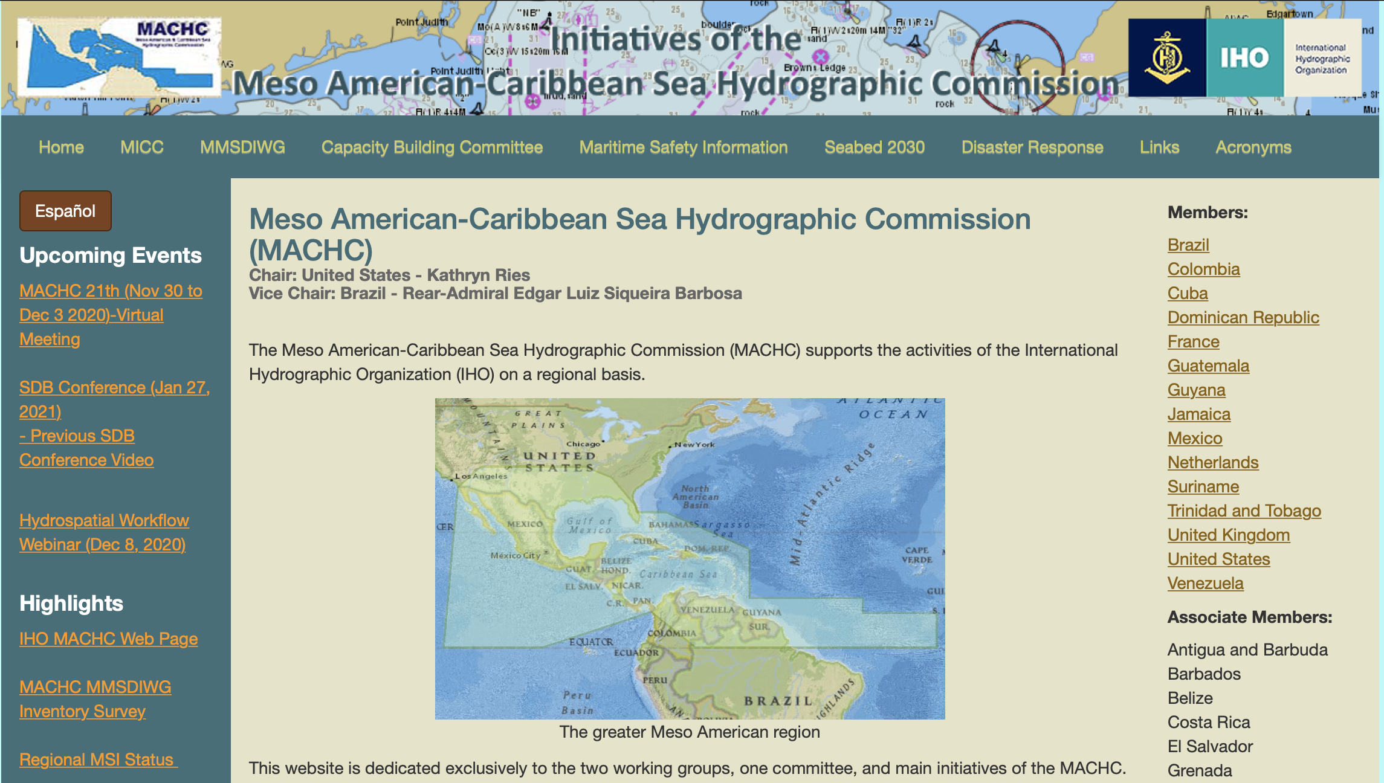
Regional MSI Status on MACHC Website
https://www.iho-machc.org/
White: No training, not providing MSI, no point of contact
NAVAREA IV/XII Contact (24x7):
navsafety@nga.mil
Red: Received training, not providing MSI, no regular coordination with the national coordinator
Green: Fulfilling all obligations, providing regular MSI or regular coordination with the national coordinator

Slide 6
Actions for MACHC National Coordinators
Review the MACHC website to verify your MSI status: https://www.iho-machc.org/msi.html
Review and verify the National Coordinator point of contact for your country: Click Here
Report any changes to navsafety@nga.mil by 1 February 2021.
In 2019, NAVAREA IV/XII received MSI from 50% of National Coordinators
In 2020, NAVAREA IV/XII received MSI from 50% of National Coordinators and confirmed satisfactory coordination with 70%.

Slide 7
IMO/IHO World-Wide Navigational Warning Service (WWNWS)
Thank you for continued support to NAVAREA IV and XII and mariners throughout the MACHC!

