Slide 1
21st Meeting of the Meso America – Caribbean Sea Hydrographic Commission National Report by
Annex D
JAMAICA

Slide 2
Jamaica Hydrography: Organizational Structure
Chief Executive Officer
Land Titles Division
Land Valuation Division
Estate Management Division
Human Resource Managment and Development
Internal Audit
Land Administration and Management Division
Adjudication Services Division
Business Services Division
Corporate Legal Services Division
Corporate Services Division
Surveys and Mapping Division
Information and Comminication Technology Division
Minister of Economic Growth and Job Creation
Notes:
Hydrographic Office – The Hydrographic Office for Jamaica is the National Land Agency of Jamaica. This is an Executive Agency, which since March of 2016 falls under the new Ministry of Economic Growth and Job Creation (EGJC).
Under Surveys & Mapping Division is the Topographic & Hydrographic Branch.

Slide 3
Top achievements during the year (3 maximum)
Mr. Diego Billings completed the academic component Cat. A Ocean Mapping Course at University of New Hampshire
Officers participated in the Seabed 2030 Webinars

Slide 4
Top challenges and/or obstructions (3 maximum) (Such as capacity building gaps)
Repairs to JDFCG vessel delaying hydrographic survey projects but almost complete
Procurement of a dedicated RTK system for hydrographic surveys underway, as National Network RTK is being affected by an unstable and incomplete mobile data coverage.
Improved NHC stakeholder participation needed to support development of hydrographic capacity.

Slide 5
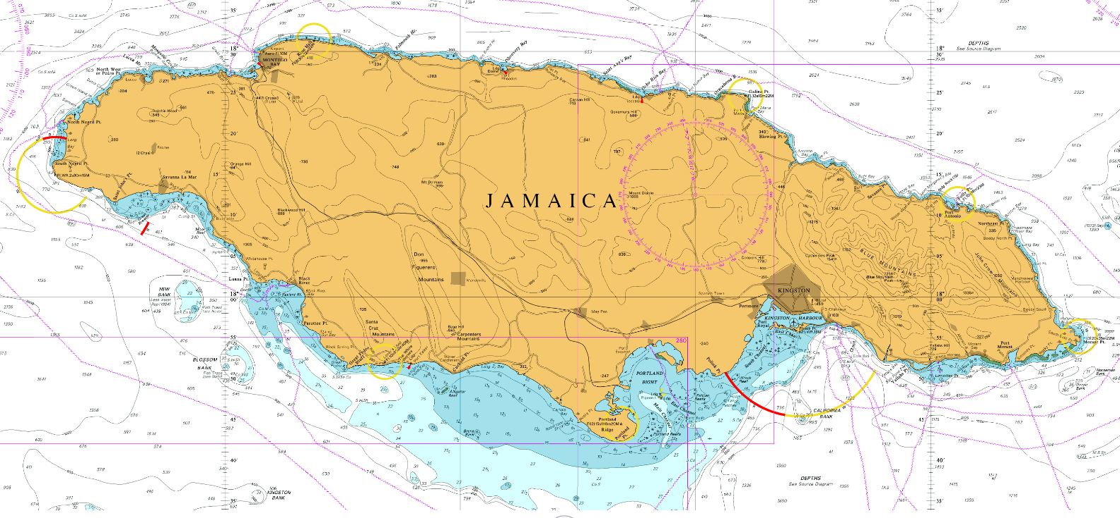
Top Plans that affect the region (3 maximum) Planned surveys
Mosquito Cove as a hurricane shelter for vessels
②
①
Port Morant Harbour, St. Thomas:
Aquaculture
Notes:
A planned survey of the Port Morant Harbour in St Thomas using single beam is pending but weather conditions have been unfavourable.
Both areas have not been surveyed used modern acquisition methods and technology.

Slide 6
End of Presentation
Thank you!
Questions ?

