Slide 1

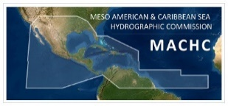
21st Meeting of the
Meso America – Caribbean Sea
Hydrographic Commission
MACHC / IOCARIBE Seabed 2030 Planning Results and Recommendations
Ms. Cecilia Cortina Guzman

Slide 2
MACHC / IOCARIBE Seabed 2030 Planning: Overview of Webinar Series
Webinar 1 - Sept 11: Where are we now? Introduction and Goals including review of current mapping status in the region
Webinar 2 - Sept. 25: How do we build the map? How can you contribute data?
Webinar 3 - Oct. 9: Increasing Data Coverage: Crowdsourced Bathymetry and Data Coverage Polygons
Webinar 4 - Oct. 23: Moving Ahead Together: Summary, Next Steps and Wrap up.

Slide 3
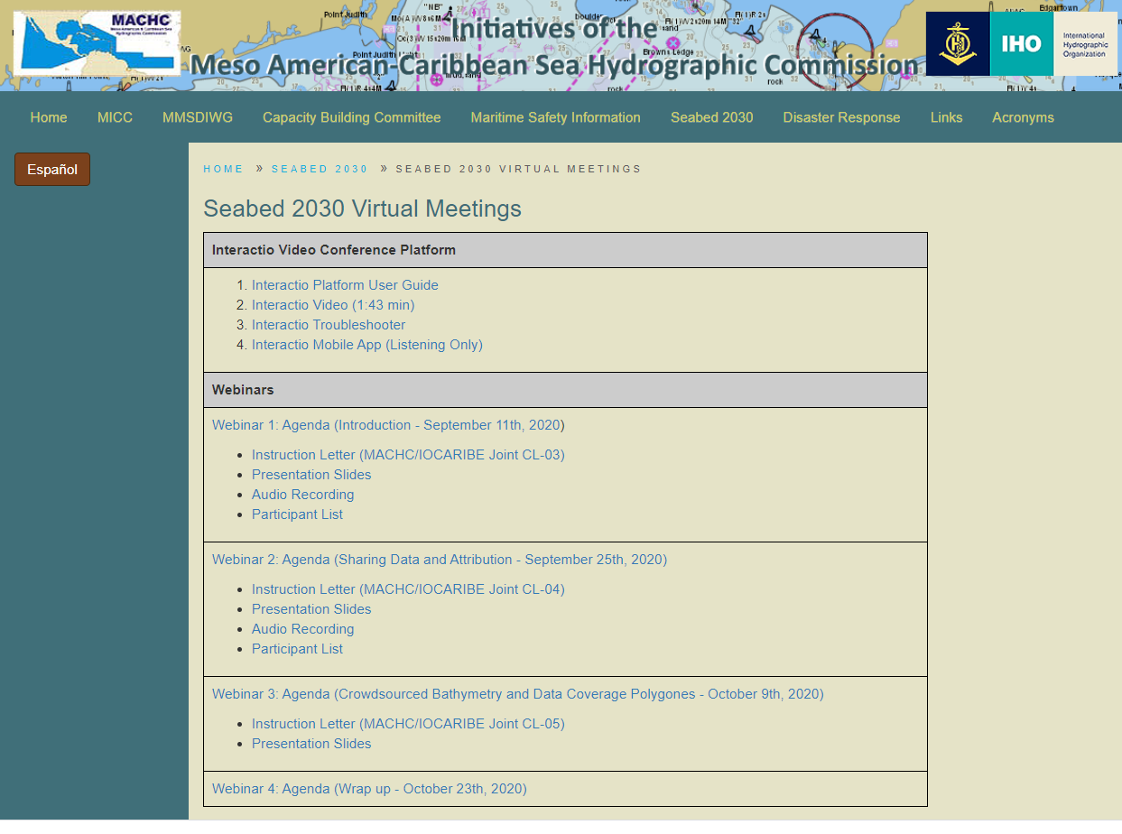
MACHC / IOCARIBE Seabed 2030 Planning: Overview of Webinar Series
https://www.iho-machc.org/documents/seabed2030_doc.html

Slide 4
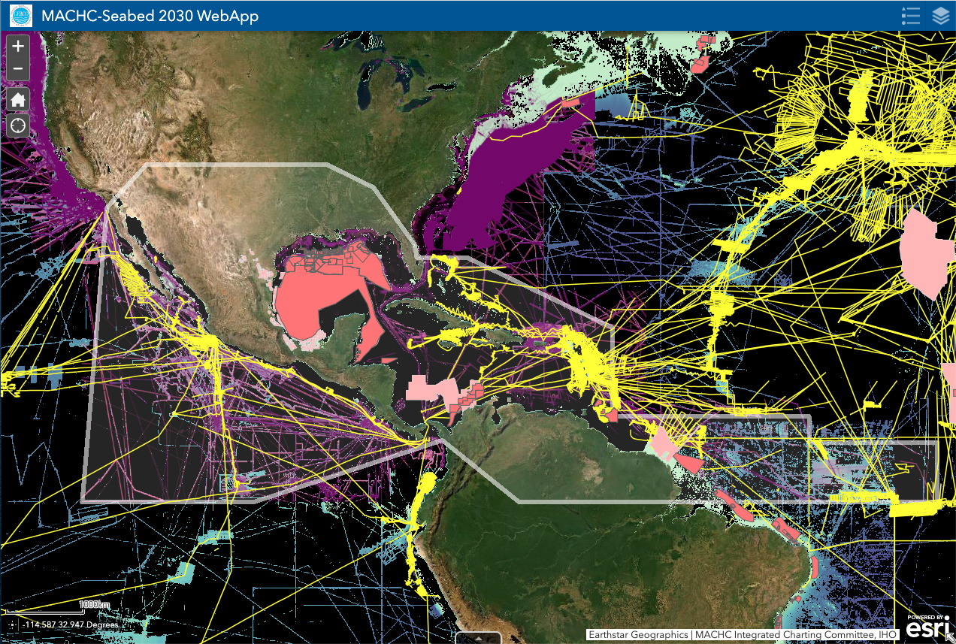
MACHC-IOCARIBE Seabed2030 Planning
Current Mapping Status in the Region
20% of the region has been mapped (based on data in the GEBCO grid)
More data exists that has yet to be shared!
The Webapp tool highlights gaps, existing public and non-public data to help prioritize future efforts to fill them.
http://bit.ly/Seabed2030-MACHC

Slide 5
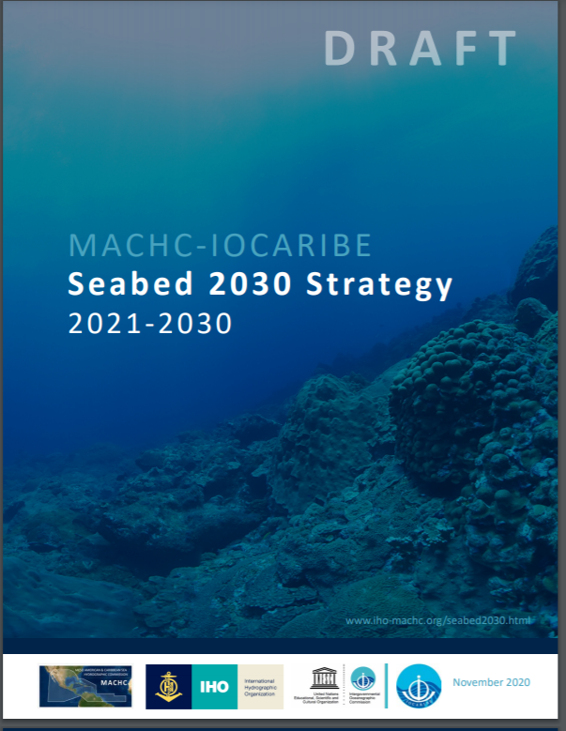
MACHC-IOCARIBE Seabed2030 Strategy Introduction

Slide 6
MACHC-IOCARIBE Seabed2030
Strategy 2021-2030
Vision: A complete baseline seabed map of the MACHC Region by 2030 that informs the sustainable, multi-purpose use of our regional ocean.
Mission: Acquire and share the data necessary to create a complete map of the MACHC Region through multi-sector partnerships and collaboration.

Slide 7
MACHC-IOCARIBE Seabed2030
Strategy 2021-2030
Goal 1: Contribute existing non-public bathymetric data to the IHO DCDB and GEBCO grid.
Goal 2: Increase data coverage
Goal 3: Build Capacity for mapping contributions

Slide 8
MACHC-IOCARIBE Seabed2030 Strategy 2021-2030
Goal 1: Contribute existing non-public bathymetric data to the IHO DCDB and GEBCO grid.
Objective 1.1. Share existing bathymetric data in the MACHC region for inclusion in the GEBCO Grid and long-term preservation and public accessibility via the IHO DCDB.
Objective 1.2. Identify existing non-public bathymetric data and create/share polygons delineating the extent of data coverage for integration into the Seabed 2030 - MACHC Web App.
Objective 1.3. Advise partners to seek access to existing non-public bathymetric data sets that have been acquired and managed by scientific investigators, private industry and public organizations.

Slide 9
MACHC-IOCARIBE Seabed2030 Strategy 2021-2030
Goal 2: Increase Data Coverage
Objective 2.1. Design, implement, and resource coordinated mapping campaigns based on identified data gaps.
Objective 2.2. Encourage the acquisition of mapping data by academic and industry survey vessels during transits through the region to fill gaps in data coverage.
Objective 2.3. Encourage the collection and contribution of crowdsourced bathymetry (CSB) data among volunteer commercial and non-commercial vessels.

Slide 10
MACHC-IOCARIBE Seabed2030 Strategy 2021-2030
Goal 3: Build capacity for mapping contributions
Objective 3.1. Expand and enhance the suite of IHO DCDB and Seabed 2030 RDACC tools available to support and assist data contributors through the packaging and provision of data at any resolution or access level.
Objective 3.2. Simplify data submission workflows and user interfaces for data entry.

Slide 11
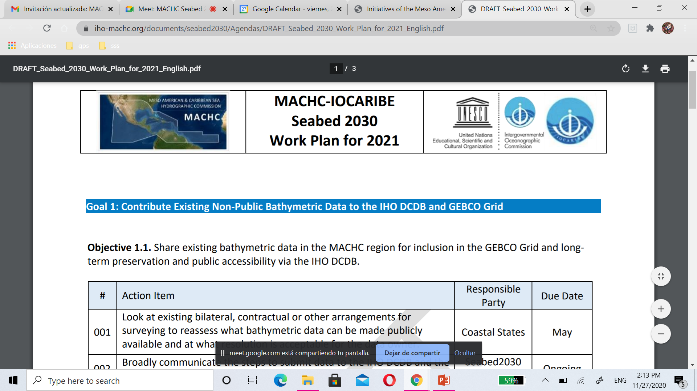
Introduction

Slide 12
MACHC-IOCARIBE Seabed2030 2021 Work Plan Activities
Objective 1.1 Share Existing Bathymetric Data
# | Action Item | Responsible Party | DueDate
001 | Look at existing bilateral, contractual or other arrangements for surveying to reassess what bathymetric data can be made publicly available and at what resolution is acceptable for the data owner. | Coastal States | May 2021
002 | Broadly communicate the steps to submit data to the IHO DCDB and the RDACC. | Seabed2030 Coordinator | Ongoing

Slide 13
MACHC-IOCARIBE Seabed2030 2021 Work Plan Activities
Objective 1.1 Share Existing Bathymetric Data
# | Action Item | Responsible Party | DueDate
003 | Contribute multibeam, single-beam and ENC to the IHO DCDB, wherever possible, for long term archive and data access. | Coastal States | As soon as possible
004 | Contribute national bathymetric data products to the RDACC at the appropriate resolution approved by the national authorities for integration into the GEBCO grid. | Coastal States | As soon as possible

Slide 14
MACHC-IOCARIBE Seabed2030 2021 Work Plan Activities
Objective 1.2 Identify existing non-public bathymetric data and create/share polygons delineating the extent of data coverage for integration into the Seabed 2030 - MACHC Web App
# | Action Item | Responsible Party | DueDate
005 | Assemble information about polygons about existing non-public bathymetric data falling under its remit not yet identified on the MACHC Web App to identify gaps. | Coastal States | As soon as possible

Slide 15
MACHC-IOCARIBE Seabed2030 2021 Work Plan Activities
Objective 1.3. Advise partners to seek access to existing non-public bathymetric data sets acquired and managed by scientific investigators, private industry, and public organizations.
 | Action Item | Responsible Party | DueDate
006 | Identify ways to promote or to support bathymetric data sharing. | Coastal States and Seabed2030 Coordinator | Ongoing

Slide 16
MACHC-IOCARIBE Seabed2030 2021 Work Plan Activities
Objective 2.1. Design, implement, and resource coordinated mapping campaigns
# | Action Item | Responsible Party | DueDate
007 | Assemble information and polygons about upcoming surveys and data acquisition opportunities to better integrate into the WebApp to define data gaps and plan coordinated mapping campaigns. | Coastal States and Seabed2030 Coordinator | As soon as possible
008 | Identify gap areas in the MACHC region without any kind of bathymetric data (distances greater than 1,000 m) providing the polygons to the respective Coastal States. | Seabed2030 Coordinator | March

Slide 17
MACHC-IOCARIBE Seabed2030 2021 Work Plan Activities
Objective 2.2. Encourage the acquisition of mapping data by academic and industry survey vessels during transits through the region to fill gaps in data coverage.
# | Action Item | Responsible Party | DueDate
009 | Explore with national authorities expanded permissions for opportunistic data acquisition via research and survey vessels during transits, consistent with national policy. | Coastal States | Ongoing

Slide 18
MACHC-IOCARIBE Seabed2030 2021 Work Plan Activities
Objective 2.3. Encourage the collection and contribution of crowdsourced bathymetry (CSB) data among volunteer commercial and non-commercial vessels.
# | Action Item | Responsible Party | Due Date
010 | Respond to IRCC CL 1/2020 or IHO CL 21/2020 to allow for the provision of CSB data from ships within waters subject to their national jurisdiction into the public domain, according to national policy. | MACHC Members and Associate Members | As soon as possible
011 | Consider carrying CSB field trials with designated “trusted nodes” (data liaisons) and data collectors (mariners) in the region to provide data to the IHO DCDB. | Interested Coastal States or other regional partners | As soon as possible

Slide 19
MACHC-IOCARIBE Seabed2030 2021 Work Plan Activities
Objective 3.1. Expand and enhance the suite of IHO DCDB and Seabed 2030 RDACC tools available to support and assist data contributors
# | Action Item | Responsible Party | Due Date
012 | Identify technical and other challenges to data collection, assembly and sharing and look for solutions. | Coastal States and Seabed 2030 Coordinator | May

Slide 20
MACHC-IOCARIBE Seabed2030 2021 Work Plan Activities
Objective 3.2. Simplify data submission workflows and user interfaces for data entry.
# | Action Item | Responsible Party | Due Date
013 | Conduct an annual review process to resolve challenges to data collection and sharing. | Seabed2030 Coordinator | MACHC 22
014 | Provide technical support and data submission guidelines for data and accompanying metadata and Type Identifier (TID) information. | Seabed2030 Coordinator | As soon as possible

Slide 21
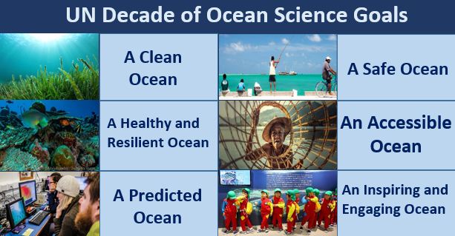
Endorsement of Strategy as regional contribution to the UN Decade on Ocean Science
High-resolution bathymetric map will greatly inform and contribute to the goals, challenges and outcomes of the UN Decade.
IOC Circular Letter 2811: United Nations Decade of Ocean Science for Sustainable Development (2021–2030)
Call for Decade Actions (No. 01/2020)

Slide 22


Endorsement of Strategy as regional contribution to the UN Decade on Ocean Science
  Ocean Decade Challenge 8: Develop a comprehensive digital representation of the ocean through multi-stakeholder collaboration that provides free and open access to explore, discover and visualize past, current and future ocean conditions.

Slide 23
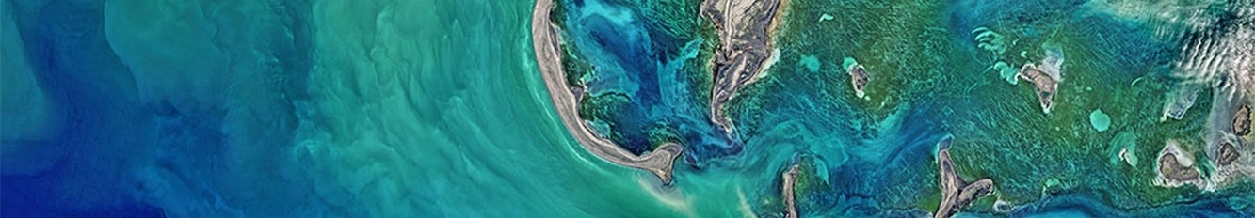
Decade Action Hierarchy
Tangible initiatives that will be implemented by a wide range of Decade stakeholders.
Decade programme
Global or regional in scale
Fulfils one or more of the Decade objectives.
Long-term (multi-year), interdisciplinary and typically multi-national.
Includes component projects, and enabling activities.
Decade Project
Decade Activity
Decade Contribution
Discrete and focused undertaking of a shorter duration.
Will typically contribute to an identified Decade programme
In support of an outcome, objective, programme, or project.
Typically a one-off standalone activity
Can form part of a programme or project or can relate directly to a Decade objective.
Supports the Decade through provision of a necessary resource
Can be either for costs related to the implementation of a Decade Action or for coordination costs.

Slide 24
Endorsement of Decade Actions/First Call by January 15th
Non-UN entities will seek endorsement of Decade Actions
UN entities will register Actions
Proponent responds to a Call for Action
Decade Board or Decade Coordination Unit reviews proposed Action
Proponents of endorsed Action provides simple annual report on implementation via online system
UN entity develops Decade Action that aligns with Implementation Plan
UN entity registers Decade Action with Decade Coordination Unit using online template
UN entity provides simple annual report on Action implementation via online system

Slide 25
Actions requested at MACHC Plenary:
Note this report
Approve the MACHC- IOCARIBE Seabed 2030 Strategy
Approve the 2021 Workplan
(3a. IOCARIBE Member approval then expected by December 30th)
4. Approve IOCARIBE submission of the Strategy by January 15th, to be considered for endorsement as a UN Decade Programme

Slide 26
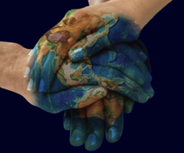
Thank you!!!

