Slide 1
S-101
S-57 to S-101 : Conversion and production scheme
Notes:
First inputs from Shom about conversion of S-57 ENCs to S-101

Slide 2
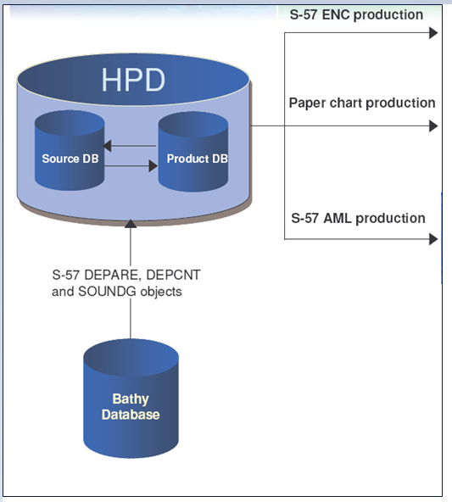
CURRENT Situation and goals
Shom goals for 2024 are :
to convert Shom ENC portfolio in S-57 (around 850 ENC cells) to S-101
to produce data directly in S-101 (stored in HPD database)
to let PRIMAR convert ENC cells to S-57 during the “Dual fuel” period (see last PAC meeting)
Current situation :
- Cartographic, hydrographic and products data are stored in a S-57 database (Caris) :
All cartographic products are derived from this database :
ENC : ER and new edition
Paper Charts: publication , new edition , block correction and Ntm
Nautical products : List of Lights and fog Signals

Slide 3
Issues
Decide conversion rules for objects and attributes that do not have a direct equivalent in both norms
principal issue in conversion between S-57 and S-101
Prepare Roadmap detailing the transition process:
Develop a scenario to go from Databases and products in S-57 to Databases and products in S-101
List steps and millstones required to follow this scenario (test and select the best tools for operations: conversion, controls…
Establish procedure for databases and/or ENC conversions
Set up Production line of S-101 ENC
Define production workflow for new cells and ER
Detail tests and validation process
Establish process for transmission to PRIMAR (datasets transmission, signature, encryption process)
Adapt the production process for paper charts to produce the charts from the S-101 database
Establish organization during and after « dual fuel period »

Slide 4
Ressources
A four people experimentation team to work on the subject of S-101 and on adjustments of production processes
TOOLS :
Contract with GEOMOD (https://www.geomod.fr/en/home/) to :
develop tools to check conversion process and review conversion rules by converting back S-101 ENC to S-57 and comparing with original S-57 ENC
ensure conversion effectiveness in order to automate the conversion process as much as possible
develop a S-100 multi-layers viewer (S-101, S-102, S-104 and S-111)
develop tools to populate S-57/S101 attributes in order to improve the display on the ECDIS (SCAMIN and Text-Placement feature)
Notes:
S-101 : ENC
S-102 : MNT
S-104 : WL
S-111 : surface currents

Slide 5
ConverterS testing
Benchmark of 5 converters:
CARIS
ESRI
Dkart
7Cs (test in progress)
GEOMOD
Resulting S-101 products visualized with the converters and in the NIWC S100Viewer
Comparison between conversion results made using the tools developed by GEOMOD
S-57
Converter software
S-101
GEOMOD Tools
dump files (.xml)
Comparison export
…
Notes:
Shom is interested to test other converters

Slide 6
Converters testS
First results
Objects or attributes with a direct equivalent in S-101 are in most cases correctly converted
Some converters allow rules to be customized (rules in a xml file)
Some converters also allow back conversion from S-101 to S-57
Some converted cells cannot be opened by the S100viewer, maybe due to topological or S-101 encoding issues
Some converters do not keep the FOID when converting objects which make the comparison between different versions of the same cell difficult
ER conversion is not possible right now
Work in progress until 2022 :
Improvement of Geomod test software
Test of converters software new versions or other converters
Work on customized conversion rules

Slide 7
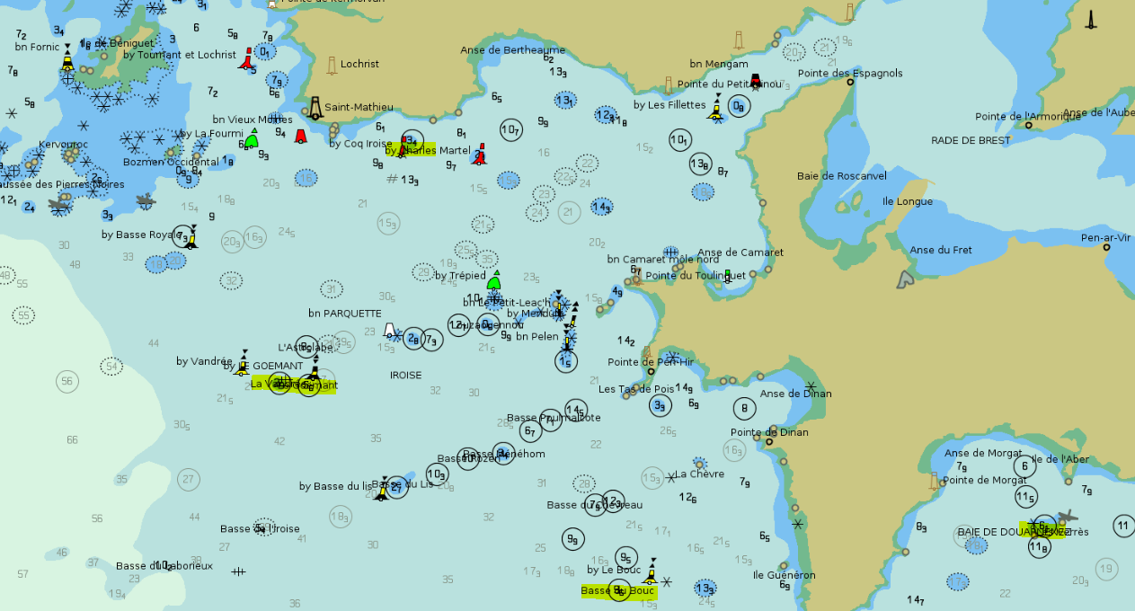
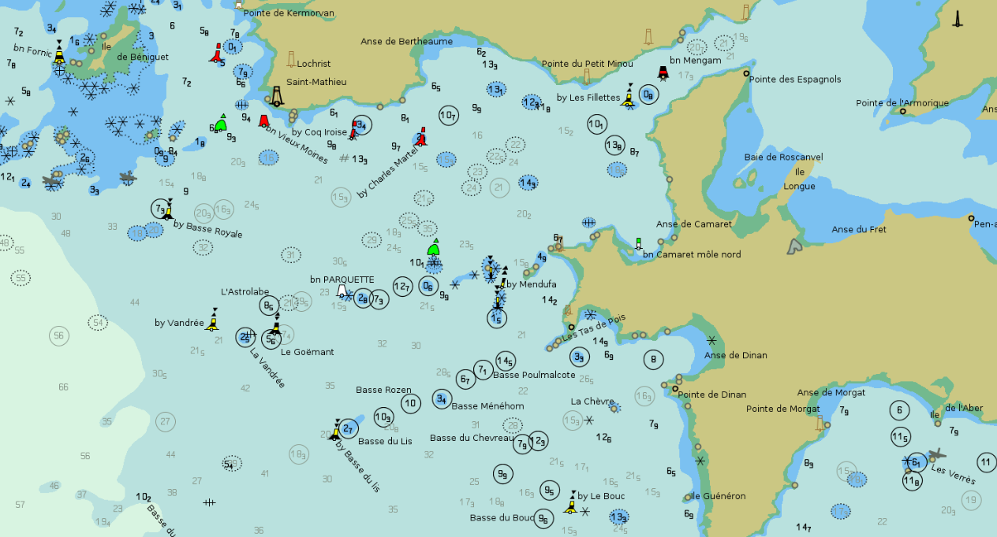
Use S-101 possibilities
Text-Placement feature
Attributes :
- Text type
- Flip bearing
- Text justification
Helps to improve clutter
At the moment, only between objects with point primitive

