Slide 1
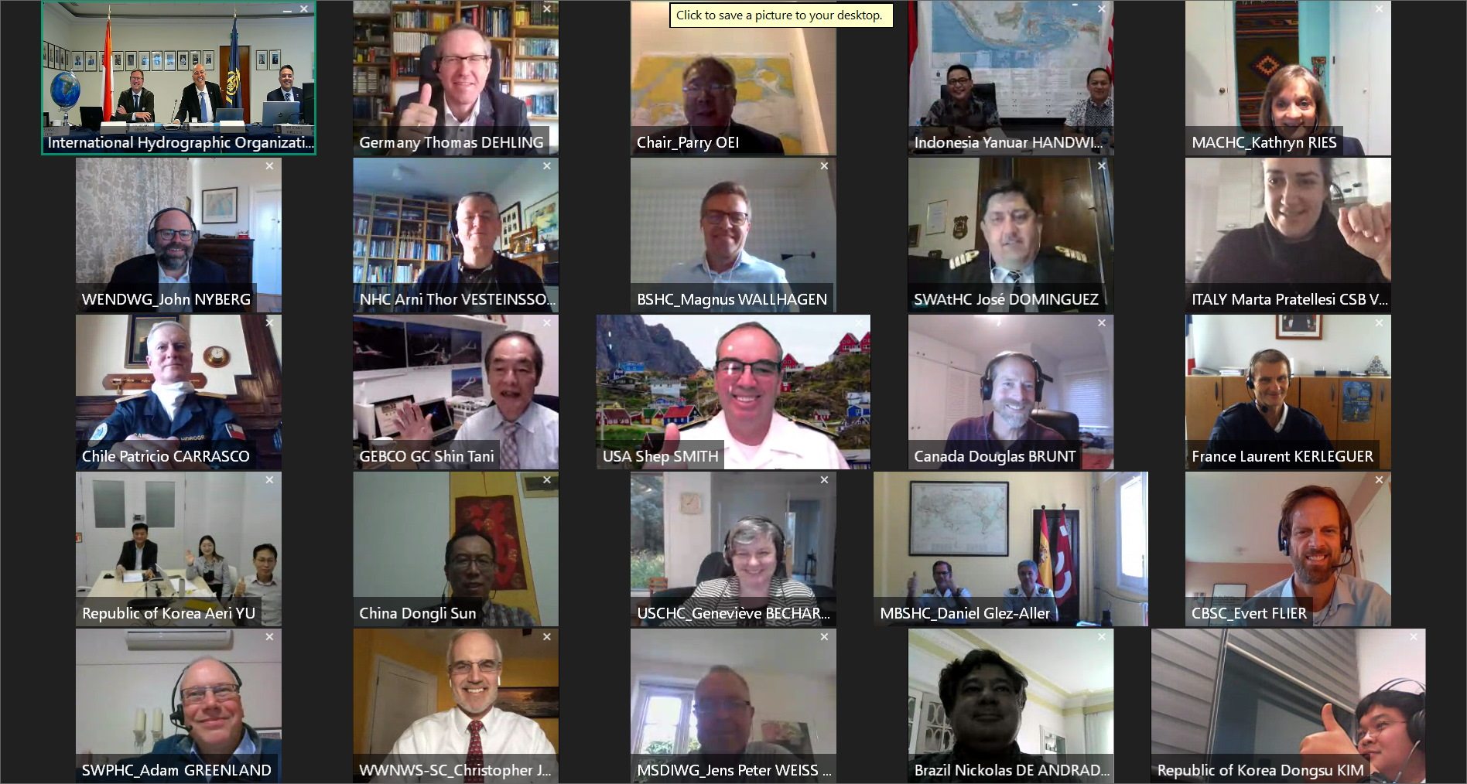
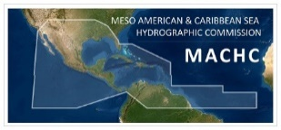
12th MEETING OF THE IHO INTER-REGIONAL COORDINATION COMMITTEE
VTC, 6-7 October 2020

Slide 2
MACHC Representation
IRCC Meeting:
IRCC 11 was held via VTC, on 6-7 October, 2020
IRCC 13 to be held in Monaco, 22-24 June 2021
MACHC Representation: Chair (USA)
Other MACHC Member States attending included:
Brazil
France
United Kingdom
United States of America
MACHC Report to IRCC12 distributed via MACHC CL 06/2020

Slide 3
IRCC Agenda Highlights
HSSC Report
Summary of RHC reports
Capacity Building, IHO Education Requirements and E-learning
-New E-learning Center proposed by the RoK
-New Initiative for Empowering Women in Hydrography
MSDI and GGIM Marine Spatial Data Working Group
Ocean Mapping Activities, including Crowd Source Bathymetry
-Update on the Seabed 2030 Project
-UN Decade on Ocean Science
Notes:
-HSSC report to be covered in the next presentation
-RHC Summary—notable, but not surprising is the impact of the pandemic on MS in the regional conferences and WG meetings and especially on the training activities. Value of increased collaboration across RHCs and regional partnerships SB2030, NSDI and others was noted
-CB: Two important new proposals were presented and adopted not only at the IRCC, but subsequently at the A-2. 1) The RoK has generously offered to establish an e-learning Center in order to address some of the constaints imposed by the pandemic and also to optimize limited resources. MS with experience in developing and providing e-learning content are invited to actively share their resources and experience. A project team has been established to develop the framework for the new center 2) Canada presented their proposal designed to Empower Women in Hydrography, to address the large imbalance of the participation of Women in maritime domains such as Hydrography. We will hear more about this important initiative under Agenda Item 5 on CB
-MSDI: The group is working on better alignment and integration of its work with UN Integrated Geospatial Information Framework (IGIF--guides countries in the development and management of their geospatial information resources--), the Open Geospatial Consortium (OGC-- an international voluntary consensus standards organization, other UN-GGIM structures/publications) and working with the UN Working Group on Marine Geospatial Information which strives to ensure that marine geospatial data is recognized as an equally important component to the land based data. how MSDI can contribute to the UN Sustainable Development Goals. The group is also focusing on data security and integrity.
CSB: The Chair emphasized the importance of raising the awareness of CSB within RHCs. The Seabed 2030 project is funding CSB regional pilot programs and ours is one of the regions being considered as one of them. The RHCs have all been asked to designate Seabed 2030 Coordinators (which we already have with Cecilia Guzman) but to expand that title and responsibility to include CSB coordination. The MACHC has already begun to do advance Seabed 2030 and CSB activities through the pre-Conference Seabed 2030 webinar series and in the Strategy and work plan developed that will be presented later in the conference.
-SB 2030: a collaborative project between the Nippon Foundation and GEBCO to inspire the complete mapping of the world’s ocean by 2030 and to compile all bathymetric data into the freely available GEBCO Ocean Map.
-UN Decade on Ocean Science: Already covered by IHO Director Luigi Sinapi
-

Slide 4
IRCC12 Actions assigned to RHCs
IRCC 12 Actions assigned to RHCs A total of 13 IRCC Actions asssigned to MACHC
Type or Focus of Actions
IRCC Actions pertaining to Seabed 2030/CSB | 5 | In progress via MACHC Seabed2030 Strategy (IRCC 12/13,14,16,17 and 20)
IRCC Action pertaining to MMSDI | 1 | Addessed by MACHC MSDI WG (IRCC12/11)
Actions already completed or already a MACHC Continuous Action | 3 | One already done (CSB and Seabed 2030) (IRCC12/3, 12, 19)
Proposed new MACHC Actions | 4 | To be added to the MACHC21 Action List (IRCC 12/1, 2, 4 and 6)
Totals | 13

Slide 5
IRCC12 Actions assigned to RHCs
Reference | Action | Responsible party | Due date | Status
IRCC 12/1 | RHC to Instruct MS in the divulgation of publication of S-67 Mariners’ Guide to Accuracy of Depth Information in Electronic Navigational Charts (ENC) to the Marine Institutions and Education Schools. | MACHC Chair | IRCC 13 | Will be new MACHC21 Action
IRCC 12/2 | Member States to review the paper on the Future of paper Charts and provide feedback on it. | MACHC Member States | IRCC 13 | Will be new MACHC21 Action
IRCC 12/3 MACHC (17.2.1.4) | Member States strongly encouraged to continue updating C-55. | MACHC Member States | IRCC 13 | Continuous MACHC Action 17.2.1.4
IRCC 12/4 | RHC to implement the IHO Resolution 2/1997 as amended by A-2 . | MACHC Chair | IRCC 13 | Partly implemented by MACHC
Notes:
IRCC Action 12/4: The MACHC Statutes are unaffected by the adoption at A-2 of Res 2/1997. The only action MACHC needs to undertake is to replace Annex 1 of the Statutes -- which actually is Res 2/1997. In fact the template used for this year’s National Reports is the one provided in the amended Res 2/1997.

Slide 6
IRCC12 Actions assigned to RHCs (cont’d)
Reference | Action | Responsible party | Due date | Status
IRCC 12/6 | Invite the Member States who have experience in developing and providing e-Learning contents to share their resources and experiences to the e-Learning Project Team. | MACHC Chair | IRCC 13 | Will be new MACHC21 Action
IRCC 12/11 | Promote the discussion of any item with relevance to SDI/MSDI/MSP and to take appropriate actions. | MACHC Chair | IRCC 13 | Addressed by MACHC MSDI WG
IRCC 12/12 | Consider CSB and Seabed 2030 initiatives be permanently added as an agenda item at future RHC meetings. | MACHC Chair and Member States | IRCC 13 | Already done for MACHC21

Slide 7
IRCC12 Actions assigned to RHCs (cont’d)
Reference | Action | Responsible party | Due date | Status
IRCC 12/13 | Encourage Member States to support the CSB initiative with positive actions, such as requiring all research vessels to collect bathymetric data for late uploading, when on passage or when it does not interfere with other research activities. | MACHC Chair and Seabed 2030 Coordinator | IRCC 13 | In progress via proposed Seabed2030 Strategy and WP
IRCC 12/14 | Support the modification of the current “RHC Seabed 2030 Coordinator” to a joint “RHC CSB/Seabed 2030 Coordinator” and provide the identification of the Coordinators | MACHC Member States | IRCC 13 | To be discussed as part of Seabed2030 agenda item
IRCC 12/16 (MACHC 20.6.4.1) | Encourage MS to release datasets or subsets into the public domain via the IHO DCDB. | MACHC Chair, Seabed 2030 Coordinator and Member States | IRCC 13 | Continuous MACHC Action 20.6.4.1 and part of Seabed2030 Strategy & WP

Slide 8
IRCC12 Actions assigned to RHCs (cont’d)
Reference | Action | Responsible party | Due date | Status
IRCC 12/17 | Encourage Member States to promote the vital need to map the entire seabed. | MACHC Chair, Seabed 2030 Coordinator & Member States | Continuous | In progress via Seabed2030 Strategy
IRCC 12/19 (MACHC 20.6.4.1) | Encourage all Member States to make existing seabed mapping data available for use by Seabed 2030 in the GEBCO Grid. | MACHC Chair, Seabed 2030 Coordinator & Member States | Continuous | Continuous MACHC Action 20.6.4.1
IRCC 12/20 | RHC to participate at Regional level in those actions of the UN Ocean Decade matching with IHO´s new strategic targets (IRCC12-08C) | MACHC Chair, Seabed 2030 Coordinator & Member States | IRCC 13 | In progress via Seabed2030 Strategy

Slide 9
IRCC Recommendations (22) for MACHC- all either completed or are in progress. Examples:
RHC to continue with the provision of intensive Capacity Building activities (i.e. courses, technical and high level visits, workshops) and also to actively seek Capacity Building partnerships.
RHC to promote the enlargement of the regional membership assisting in the recruitment of new IHO Member States.
RHC MS to consider participating in the Empowering Women in Hydrography project.
RHC to develop a Disaster Response Framework on the MACHC Initiative Website: (https://www.iho-machc.org/documents/dr_doc.html)
Member States to promote bilateral discussions regarding the ENC overlapping issues.
Notes:
MACHC has a very active Capacity Building program and the new CB plan for 2021-2023 has been developed with regional partners.
MACHC continues to encourage Associate Members to become Full IHO members—we welcomed Guyana just last year
MACHC 21 is introducing this initiative now
MACHC Initiatives website provides information on senior and working level POCs for disaster response and complete country/industry/regional disaster response capability and resource templates.
MACHC MS engaged in addressing ENC overlap issues through the MICC.

