Slide 1
23rd Conference of the Meso American - Caribbean Sea Hydrographic Commission National Report by
United States of America

Slide 2
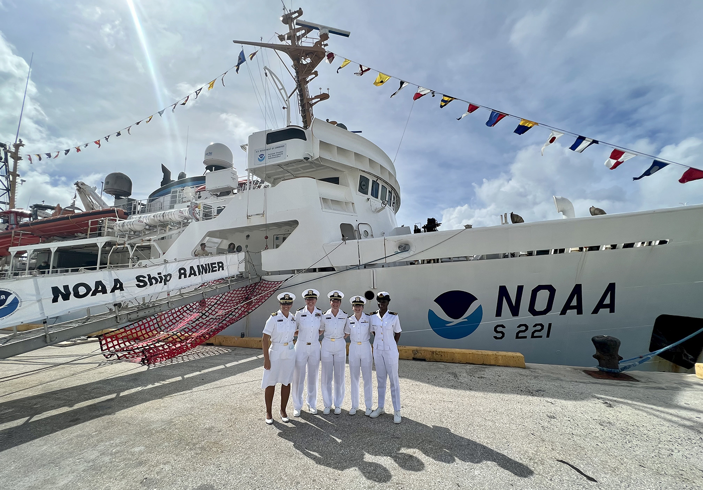
Top Achievements during the year (3 maximum)
Navy accomplished cooperative survey operations with a partner nation.
NOAA successfully hosted three women aboard NOAA ships during the 2022 survey season, including a candidate from Suriname. This supports the IHO’s Empowering Women in Hydrography Project.
NGA developed the Certified Printed ENC (CPENC) product to replace the traditional Standard Nautical Chart (SNC) in order to better align the hard copy product to the current ENC.
Sub-lieutenant Ogungbamila (Nigeria) with NOAA Ship Rainier in the Marianas Islands
Notes:
2. During the 2022 survey season, NOAA supported the IHO’s Empowering Women in Hydrography initiative by hosting three women aboard NOAA ships for a hands-on experience. Three candidates were supported, hailing from Nigeria, Japan and Suriname. This support is expected to continue throughout the 2023 and 2024 survey seasons.

Slide 3
Top Challenges and/or Obstructions (3 maximum)
Navy has seen significantly reduced funding (tied to global priorities) to support future joint/collaborative surveys and/or subject matter expert engagements.
General global workforce challenges as a result of COVID-19 persist.
NGA is transitioning the Notice to Mariner (NTM) workforce from the traditional textual NTM process to support digital production processes like ENC / CPENC.

Slide 4
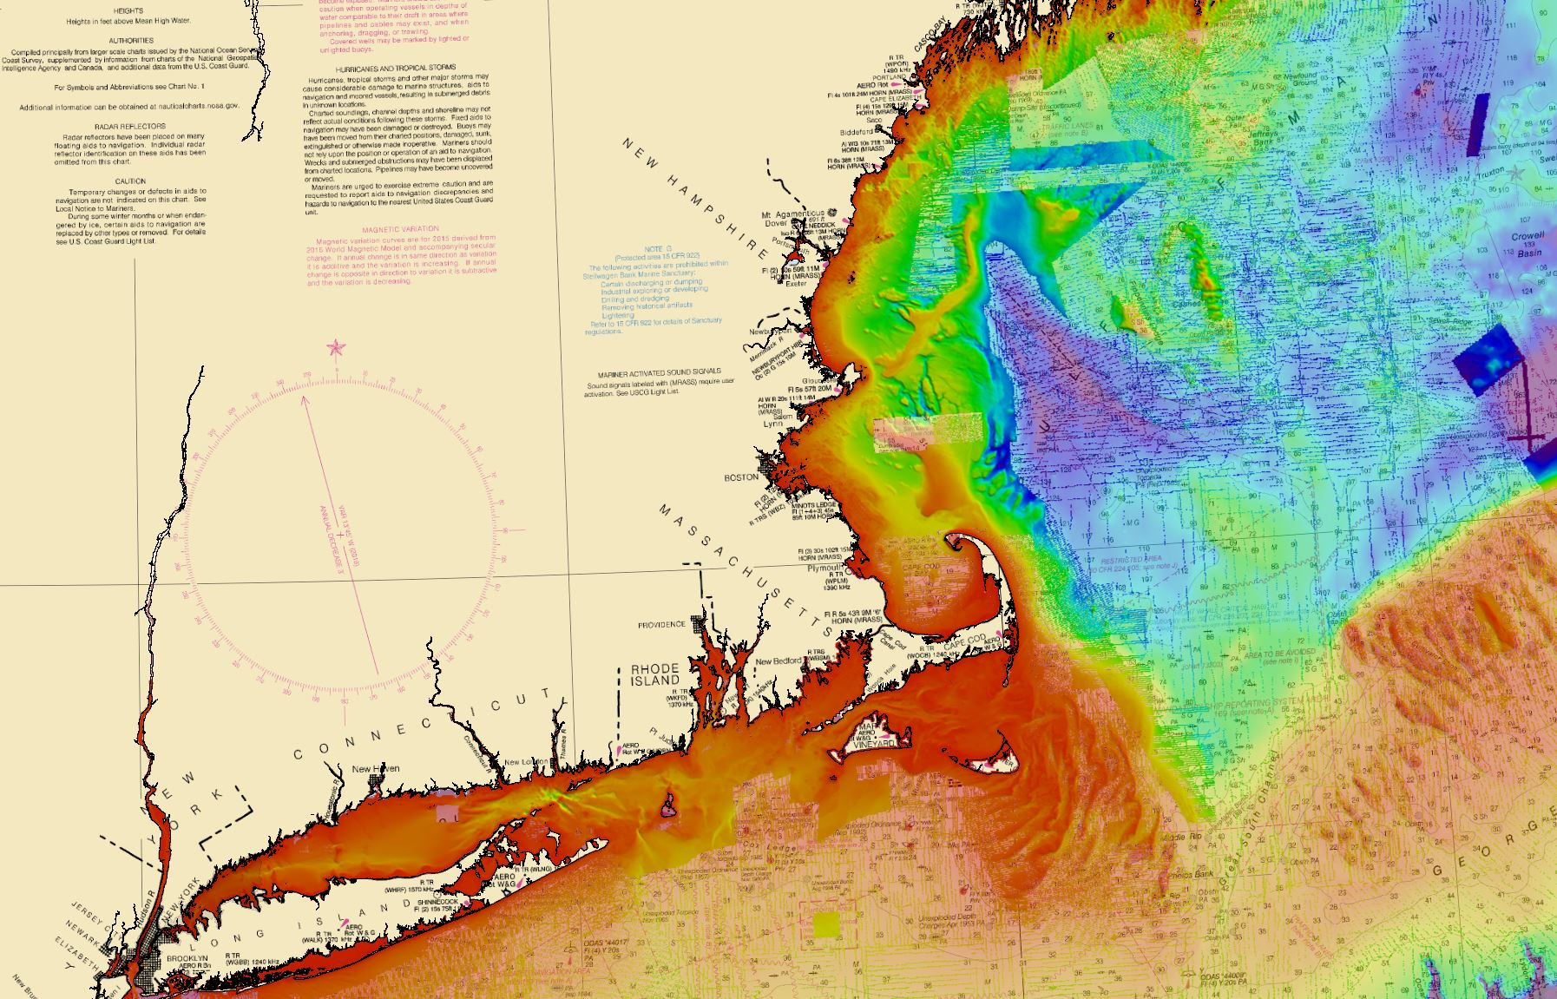
Top Plans that affect the region (3 maximum)
Improved coordination and communication between Navy, NGA and partner nations to maximize data availability and releasability for Primary Charting Authority use.
Completion of the initial data build of NOAA's National Bathymetric Source for the Gulf of Mexico, Florida, and the Caribbean.
NGA developed the Source Maritime Automated Processing System (SMAPS) environment to automate the processing of incoming messages on the Watch in order to increase the analytic efficiency, and send out more timely alerts to the mariner.
Example build of bathymetry for National Bathymetric Source (New England)

