Slide 1
24th Meeting of the Meso America – Caribbean Sea Hydrographic Commission National Report by
Kingdom of the Netherlands

Slide 2
Top achievements during the year (3 maximum)
Satisfactory status for surveying in the MACHC area, especially with the availability of the Expeditionary Survey Boat and the deep water echo sounder o/b HNLMS Pelikaan.
Satisfactory status for nautical charting in the MACHC area, especially with the delivery of the new HD ENC and S-102 test data set for Oranjestad, Aruba.
Delivery of the EMODnet Bathymetry Caribbean grid as a European contribution to the Caribbean MSDI.

Slide 3
EMODnet Bathymetry grid

Slide 4
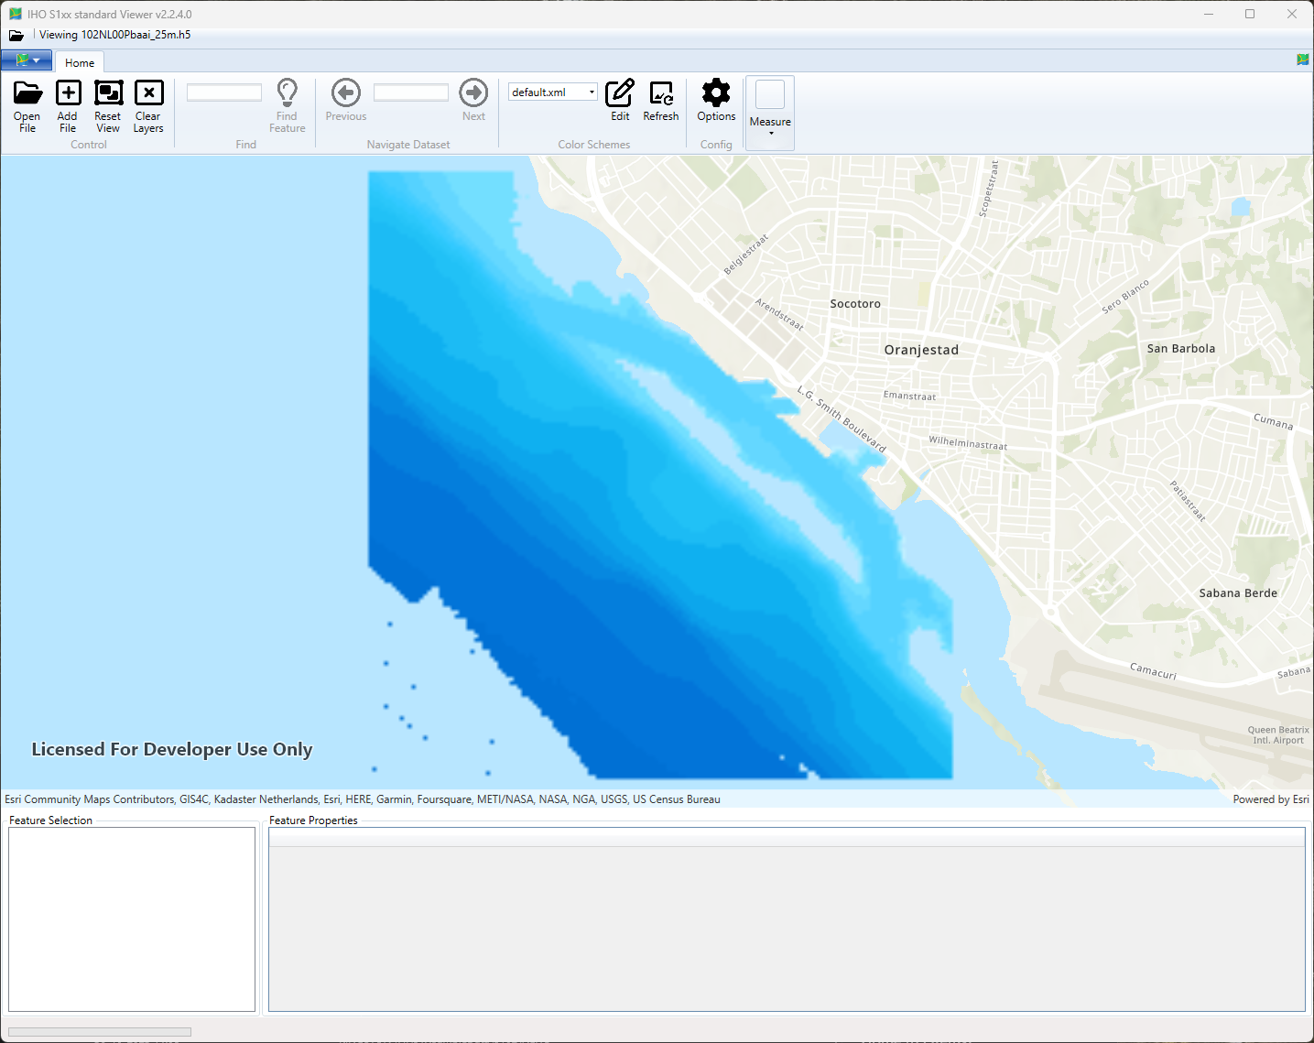
S-102 Caribbean test data set

Slide 5
Top challenges and/or obstructions (3 maximum) (Such as capacity building gaps)
Ongoing work to establish maritime boundaries
Ongoing work to establish new web services for geographic names and administrative units
Rescheming for paper charts and ENCs.

