Slide 1
24st Meeting of the Meso American – Caribbean Sea Hydrographic Commission National Report by
Annex D
HAITI

Slide 2
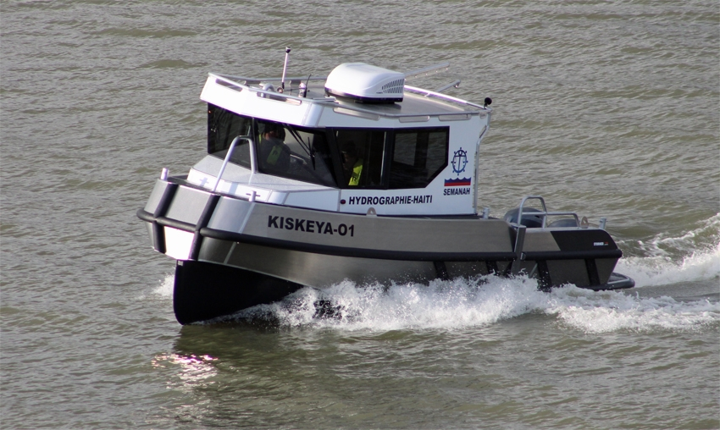
Top achievements during the year (3 maximum)
1- Reception OF our HYDROGRAPHIC SURVEY BOAT (STORMER PORTER 78, KISKEYA 01)

Slide 3
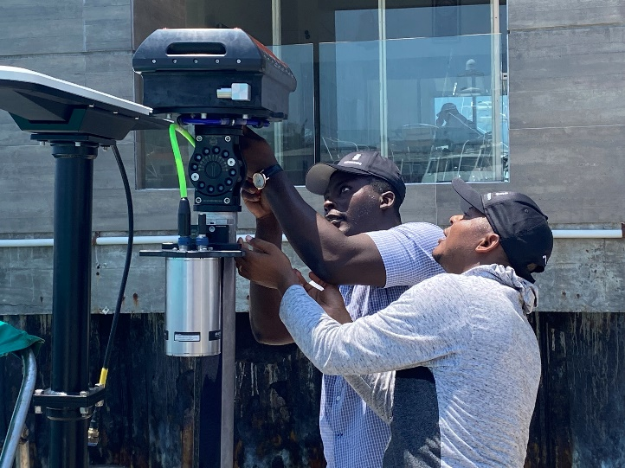
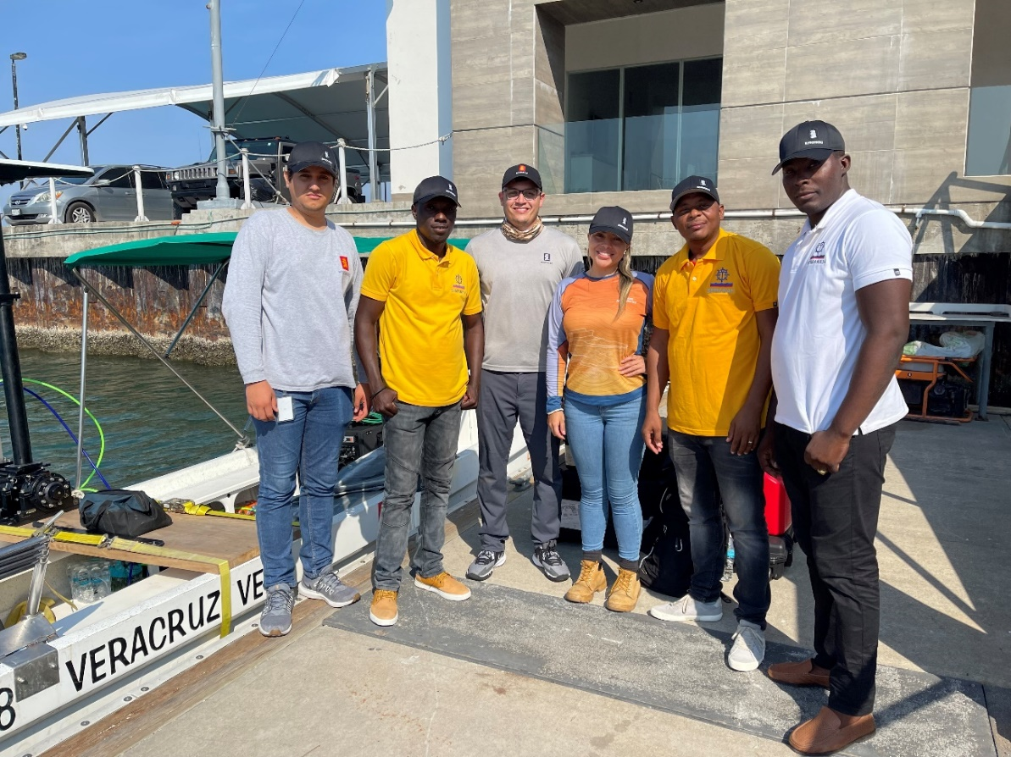
Top achievements during the year (3 maximum)
2- TRAINING IN VERACRUZ, MEXICO- June 2023
Kongsberg Maritime Mexico

Slide 4
Top challenges and/or obstructions (3 maximum) (Such as capacity building gaps)
1- Realization of hydrographic survey in the main channel and the Thor-Vareux channel (oil terminals).
2- Technical assistance (Realization of survey, reduction of tide, cartography).

Slide 6
Top Plans that affect the region (3 maximum) (Charts, surveys, training, other)
1- Realization of hydrographic survey in the main channel and the Thor-Varreux channel (oil terminals) for the deployment of ATON.
2- Construction of the new Lighthouse (Jacmel- Southeast, Pointe a Baguette).

Slide 7
Top Plans that affect the region (3 maximum) (Charts, surveys, training, other)
18.2349 N, -72.5605W

