Slide 1
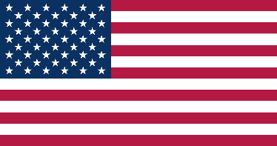
25th Conference of the Meso American - Caribbean Sea Hydrographic Commission National Report by
United States of America

Slide 2
Top Achievements during the year (3 maximum)
Coast Survey acquired over 1000 SNM of updated bathymetric data within the Gulf of Mexico in FY24 via traditional hydrographic survey ships, an uncrewed surface vessel operating from shore and employment of UxS for survey operations from NOAA Ship THOMAS JEFFERSON. The National Bathymetric Source Model continues to be maintained throughout the MACHC bounds, providing a compiled bathymetric surface of the best available data.
NOAA has continued the rollout of the new gridded ENC scheme. Over 50% of the estimated 7,300 gridded ENC cells have been completed as of October 2024. Successful interagency collaboration with NGA (Navassa Island coverage shift) and MACHC member states has been key to resolving overlaps in coverage during the process.
NGA created and implemented a Worldwide ENC grid for use in building its ENC portfolio. This ENC grid provides for a standardization of ENC scales and coverage across the portfolio. With a Global portfolio created as of Nov 1st 2024 as first step in preparation for transition to S-100

Slide 3
Top Challenges and/or Obstructions (3 maximum) (Such as capacity building gaps)
NOAA recognizes the substantial S-101 transition challenges it and other member states face. Resources for standard development, equipment, and staff training will have to be allocated as we approach the implementation of S-100 products.
NGA plans to cancel all traditional paper charts and their US Notice to Mariners by January 1 2026 and will shift paper chart production activities to a smaller suit, created via the Certified Printed Electronic Navigational Charts (CPENC) process maintained by graphical corrections.

Slide 4
Top Plans that affect the region (3 maximum) (Charts, surveys, training, other)
NOAA continues to lead capacity building activities such as hosting three female hydrographers, including one from a MACHC member state, aboard NOAAS Thomas Jefferson during the 2024 survey season as part of the IHO's Empowering Women in Hydrography (EWH) Project.
Improved coordination and communication between Navy, NGA and partner nations to maximize data availability and releasability for Primary Charting Authority use
NGA intends to provide opportunities for representatives from developing countries to participate in Capacity Building Training.

