Slide 1
21st Meeting of the North Indian Ocean
Hydrographic Commission
IHO Secretariat Report
Abri Kampfer
IHO Director

Slide 2
IHO and regional membership
➢ Since NIOHC 20 Conference Iraq, Angola acceded to the IHO
Convention and the IHO membership now stands at 98. With the IHO CL
36/2021, since September 2021 the Democratic Republic of
reinstated as a Member State of the IHO. Serbia, Syria and
suspended from Member States rights.
➢ The IHO Secretariat stands ready to assist those non-IHO
Congo has been
Vanuatu remain
Member States
with the application process for membership of the IHO, and to pay High
Level Visits to those States in the NIOHC
Recommendation:
NIOHC is invited to encourage and propose to the
States not yet IHO Member States.
region not yet IHO Member States.
IHO Secretariat High Level Visits to those
3

Slide 3
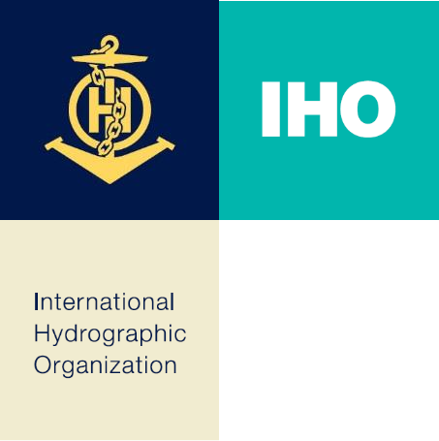
IHO COUNCIL
•
•
Full C-5 Report with actions is available on the IHO website
IHO Council 5 Meeting convened 19 to 21 October in Monaco, hybrid in person/VTC
• Dr Geneviève Béchard (Canada) as Chair
• Mr Thai Low Ying-Huang (Singapore) as Vice-Chair
Hybrid/VTC Meeting allowed for a large participation of 117 members – NIOHC was well represented
Council 5 plays an important contribution to the preparations for the third session of the
IHO Assembly (2023)
Focus of Council 5 was to consider proposals from HSSC, IRCC, the Secretariat for delivery of SPIs for implementation of the IHO Strategic Plan, the Roadmap for S-100
Implementation Decade (2020 - 2030)
Chair also recognized the need for the IHO to continue supporting basic Capacity
Building whilst also supporting the migration to S-100
•
•
•
•

Slide 4
IHO COUNCIL(cont.)
The sixth meeting of the IHO Council is scheduled to take place in Monaco, from 18 to 20 October 2022. The preparation of this meeting has already started (see CCLs 01/2022, 02/2022 and 03/2022), the deadline for submission of proposals by IHO Member States expired on 18 July 2022, whilst a revised provisional agenda together with supporting documents and timetable is available to Member States on C-6 web-page. Ahead of the 3rd Session of the IHO Assembly, the main topics on the C-6 agenda will be the “Roadmap for the S-100 Implementation Decade”, the “Duel Fuel concept for S-100 ECDIS”, the “IHO Strategic Plan 2021-2026”, the “new Capacity Building Strategy” and then the “IHO Budget and Work Programme 2023 and for the period 2024-2026”.
Recommendations:
NIOHC is invited to continue on the implementation of the IHO Strategic Plan and support IRCC in identifying measures and values to measure those SPI of regional interest allocated to IRCC, in accordance with IRCC14 List of Actions, Decisions and Recommendations to RHCs.

Slide 5
3rd IHO Assembly 2023
Due to the ongoing uncertainty caused by the global COVID pandemic, the IHO Secretariat has been forced to identify an alternative venue for the third session of the IHO Assembly (A-3), as the Auditorium Rainier III is likely to still be in use as the Principality’s primary COVID testing and Vaccination Centre.
The new venue will be the Grimaldi Forum Exhibition Centre and the dates have been changed to Tuesday 2 May to Friday 5 May 2023. The Opening Ceremony for the Assembly will take place on Tuesday morning, 2 May 2023. During that Ceremony, it is intended to celebrate the 120th Anniversary of the creation of GEBCO, as well as to invite those new Member States that have joined the Organization since the Second Session of the IHO Assembly to present their flag. An Industry and a Member States exhibition will take place in the same period of A-3. IHO Member States are invited to consider sending a ship to the Port of Monaco during A-3.

Slide 6
IHO GIS
and Databases
✓
An
Esri-based
GIS
solution
has been
implemented
for the
efficient
visualization
of
geospatial
data
stored in the
Country
Information
System,
website
enabling access to various
layers and functions through the IHO
such
as
the IHO
ENC
Catalogue.
Currently,
five
WebGIS
applications have been available to
the public in this new
environment.
✓
Work
has
continued
on
developing
a
GIS database
application
to
support
C-55 -
Status
of
of
Hydrographic
Surveying
and
Charting
Worldwide
and
the
work
the
IHO.
8

Slide 7
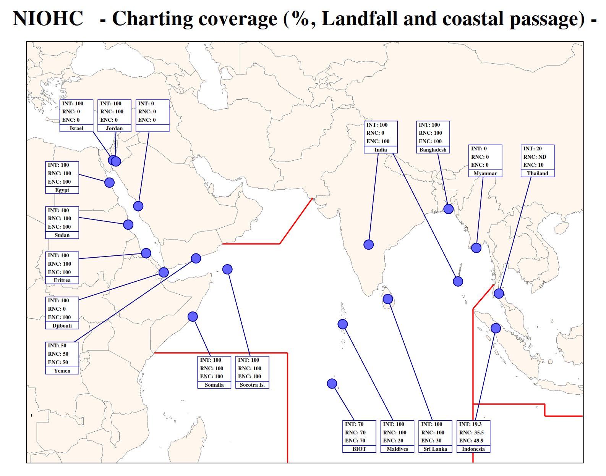

Slide 8
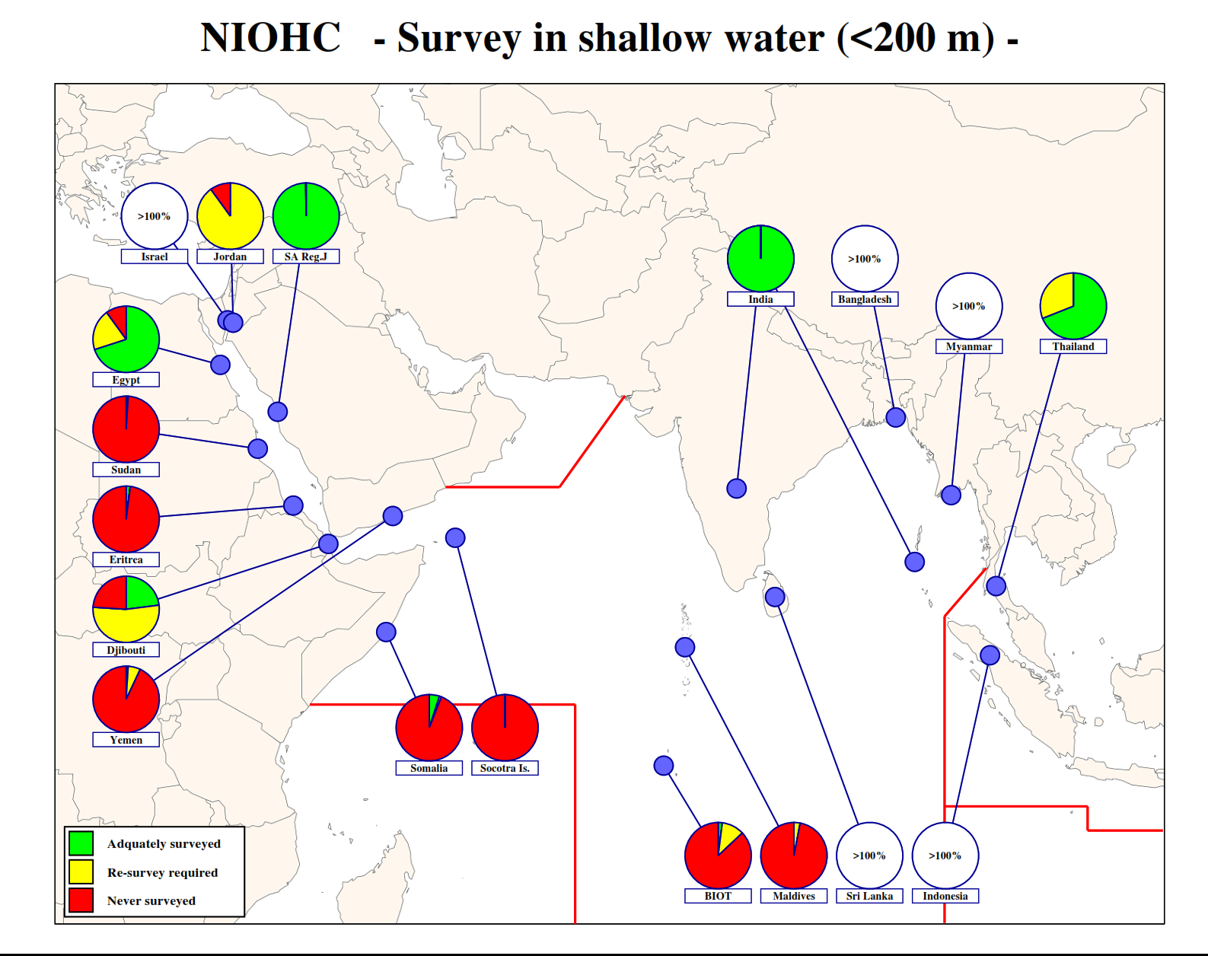

Slide 9
IHO GIS and Databases
Recommendations:
•
Countries in the NIOHC Region are invited to review their entry in
IHO Yearbook and C-55 and to provide the IHO Secretariat with
the
the
appropriate
updates
or
to
report no
change
(CL
20/2019
refers).
9

Slide 10
Statistics on Member States participation in IHO Working groups in 2021
IHO Technical Working Groups & Project teams:
Data Quality, WEND, S-101, Tides, Water Level & Currents, Nautical Information & Publication, ENC, Nautical Cartography, Hydrographic Survey, Crowd Source Bathymetry, MSDI, IHO-EU
Altogether 460 participants from 40 Member States:
Argentina, Australia, Belgium, Brazil, Canada, Chile, China, Croatia, Colombia, Denmark, Estonia, Finland, France, Germany, Greece, Ireland, India, Iran, Indonesia, Italy, Japan, Latvia, Lebanon, Mexico, Malaysia, Netherlands, New Zealand, Norway, Republic of Korea, Peru, Portugal, Romania, Singapore, South Africa, Spain, Sweden, Turkey, United Kingdom, Uruguay and USA

Slide 11
IHO Outreach
World Hydrography Day
✓
As announced with IHO CL 01/2022, the theme for WHD 2022 is “Hydrography - contributing to the United Nations Ocean Decade”
10

Slide 12
IHO Outreach
Considering the impact of digital outreach, in 2021, the IHO website had a total of 562,207 page views. The LinkedIn page had 4544 followers in December 2021, and saw a record 35,253 views from all its posts in June 2021, reaching total post impressions of 228,481 in 2021. The upwards trend continued on Facebook with a post on a missing GEBCO chart sheet getting 2.7K impressions in April 2021. On Twitter, the record for the year was a total of 22.9K impressions on posts in June 2021.
11

Slide 13
IHO Outreach
International Hydrographic Review
✓
The IHO Secretariat worked with the University of New Brunswick
(UNB),
Canada,
in
a
project to
develop
a
digital
repository of
the
complete
library
of
the
IHR.
As
a
result,
are
volumes
from
the
entire
at:
collections
(1923
to
2018)
available
online
ttps://journals.lib.unb.ca/index.php/ihr.
To promote and modernize the distribution of the content of the IHR
the IHO Secretariat established a new IHR website that is available in:
https://ihr.iho.int/.
✓
Recommendations:
NIOHC members are invited to submit papers for publication in the IHR.
12

Slide 14
Actions requested of
Note the Report
NIOHC
1.
2.
Consider
Report
the
recommendations
proposed
in
the
3.
Review entries related to IHO C-55
at least annually
and P-5 (Yearbook)
4.
Consider
submitting
papers
for
publication
in
the
International Hydrographic Review
Take any other actions as considered appropriate
5.
13

