Slide 1
21st Conference of the NIOHC
HSSC 14 Report
Hydrographic Services and Standards Committee
Agenda Item NIOHC21-06.4

Slide 2
Update items to be reported
Implementation of the IHO Strategic Plan (SPIs)
S-100 Product Specifications :
advancement,
priorities & timeline
Focus on S-98 Interoperability
Dual Fuel Concept for S-100 ECDIS Governance Document
Revision of ECDIS Performance Standards
Other achievements or progress

Slide 3
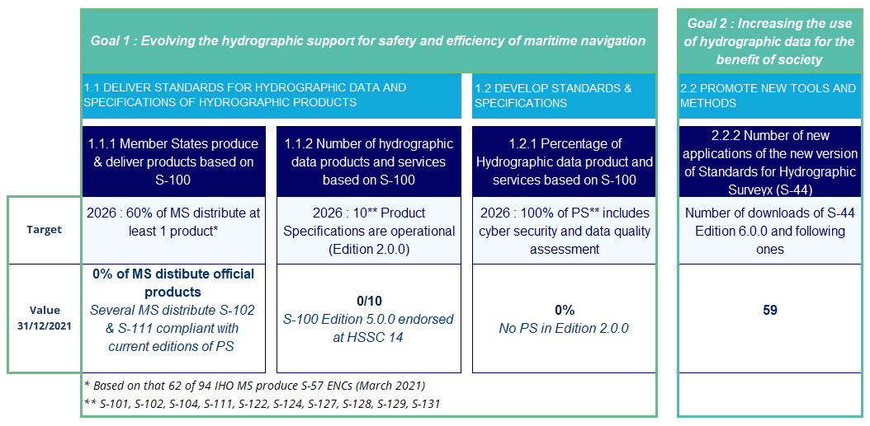
Implementation of the iho strategic plan Strategic performance indicators allocated to HSSC

Slide 4
Progress in the development of S-1xx PS
Endorsement of new Editions at HSSC14
Approval of first Editions (1.0.0) for implementation and testing
S-98 Interoperability
S-104 Water Level
S-128 Catalogue of Nautical Products
 | Edition | Expected MS Approval
S-100 Universal Hydrographic Data Model | 5.0.0 | CL expected for 09/22 finalization of XML schemas underway
S-99 Operational Procedures for the Organisation and Management of the S-100 GI Registry | 2.0.0 | 30/09/2022 (CL 24/2022)
S-102 Bathymetric surface New scope towards navigation | 2.1.0 | 20/09/2022 (CL 21/2022)

Slide 5
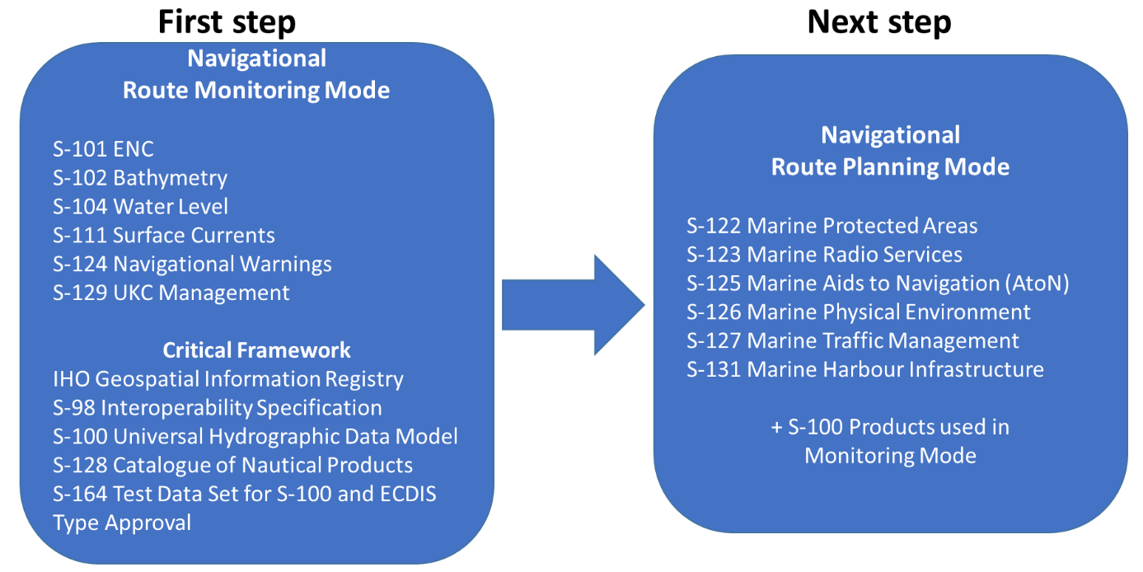
S-100 Implementation priorities
Top
priorities
Mandatory
to revise ECDIS PS

Slide 6
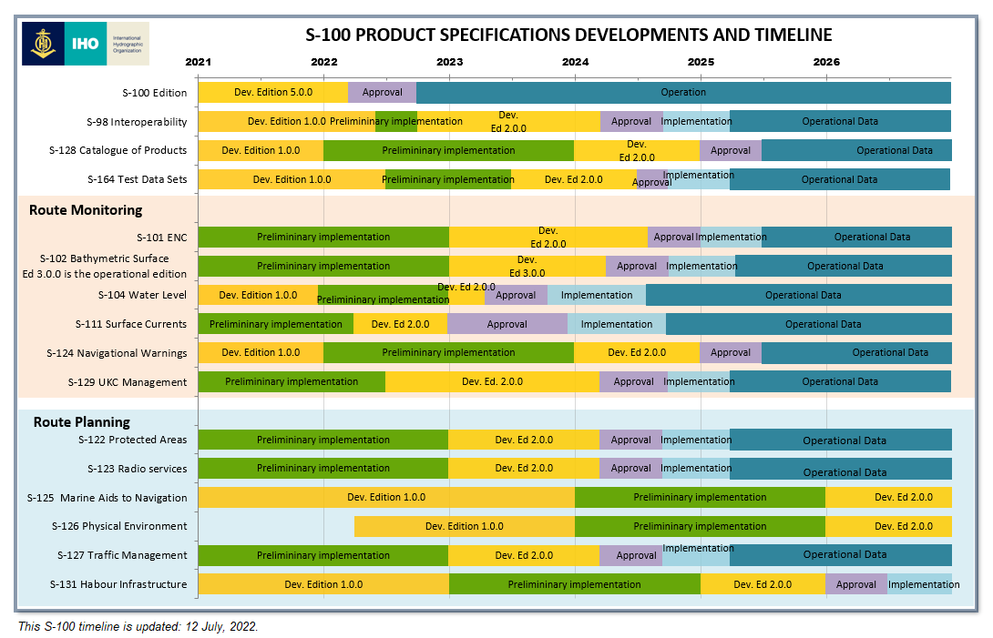
S-100 Timeline

Slide 7
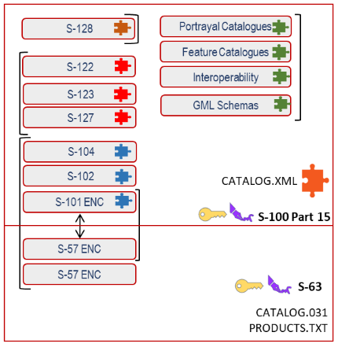
dual fuel concept for S-100 ECDIS Governance document from production, packaging and use
The governance document provide a central view of how S-100 ECDIS works, in particular with S-57 and S-101 ENC (DF-Concept) during the transition period
Production strategy : Conversion S-57 ↔ S-101 / Co-production of S-57 & S-101 from superset model
ENC scheming and scales
Packaging
Import data
Loading Strategy : vertical & horizontal priorities
Display & use in a single User Interface
https://iho.int/uploads/user/About%20IHO/Council/council6/C6_2022_04.1A_HSSC_Report%20Annex%20C-ver1.0.pdf

Slide 8
REVISION of Ecdis performance standards
IMO MSC104 agreed in October 2021, to revise the resolution on ECDIS Performance Standards (IMO MSC.232(82)) to include support for S-100
IHO organized and chaired a drafting group (HSSC Chair group, CIRM, IEC, INTERTANKO and a few other relevant stakeholders) to submit a redline version of a proposed ECDIS PS resolution to the IMO NCSR9 meeting, held in June 2022.
In addition to the inclusion of S-100, the proposal also included editorial changes and based on user experience, some functional changes aimed to improve safety. The proposal also introduced a mandatory support for standardized route exchange.
NCSR9 considered the inclusion of route exchange outside the scope of the existing output,
All other proposed changes were endorsed by NCSR9.
NCSR9 endorsed an implementation phase for the new resolution, including S-100 : a transition period was agreed upon :
S-100 ECDIS will be legal to use after 1 January 2026 and
from 1 January 2029 new systems must comply with the new IMO Resolution on ECDIS PS.

Slide 9
Other achievements or progress during HSSC14
Endorsement of recommended revisions of IHO Resolutions to introduce S-100
Approval of a «S-57 ENC to S-101 Conversion Guidance» (S-65 Ed 1.0.0) for implementation and testing
Introduction of a new task in ENCWG work plan for the development of an encoding guidance for the backward conversion (S-101 to S-57)
Establishment of a sub-WG of NCWG to develop a Baseline Symbology to support automated production of paper charts from S-101 date (BSPT)
Progress on IHO-Singapore Lab projects : S-57 to S-101 conversion and database for Marine Harbour Information (S-131)
New revision of the UOC (S-57 Annex A) and new edition of the ENC Validation Checks (S-58 Ed 7.0.0)
Endorsement of the Hydrographic Survey Standard S-44 draft Edition 6.1.0
Note the vacancy of DQWG chair and secretary and consider among MS the nomination of officer’s bearers

Slide 10
Top challenges FOR THE NEXT 2-3 YEARS
The inclusion of S-100 in the IMO regulatory framework should be seen as a major success for IHO
➔ IHO with its Member States clearly need to meet the deadlines setup in the S-100 timeline :
to achieve operational status on the prioritized S-100 PS
and for Member States to achieve substantial coverage of S-101 by 2026.

Slide 11
HSSC recommendations for NIOHC21
Note the HSSC 14 report
Note the important challenges on the S-100 implementation and the commitments towards IMO and IEC
Encourage MS to actively support the development of priority PS
Take any action as appropriate

