Slide 1
21st Meeting of the North Indian Ocean Hydrographic Commission National Report by
SRI LANKA

Slide 2
Main achievements during the year
Publishing of Colombo Harbour ENC (LK5G03D4) – Western port of Sri Lanka
Launching of MSDI web portal for Sri Lanka
Joint survey to reconfirm baseline of Sri Lanka with Land Survey Department
Establishment of database and online data processing unit for Crowd Sourced Bathymetry (CSB)
Conduct Survey in Anawilundawa Sanctuary to assist Mangrove Restoration site
Production of the Nautical Chart of Puttalam Harbour

Slide 3
Main challenges and/or obstructions
Updating old Survey Data of the National Charts
Lack of Cartography qualified professionals
Lack of equipment to undertake Hydrographic surveys (Eg. MBES)
Covid -19 pandemic affected all activities including planned hydrographic surveys & Capacity Building (CB) activities
Fund limitation due to present economic crisis in the country

Slide 4
Progress on Surveys
Surveys in support of national charting
Surveys in support of defence requirements
Surveys in support of projects of national interest
Surveys as consultancy service

Slide 5
Progress on Charting
Updated ENC Cells including recently created Colombo Harbour ENC
Production of ENCs in all scale bands with new survey data is in progress
Production of own INT charts for Colombo harbour & Approaches, and Colombo to Sangamankanda is in progress

Slide 6
Progress on Maritime Safety Information (MSI)
Issuing of Notices to Mariners through UKHO
Dissemination of NAVAREA warnings through NAVAREA VIII Coordinator

Slide 7
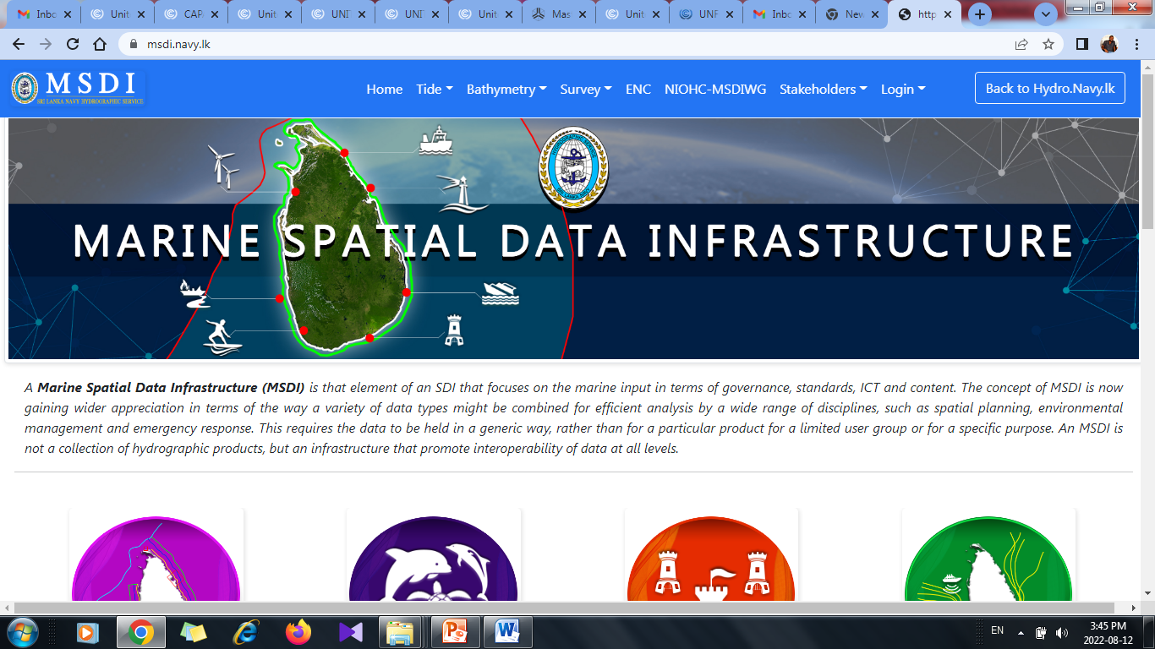
Progress on MSDI
Ministry of Defence currently maintains data repository with respect to hydrographic and oceanographic data of the country.
Online portal for National MSDI was launched on 25th February 2022

Slide 8
Capacity Building
Contribution
Survey Recorder III & Survey Recorder II at Navy Hydrographic School
Training modules for Universities including practical training
Request for Support
CAT ‘B’ Cartographic Training
CAT ‘A’ and CAT ‘B’ Hydrography training
Cartographic training for production of ENCs, Additional Military Layers (AMLs) & Paper Nautical Charts and their maintenance
Training and capacity building on MSI & MSDI
Joint surveys in SL waters with MB / LIDAR surveying and processing capabilities

Slide 9
Contribution to the region
ENC production to cover the SLOC coming under National Maritime Jurisdiction has been given a higher precedence
Remain open for Regional Cooperation on Hydrographic matters
Commitment towards Seabed 2030

Slide 10
Lessons learnt to share
Need of proper mechanism for MSDI implementation in the country
Utilization of virtual platform to meet the CB requirements by implementing virtual programmes
Ex. “Learn through Each Other” programme 2021
Necessity of the regional assistance for the mitigation of maritime hazards and the collective collaboration
Necessity of migrating production of ENCs from S-57 to S-100

Slide 11
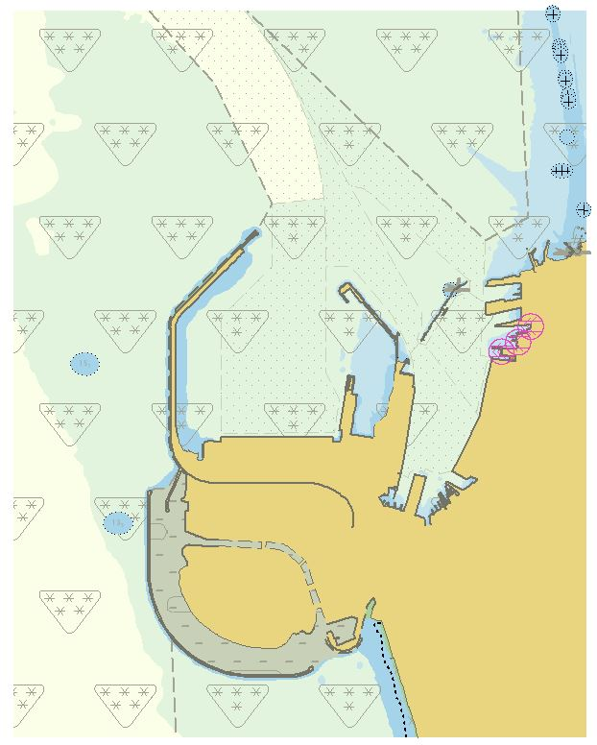
Success stories to share
Publishing of Colombo Harbour ENC (LK 5G03D4) through UKHO
Launching of National MSDI Web portal for Sri Lanka

Slide 12
THANK YOU !

Slide 13
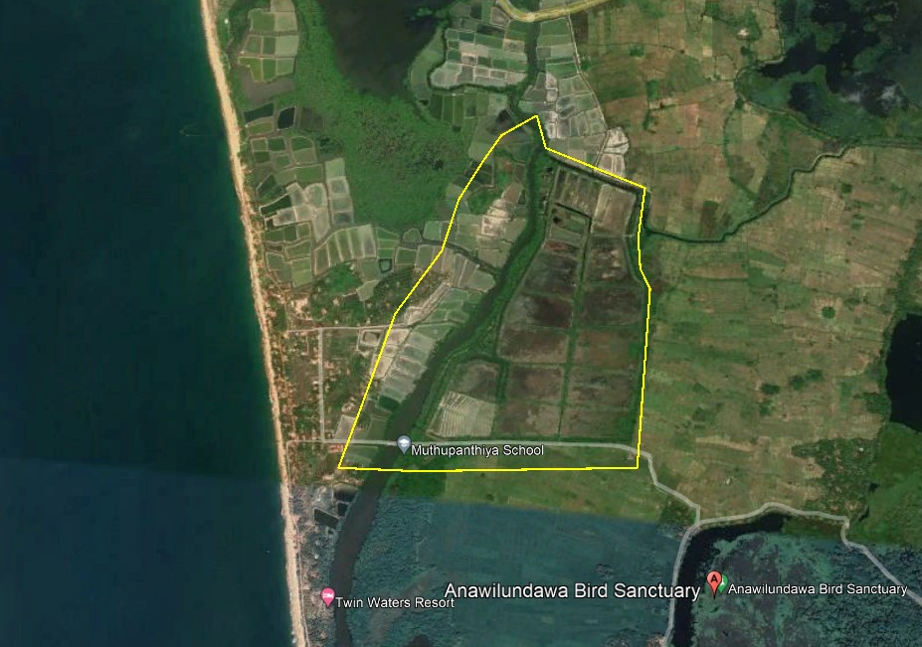
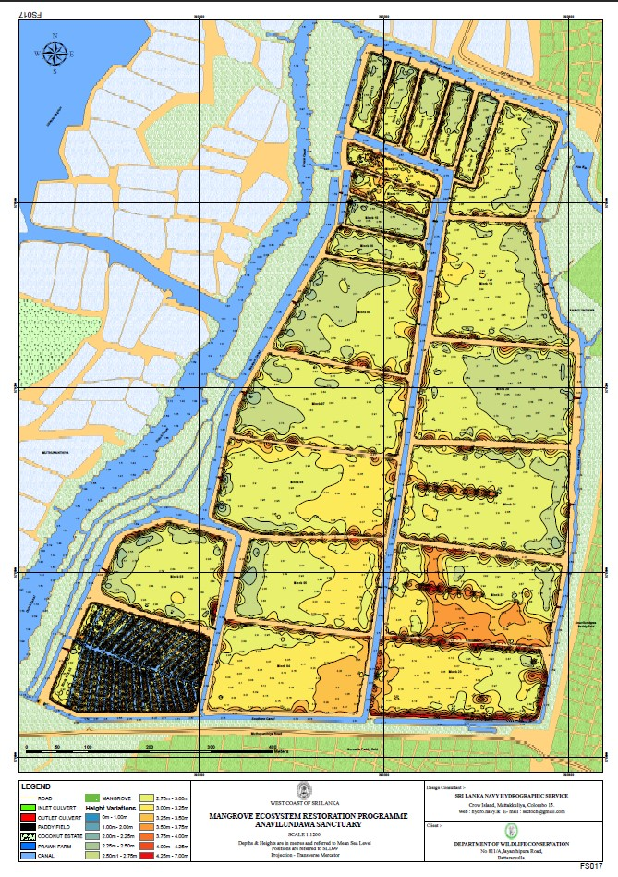
Anawilundawa wetland

Slide 14
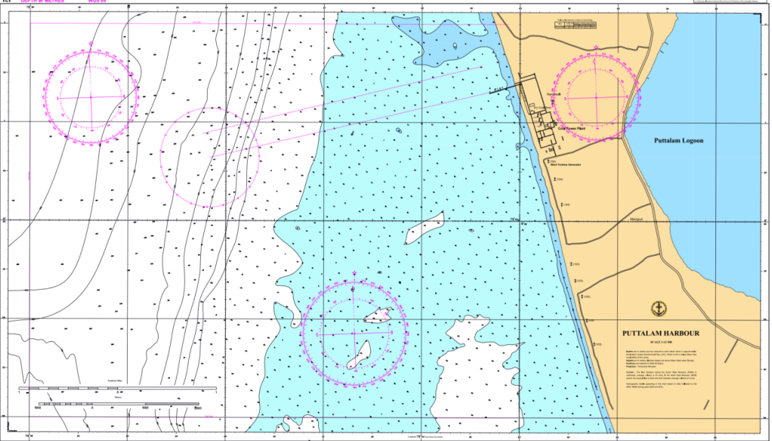
Puttalama Harbour Nautical Chart

