Slide 1
21st Meeting of the North Indian Ocean Hydrographic Commission National Report by
SULTANATE OF OMAN

Slide 2
Main achievements during the year
The new website of the Oman National Hydrographic Office will be launched at the end of this year.
ONHO will issue 16 ENC and 6 paper charts at the end of this year.
Sea of Oman survey ( 60 NM²).

Slide 3
Progress on surveys, charting and MSI
Surveys:
C-55
Year | Coverage Km² | Coverage NM²
2020 | 555 | 161.8
2021 | 449 | 130.9
2022 | 206 | 60
Depth | A (adequately surveyed) | B(requires re-survey) | C(not systematically surveyed)
< 200m | 45% | 11% | 44%
> 200m | 63% | 8% | 29%

Slide 4
Progress on surveys, charting and MSI
published new charts | 1.PORT OF SALALAH (OM102) 2.APPROCHES TO PORT OF SALALAH (OM303)
plans to publish new charts during this year | 1.JUZUR AD DIMANIYYAT (OM304)
plans to issue new editions during this year | 1.RA’S DARBAT ALI TO PORT OF SALALAH (OM 1200) 2.PORT OF SALALAH TO RA’S JANJARI (OM1201) 3.APPROACHES TO SUHAR PORT (OM257)
Charting :
1. Paper Chart

Slide 5
Progress on surveys, charting and MSI
published new ENC & new Edition | 1.PORT OF SALALAH (OM102) 2.APPROCHES TO PORT OF SALALAH (OM303) 3.RA’S DABA TO KHAWR AL-HABALAYN (OM1218) 4.HAMAR NAFUN TO RA’S HALLAT (OM503) 5. RA’S AL HADD TO DAGHMAR (OM1212) 6. PORT SULTAN QABOOS (OM52) 7. WESTERN APPROACHES TO MUSCAT (OM255) 8. EASTERN APPROACHES TO MUSCAT (OM254) 9.RA’S DARBAT ALI TO PORT OF SALALAH (OM 1200) 10.PORT OF SALALAH TO RA’S JANJARI (OM1201)
2. ENC

Slide 6
Progress on surveys, charting and MSI
plans to publish new ENC during this year | 1.JUZUR AD DIMANIYYAT (OM304) 2.KHASAB PORT (OM101) 3.OM7500 4.OM7501
plans to issue new editions during this year | 1.APPROACHES TO PORT SUHAR (OM257) 2. RA’S DABA TO KHAWR AL HABALIN (OM1219)
2. ENC

Slide 7
Progress on surveys, charting and MSI
MSI

Slide 8
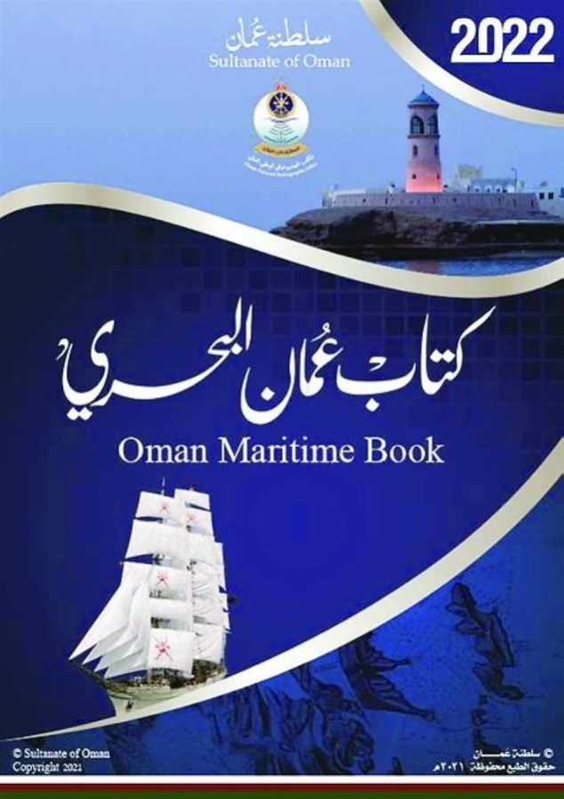
Progress on surveys, charting and MSI
MSI

Slide 9
Capacity Building
2 officers completed CAT-B course in cartography in May 2022, UK.
1 officer following CAT-B course in cartography from August to December 2022, UK.
2 officers following CAT-A course in hydrography from April to October 2022, UK.
3 technicians following IC-ENC Validation training course in July 2022.
1 officer expected to attend GEBCO course in September 2022, US.
4 officers attended to IC-ENC technical conferences (VTC) in 2022.
1 officers and 4 technicians attend introduction to ArcGIS course in Esri Muscat, Oman.
1 officer completed CAT-B course in hydrography in June 2022, UK.

Slide 10
Oceanographic Activities
Different sectors and organizations are responsible for most oceanographic activities in Oman. Most of that oceanographic data is archived within ONHO
Oman monitors tides around the Omani coast through a number of permanent stations fitted with fully automated precise sensors with satellite connectivity

Slide 11
Other Activities
ONHO has participated in some IHO-WGs, such as WENDWG and MSDIWG. Also, participated in IC-ENC SC23.
Next November, Oman is planning to hold the 9th meeting of RSAHC in Muscat.
Oman is the Chair of ROPME Sea Area Hydrographic Commission (RSAHC) and represented ROPME HC member states in IRCC 14th meeting 06-08 Jun 22.
In June, ONHO celebrated Hydrographic day.
ONHO is part of a national team for the United Nations Decade of Ocean science for sustainable development

Slide 12
Lessons learned to share
Importance of VTC workshops, courses and meetings during pandemics such as Covid19.
Lack of communication and enthusiasm of member states obstructs the development of the region hydrographically.

Slide 13
Conclusion
ONHO works in cooperation with national and international organizations to provide hydrographic services
ONHO develop new technologies to deliver better hydrographic services to all sectors/users for safe navigation in Omani waters

