Slide 1
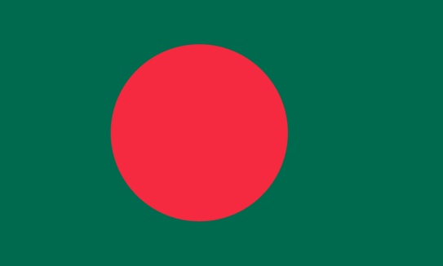
24th Meeting of the North Indian Ocean Hydrographic Commission National Report by
BANGLADESH

Slide 2
MAIN ACHIEVEMENTS DURING THE YEAR
Successfully conducted IHO Cat B Hydrography Course. 01 Foreign Officer attended the course
12 Paper charts and 07 ENCs were updated and distributed
Encrypted ENC distribution system developed as Data Server
Published Bangladesh Navy (BN) Tide Tables 2025
Published BN Annual Summary of Notices to Mariners

Slide 3
MAIN ACHIEVEMENTS DURING THE YEAR
Marine Weather forecast App is launched for mariners to receive the update information
Inclusion of Autonomous Survey Platform (AUV, ASV, ATSS) is underway to accomplish more challenging task in future survey operation
BN organized a seminar to celebrate WHD-2024 in presence of all maritime stakeholders to highlight the importance of hydrography for national development

Slide 4
MAIN CHALLENGES AND/OR OBSTRUCTIONS
Due to dynamic and deltaic condition frequent hydrographic survey is required to update nautical charts
Presence of Turbid water in the coastal region possess considerable challenges in case of Multibeam data acquisition (Limited swath coverage and processing of Multibeam data is quite time consuming)
Cartographers face difficulties in matching data of different survey due to rapid and constant changes of depth in coastal areas

Slide 5
PROGRESS ON SURVEYS, CHARTING AND MSI
Surveys
Hydrographic Survey is ongoing for the survey season 2024-2025
Processed data will be applied for updating relevant INT series and National series charts/ENCs
Charting
12 National series Paper charts (01 New Chart & 11 New Edition) published
02 ENCs (New Chart) and 05 ENCs (New Edition) published
All ENCs are being updated in regular interval

Slide 6
PROGRESS ON SURVEYS, CHARTING AND MSI
MSI
Notices to Mariners. Issued by Bangladesh Navy Hydrographic and Oceanographic Center (BNHOC) and Department of Shipping through Mercantile Marine Office (MMO) regularly
Meteorological Warning. Meteorological warnings are prepared and distributed by Bangladesh Meteorological Department (BMD)
NTM Distribution System. NTM is issued and distributed by Bangladesh Navy Hydrographic and Oceanographic Center (BNHOC) and Mercantile Marine Office (MMO)

Slide 7
PROGRESS ON SURVEYS, CHARTING AND MSI
MSI
NAVTEX Coverage. Transmitted with the help of NAVAREA coordinator India as part of NAVAREA VIII
Website for NTM and other Warnings. All updated warnings including the Notices to Mariners are available in the website of BNHOC (www.bnhoc.navy.mil.bd) and Mercantile Marine Office (https://mmd.gov.bd/)

Slide 8
CAPACITY BUILDING
Contribution
Ser | Name of Training | Duration (weeks) | Number of Student
1. | 18th Basic Hydrographic Course (CAT B)- 2024 | 24 | 07 (Including 01 Foreign participant)
2. | SR-II 'Q' 2024 | 25 | 16
3. | SR-III 'Q' 2024 | 23 | 12
4. | 2nd Paper Chart Refresher Course 2024 | 06 | 07

Slide 9
CAPACITY BUILDING
Request for Support
Category A training in Hydrography
Category B training in Hydrography and Cartography
Conversion Training (S-57 to S-101)
Establishment of MSDI (Marine Spatial Data Infrastructure)

Slide 10
OCEANOGRAPHIC ACTIVITIES
General
Bangladesh Navy Hydrographic Department (BNHD) is conducting oceanographic survey in limited scale by using available platforms and equipments
BNHD has taken initiative to develop an Oceanographic Database on various seabed sample and seawater properties
BNHD facilitates sampling and necessary assistance to all maritime R&D organizations, educational institutes and universities to collect oceanic data for research activities

Slide 11
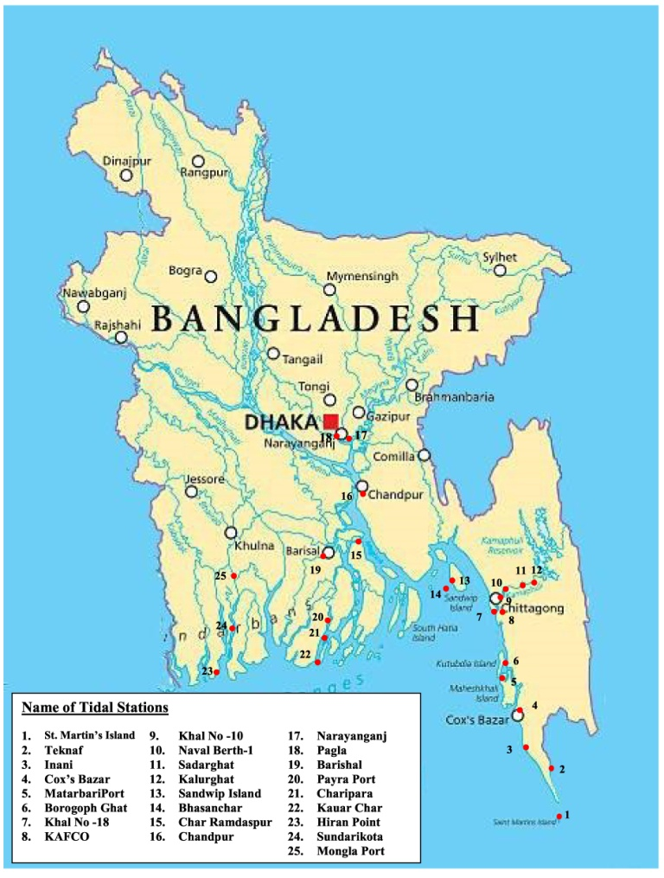
OCEANOGRAPHIC ACTIVITIES
Tide Gauge Network
Bangladesh maintains a tidal network of more than 25 tidal stations along the coastal belt of Bangladesh
Installations of 04 in number Radar based Automatic Tide Gauges with GSM Telemetry facilities is in progress by Bangladesh Navy and more will be added in future
Figure: Tidal Network

Slide 12
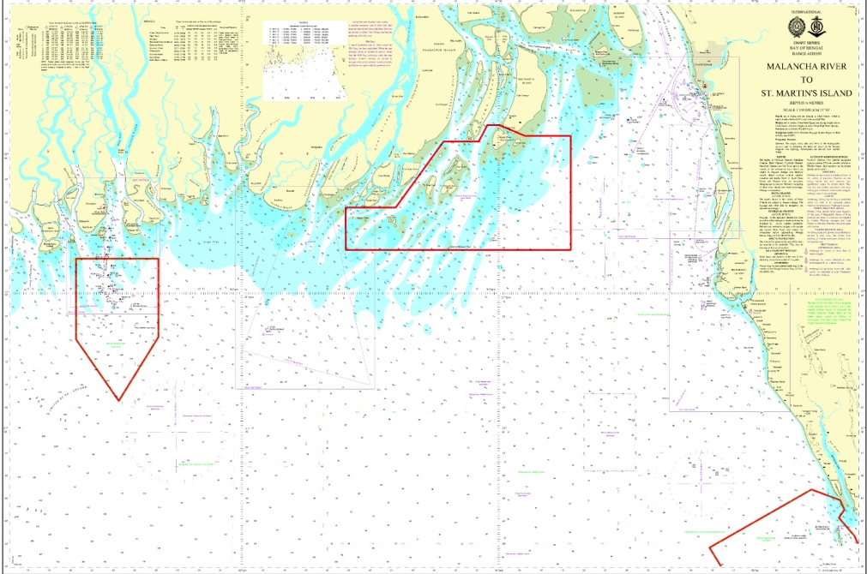
OTHER ACTIVITIES
Environmental Protection
Marine Reserve Area (MRA) and Marine Protected Areas (MPA) are well demarcated in BD charts
Bangladesh Navy and Bangladesh Coast Guard vessels regularly monitors the marine pollution and ensure compliance
Fig: MRA and MPA

Slide 13
OTHER ACTIVITIES
Environmental Protection
02 in number Fishing charts has been circulated to all fishing vessels operated within jurisdiction of Bangladesh maritime water for better supervision and monitoring
MSDI Progress
Conceptual phase
Fig: MRA and MPA

Slide 14
CONCLUSION
Required Capacity building support in Hydrographic and Cartographic field for further improvement and gain self sufficiency
BNHD is ready to share her expertise and experience with other Member States for mutual benefit

