Slide 1
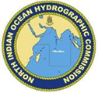
NIOHC24 (2025) Meeting
North Indian Ocean Hydrographic Commission
11-13 February 2025
Bangkok, Thailand
NATIONAL REPORT
OF
KINGDOM OF SAUDI ARABIA

Slide 3
Content
01
Introduction
02
Hydrographic Activities
02
03
Capacity Building (CB)
Oceanographic Activities
04
Oceanographic Activities
05
National Spatial Data Infrastructure
06
Innovation
07
Other Activities
Conclusion
02
North Indian Ocean Hydrographic Commission

Slide 4
Introduction
GEOSA Hydrography Executive Directorate is dedicated to developing and maintaining the capacity to provide high-quality, standardized, and timely hydrographic data products and services.
GEOSA mission is to ensure the broadest possible use and distribution of these marine data products, facilitated through a structured framework of Governance, Regulation, and Operational functions.
The Hydrography Executive Directorate within GEOSA serves as the UN-GGIM Water Theme Regulator, overseeing Hydrography, Hydrology, Hydrogeology, and Internal Waters
Saudi Arabia is bordered to the west by the Red Sea and the Gulf of Aqaba and the east by the Arabian Gulf and GEOSA has been conducting hydrographic surveys to produce up-to-date charts.
The hydrographic surveys of the Kingdom waters in both the Red Sea and the Gulf of Aqaba have now been completed and work is in progress within the Arabian Gulf.
MSI
North Indian Ocean Hydrographic Commission

Slide 5
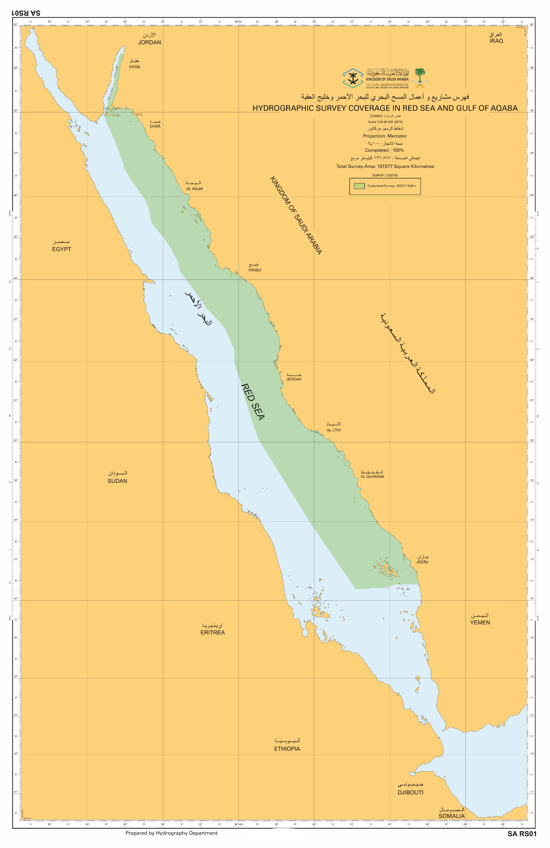
Hydrographic Surveys
GEOSA since its establishment has surveyed all the Saudi Marine Areas in Red Sea and the Gulf of Aqaba and produced ENCs, PNCs and CZMCs at various scales.
GEOSA is planning to resurvey the coastal area in the Red Sea and Gulf of Aqaba for monitoring changes in the coastline and update nautical charts that are affected by development along the coast and in shallow water areas.
Region Coverage | Percentage
Red Sea and Gulf of Aqaba | 100 %
MSI
North Indian Ocean Hydrographic Commission

Slide 6
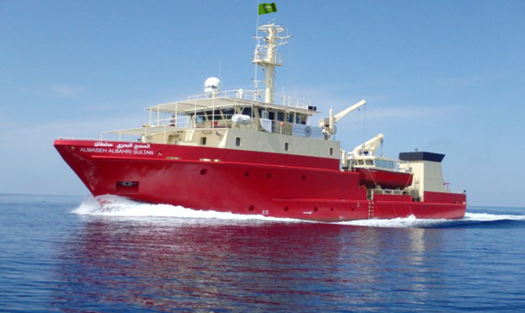
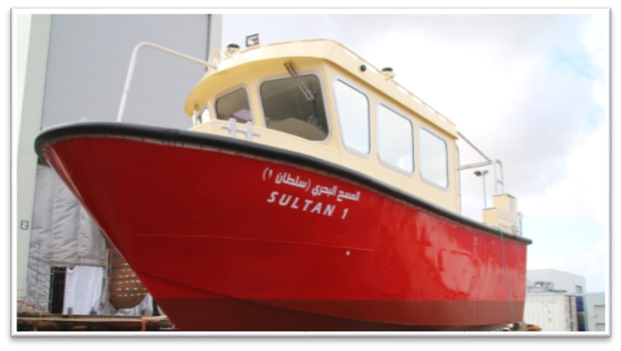
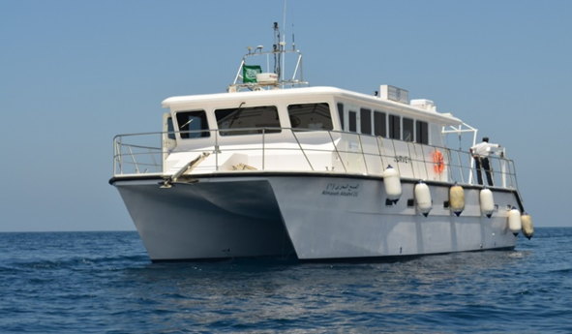
Hydrographic Survey Vessels
GEOSA’s Vessel fleet for hydrographic survey activities are the following:
( ALMASH ALBAHRI SULTAN )
FR. Fassmer GmbH & Co. KG
43.72 m | Length Overall
9.80 m | Molded Beam
2.80 m | Designed Draught
11 knots | Maximum Speed
24 | Crew
( ALMASH ALBAHRI SULTAN 1 & 2 )
FR. Fassmer GmbH & Co. KG
8.40 m
2.70 m
0.60 m
14 knots
5
( ALMASH ALBAHRI 1 )
Nautical Lines Marine LLC
16.00 m
5.95 m
1.00 m
12 knots
10

Slide 7
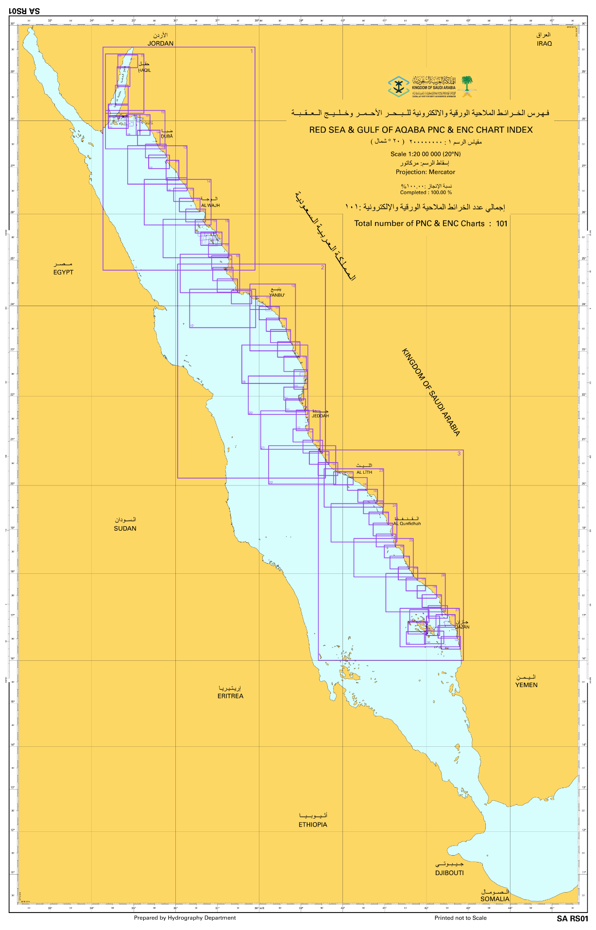
New Charts & Updates:
In the Red Sea and Gulf of Aqaba, GEOSA-designed chart scheme includes 86 charts serving various navigation purposes.
Recently, GEOSA has expanded this collection with an additional 15 large-scale charts, bringing the total to 101 PNC and ENC charts. these 15 new PNC and 15 ENC charts have been completed.
GEOSA through its cooperation with IC-ENC, GEOSA has issued 49 out of 101 ENC charts for the region.
HSP 16
Red Sea & Gulf of Aqaba PNC & ENC
Navigational Purpose | Scale | Planned PNC & ENC | Produced PNC | Produced ENC | Issued ENC
General | 1:500,000 | 3 | 3 | 3 | 0
Coastal | 1:150,000 | 17 | 17 | 17 | 0
Approach | 1:50,000 | 58 | 58 | 58 | 34
Harbor | (1:10,000، 1:15,000) | 23 | 23 | 23 | 15
Total |  | 101 | 101 | 101 | 49
MSI
North Indian Ocean Hydrographic Commission

Slide 8
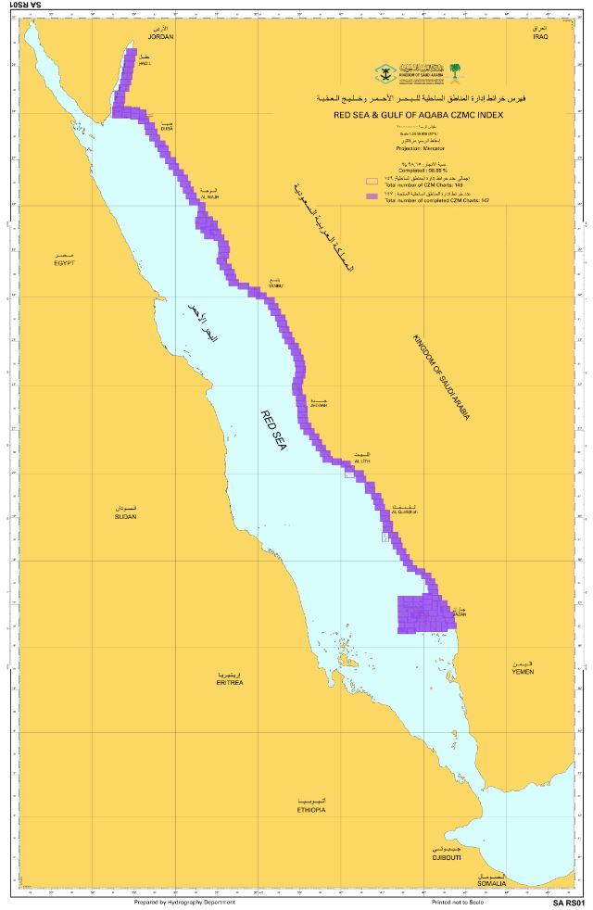
New Charts & Updates:
GEOSA is also preparing customized products as per the requirement of its stakeholders.
CZMC in Red Sea & Gulf of Aqaba
Type | Scale | Planned | Completed
CZMC | (1:25000) | 149 | 147
Total |  | 149 | 147
MSI
North Indian Ocean Hydrographic Commission

Slide 9
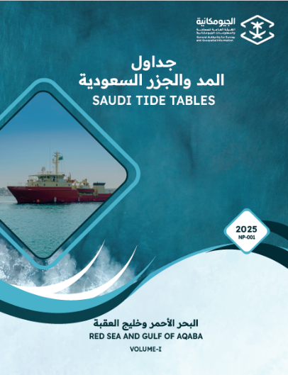
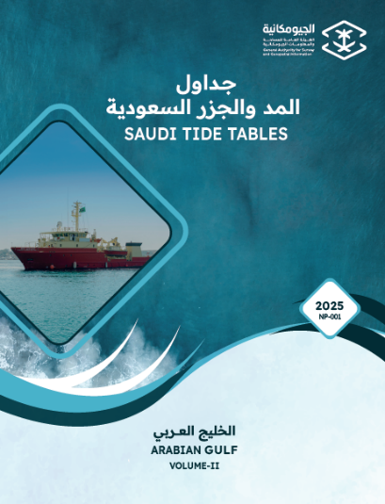
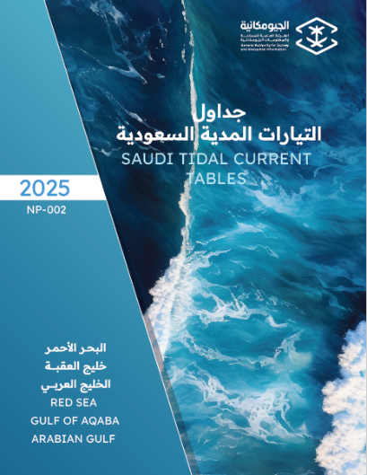
New Publications/Updates
The National Tide Tables (NP-001) for 2025 have been published using validated tide data from the GEOSA National Tide Gauge Network and the Temporary Tide Stations established in the Red Sea, Gulf of Aqaba and Arabian Gulf during previous hydrographic surveying projects.
The National Tidal Current Tables (NP-002) for 2025 have been published using ADCP data.
Both publications are provided in soft and hard copies to Port Authorities, Government, and Private Agencies. They are also available upon request for Mariners on the GEOSA web portal (www.geosa.gov.sa)
MSI
Conclusion
North Indian Ocean Hydrographic Commission

Slide 10
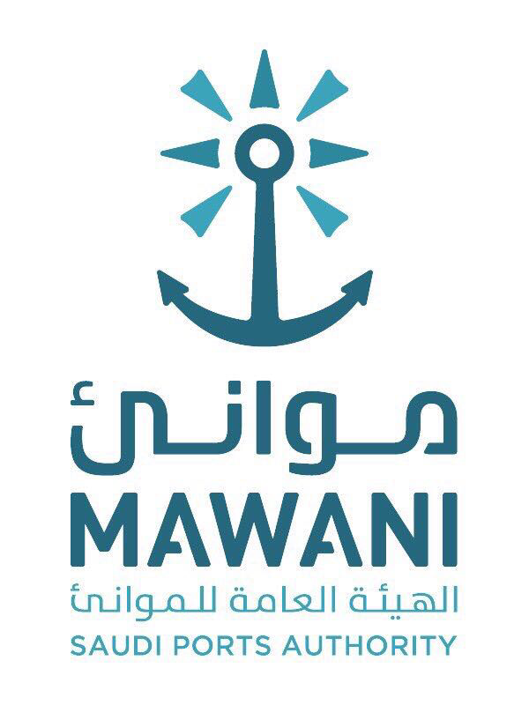
MSI
The National Coordinator of the Kingdom of Saudi Arabia is the Ministry of Transport / Saudi Port Authority (MAWANI).
GEOSA updates charts through liaison with MAWANI and NAVAREA coordinator using available inputs.
The Chart Correction actions and validation for GEOSA’s produced ENCs and PNCs remains the full responsibility of GEOSA.
MSI
North Indian Ocean Hydrographic Commission

Slide 11
C-55
Hydrographic Surveying:
Status of hydrographic survey of all navigable waters, including internal waters, out to the limits of the EEZ:
A = percentage which is adequately surveyed.
B = percentage which requires re-survey at larger scale or to modern standards.
C = percentage which has never been systematically surveyed.
 | A | B | C
Depths < 200m | 100% | 16 % | 0%
Depths > 200m | 100% | 0% | 0%
MSI
North Indian Ocean Hydrographic Commission

Slide 12
C-55
Nautical Charting:
Status of nautical charting within the limits of the EEZ.
A = percentage covered by INT series, or a paper chart series* meeting the standards in S-4.
B = percentage covered by Raster Navigational Charts (RNCs) meeting the standards in S-61.
C = percentage covered by ENCs meeting the standards in S-57.
Purpose/Scale | A PNC | B | C
Offshore passage/Small | 100% | 0 | 100%
Landfall and Coastal passage/Medium | 100% | 0 | 100%
Approaches and Ports/Large | 100% | 0 | 100%
Percentage of Group A showing depths in metres | 100%
Percentage of Group A referenced to a satellite datum | 100%
MSI
North Indian Ocean Hydrographic Commission

Slide 13
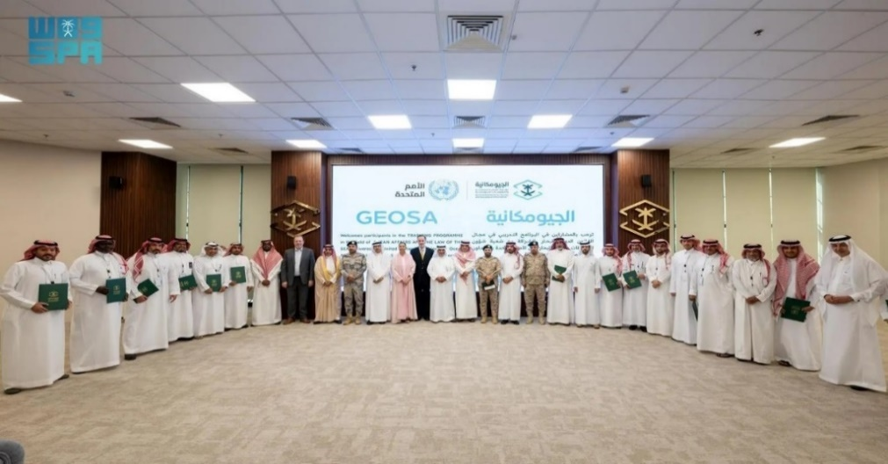
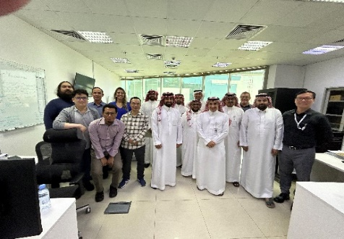
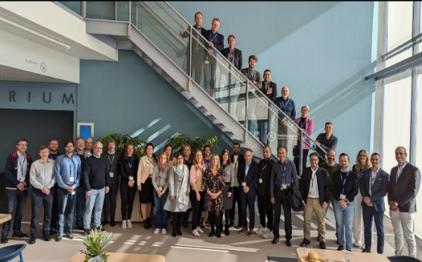
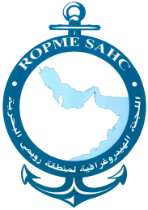
Capacity Building (CB)
Capacity building within the organization has been successfully achieved through the effective utilization of IC-ENC sponsored courses, alongside knowledge transfer during hydrographic surveying projects in Saudi waters.
In-house training is continuously incorporated as part of GEOSA's on-the-job training program.
In 2024, GEOSA organized a training course on Ocean Affairs and the Law of the Sea, which was attended by fifty (50) participants from nine (9) government departments.
An Introduction to Hydrography course was held internally for government stakeholders
Maritime Safety Information (MSI) training course attended in Bahrain.
Third-party training courses have been identified, and the personnel are expected to participate in these programs

Slide 14
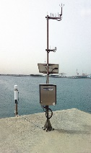
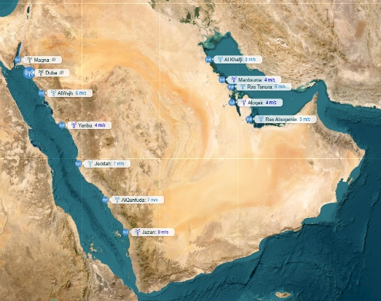
Oceanographic Activities
Oceanographic data is primarily collected during hydrographic survey projects.
GEOSA collects tide and meteorological data from its national tide gauge network (NTGN), which was established by GEOSA in 2012.
The NTGN consists of 12 stations distributed along the eastern and western coasts of the Kingdom of Saudi Arabia.
The NTGN is linked to GEOSA through a secure automated system for sending and receiving data.
Enhancements to this network are currently underway to add 10 more tide gauge stations.
MSI
North Indian Ocean Hydrographic Commission

Slide 15
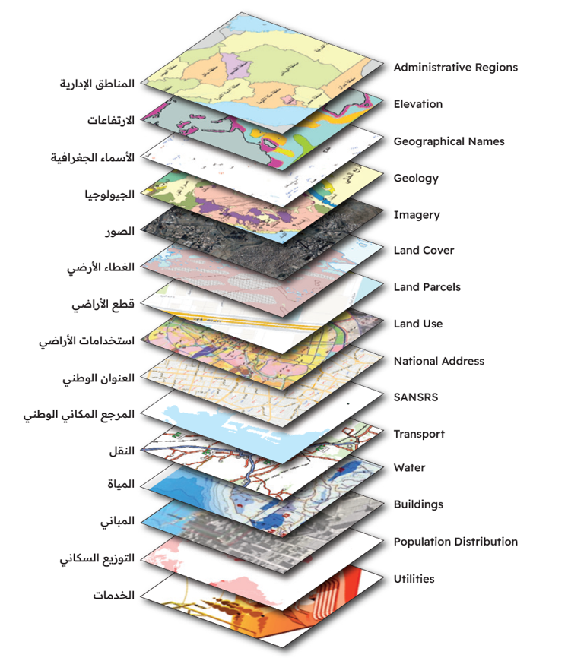
National Spatial Data Infrastructure
Establishing 15 main Themes, working groups of Themes, defining regulating aspects for each Theme.
Building guides and technical specifications for the main Themes.
Water theme include Hydrography, Hydrology, Hydrogeology, and Inland waters.
GEOSA maintaining and advancing a National Geospatial Platform.
MSI
North Indian Ocean Hydrographic Commission

Slide 16
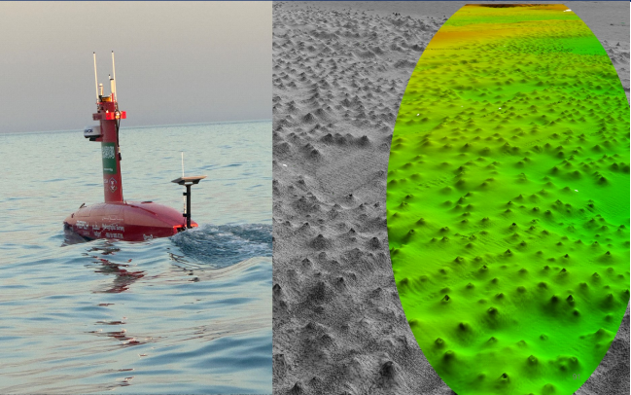
Innovation
GEOSA introduced innovative technologies, namely Uncrewed Surface Vessels (USVs), in support of the offshore surveying operations in Saudi Waters.
This innovation enabled improved operational efficiencies, efficient use of resources, cost reductions and significant reduction in carbon emissions.
MSI
North Indian Ocean Hydrographic Commission

Slide 17
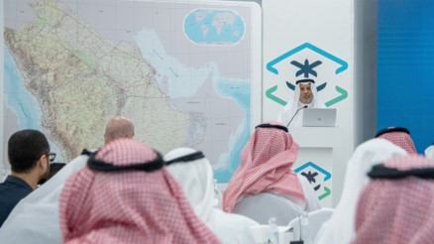
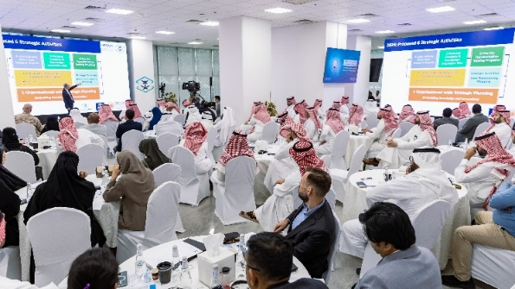
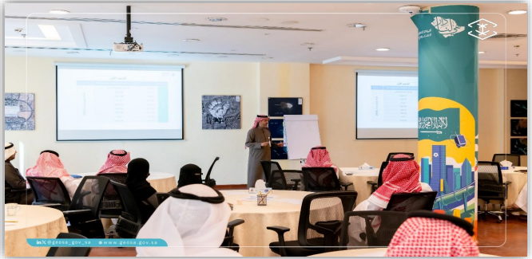
Other Activities
GEOSA is also preparing customized products as per the requirement of its stakeholders (e.g. PNC & ENC designed for NEOM and Red Sea Global Projects Area).
The Hydrographers and Cartographers are actively participating in the national exhibitions and seminars.
GEOSA is working on integrating the Hydrographic Data Management (HDM) project with the National Geospatial Center (NGC) to make the products readily available online as part of self-sustainability.
GEOSA is collaborating with Stakeholders and Educational Institutions for sharing knowledge and hydrographic survey awareness
GEOSA is working towards production of the S-100 products using dual-fuel methodology (where S-101 & S-57 ENCs to be produced simultaneously).

Slide 18
THANK YOU

